Slide 1
PET INVENTORY SYSTEM
PRESENTED BY
GROUP NAME: 404 FOUND SNEHAL PATEL (001021675) SHIVI BHATT (001027605)
MARISA THOMAS(001020479) NIRAMAY KELKAR(001080777)

Slide 2
INDEX
Summary of the design
E-R Diagram
SQL DDL statement for implementing DB
Database Objects Created(Views, Stored Procedure, Functions, Triggers)
Report - Power BI

Slide 3
SUMMARY OF DESIGN
Pet Inventory System which will help visualize sales data pertaining to a particular store such sales per month order price, supply amount and employee payout. The system also gets the details of medical record and immunization record of pet which will be useful for owner to produce it to customer. Apart from that system also maintains sensitive data of the user for security purpose using encryption techniques. The system keep track of all the products and order line details using the audit table which help the user to keep track of stock of the products as and when required. The system has the capability to generate the sales reports. It will help the shop owner to make decisions based on the historical data and manage the business efficiently.

Slide 4
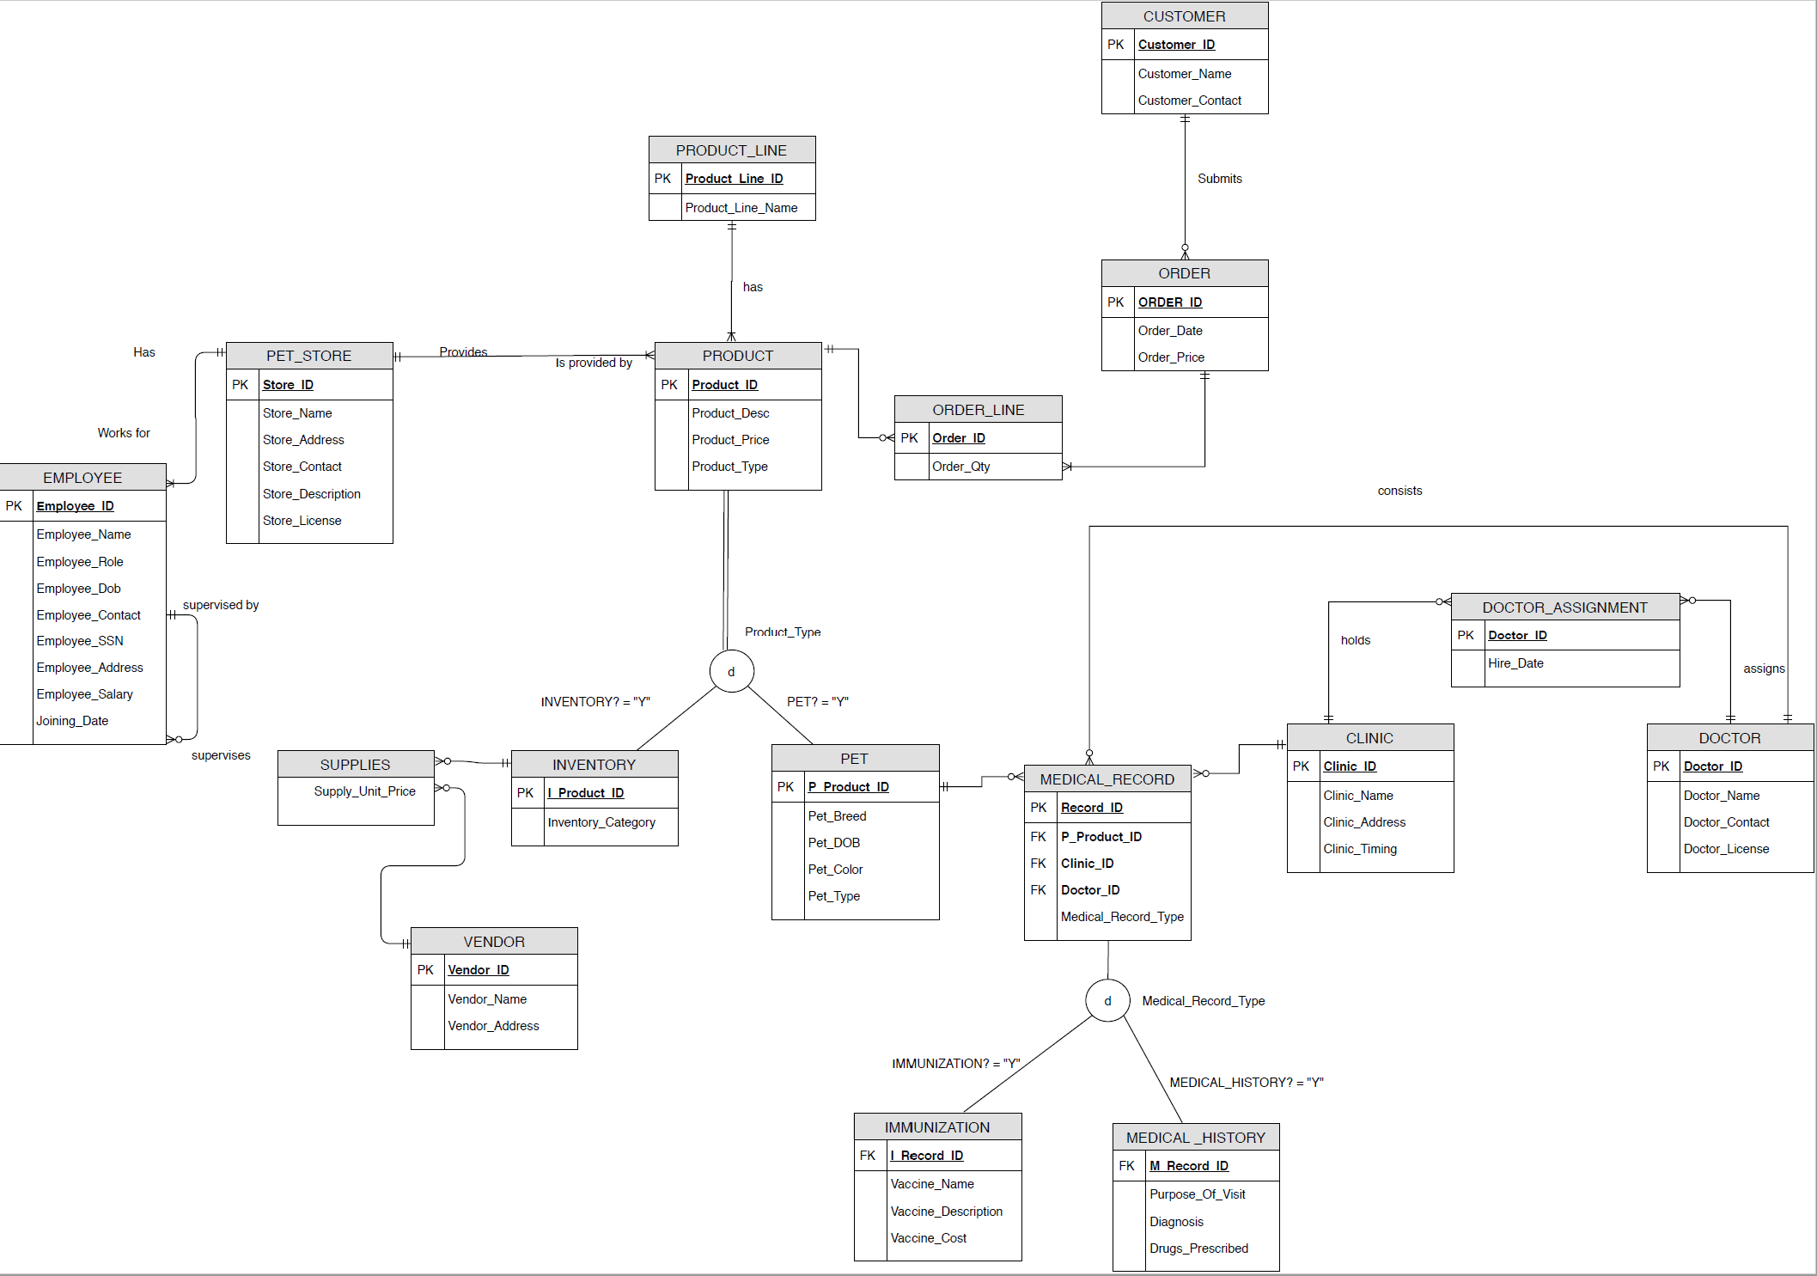
FINAL ENTITY RELATIONSHIP DIAGRAM

Slide 5
DDL IMPLEMENTATION DETAILS
Created the following list of tables for implementing the project
Tables created: 17
Pet store
Employee
Product Line
Product
Inventory
Pet
Vendor
Supplies
Customer

Slide 6
DDL IMPLEMENTATION DETAILS
Created the following list of tables for implementing the project
(cont’d)
Order
Order Line
Doctor
Clinic
Doctor Assignment
Medical Record
Immunization
Medical History

Slide 7
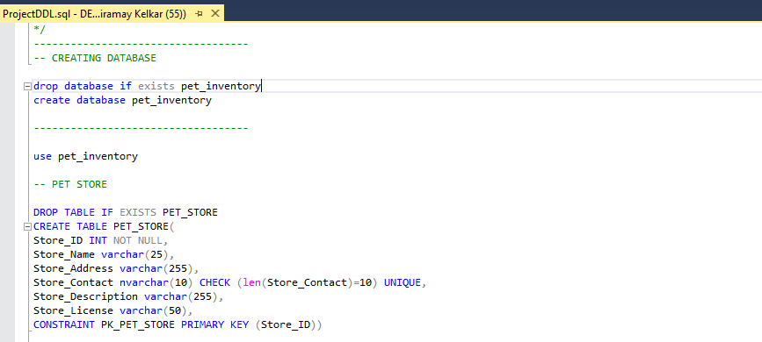
Place your screenshot here
DDL IMPLEMENTATION SCREENSHOTS

Slide 8
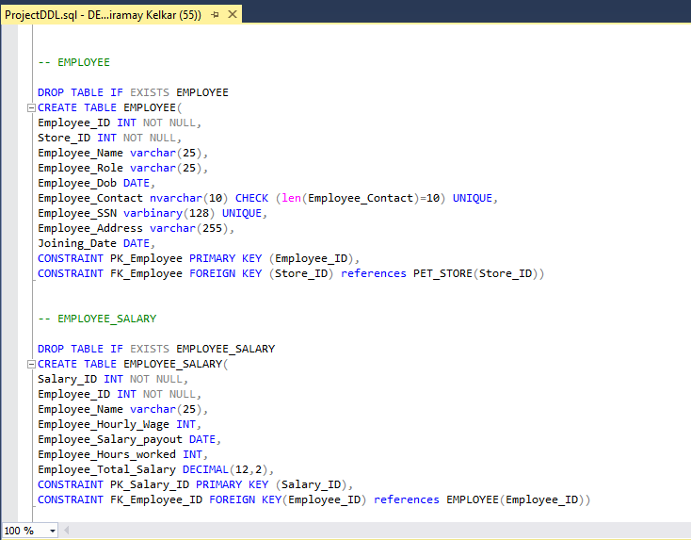
Place your screenshot here
DDL IMPLEMENTATION SCREENSHOTS

Slide 9
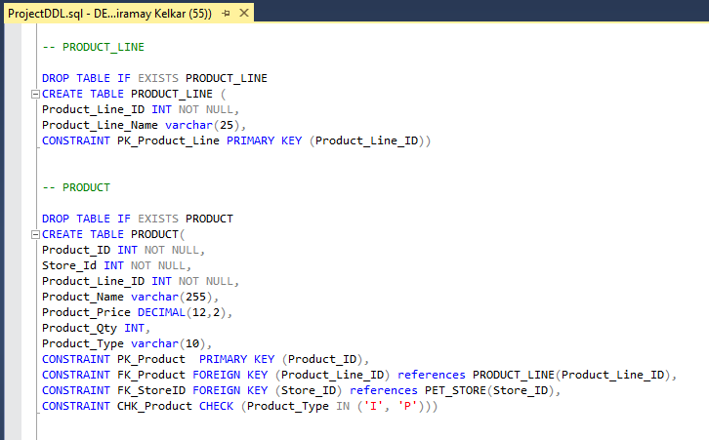
Place your screenshot here
DDL IMPLEMENTATION SCREENSHOTS

Slide 10
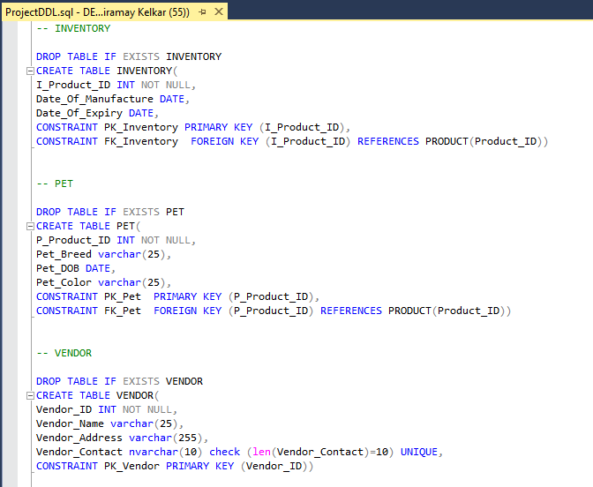
Place your screenshot here
DDL IMPLEMENTATION SCREENSHOTS

Slide 11
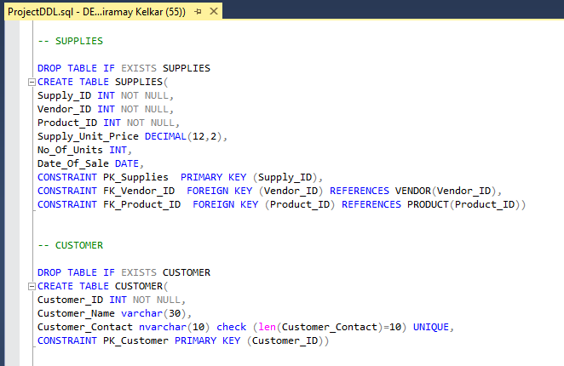
Place your screenshot here
DDL IMPLEMENTATION SCREENSHOTS

Slide 12
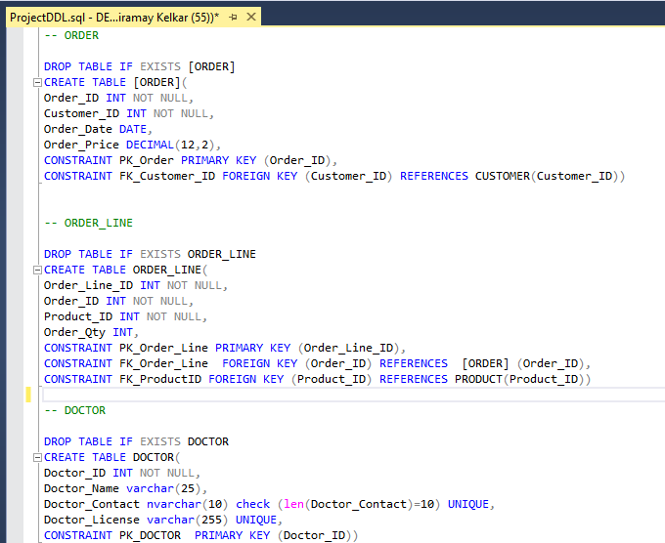
Place your screenshot here
DDL IMPLEMENTATION SCREENSHOTS

Slide 13
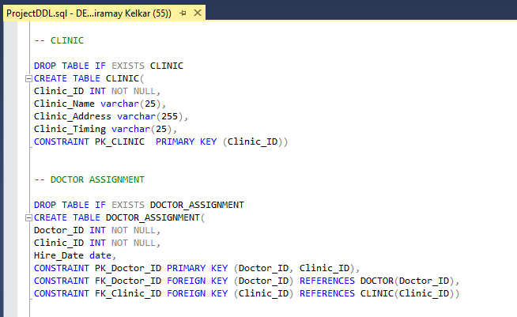
Place your screenshot here
DDL IMPLEMENTATION SCREENSHOTS

Slide 14
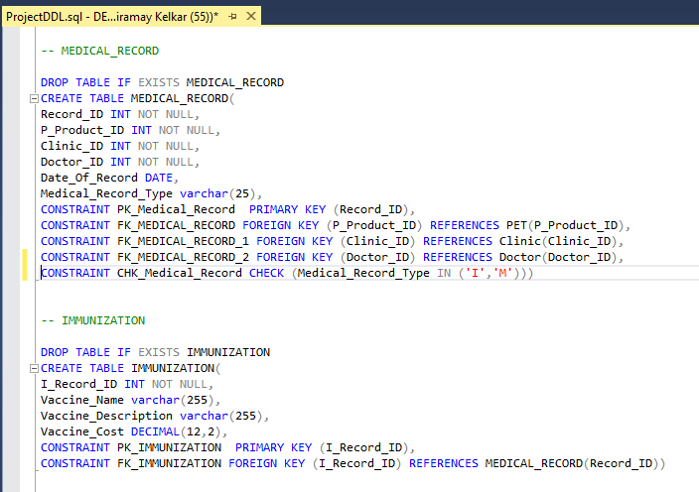
Place your screenshot here
DDL IMPLEMENTATION SCREENSHOTS

Slide 15
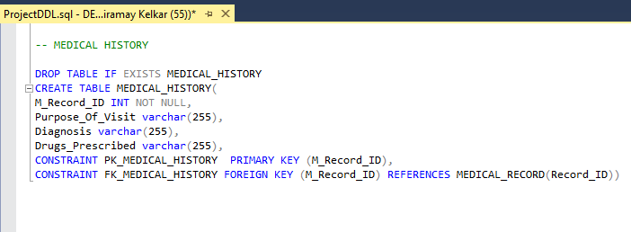
Place your screenshot here
DDL IMPLEMENTATION SCREENSHOTS

Slide 16
STORED PROCEDURES
Stored procedures for performing operations on the database for ease of use
GetProductQuantity()
Stored procedure which returns product quantity when passed in product id.
Can be used when performing operations on product

Slide 17
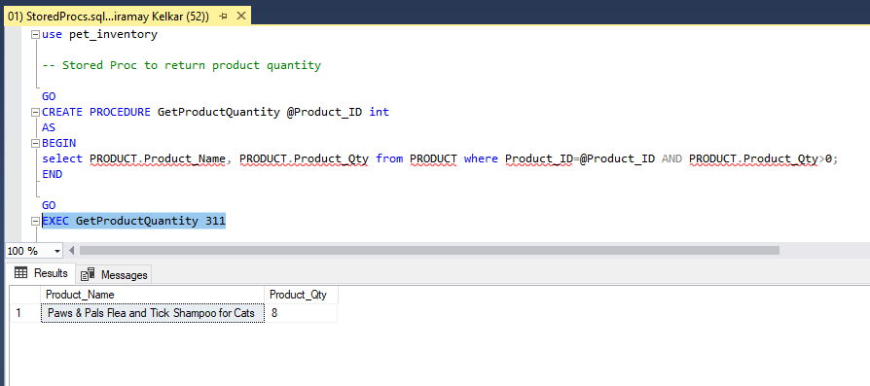
Place your screenshot here
STORED PROCEDURES IMPLEMENTATION SCREENSHOTS

Slide 18
STORED PROCEDURES
Stored procedures for performing operations on the database for ease of use
2. GetPetImmunizationRecords()
Stored procedure which returns pet’s immunization records when passed a PetId

Slide 19
STORED PROCEDURES
Stored procedures for performing operations on the database for ease of use
3. GetMedicalHistory()
Stored procedure which returns pet’s medical history records with a doctor when passed a PetId

Slide 20
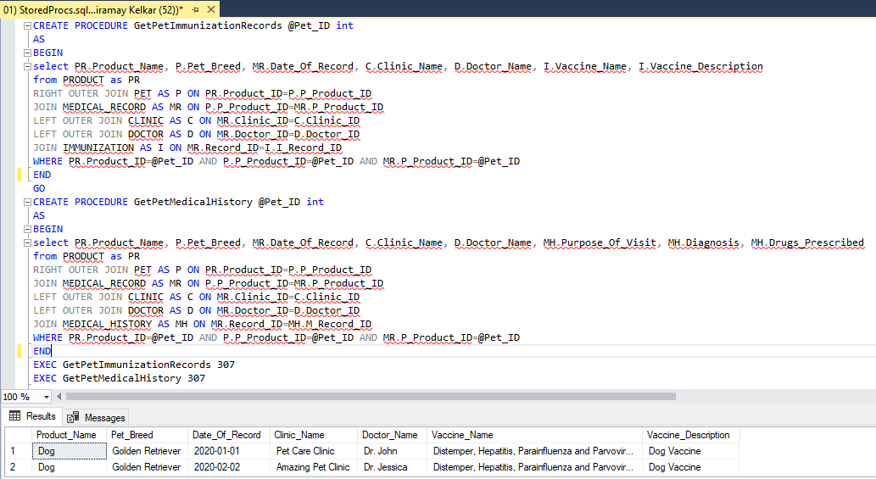
Place your screenshot here
STORED PROCEDURES IMPLEMENTATION SCREENSHOTS

Slide 21
STORED PROCEDURES
Stored procedures for performing operations on the database for ease of use
4. AddNewEmployee()
Stored procedure which adds new employee as and when required for Pet Shop

Slide 22
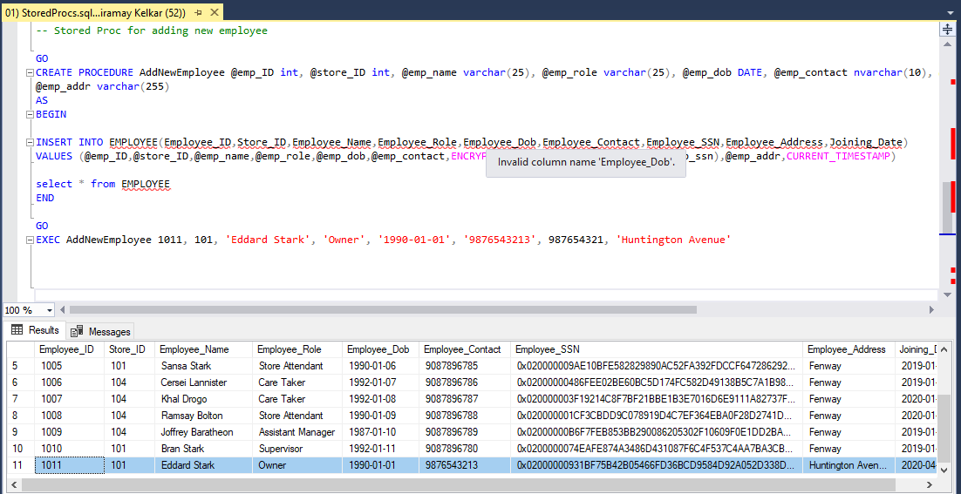
Place your screenshot here
STORED PROCEDURES
IMPLEMENTATION SCREENSHOTS

Slide 23
VIEWS
Created views which can be used while using the data for reporting purposes
ClinicMedicalRecords()
View to show number of medical records in a clinic

Slide 24
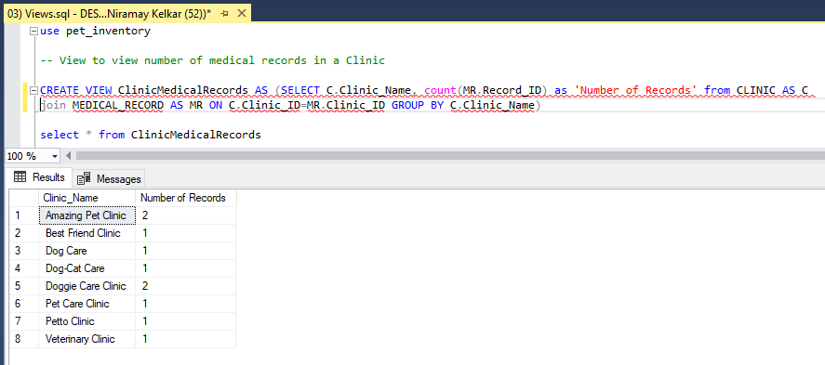
Place your screenshot here
VIEWS IMPLEMENTATION SCREENSHOTS

Slide 25
VIEWS
Created views which can be used while using the data for reporting purposes
2. CalcHighestSalaryView()
View which shows Highest salary from the list of employees the pet shop has employed

Slide 26
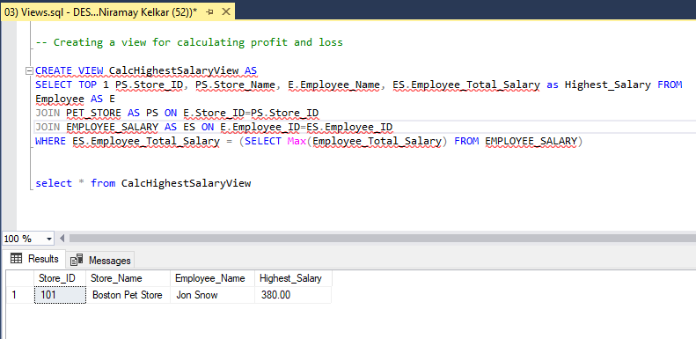
Place your screenshot here
VIEWS IMPLEMENTATION SCREENSHOTS

Slide 27
USER DEFINED FUNCTIONS
User defined function to create a derived column and perform calculation
AgeFunc()
Function to create a derived column Age in Employee table based on the Date of birth

Slide 28
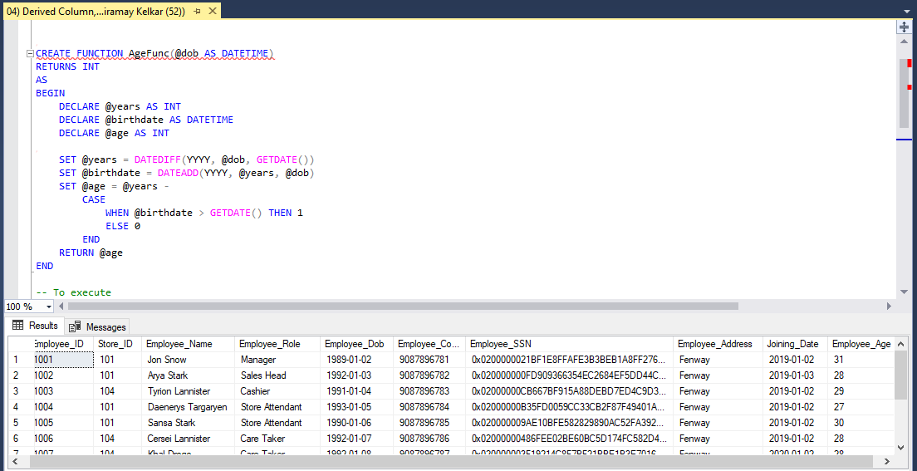
Place your screenshot here
FUNCTIONS IMPLEMENTATION SCREENSHOTS

Slide 29
NON CLUSTERED INDEXES AND ENCRYPTION
In a pet store, it is most likely for a product to be searched by its name. Non-clustered index created for faster retrieval of product details.
SSN is sensitive personal data, hence stored in encrypted form(ENCRYPTBYPASSPHRASE)
Non-clustered index on Product Name and encrypting SSN of employee

Slide 30
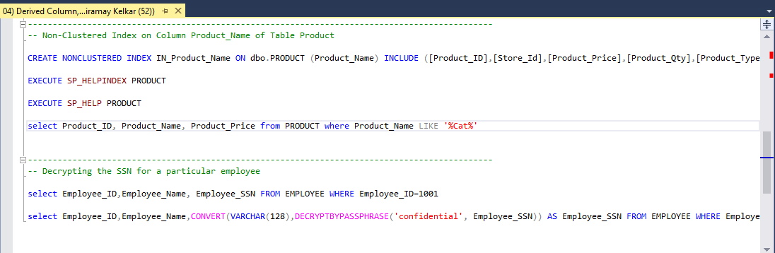
Place your screenshot here
NON-CLUSTERED INDEX IMPLEMENTATION SCREENSHOTS

Slide 31
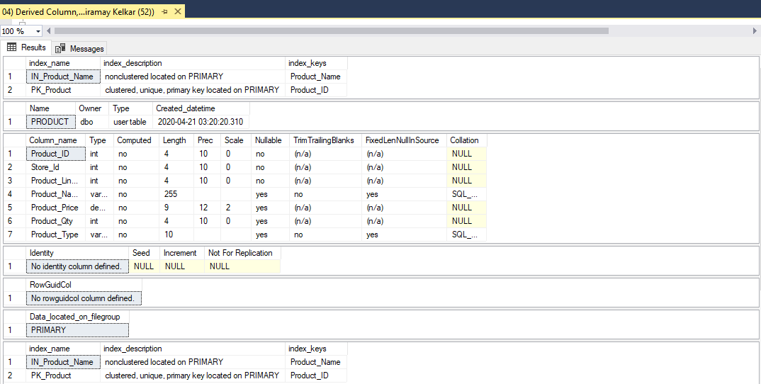
Place your screenshot here
NON-CLUSTERED INDEX IMPLEMENTATION SCREENSHOTS

Slide 32
TRIGGERS
We have used trigger for the purpose of auditing product and order line table using which user can keep track of product quantity sold and number of orders made and other such data. This capability helps user to make efficient decision on the business.
TR_ORDER_LINE_UPDATE_AUDIT
Audit
TR_PRODUCT_UPDATE_AUDIT
TR_PRODUCT_INSERT_AUDIT
TR_PRODUCT_DELETE_AUDIT

Slide 33
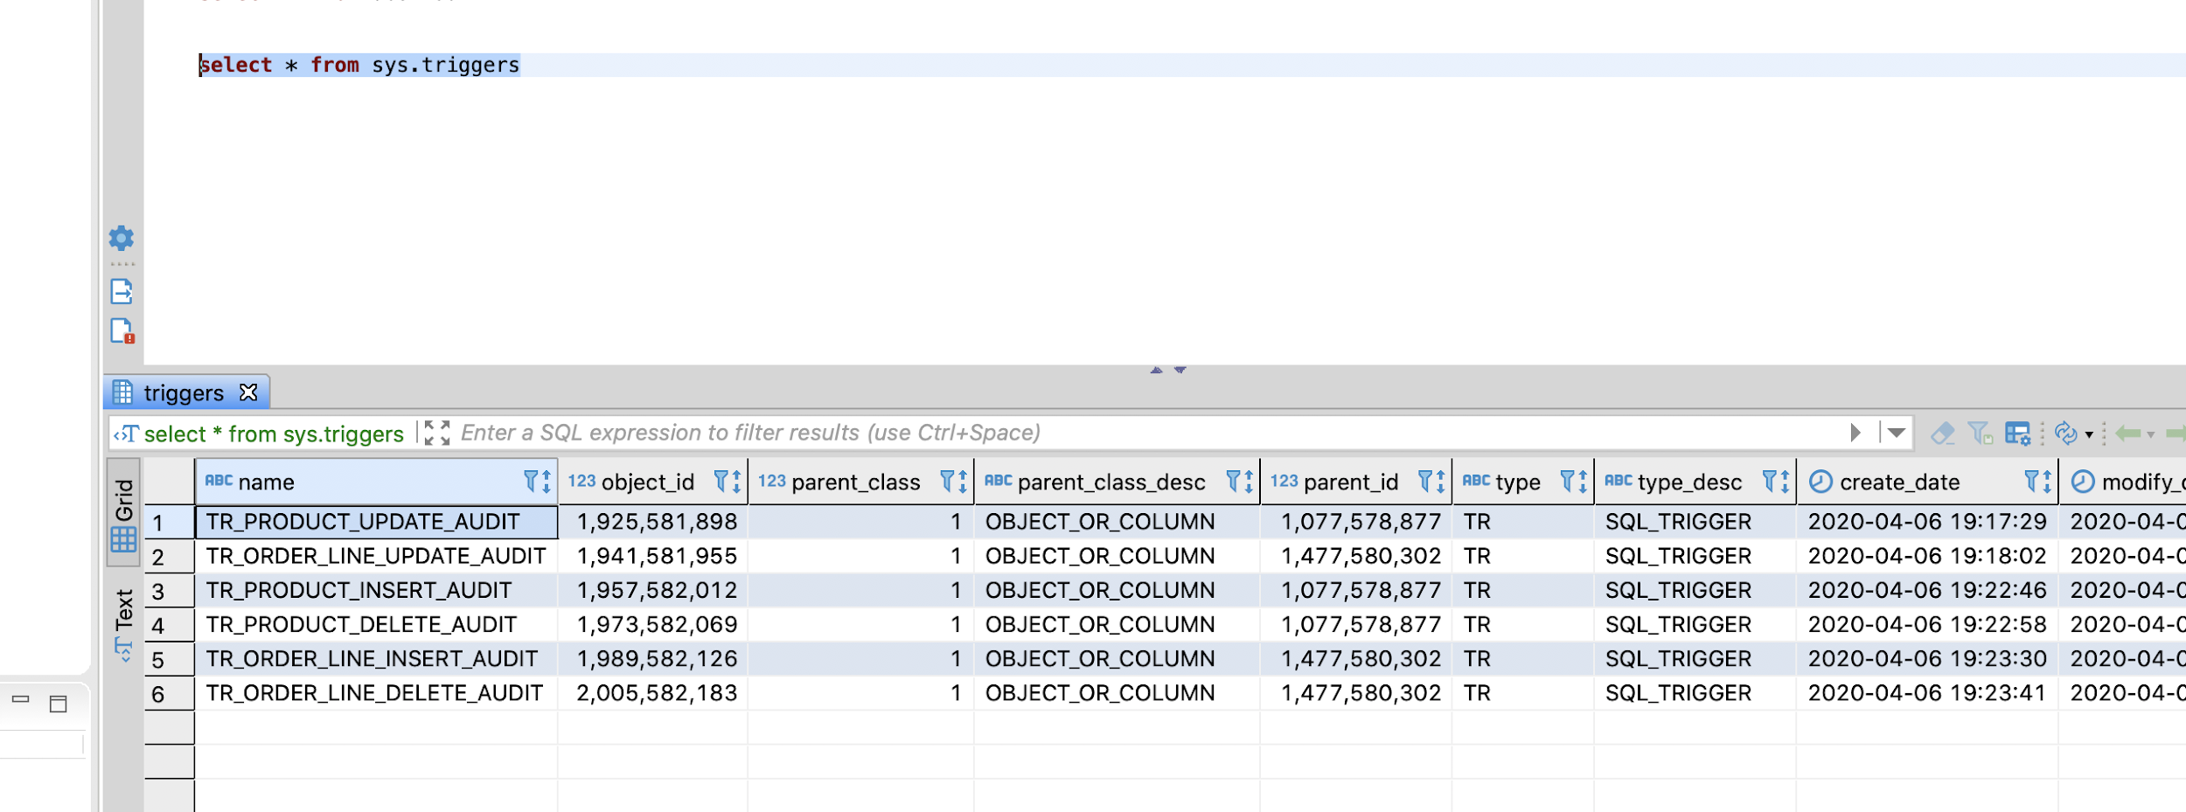
Place your screenshot here
TRIGGER IMPLEMENTATION SCREENSHOTS

Slide 34
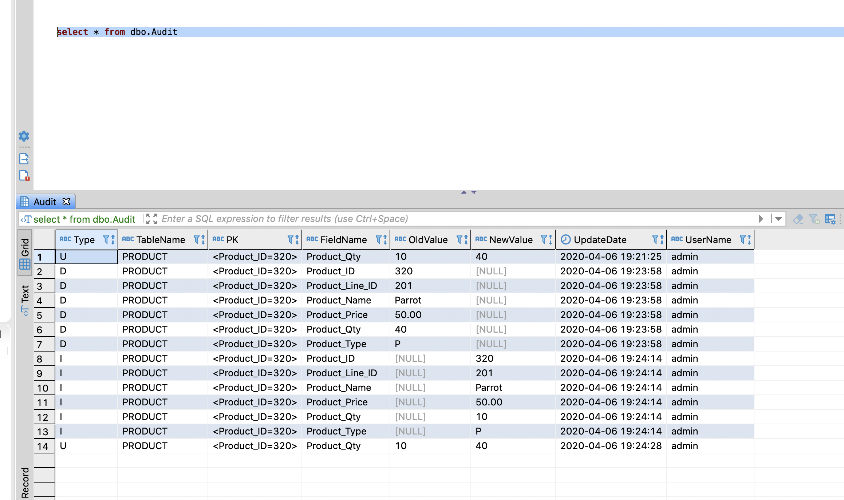
Place your screenshot here
TRIGGER IMPLEMENTATION SCREENSHOTS

Slide 35
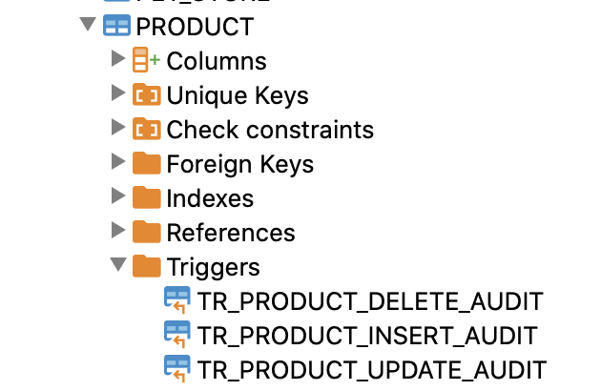
Place your screenshot here
TRIGGER IMPLEMENTATION SCREENSHOTS

Slide 36
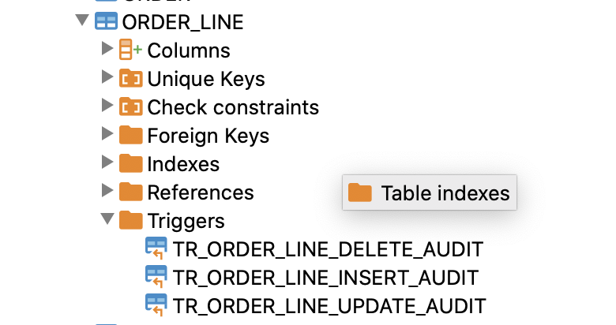
Place your screenshot here
TRIGGER IMPLEMENTATION SCREENSHOTS

Slide 37
POWER BI REPORT IMPLEMENTATION DETAILS
Dashboard which shows expenditure and then the profit-loss based on it per month
Views used:
GetOrderAmountForReport
GetSuppliesAmountForReport
GetEmployeeSalaryForReport

Slide 38
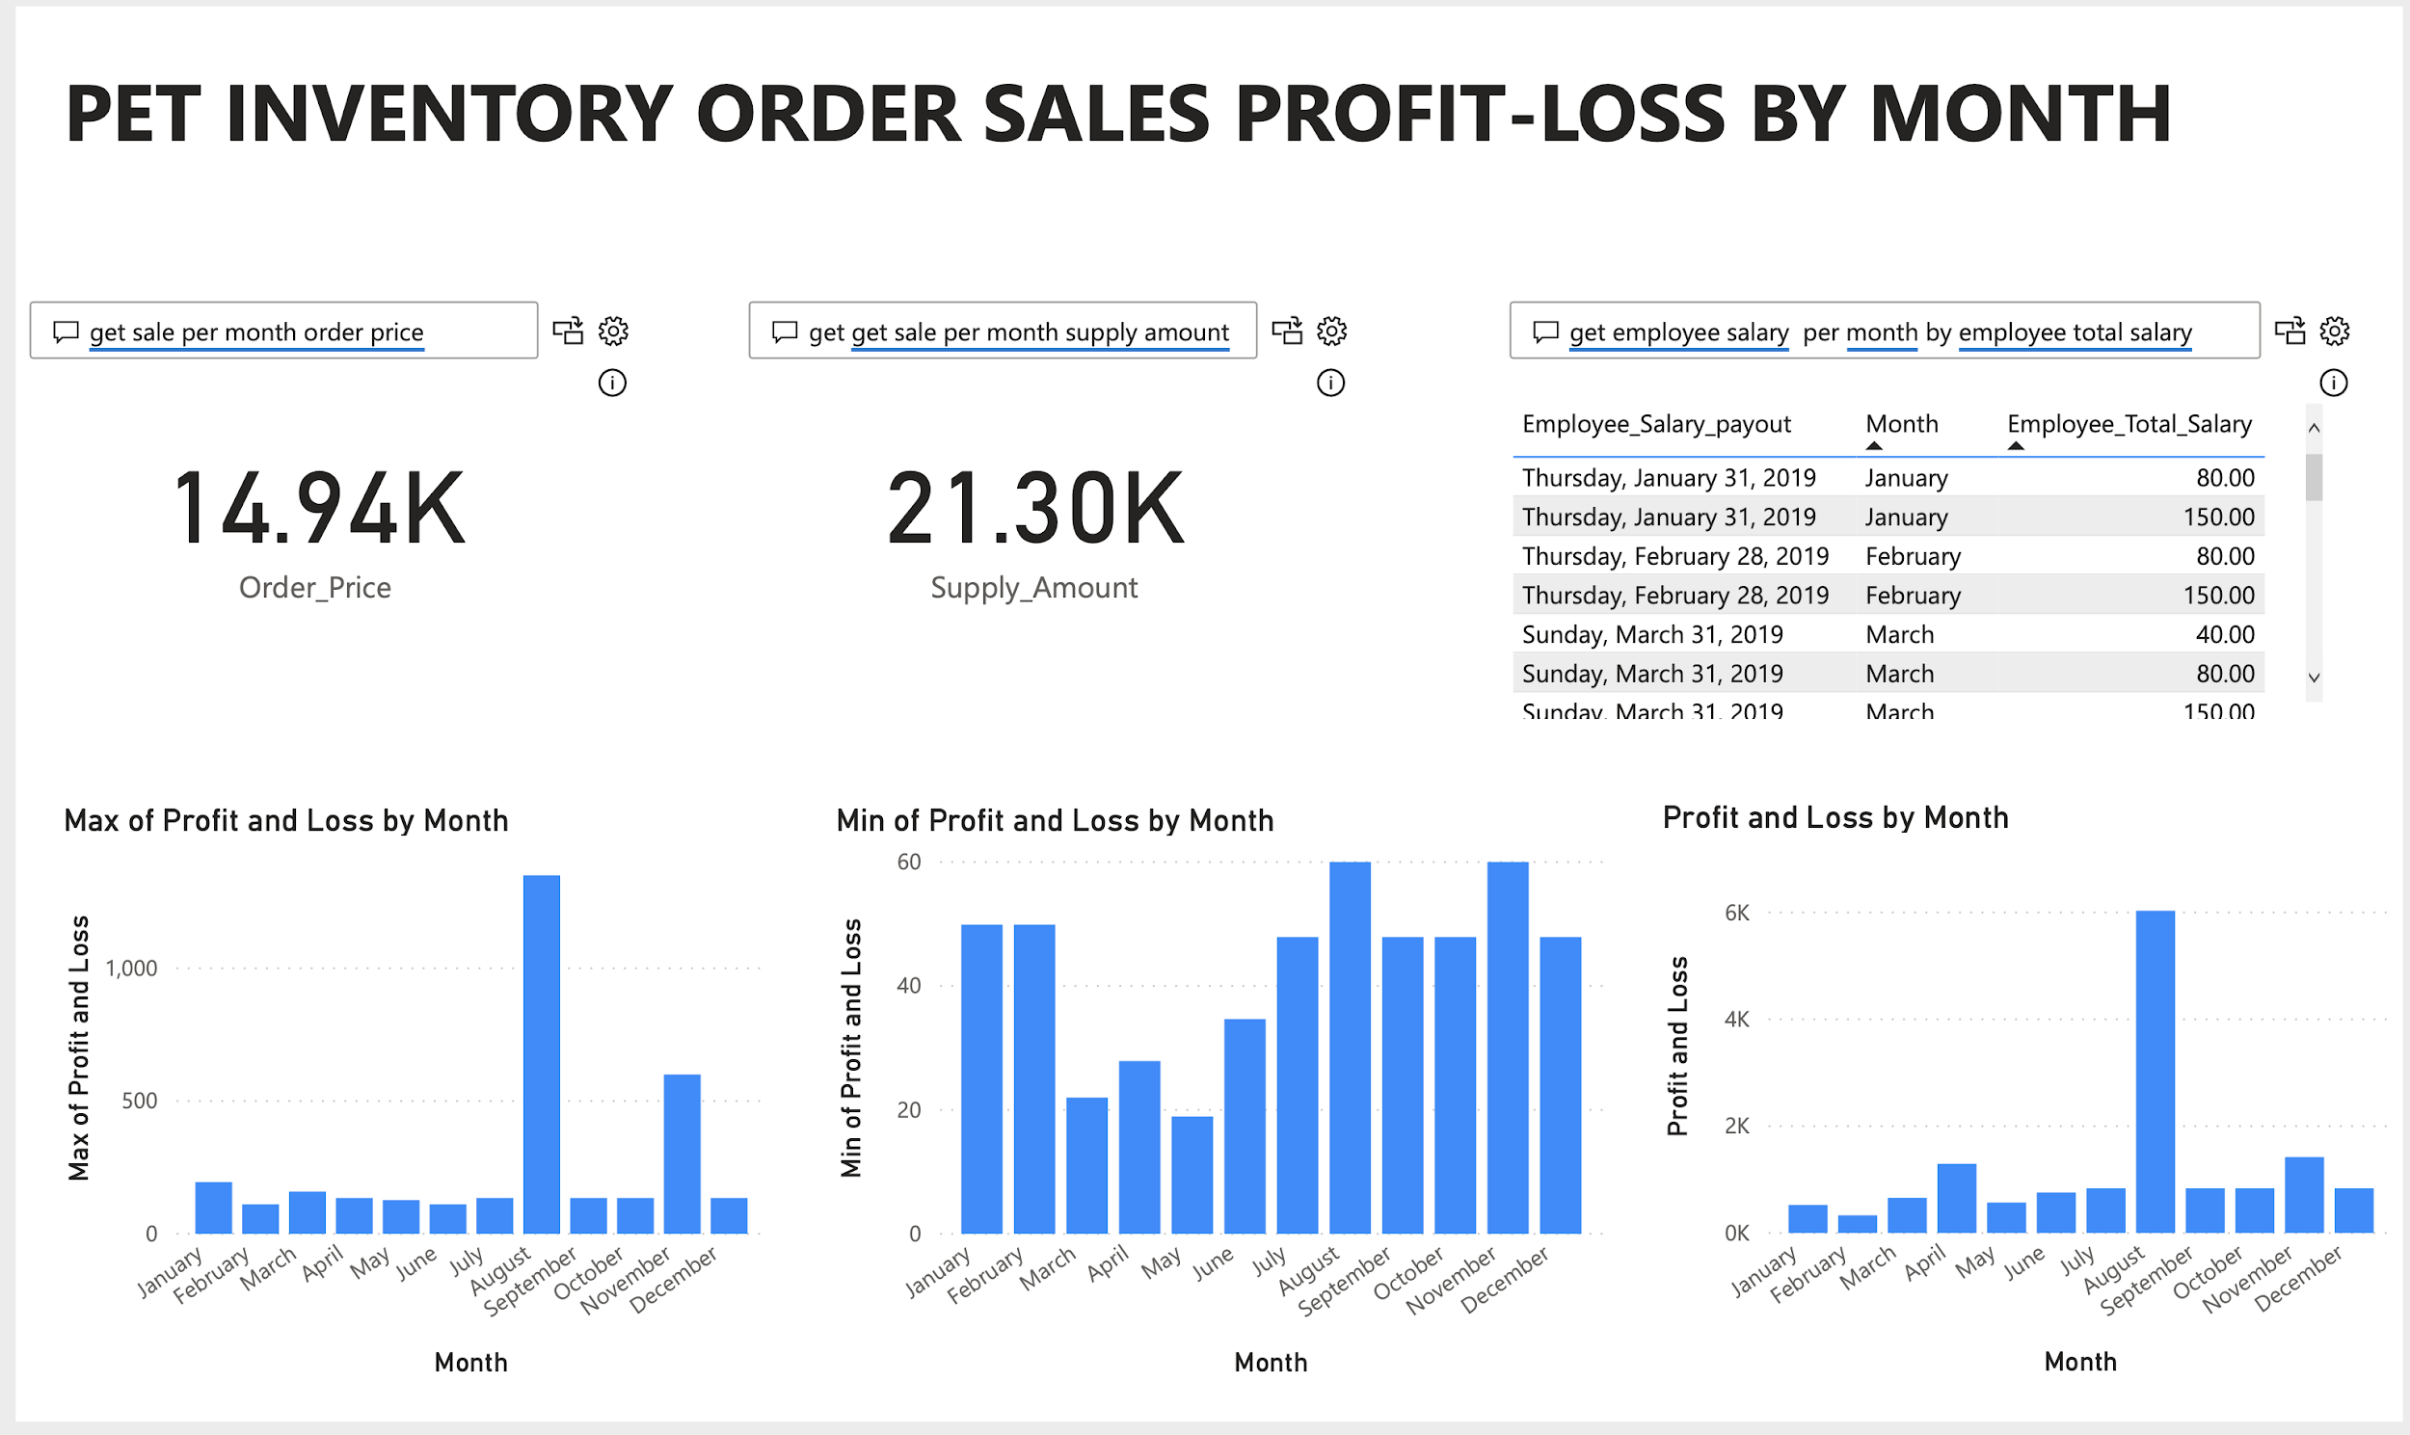
Place your screenshot here
POWER BI IMPLEMENTATION SCREENSHOTS

Slide 39
THANKS!
Any questions?
You can find me at
bhatt.s@husky.neu.edu
kelkar.n@husky.neu.edu
patel.sneha@husky.neu.edu
thomas.m@husky.neu.edu

