Slide 1
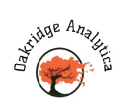
Graduate Certificate in Analytics Project Management
Team Members:
Rupali Kumari
Shivangi Verma
Aayush Mathur
Chaitanya Muthaiyan
Rishabh Ambwani

Slide 2

Agenda
Introduction & Vision
Business Objectives
Data Governance Structure
Actionable Insights
Managing Our Engagement
Key Takeaways and Conclusion
Q&A

Slide 3
Introduction & Business Objectives

Slide 4
Introduction
We are Oakridge Analytica, analytics consulting company working in the areas of HR, Finance and Operations domains across the world. We help clients become data-driven organizations to achieve better performance more efficiently.
In this engagement, we will support GoRecruit Private Limited, one of the leading recruitment agencies, in setting up a governance structure for their recently created analytics wing and simultaneously work on a recent data (July 2020) to generate a market assessment report to be published on their website.
Engagement Vision
Through this engagement we strive to build an accurate, timely and long-term analytics system that will help GoRecruit increase market share, give edge over its competitors and extend the capability of the analytics wing workforce to be self-sufficient in driving the future analytics engagements/projects

Slide 5
Business Overview and Engagement Areas
Executive Committee
Business Objectives –
Ameliorate their newly setup analytics wing
Increase profit margin by targeting
high-margin job postings
Bridge the gap between analytics professionals
and companies
Set up a governance structure for their newly created analytics wing
Analytics Wing
Mode 1
Enterprise Reporting
Mode 2
Advanced Analytics
Analytics
Team 1
Analytics
Team 2
Finance
Human Resources
Branding
Internal Backend
Data Science
Oil & Gas
Financial Services
Digital Arm
Recruitment Arms
*ENGAGEMENT AREAS
Conduct a POC where our team will engage in exploratory data analysis followed by comprehensive dashboard
Mode 1 will be more stable, reliable, and high performance for enterprise reporting, whereas
Mode 2 will deliver innovative, flexible, and quick-turnaround analytics services for augmented data discovery and process automation.

Slide 6
Data Governance Structure

Slide 7
‘As-Is’ state - Resolving business query flow
Enterprise
Key challenges & pain points -
Delay in resolving the business query leading to delayed decision making
Less collaboration among functional units while sharing data
Overall more expended effort
Executive Business Analyst
CEO
Board Of Directors
Oil & Gas Arm
Require more info ?
Recruiter/
Data User
Data Custodian
No
Trifecta
Domain 1 Data Manager
Yes
Principles
Policies
Performance
Data is an Asset
Digital Arm
Any legal issue ?
Data Cleaning
Yes
Data Quality
Lawsuits Count
Data Storage
Mismatch Count
Data Privacy
Domain 2 Data Manager
No
Data Transfer
Data Privacy Training
Data Security
Legal
Stewarded Data

Slide 8
‘To-Be’ state - Revised business query flow
Data Stewardship Structure
Exe Committee
CDO
Exe Business Analyst
ESC
Data Stewardship Council: Analytics Head together with respective domain (recruitment arms) head
Impact -
Shorter time to report and consequently timely decisions by ESC
Improved accuracy of data
Reduced compliance effort
Mitigate data leakage risk
CEO
Entire flow monitored by DGPO
Board Of Directors
DGPO Team
Raises business query in the system
Oil & Gas Arm
Is more
info required ?
Ticket is closed
Trifecta
No
Principles
Policies
Performance
Manager cum Data Steward
Recruiter/Data User
SLA Query resolution
Analytics Team 2
Data is an Asset
SLA violation count
Yes
Data Cleaning
No
Data Quality
Data Storage
Lawsuits Count
Mismatch Count
Analytics Head
Data Privacy
Data Protection
Yes
Training Hrs. Clocked
Data Security
Standardisation
Data Leakage Count
Domain Data Custodian
Any issue ?
Data Sharing
Missing Records Ct.
Stewarded Data
Urgent Processing

Slide 9
Actionable Insights (Dashboard)

Slide 10
Key Insights Within ‘Data Engineer’ Job Class
Regions with high Employability
Not many states are hiring Data engineers. Though there are more opportunities in Texas.
Data Engineers earn much higher in California as compared to other states
Cities in CA and TX hire the most Data Engineers. Citywise, New York and Chicago are also on top of the chart.
Companies hiring Data Engineers
Big portion of companies hiring Data Engineers are headquartered in California.
With such high level of demand, Data engineers' salaries are obviously undervalued.
Sectors where Data Engineers are hired
IT companies hire the most Data Engineers, followed by Business Services and Finance companies
Healthcare-related Data Engineer jobs seem to have better pay

Slide 11
Managing Our Engagement

Slide 12
Effort Estimation
Project Management
Data Understanding
ALL
5 days
5 Member Team:
Data analytics Manager (1) DM
Dashboard Developer (2) DD
Data Analyst (2) DA
Aug 31 - Sep 6
Data Preparation
DA
5 days
DA
Sep 7 - Sep 13
Development
DD
DD
5 days
Data Governance
Sep 14 - Sep 20
Testing
DM
ALL
2 days
15 days
Deployment
Sep 7 - Sep 17
Sep 21 - Sep 23
ALL
ALL
5 days
Sep 23 - Sep 29
Week 1
2
3
4
5
2020
Sep 7, 2020
Sep 29, 2020
Project Approval
Handoff to Production

Slide 13
Engagement Execution
Total Story Points – 90
No. of working days – 18
Deviation from initial plan
Data cleaning – There were a lot of missing values and data was more dirty than expected. It took us time to clean and transform the data.
Dashboard creation – Since it was our first time creating a dashboard it took us sometime to get used to the software and to take out the insights from the data.
End of development

Slide 14
Key Risks Involved
Risk | Risk Description | Impact | Probability | Risk Exposure | Mitigation
Data Quality | While data quality check might be done on a small sample of data, but the same quality of the data might not be present throughout the entire dataset. | 4 | 3 | 4 | We found that the data was quite dirty with a lot of missing values. A columns had to be standardised. Since this was the first arm we were doing an analytics project for data quality policies will be implemented which will help in mitigating this problem
Scope of work | This proposal and timeline are based on the current scope of work and business objectives. Any new requests or requirements will lead to a delay in the delivery of the project. | 3 | 2 | 3 | Since the business problems and objectives were cleared before starting the project this was not an issue
Change Management | Representatives from each department should be involved in the project to ensure smooth transition in the data governance changes. | 4 | 3 | 3 | The data governance structure has changes quite a bit in the organisation and needs to be implemented properly. All relevant stakeholders need to be involved in this process. Training and workshops also need to be conducted for each employee.
1(Low) – 5(High)

Slide 15
Key Takeaways & Conclusion

Slide 16
Conclusion and key takeaways for our respective stakeholders
The published market assessment report will ultimately cater to the following stakeholders-
GoRecruit
- Revamped data governance structure
-Comprehensive dashboard that enables data driven leads targeting
Analytics Professional
They can better target their job postings based on location, sector, pay and company ratings
Hiring Managers
Review why some organisations have ratings with respect to their competition
Academic Institutes
Is their curriculum robust enough to make their students employable ?
SQL, Python and Cloud are highly desirable to have

Slide 17


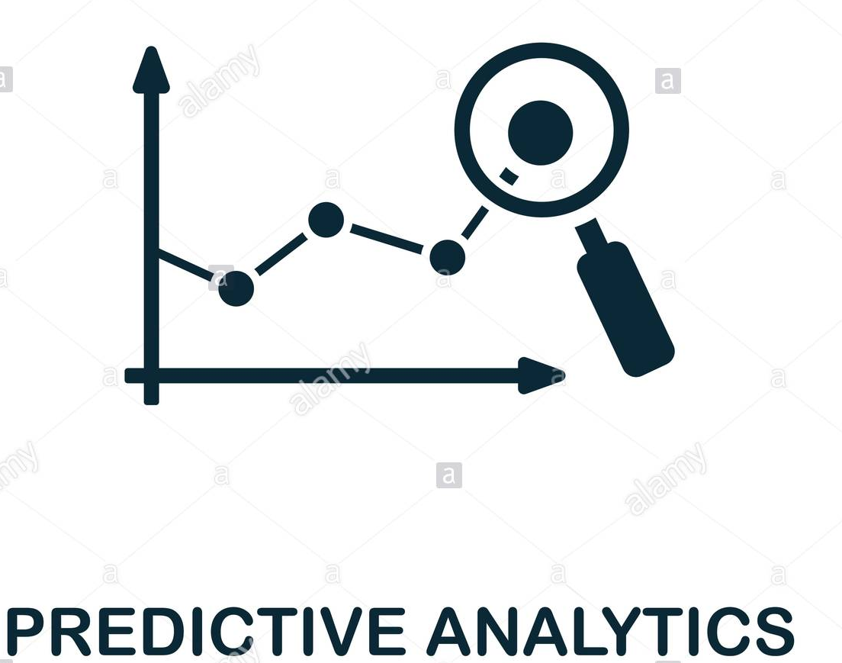

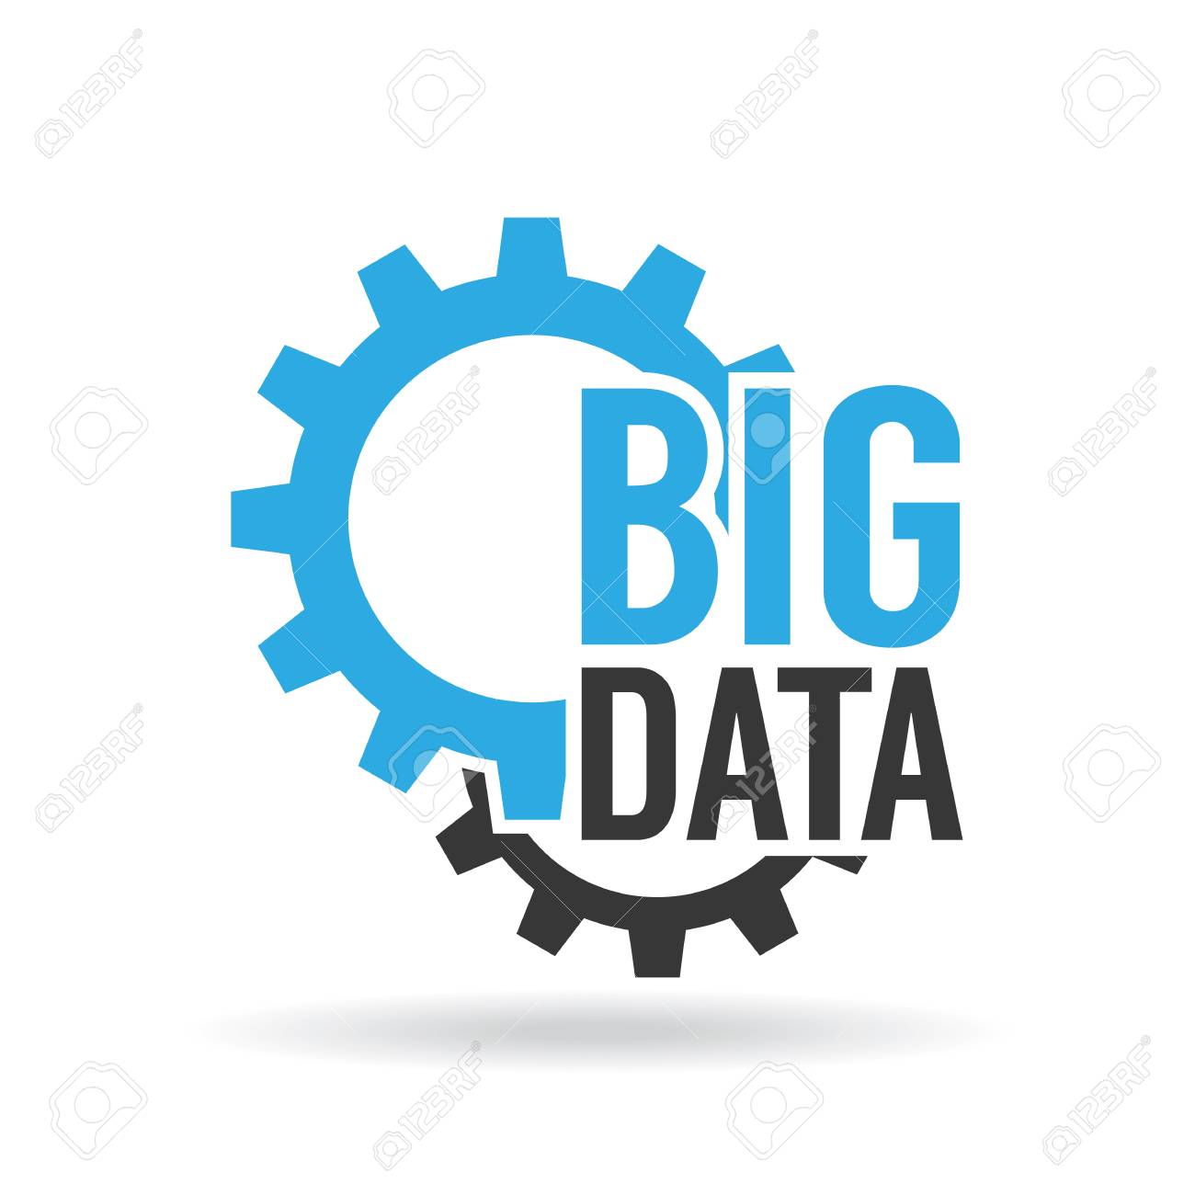


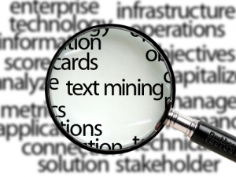
Future Road Map - Analytics
“With this engagement Go Recruit has entered the experimental stage and we believe with continued executive will towards a data driven organisation, they will soon enter exponential or disruption stage”
GoRecruit
Exponential
Analytics Maturity Stage
Experimental
Existential
2020
2021
Timeline

Slide 18
Future Road Map - Analytics
“With this engagement Go Recruit has entered the Descriptive and Diagnostic stage and we believe with continued executive will towards a data driven organisation, they will soon Predictive Analytics journey”

Slide 19
Thanks ! Q & A

Slide 20
Appendix

Slide 21
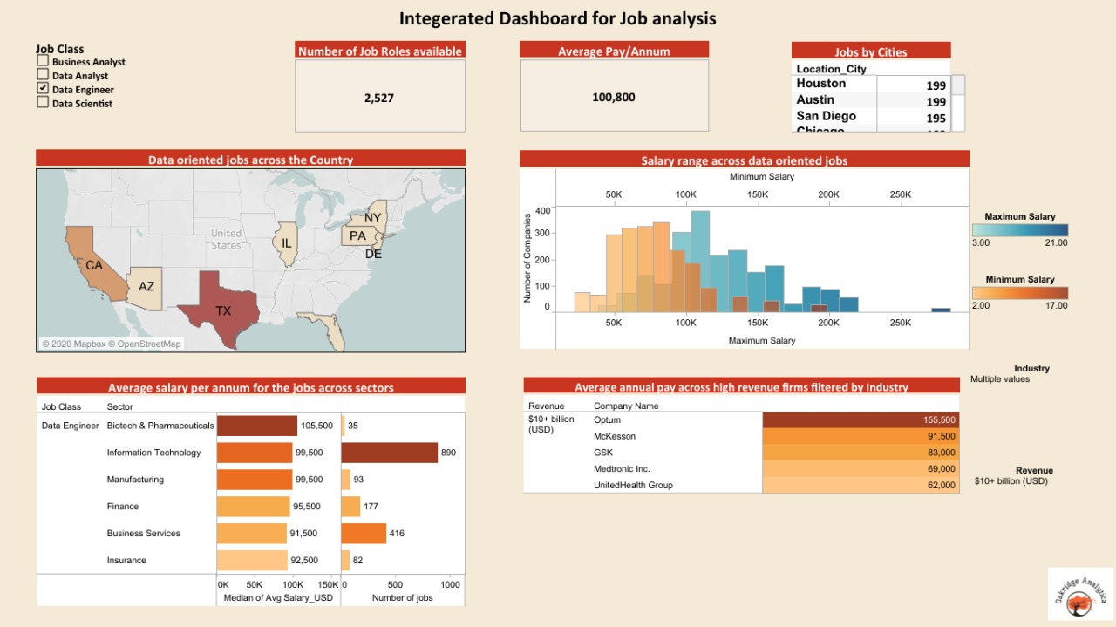
Dashboard 1/2

Slide 22
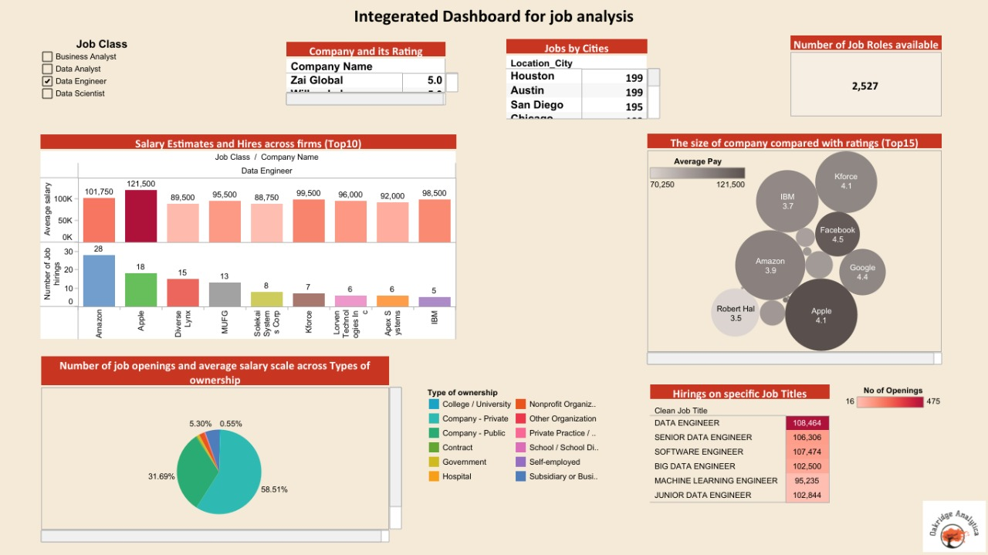
Dashboard 2/2

Slide 23
Data Stewardship Structure
ESC
Data Stewardship Council: Analytics wing Head together with Respective domain (recruitment arms) heads i.e. Data Managers
Chief Data Officer
One of the Board members that leads the overall data practice of the company and focuses more on strategy
Executive Business Analyst
Overseas the enterprise reporting and supports the CEO and Chief Data Officer in ad-hoc data driven business queries
Analytics Head
Overseas reporting of operational as well research data
Data Manager
Analytics Head together domain leaders from different recruitment arms with indepth knowledge of business operation and data requirements that also form the stewardship council
DGPO Team

Slide 24
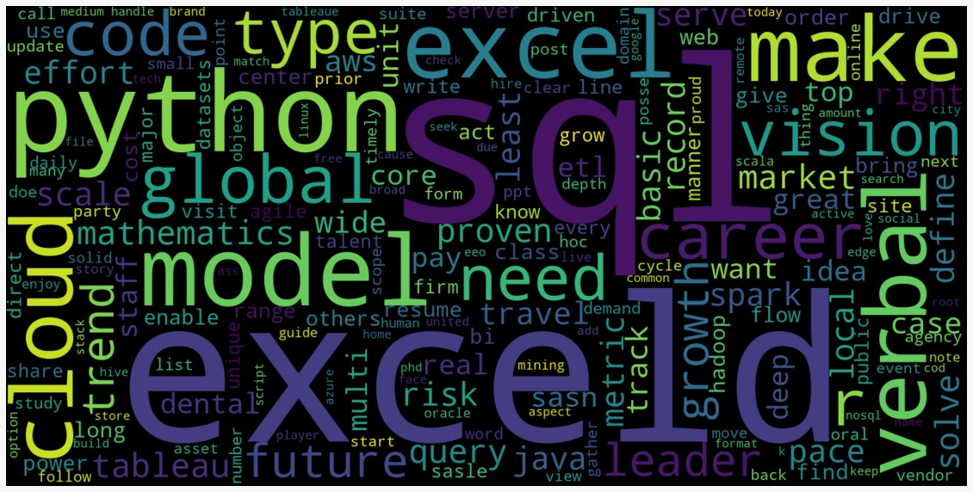
Word Cloud – Desirable Skill In Analytics Domain

Slide 25
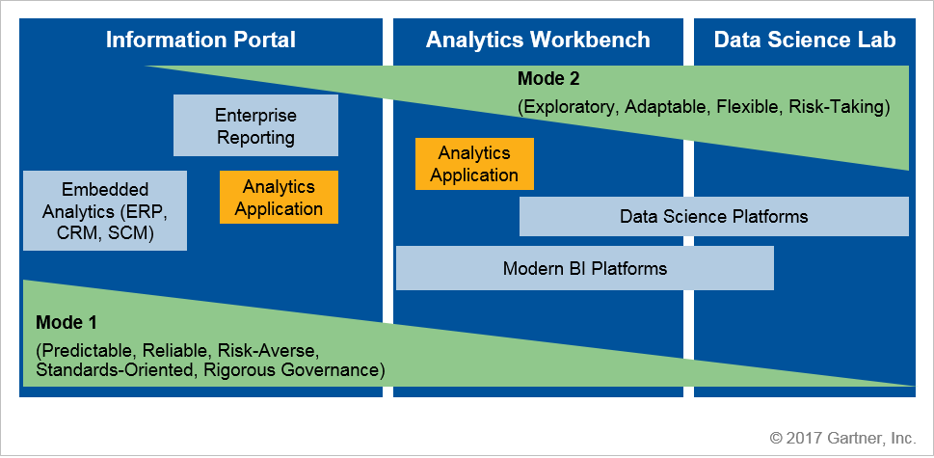
Extended Bi-Modial Approach
Mode 1 will be more stable, reliable, and high performance for enterprise reporting, whereas
Mode 2 will deliver innovative, flexible, and quick-turnaround analytics services for augmented data discovery and process automation.

Slide 26
Task Segmentation
Phase | User stories | Story Points | Iterations
 |  |  | 1 | 2 | 3 | 4 | 5 | 6
Business Understanding | As a analytics team we have to identify business goals, objectives, scope and stakeholders | 15 | 14 | 10 | 8 | 4 | 2 | 0
 | As a analytics team we have to identify risks and consult on probable mitigation | 10 | 8 | 6 | 5 | 4 | 2 | 0
 | As the data analytics manager, I have to assess current governance structure maturity level and establish target maturity level | 10 | 9 | 7 | 5 | 4 | 2 | 0
 | As the data analytics manager, I have to define organisational structures and roles | 8 | 7 | 6 | 5 | 4 | 2 | 0
 | Identify required tools | 5 | 4 | 3 | 2 | 1 | 0 | 0
 | As a analytics Team we have to determine project plan | 5 | 4 | 4 | 3 | 2 | 0 | 0
Data Understanding | As the data analytics manager, I have to Identify data policy, standards and privacy norms | 9 | 7 | 6 | 4 | 3 | 1 | 0
 | As the data analytics manager, I have to analysis the governance structure of the organisation | 9 | 7 | 6 | 5 | 4 | 2 | 0
 | As a team, we need to understand the data and the meaning behind each column. | 10 | 8 | 8 | 7 | 5 | 3 | 0
Data Preparation | As the data analyst, I have to do data cleaning | 5 | 4 | 3 | 2 | 1 | 0 | 0
 | As the data analyst, I have to do data transformation | 10 | 8 | 8 | 7 | 5 | 2 | 0
 | As the data analyst, I have to do outliers and missing data analysis | 10 | 8 | 8 | 8 | 6 | 3 | 0
Development | As the developer, I have to create an interactive dashboard that provides valuable insights to end users | 10 | 8 | 7 | 7 | 5 | 2 | 0
 | As the data analytics manager, I have to develop policies and standards | 5 | 4 | 3 | 2 | 1 | 0 | 0
 | As the data analytics manager, I have to build data governance structure | 10 | 8 | 7 | 6 | 4 | 2 | 0
Deployment | As the data analytics manager, I have to implement the data governance structure and policies | 6 | 4 | 3 | 2 | 2 | 1 | 0
 | As a team we deploy the dashboard | 6 | 4 | 2 | 1 | 1 | 1 | 0
Total |  | 143 | 116 | 97 | 79 | 56 | 25 | 0

