Slide 1
Virus spreading General hospital problem

Slide 2
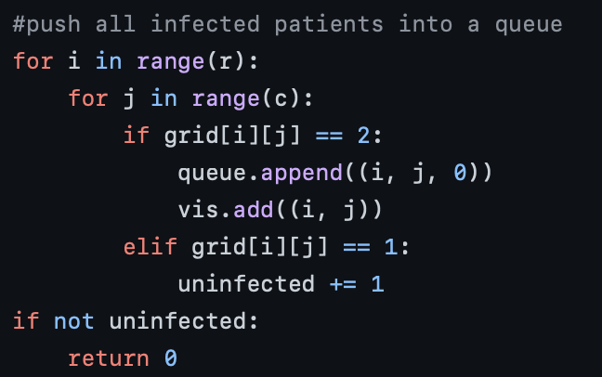
0,0
0,1
0,2
Goal :To evaluate time required to spread the virus
A
B
C
1,0
1,1
1,2
D
E
F
2,0
2,1
2,2
G
H
I
queue
vis
(0,0,0)
(0,0)
Infected=1
Uninfected=6
Empty room=2

Slide 3
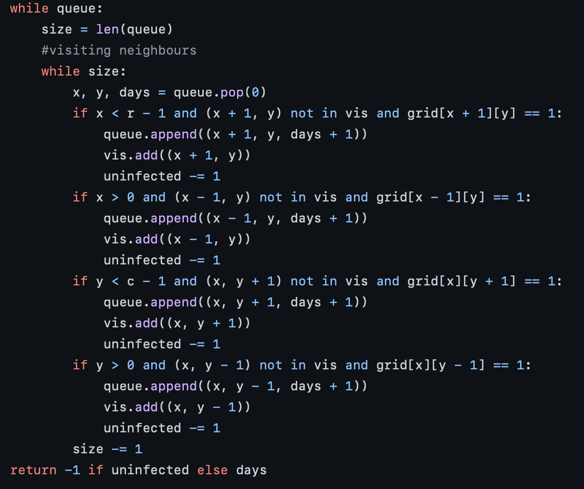
A
B
C
D
E
F
G
H
I
queue
vis
(0,0,0)
(0,1,1)
(1,0,1)
(0,0),(0,1),(1,0)
Uninfected=4
At end days =4

