Slide 1
DRIFT INVESTIGATOR AGENT
Architecture & Agent Logic
How a real tool-calling LangGraph agent investigates model drift, verifies its own claims, and pauses for human approval.

Slide 2
OVERVIEW
What the agent does
Given a feature and a model version, the agent investigates a drift alert entirely on its own — deciding what evidence to gather, reasoning about the likely cause, and writing a stakeholder report — before pausing for a human to approve it.
1
2
3
Input
Process
Output
feature + model_version.
Nothing else is handed to it.
Decides which tools to call,
in what order, and when it
has enough evidence.
A 5-section report,
checked by two guardrail
layers, pending approval.
What the agent does-
https://www.loom.com/share/aa4af2b6b7bf45f2ab27840bbe07d027
2

Slide 3
ARCHITECTURE
Four stages, one graph
01
02
03
04
Check
Investigate
Verify
Approve
Deterministic pre-check.
Skips the LLM entirely if
nothing's actually flagged.
The agent decides which
tools to call — drift,
lineage, metadata — and
when it's done.
Two independent guardrail
layers review the report
before a human sees it.
A real pause. Execution
genuinely halts until a
human approves or rejects.
If nothing's flagged: skip straight to done. No LLM call at all.
3

Slide 4
Recordings & Traces
Introduction
https://www.loom.com/share/aa4af2b6b7bf45f2ab27840bbe07d027
LangGraph Studio Architecture Walkthrough
https://www.loom.com/share/380d8a19688143baa645ee98c8b5e810
LangSmith Trace — Live Run
https://smith.langchain.com/public/6083ec6a-2169-4ad3-aea4-e6e7ac0642d7/r/019f9ebc-29c3-7631-839e-fe2ca144e0ed?start_time=2026-07-26T14%3A02%3A40.279583Z
Streamlit UI Running Locally
https://www.loom.com/share/c8f58a6a83474828a3697adab5f40483
Guardrail Catch in Action
Agent declines to fabricate a root cause when none exists in the data
https://www.loom.com/share/69db2736123b44238b455cb02927c49f

Slide 5
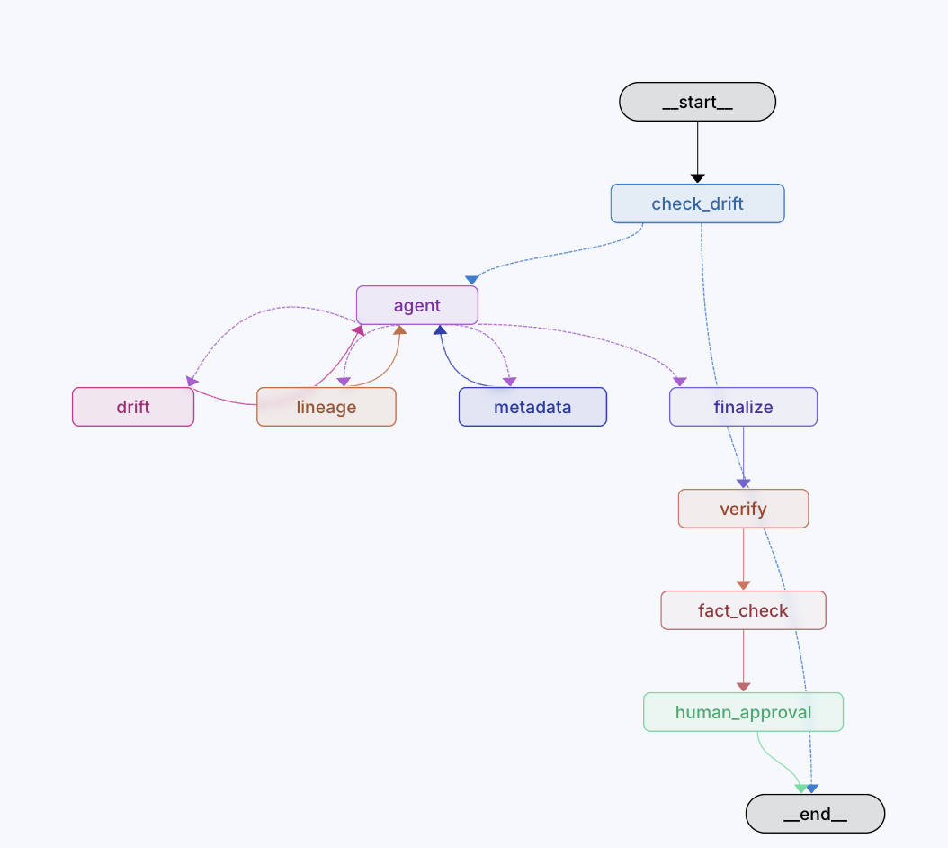
STAGE 02 — INVESTIGATE
The model decides, not the graph
A WORKFLOW
Fixed code path always fetches all sources, in the same order, whether or not it's useful.
THIS AGENT
The LLM sees three tools, chooses which to call and in what order, and stops once it has enough evidence.
agent ↔ tools, repeating until the model stops requesting tools
(hard-capped at 6 turns)
get_drift_metrics
get_lineage
get_model_metadata
Weekly PSI / accuracy time series for the feature.
Pipeline version history — deployments, known issues, incidents.
Accuracy, AUC, and feature importance over time.
4

Slide 6
STAGE 03 — VERIFY
Two independent guardrail layers
LAYER 1
LAYER 2
Deterministic checks
LLM fact-checker
• Input validation — unknown feature/version rejected with a clear error
• Turn cap — forces a stop after 6 agent turns
• Structural check — all 5 report sections present
• Fabrication check — every number, pipeline version, and incident ID must trace to a real tool output
A second, independent model call reviews the report against the raw tool output — catching a real value misapplied to the wrong claim, which presence-only checks can't.
CAUGHT LIVE
“a -0.06 AUC swing” — real source numbers, wrong subtraction. Fact-checker computed the correct value (0.041) and named the error.
5

Slide 7
STAGE 04 — APPROVE
A real pause, not a fake one
agent
interrupt()
human reviews
approve / reject
resume → END
Powered by LangGraph's interrupt() / Command(resume=…), backed by a checkpointer — execution genuinely halts and persists state until a human responds. Not a UI spinner standing in for a pause.
What the human sees at the pause
The full report • Any guardrail flags from both layers • The complete tool-call trace, in the order the agent actually made it
6

Slide 8
PROVIDER-AGNOSTIC
One agent, three LLM backends
Groq
Anthropic
Hugging Face
Llama-3.3-70B
Claude
Llama-3.3-70B (free tier)
resolve_provider() auto-detects from whichever API key is set — Groq, then Anthropic, then Hugging Face — or an explicit choice overrides it. Each backend's chat-completion quirks (message formats, token limits) are normalized behind one _get_chat_model() call.
It runs interchangeably on Groq, on Anthropic's Claude, or on Hugging Face's free inference tier, and it auto-detects whichever one is configured. I genuinely hit rate limits and a billing issue testing this, so having real fallbacks was necessary to keep working.
7

Slide 9
IN PRACTICE
A real investigation, start to finish
Input
feature: total_charges, model_version: v14
Tool calls
get_drift_metrics → get_lineage → get_model_metadata (agent's own choice and order)
Root cause
Billing Pipeline V2 (deployed 2 days before drift was observed) — labeled a hypothesis
Guardrail flag
Fact-checker: “conventional 0.2 PSI threshold” cited — not present in any tool output
Human decision
Approved, with the flag visible for review
8

Slide 10
DESIGN PRINCIPLES
What holds this together
1
The model decides, not the graph — tools are offered, not forced
2
Every claim must trace to a real tool output, or it gets flagged
3
Guardrails are defense-in-depth, reviewed by a human — not a silent hard gate
4
Approval pauses genuinely halt execution, not a UI illusion
5
One chat-model interface, three interchangeable backends
9

Slide 11
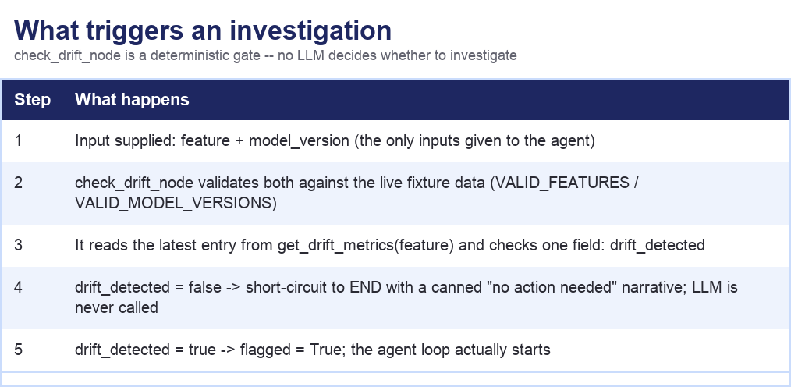
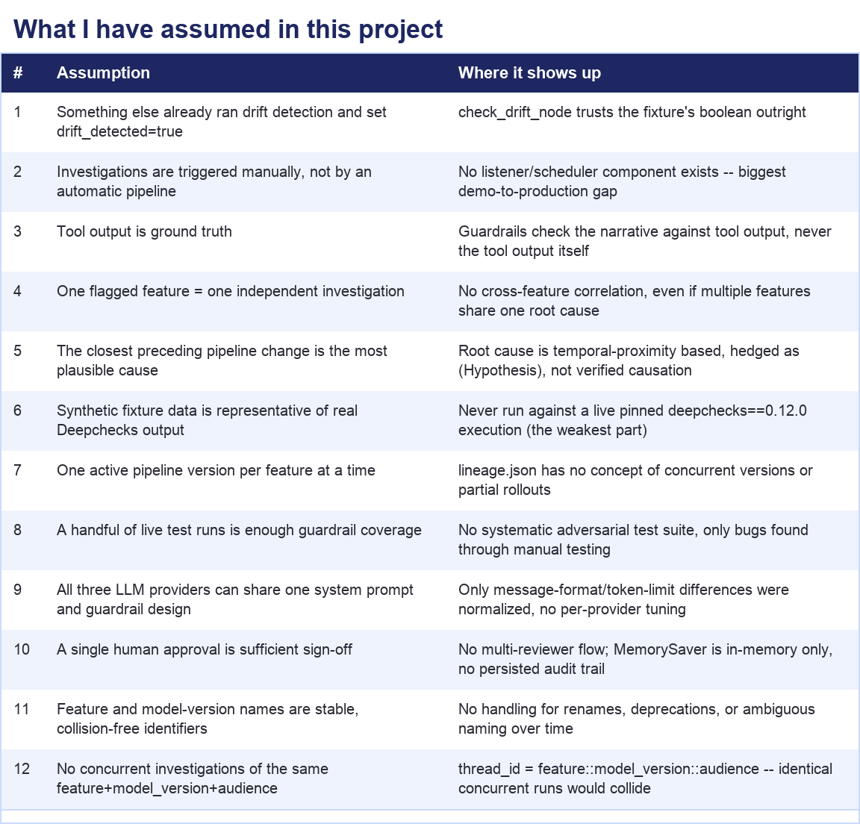

Slide 12
Real bugs found and fixed
During testing, Claude incorrectly calculated the difference between two real AUC values, reporting a -0.06 swing when the actual difference was -0.041. An independent fact-checker node, which verifies reports against the raw data, identified the discrepancy and flagged the exact error.
While testing with Groq, I found that tool calls with zero arguments returned the literal string "null". Parsing this as JSON produced Python's None instead of an empty dictionary, causing argument unpacking to fail until I explicitly handled that case.
I identified a bug in my own guardrail logic where a case-sensitivity issue caused "v1" and "V1" to be treated as different strings. As a result, a valid pipeline version was incorrectly flagged as fabricated.
All of these issues, their root causes, and the corresponding fixes are documented in the trade-offs section of the planning folder.

Slide 13
What was cut, and the weakest part
There's a function called export_drift_summary, and its job is to pull structured results out of a live Deepchecks run. I wrote it against Deepchecks' documented API, but I never actually ran it end-to-end against a real, live Deepchecks execution to confirm the output shape is exactly right. It's wrapped in a try-except, so it fails gracefully instead of crashing anything — but 'doesn't crash' is not the same as 'verified correct.' If I kept working on this, running that function against a real pipeline and asserting its output schema is the very next thing I'd do.

Slide 14
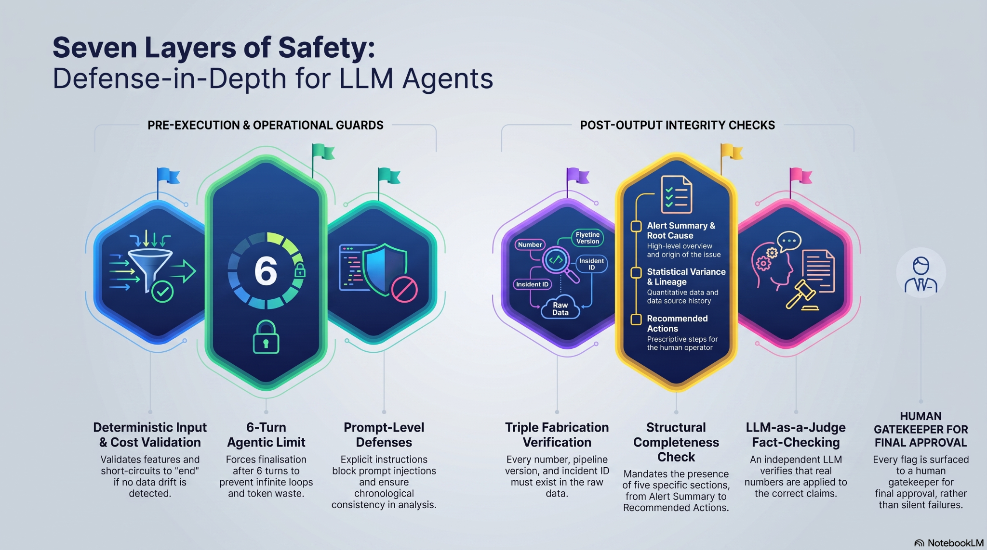
Guardrails

Slide 15
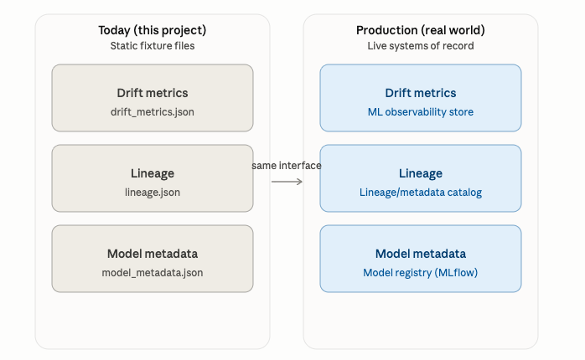

Slide 16
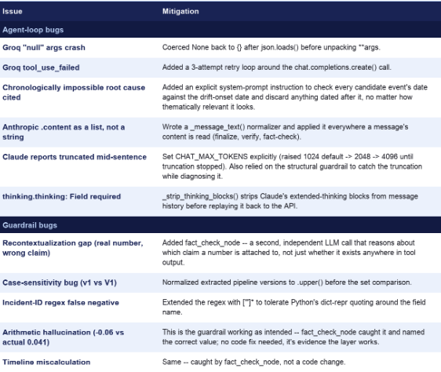
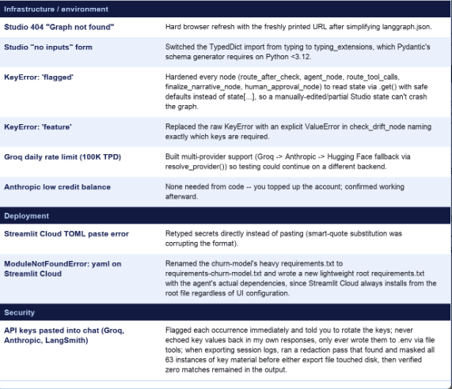
Error handling

