Slide 1

Brain cancer gene expression using Neural Networks
Presented by:
Shivika Prasanna
Ahmad Alhonainy
Abdulmateen Adebiyi
Hulayyil Alshammari
For Machine Learning for Biomedical Informatics
Images have been taken from sources cited on the slides.
Code available on: https://github.com/ShivikaPrasanna/brain_cancer_gene_expression.git

Slide 2






Outline:
Introduction
Objective and Dataset
Benchmark Comparison
Our Model
Evaluation
Conclusion

Slide 3
Introduction
Level of gene expression depends on factors
Type of cell
Developmental stage of the organism
Presence of external signals or environmental stimuli
Regulation of gene expression critical for maintaining proper balance of proteins and other molecules within cells

Slide 4

Objective and Dataset
Goal:
Predict the class of gene expression in Brain Cancer dataset
SBCB lab focuses on the computational analysis of biological structures
Curated Microarray Database (CuMiDa) containing 78 cancer datasets curated from 30,000 studies
Provide standardized preprocessing and benchmark results
Facilitate machine learning studies in cancer research
Source: https://sbcb.inf.ufrgs.br/

Slide 5
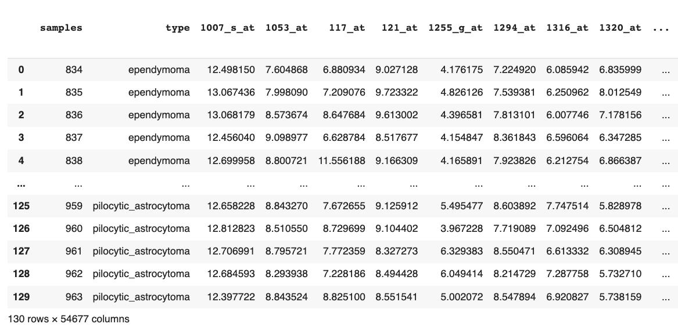
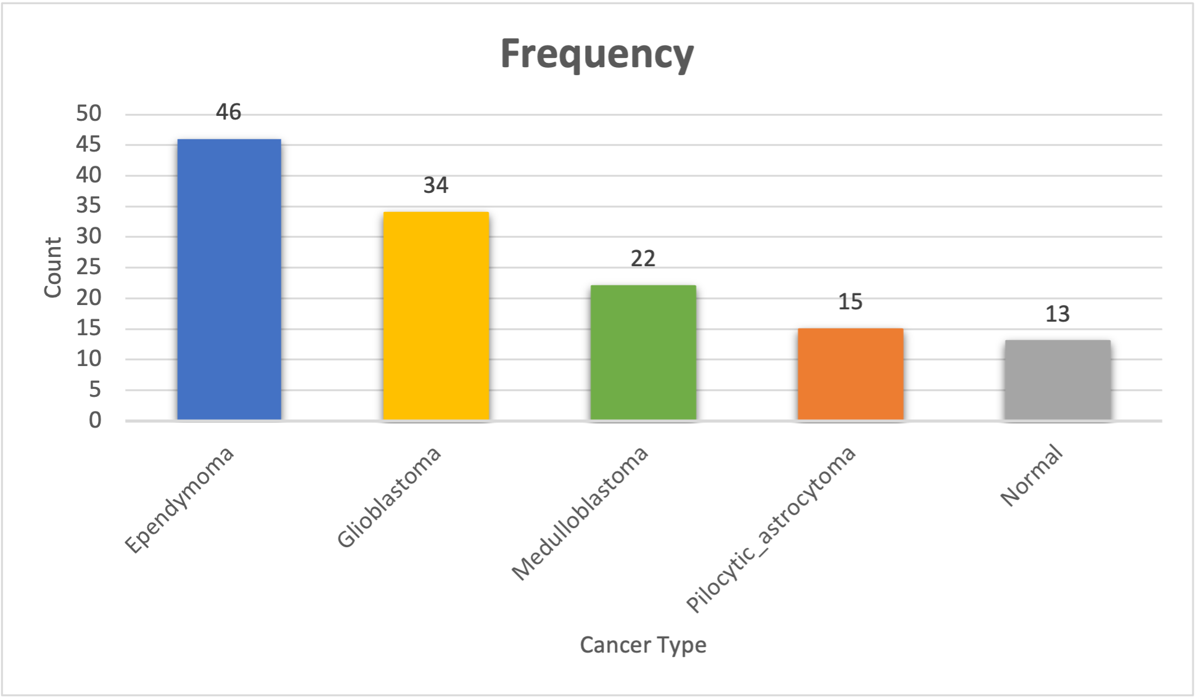


Objective and Dataset
GSE50161 on brain cancer gene expression
5 classes
54,676 genes
130 samples
Distribution of the 5 classes
Source: https://sbcb.inf.ufrgs.br/

Slide 6
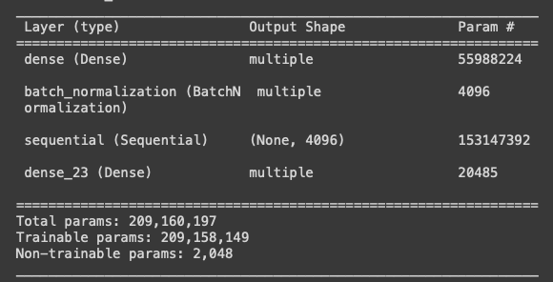
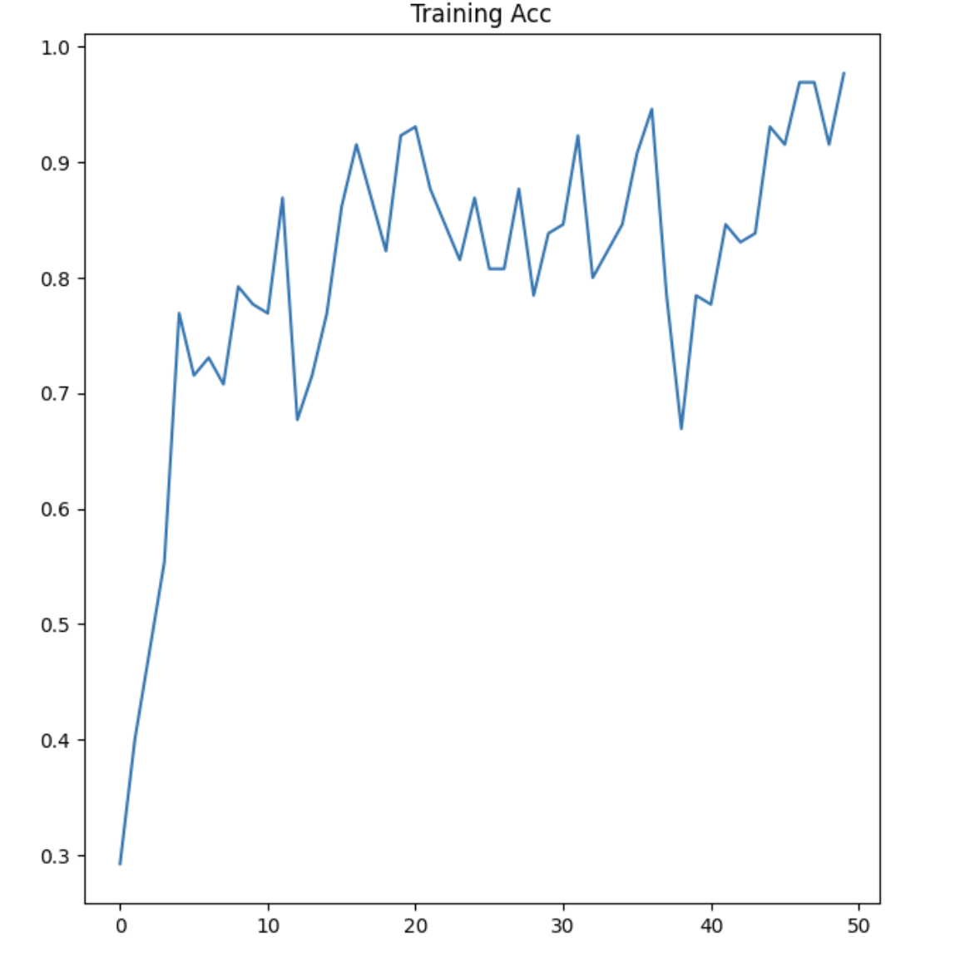
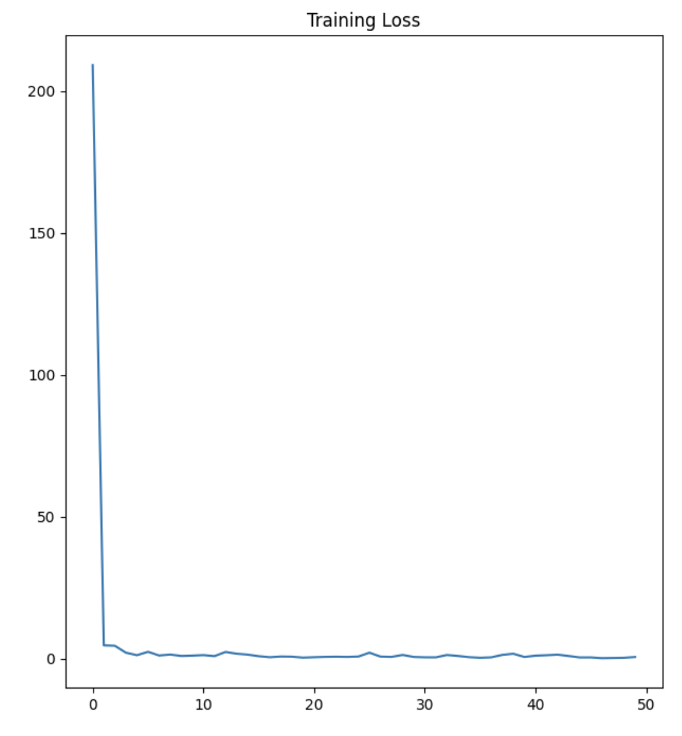
Benchmark Comparison
Model:
Train-test split of 100-0
ResMLP (Sequential)
Dense layer (Activation: ReLU)
Batch normalization
Optimizer: Adam
Loss: Sparse Categorical Cross Entropy
Model Training Parameters:
Epochs: 50
Batch size: 16
Source: https://www.kaggle.com/code/jiaowoguanren/brain-cancer-gene-expression-tf-resmlp-0-98

Slide 7
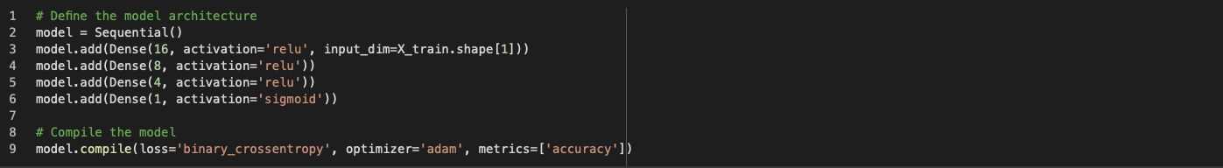
Our Model
Neural Network
Model definition:
Train-test split of 90-10 due to small size
Sequential model
4 dense layers (16, 8, 4, 1 units)
Activations:
Layers 1-3: ReLU
Layer 4: Sigmoid

Slide 8
Our Model
Loss: Binary Cross Entropy
Optimizer: Adam
Metrics: Accuracy

Slide 9
Our Model
Model Training Parameters
Early Stopping
Monitor: loss
Patience: 10
Mode: min
Model Checkpoint
Monitor: loss
Save best model with min loss
Learning Rate
Monitor: loss
Factor: 0.1
Mode: min

Slide 10
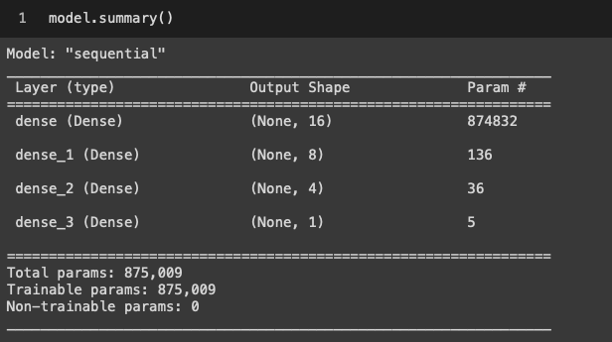
Model Summary

Slide 11

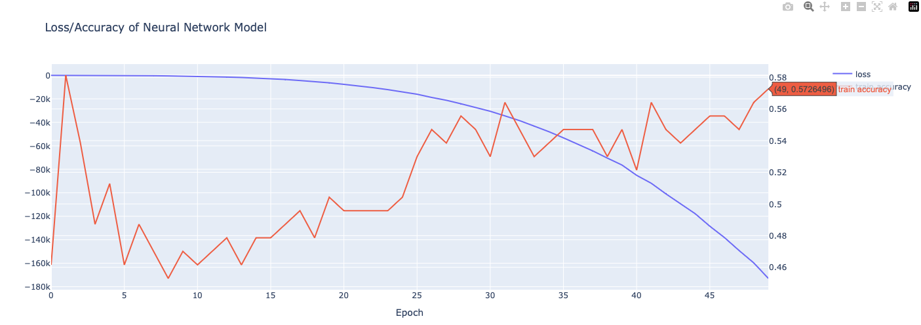
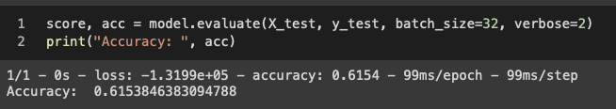
Evaluation
Metrics | Value
Training Accuracy | 0.57
Test Accuracy | 0.61
Epochs | 50
Batch size | 16

Slide 12
Conclusion
Neural networks can be used to classify the gene expression
Into 3 classes for Brain Cancer dataset due to extreme class imbalance, namely ependymoma, glioblastoma, medulloblastoma
Data was split into 90-10 due to dataset size
Model developed had fewer layers to accommodate the data size
Multiple experiments were carried out to finalize the best model
SMOTE for additional synthetic data points yielded similar test accuracy of 59%
Smaller model of 2 layers yielded test accuracy of 60%
Hyperparameter tuning on the batch size, epochs and split ratio

