Slide 1
C&I ROOFTOP SOLAR ENTRY STRATEGY FOR UAE FREE ZONES
Feasibility and strategic analysis for a mid-sized EPC firm
Shivkanya Balamurugan

Slide 2
WHY THIS MARKET NEEDS A CLOSER LOOK
  Situation: The UAE has ambitious net-zero goals (2050). Dubai's major free zones (JAFZA, Dubai South, DIC) contain thousands of large, flat-roofed warehouses and factories with high daytime energy consumption.
  Complication: A mid-sized Solar EPC sees potential but lacks clarity on market attractiveness, competition, and the optimal entry model to win in this space.
  Key Question: Should we enter the Dubai C&I rooftop solar market, and if yes, how?
Shivkanya B

Slide 3
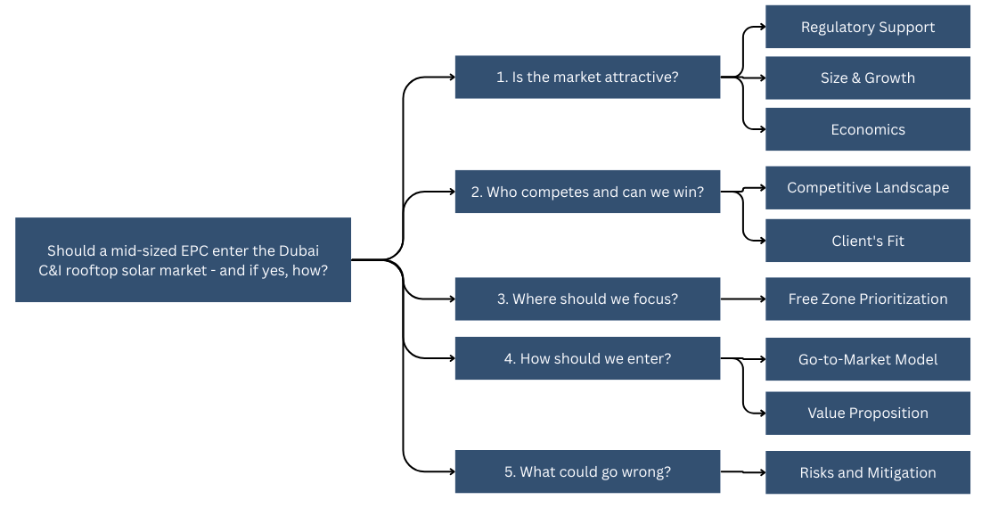
OUR STRUCTURED APPROACH
Shivkanya B

Slide 4




FOUR POWERFUL DRIVERS CREATE A COMPELLING MARKET FOUNDATION
Regulatory
Strong Tailwind
UAE Net Zero 2050,
Shams Dubai program
Economic
Favorable Math
High irradiance + high tariffs = strong IRR
Operational
Perfect Load Match
C&I daytime ops align with solar generation
Strategic
ESG Imperative
Tenant decarbonization goals drive demand
Shivkanya B

Slide 5
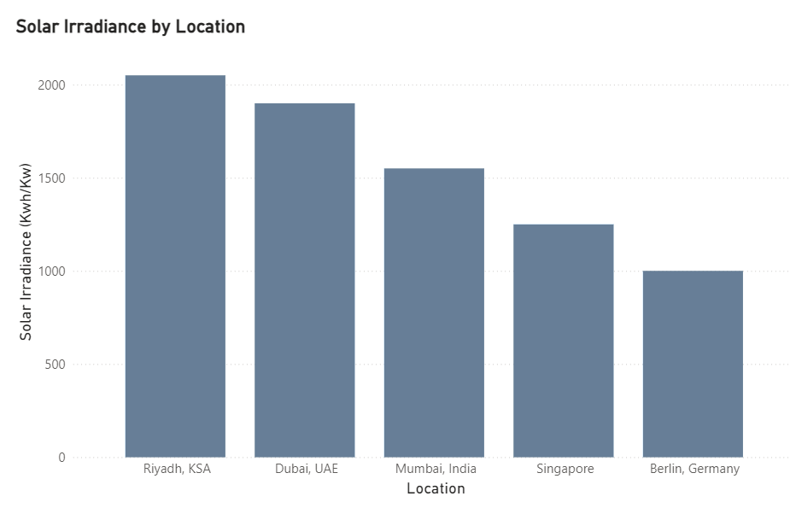
WORLD-CLASS SOLAR RESOURCE ENSURES HIGH AND PREDICTABLE OUTPUT
Key Takeaway: Dubai's ~1,900 kWh/kW/year is among the highest globally, ensuring robust system performance and predictable economics.
Graph created using PowerBI
Shivkanya B

Slide 6
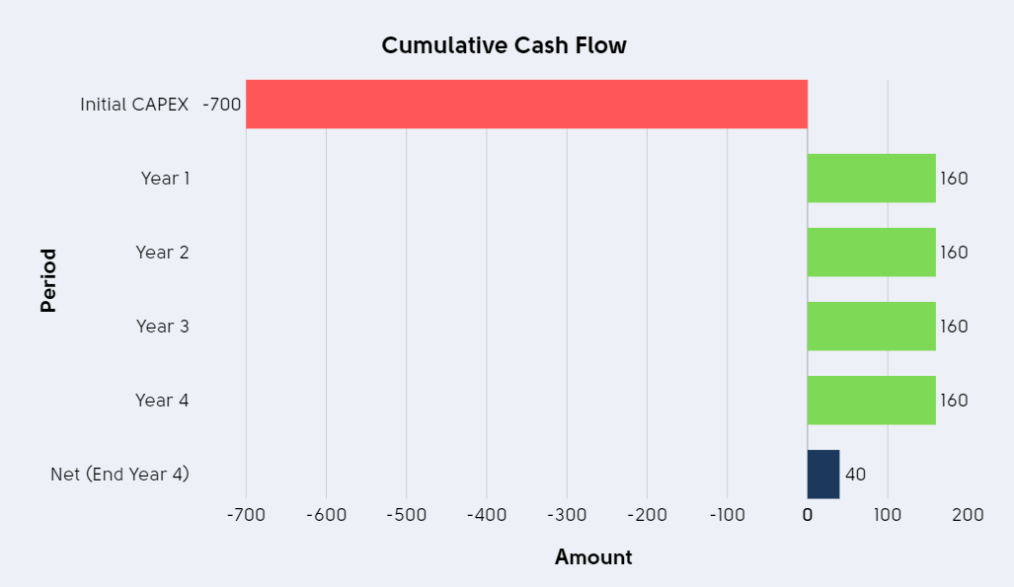
FOR FREE ZONE BUSINESSES, SOLAR IS A HIGH-ROI OPERATIONAL INVESTMENT
  Typical payback: 4–6 years
  Attractive long-term savings potential
  Strong alignment with daytime operations
  High predictability due to Dubai irradiance
Graph created using PowerBI
Shivkanya B

Slide 7
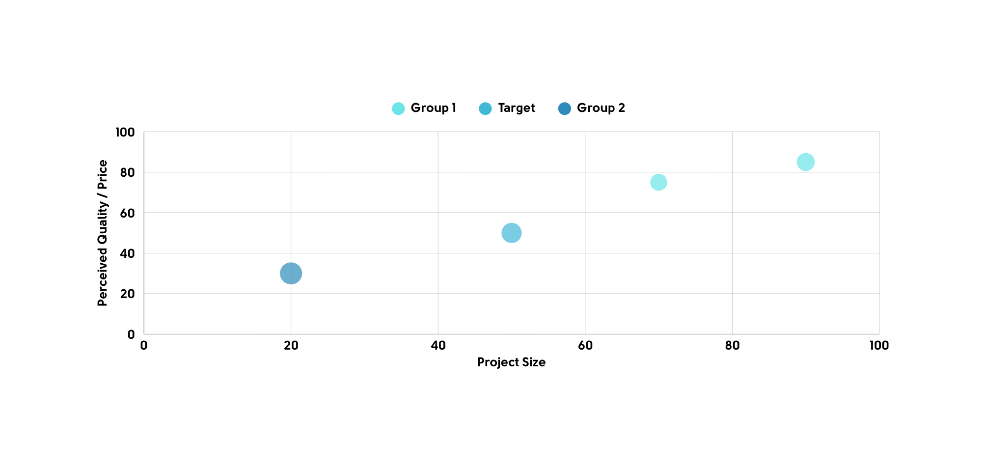
THE MID-MARKET SEGMENT (50–500 KW) IS UNDERSERVED BY QUALITY PROVIDERS
An opportunity exists for a reliable, quality-focused player in the mid-market.
Graph created using PowerBI
Shivkanya B

Slide 8
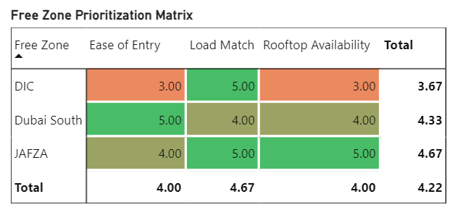
JAFZA EMERGES AS THE CLEAR PRIORITY FOR INITIAL FOCUS
  JAFZA: Highest overall potential. Recommended to launch here.
  Dubai South: Strong future candidate. Modern infrastructure.
  DIC: Viable but requires more selective site assessment.
Graph created using PowerBI
Shivkanya B

Slide 9
"QUALITY-FOCUSED, JAFZA-FIRST, CAPEX-LED" ENTRY MODEL
1. TARGET: Owner-occupied & long-lease warehouses in JAFZA.
2. MODEL: CAPEX sales facilitated by partner financing. Offer "Feasibility Audit" as lead gen.
3. PROPOSITION: Compete on reliability & lifecycle value: Tier-1 equipment, O&M guarantee, approval navigation.
Shivkanya B

Slide 10
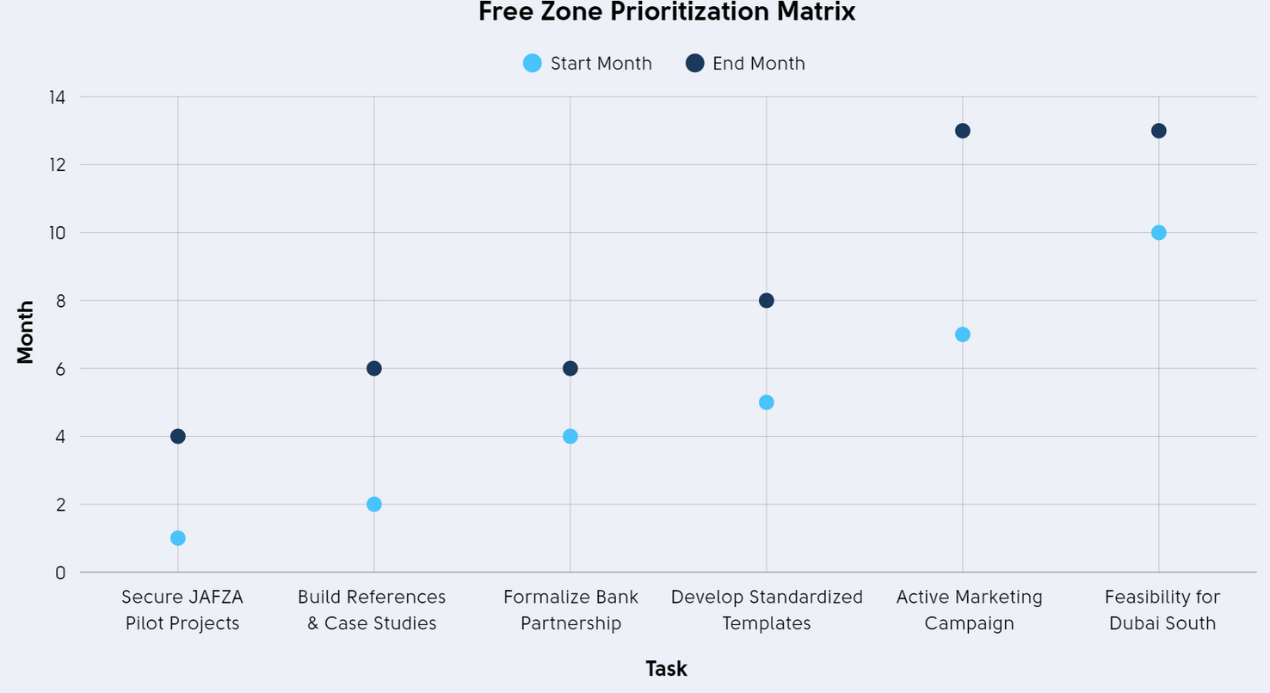
A PHASED 12-MONTH PLAN TO BUILD MOMENTUM AND SCALE
  Month 3: Secure first pilot project.
  Month 6: Formalize bank partnership.
  Month 12: Achieve 5–8 MW contracted pipeline.
Graph created using PowerBI
Shivkanya B

Slide 11
IDENTIFIED RISKS ARE MANAGEABLE WITH PROACTIVE PLANNING
Risk | Impact | Mitigation
Rooftop Structural Issues | High | Mandatory, billable structural audit pre-contract
Customer CAPEX Hesitation | Medium | Pre-arranged financing options via bank partner
Approval Delays | Medium | Dedicated approvals specialist with DEWA/zone relationships
Shivkanya B

Slide 12
RECOMMENDATION:
ENTER THE MARKET WITH A FOCUSED, DISCIPLINED STRATEGY
  ENTER the Dubai C&I rooftop solar market.
  FOCUS on the quality mid-market gap in JAFZA.
  EXECUTE via a CAPEX-led model, underpinned by financing and quality guarantees.
This approach captures a serviceable market opportunity with a compelling customer value proposition and manageable risk.
Graph created using PowerBI
Shivkanya B

