Slide 1

E-Learning Platform
Major Project – II
CS-805
Problem Statement: Design and Development of E-Learning Platform
Project Group Number: 16
Group Member Details: Abhishek Shukla
Saurabh Agrawal
Shiv Kumar Sharma
Sourabh Gour
Guide Details: Prof. Bhavana Soni

Slide 2
Idea/Approach Details
Abstract :
The project is a comprehensive e-learning platform designed for targeted study material.
It provides domain-specific study materials.
Users can access curated materials.
The platform allows course uploads by teachers, enhancing it with updated study material.
The overall aim is to create an interactive, insightful, and secure platform for effective learning and knowledge sharing.
Bridges the gap between traditional and digital education, making learning cost-effective and efficient for students and educators.
Idea Solution/Prototype here :
In the realm of online learning, the shortcomings of generic materials and the absence of a centralized platform have led to a crucial deficit in specificity and collaboration. Recognizing this challenge, Our team has developed an advanced E-Learning Platform that facilitates seamless online education with three levels of authorization: Students, Teachers, and Admins. Teachers can create and upload courses, providing high-quality educational content across various subjects. Students can browse, purchase, and access courses to enhance their knowledge at their own pace. Admins oversee platform operations, managing users and content to ensure a smooth learning experience. The platform offers a user-friendly interface, secure payment integration, and an interactive learning environment, making education more accessible and efficient for both learners and educators.
Technology stack :
Frontend:
HTML/CSS/JavaScript/React.js: Standard web technologies for structuring content and enhancing interactivity.
Backend:
Node.js: To run the server-side logic and handle requests from the frontend.
Express.js: A web application framework for Node.js, simplifying the process of building robust APIs.
MongoDB: A NoSQL database for storing user data, study materials, quiz results, and other relevant information.
Mongoose: An ODM (Object Data Modeling) library for MongoDB and Node.js, facilitating interaction with the database.

Slide 3
Project Requirements
Functional Requirements
Non-Functional Requirements
User Registration and Login: Users should be able to register and login to the platform using their credentials.
Access Study Materials: Students should be able to access courses uploaded by educators.
Purchase Study Material: Students should be able to securely purchase course through Razorpay.
Upload Courses: Teachers should be able to Create, edit, and delete courses.
Programming IDE: The platform provides students with IDE to run SQL queries and test their practical knowledge.
Admin Panel: Administrators should be able to manage users and categories through dedicated admin panel.
Security: The platform should prioritize security best practices to protect user data and prevent unauthorized access.
Scalability: The platform should be scalable to accommodate a growing number of users and data.
Performance: The platform should provide fast response times and efficient data processing.
Usability: The platform should be user-friendly with an intuitive interface.
Reliability: The platform should be reliable, providing consistent service without unexpected downtime.
Maintainability: The system should be easy to update and maintain.

Slide 4
Project Requirements
Hardware and Software requirements (Developer)
Hardware Requirements:
Personal Computer: A standard personal computer or laptop having 4GB RAM with minimum storage 50GB available.
Storage: Adequate storage space personal computer for the project files and database.
Software Requirements:
Operating System: Any modern operating system like Windows, macOS, or Linux that supports the necessary development tools.
Database Management System: MongoDB, MySQL.
Server-side Language: A server-side language like Node.js for backend development.
Client-side Language: A client-side language like JavaScript, HTML, CSS for frontend development.
Integrated Development Environment (IDE): An IDE like Visual Studio Code for writing and managing the code.
Version Control System: A version control system like Git for tracking changes and collaborating with team members.
Hardware and Software requirements (Client)
Hardware Requirements:
Device: A device with internet access, such as a computer, laptop with minimum 2 GB RAM.
Software Requirements:
Web Browser: A web browser like Chrome, Firefox, Safari, or Edge.

Slide 5
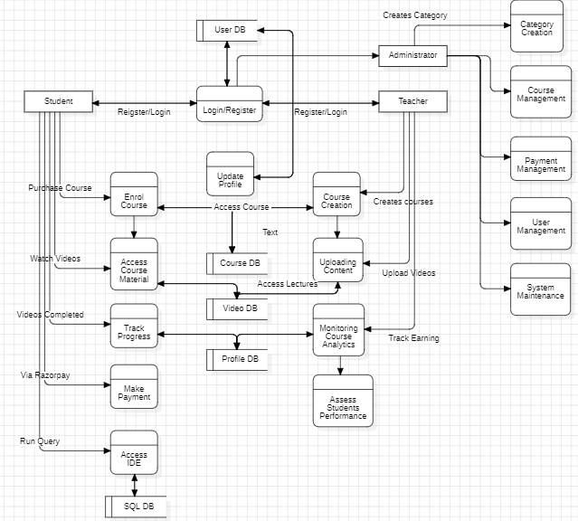
Design
Data Flow Diagram:

Slide 6
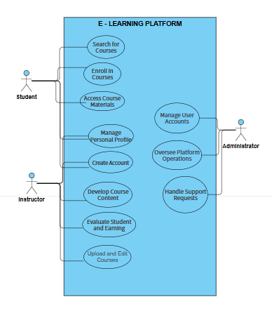
Design
Use Case Diagram:

Slide 7
Design
Dependencies / Show stopper :
Dependencies:
Internet Connectivity:
Stable internet connection required for user access.
Browser Compatibility:
Platform must be compatible with major web browsers.
Development Tools:
Specific tools required, including Git, Visual Studio Code.
Database Systems:
Dependency on MongoDB and SQL for data storage.
Node.js and Express.js:
Reliance on Node.js and Express.js for backend development.
React.js:
Dependency on React.js for frontend development.
Show Stoppers:
Poor User Experience (UX):
Consistent negative feedback on UI, navigation, or overall user experience.
Ineffective Content Management:
Difficulties in managing and curating study materials, quizzes, and blog content, impacting user experience.
Security Vulnerabilities:
Critical flaws compromising user data or system integrity.
Scalability Issues:
If the platform cannot handle a growing number of users or data, it could hinder the project.

Slide 8
Deployment Details
Testing:
In the testing phase, we systematically evaluate our project for functionality, performance, and security. After testing the app thoroughly. We can deploy the application.
Distribution Platform:
Choosing any one hosting platform like AWS, Vercel, Render followed by server configuration and managing both frontend and backend.
Maintenance:
Plan for ongoing maintenance, including server updates, database maintenance, and keeping dependencies up to date.

Slide 9


