Slide 1
DIGITAL TWIN POC FOR PREDICTIVE HEALTHCARE
Forecasting Glucose Spikes & Assessing Cardiovascular Risk via Multi-Modal Sensor-EHR Fusion
Happiest Health Reimagining & Reforming Healthcare in India Summit - 2026, Bengaluru
Team: Team DigitalTwin | Student Innovation Incubator

Slide 2
HAPPIEST HEALTH SUMMIT 2026
Problem Statement: The Reactive-to-Proactive Shift in India
• The Dual Chronic Epidemic: India has over 101M individuals diagnosed with Type 2 Diabetes and 315M with Hypertension (ICMR-INDIAB).
• South Asian Phenotype: Earlier onset at lower BMI thresholds ('thin-fat phenotype'), accelerating cardiovascular comorbidities.
• Limitations of Current Medicine: Reactive episodic consultations occur only after organ damage has already started.
• The Digital Twin Vision: A dynamic virtual replica of the patient ingesting real-time wearable telemetry alongside longitudinal EHR records to preempt adverse events.

Slide 3
HAPPIEST HEALTH SUMMIT 2026
Multi-Modal Architecture: Ingestion & Privacy Compliance
• Stream 1: Static EHR Telemetry Synthetic longitudinal clinical cohort (500 Indian patients), demographics, comorbidities, medications, and quarterly lab panels (HbA1c, fasting glucose, lipid profiles, eGFR).
• Stream 2: Dynamic Wearable Streams Continuous Glucose Monitor (5-min intervals), continuous heart rate and HRV (RMSSD/SDNN), sleep architecture hypnograms, and hourly step counts.
• Sandbox & Privacy Rules: 100% compliant with India's DPDP Act and HIPAA using synthetic generators parameterized on authentic clinical distributions.
• Continuous Synchronization: Real-time state ingestion updating the virtual patient's metabolic and hemodynamic state buffers.

Slide 4
HAPPIEST HEALTH SUMMIT 2026
Predictive Engine: BiLSTM + Attention, XGBoost & Neural Fusion
• 1. BiLSTM with Self-Attention (Glucose Spike Forecasting): Ingests 6-hour sliding windows (72 steps) to predict the next 2-hour trajectory (24 steps), forecasting spikes before onset.
• 2. XGBoost with SHAP (ASCVD 10-Year Risk): Combines static clinical history with wearable biometric metrics (resting HR, nocturnal HRV, sleep efficiency) to predict cardiovascular risk with explainable attribution.
• 3. Multi-Modal Intermediate Fusion Neural Network: A hybrid dual-branch architecture (temporal LSTM branch + static MLP branch) learning joint cross-modal risk representations.
• 4. Clinical Alert Manager: Intelligent hysteresis debouncing across 4 triage tiers (Critical, High, Moderate, Info) to prevent alarm fatigue.

Slide 5
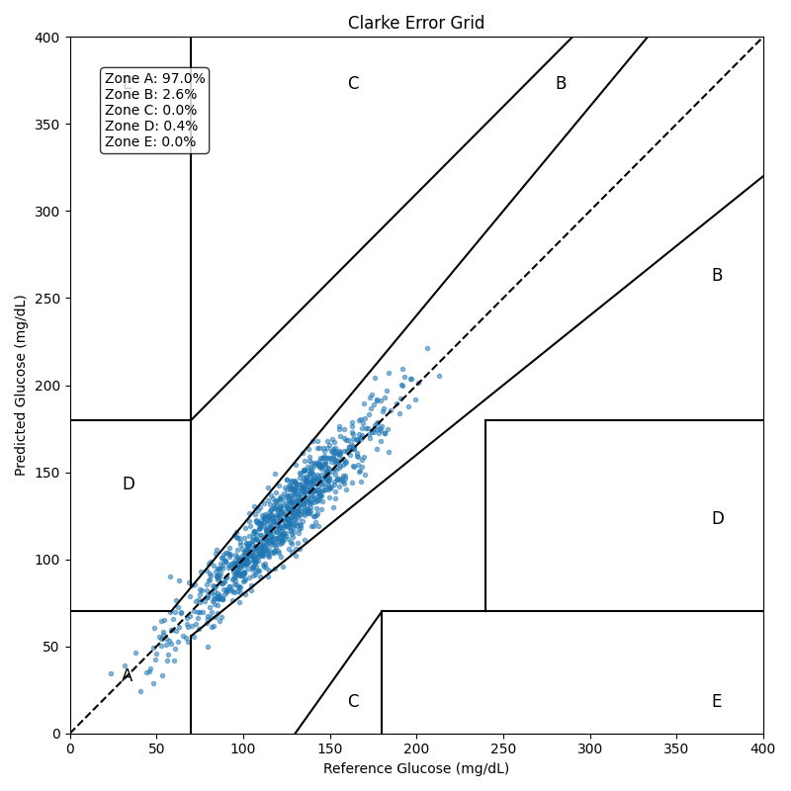
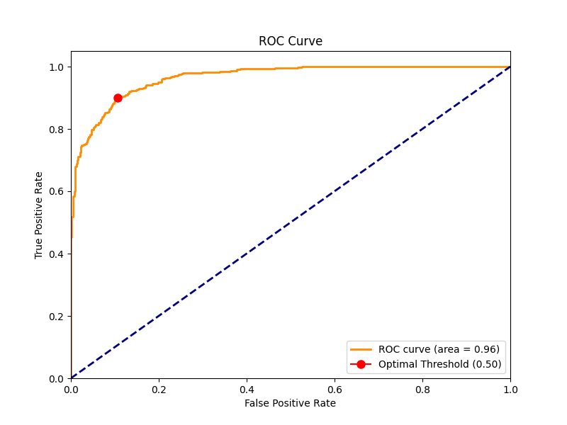
HAPPIEST HEALTH SUMMIT 2026
Clinical Validation & Quantitative Results
Glucose Prediction Metrics:
• Clarke Error Grid (A+B): 99.60% (Exceeds >95% clinical standard)
• MARD (Device Accuracy): 7.47% (Target <10%)
• RMSE / MAE: 10.31 mg/dL / 8.36 mg/dL
Cardiovascular Risk Metrics:
• AUC-ROC: 0.965
• PR-AUC: 0.968
• Sensitivity / Specificity: 89.80% / 89.39%
• F1 Score: 0.8980

Slide 6
HAPPIEST HEALTH SUMMIT 2026
Clinician Interface & What-If Counterfactual Simulator
• Dynamic Patient Roster: Instant retrieval of clinical twins with live vitals, condition histories, and longitudinal telemetry.
• Continuous Glycemic Timeline: Observed CGM signals paired with 2-hour predictive trajectory bands and early alert indicators.
• ASCVD Risk & SHAP Explainability: Identifies top contributing risk drivers per patient (e.g. nocturnal BP non-dipping, elevated HbA1c, smoking).
• Interactive 'What-If' Simulation: Allows doctors to simulate pharmacological and lifestyle interventions (e.g. 30 min daily exercise + SGLT2i titration) and view modeled risk drops.
• Operational Deployment: Streamlit application served at http://localhost:8501.

Slide 7
HAPPIEST HEALTH SUMMIT 2026
Impact & Roadmap for Indian Healthcare Ecosystem
• Clinical Efficacy: Transitioning Indian chronic care from reactive firefighting to automated 2-hour early warning interventions.
• Affordability & Accessibility: Engineered to run seamlessly on consumer-tier wearable telemetry and open-source clinical models.
• Summit Showcase - November 2026: Ready for stage demo at the Bengaluru summit with end-to-end multi-modal data streaming and clinician dashboard.
• Open Source Availability: Fully reproducible codebase with unit testing, synthetic dataset generator, and complete documentation under MIT License.

