Slide 1


Amazon Sales

Slide 2


Today's agenda
Project recap
Project objective
Process
Insights
Data overview
Summary

Slide 3

Amazon is an American Tech Multi-National Company whose business interests include E-commerce, where they buy and store the inventory, and take care of everything from shipping and pricing to customer service and returns. This dataset is having the data of 1K+ Amazon Product's Ratings and Reviews as per their details listed on the official website of Amazon.
Project Recap

Slide 4

Project Objective
To analyze Amazon product performance across categories using sales, discounts, reviews, and ratings to uncover actionable insights.
Tools: Power BI, Data Cleaning, DAX

Slide 5
Process
1
Data Collection
2
Data Understanding
3
Data Cleaning
4
Data Visualization
5
Uncover Insights

Slide 6
Data Overview
Data Source:
Amazon sales dataset (scrapped from the Kaggle)
Total Records:
1,464 Rows
Key Columns Used:
Product Name: Name of the listed products
Category: Product category
Actual Price: Actual price of product
Discounted Price: Price of the product after discount
Discount Amount Difference: Difference between actual price and discounted price
Discount Percentage: Percentage discount offered
Rating: Average rating out of 5
Rating Count: Total number of user rating
Review Count: Number of written reviews

Slide 7

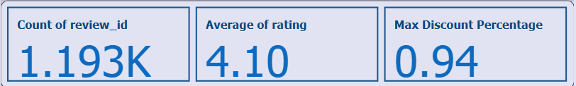
Insights
Total Reviews
It indicates a healthy volume of customer feedback. It is useful for measuring engagement.
Average Rating
It reflects a generally positive customer sentiment. It shows product quality and satisfaction.
Maximum Discount (%)
It highlights the most heavily discounted product. It is useful to spot aggressive pricing strategies.

Slide 8
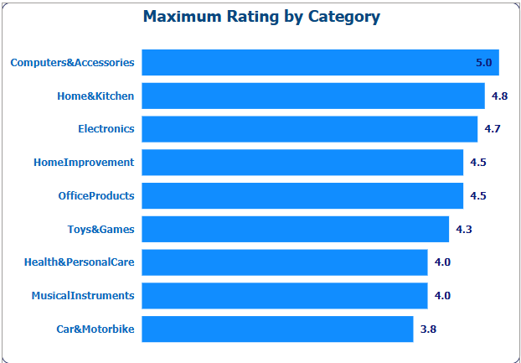
Top-rated Category
Computers & Accessories received a perfect 5.0 rating which shows high satisfaction and product quality in this segment.
Other top-rated Category
Home & Kitchen and Electronics segment also score high 4.8 and 4.7, respectively, indicating strong customer trust and satisfaction.
Mid-rated Category
Categories like Toys & Games and Health & Personal Care show good ratings 4.3 and 4.0, respectively but they need strategies for improvement.
Lowest-rated Category
Car & Motorbike has the lowest rating 3.8, suggesting potential quality or satisfaction concerns.

Slide 9
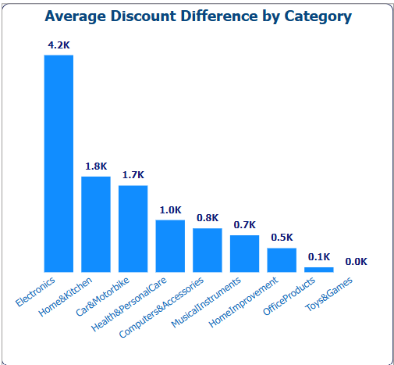
Electronics category has the highest average discount difference which is 4.2K. It indicates significant markdowns which likely used to boost sales or clear stock.
Home & Kitchen and Car & Motorbike also show relatively high discount differences 1.8K and 1.7K, respectively -possibly used to stay competitive.
Toys & Games has zero discount difference, meaning it either has fixed pricing or minimal promotional pricing strategies

Slide 10
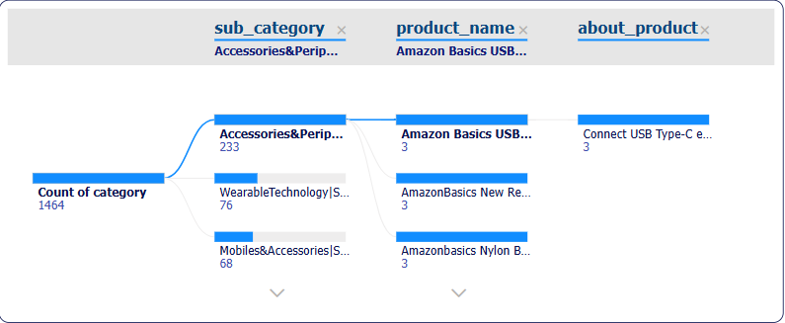
This decomposition tree visual breaks down the total number of products which is 1,464 into sub-categories, product names, and then into product-level details.
Top sub-category:
Accessories & Peripherals has the highest count with 233 products, followed by Wearable Technology (76) and Mobiles & Accessories (68).
Product name:
From Accessories & Peripherals, we can drill down to individual products like: Amazon Basics USB Type-C Cable, AmazonBasics Nylon Braided Cable, and many more.
We can also explore product specifications like “Connect USB Type-C enabled devices…” at the most granular level.

Slide 11
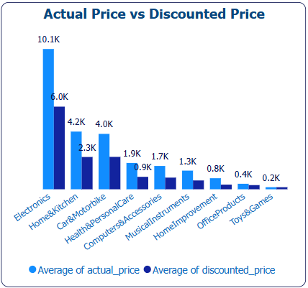
Electronics category has the highest average price which is ₹10.1K and also the largest discount, bringing it down to ₹6K - shows strong discounting to drive demand.
Home & Kitchen and Health & Personal Care follow with moderate pricing and noticeable discounts.
Office Products and Toys & Games are the lowest-priced categories, with smaller or negligible discounts.

Slide 12
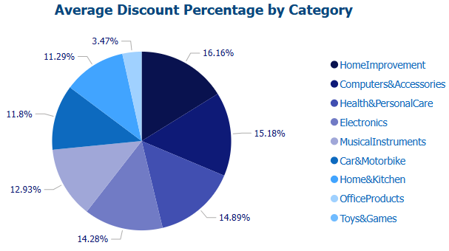
Home Improvement offers the highest average discount 16.16%, suggesting aggressive pricing or high competition.
Computers & Accessories, Health & Personal Care, and Electronics 15.8%, 14.89%, and 14.25%, respectively, also see significant discounting.
Office Products receive the lowest average discount (3.47%) and Toys & Games not even have average discount (0.00%), possibly due to steady demand or lower margin flexibility.

Slide 13

Average Rating across all products is 4.1, with over 1.1K reviews recorded.
Electronics leads in average discount difference and actual price, indicating deep price reduction.
Home Improvement offers the highest average discount percentage (16.16%).
Toys & Games consistently have low discounts and lower max ratings, suggesting pricing stability or niche demand.
Summary

Slide 14
Thank you!
ANY QUESTIONS?

