Slide 1
SMART WEARABLE FOR THE BLIND
SHIVOM SEHGAL

Slide 2

ABSTRACT
IN THIS PROJECT, WE TEND TO MAKE A SMART WEARABLE FOR THE BLIND WHICH COULD HELP THE PERSON IN HIS DAY TO DAY ACTIVITIES. WITH THE HELP OF AN ULTRASONIC SENSOR AND BY ATTACHING A BUZZER, THIS DEVICE COULD GUIDE THE PERSON OF UPCOMING OBSTACLES IN HIS PATH AND ALSO WITH THE HELP OF THIS DEVICE HE WILL HAVE HOME AUTOMATION AT HIS FINGERTIP AND ALSO WILL HAVE GPS ATTACHED TO HIM ALL THE TIME AND THE COORDINATES OF HIS LOCATION WILL BE CURRENTLY UPDATED TO HIS CARETAKER WITH THE HELP OF SMS ON HIS PHONE.

Slide 3
INTRODUCTION
Blindness is one of the most, if not the most, misunderstood type of disability. The general masses have their own pre-conceived notions about the blind people that they firmly believe to be true without even getting in touch with a blind person. Most of the members of the non-blind community believe that the blind people cannot do their work or live a normal life. By this project we tend to break this myth and prove that blind people can lead a normal life full of independence.
In this project we intended to make a smart wearable for the blind which could provide independence in day-to-day works like walking on a street or switching on the air conditioner without the help of another individual.

Slide 4
COMPONENTS REQUIRED
Component | Rating | specification | Application In system
Arduino Uno | 3.3V / 5V | ATmega328 microprocessor | Micro controller
Ultrasonic HCSR-xx module | 5V | Max Range: 4m Min Range: 2cm Measuring Angle: 15 degree
xCluma Active buzzer | 5V (or analog mode)
Vibration mini motor | 5V |  | Used as an alarm
TTP223 Touch sensor | 2V to 5.5V |  | Fingertip controlled home automation
BT module HC-05 | 3.3V / 5V | 2.4GHz protocol frequency | Communication interface for home automation
AC DC relay | 230V – 5V | Operating time: 10msec Release time: 5msec | Digital Home automation
u‑blox neo 6m GPS | 3.3 V |  | Find coordinates
SIM 900A GSM | 3.3 V | Dual-Band 900/ 1800 MHz. | Sending coordinates as sms
USB to TTL | 5V – 3.3 V | TTL Serial converter

Slide 5
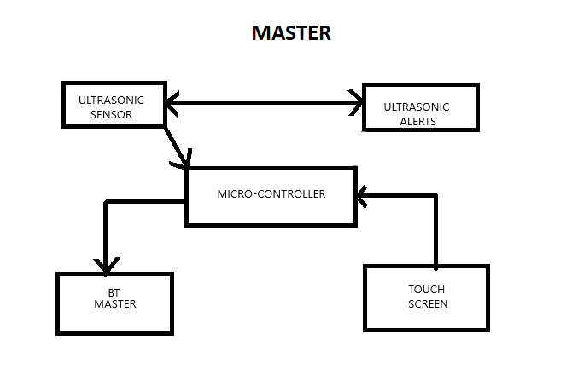
BLOCK DIAGRAM (MASTER SIDE)

Slide 6
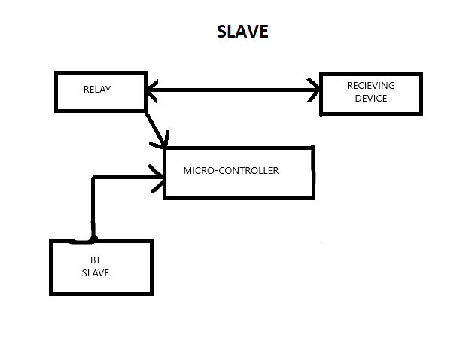
BLOCK DIAGRAM (SLAVE SIDE)

Slide 7
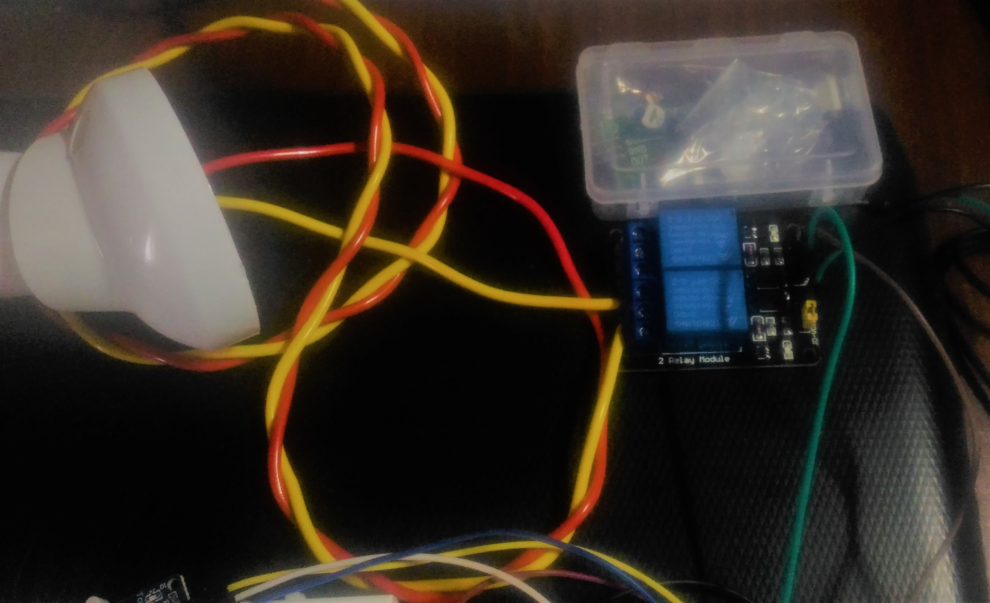
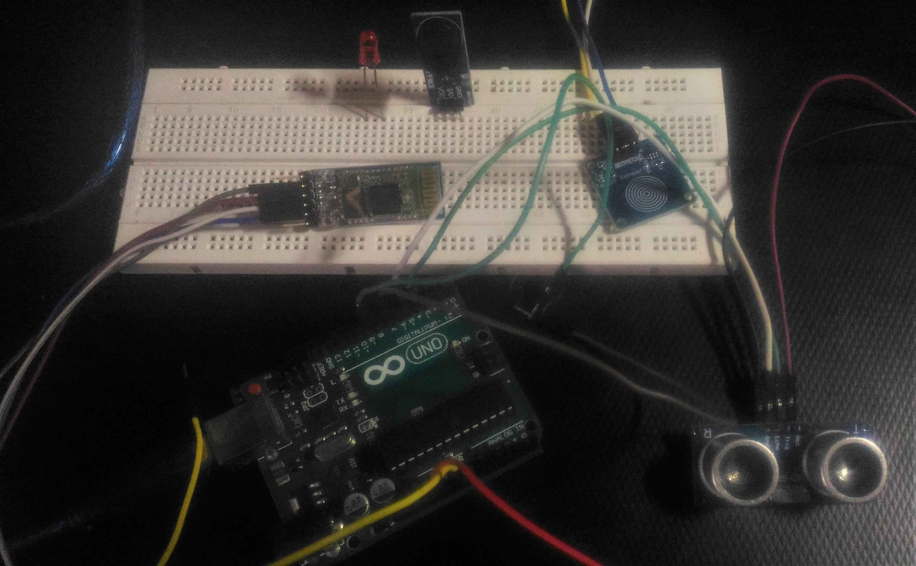
HARDWARE PHOTOGRAPHS

Slide 8
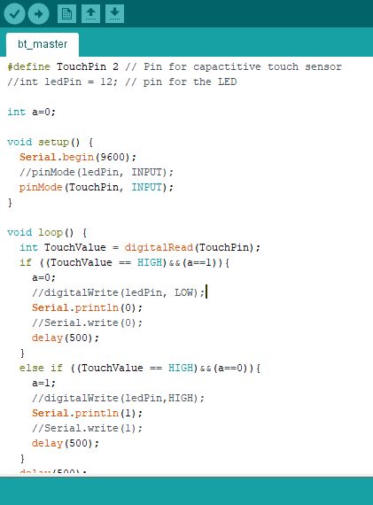
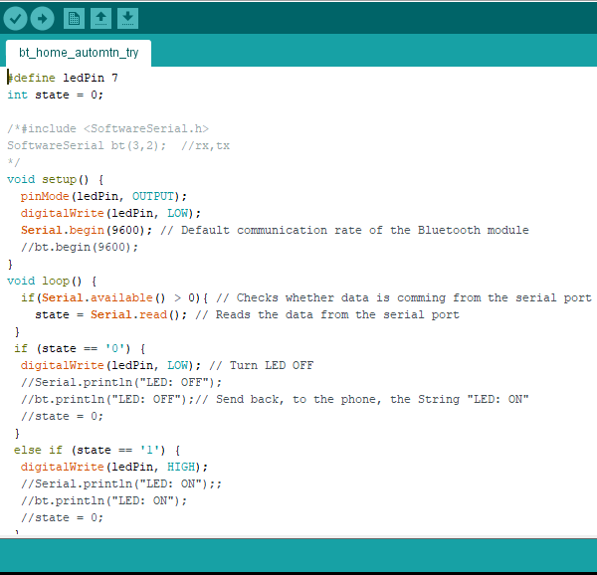
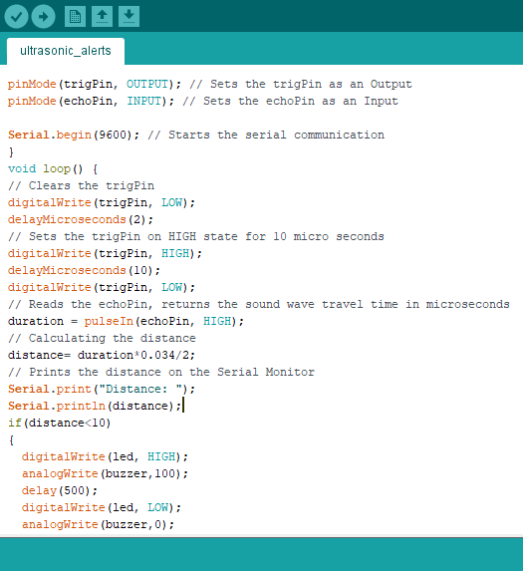
SOFTWARE PHOTOGRAPH

Slide 9
FUTURE SCOPE
THE HARDWARE MODEL AS A WHOLE CAN BE MORE SMALLER AND MORE EASIER TO WEAR.
VOICE ACTIVATION IN THE WHOLE HOUSE

Slide 10
RESULTS
We have made a smart wearable for the blind which is subdivided into two parts(master side and slave side).
On the master side the ultrasonic sensor and vibrating motor is attached which detect the obstacles in the path of the individual and direct the information to the microcontroller which indeed is connected to the Bluetooth master and touch screen for reception of information.
On the slave side Bluetooth slave receives the signal from the Bluetooth master and feeds it to the microcontroller which is connected to the relay for home automation.

Slide 11
CONCLUSION
In this project we made a smart wearable for the blind which could provide independence in day-to-day works like walking on a street or switching on the air conditioner without the help of another individual and tried our level best to break the myth that Most of the members of the non-blind community believe that the blind people cannot do their work or live a normal life. Through this wearable the individual can have the leisure of doing normal things (like walking Etc) without diluting his confidence.

Slide 12
REFERENCES
Daily Life Problems Faced by Blind People(https://wecapable.com/)
https://www.academia.edu/40218183/Low-Cost_Open_Source_Ultrasound-Sensing_Based_Navigational_Support_for_the_Visually_Impaired
https://www.academia.edu/39711322/On_Blindness

Slide 13
THANK YOU

