Slide 1


Slide 2

Apache Spark
In Fast Cluster Computing

Slide 3

Introduction to Apache Spark
Apache Spark is a lightening fast cluster computing designed for fast computation.
Runs programs up to 100x faster than Hadoop Map Reduce in Memory and 10x faster in disk.
Spark was introduced by Apache Foundation for speeding up the Hadoop computational computing software process.
Spark uses Hadoop in 2 ways but spark is not a modified version of Hadoop
Storage
Processing

Slide 4
Evolution of Apache Spark
Spark is one of the Hadoop’s sub project developed in 2009 in UC Berkeley’s AMPLab
Open Sourced in 2010
It was donated to apache software foundation in 2013

Slide 5
Features of Apache Spark
Speed
100x faster in memory
10x faster in disk
Supports Multiple Languages (Built In APIs for Java, Scala, Python)
Advanced Analytics

Slide 6
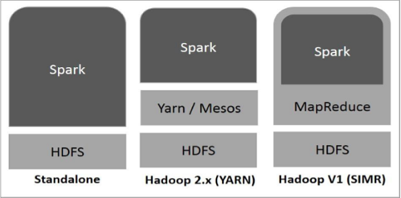
Spark’s Relationship with Hadoop

Slide 7
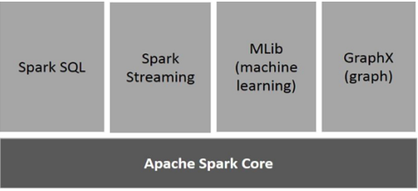
Components of Spark

Slide 8
Spark Data Structure – RDD
Resilient Distributed Datasets (RDDs)
Fundamental Data Structure of Spark
Immutable Distributed collection of objects
Datasets in RDD divided into logical partitions, which may be computed on different nodes of the cluster.
Can contain python, java or scala objects including user defined classes

Slide 9
RDD Continued
RDD Creation
Through deterministic operations on data
Or some other stable storage like HDFS
Or Other RDDs
Operations on RDD
Iterative
Interactive

Slide 10
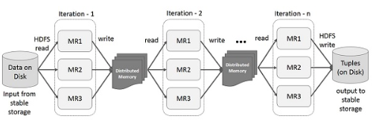
Iterative Operations on Spark RDD

Slide 11
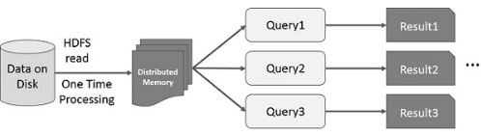
Interative Operations on Spark RDD

Slide 12
Spark Installation and Hands On
http://spark.apache.org - Office Releases and Documentation
Databricks Community Edition for Cluster based Spark Environment
https://bit.ly/sfopenlabs

Slide 13


