Slide 1

Open source software
PPT Made by: SHIVRAJ CHALWADI
Details about PENCIL 2D open source software.

Slide 2

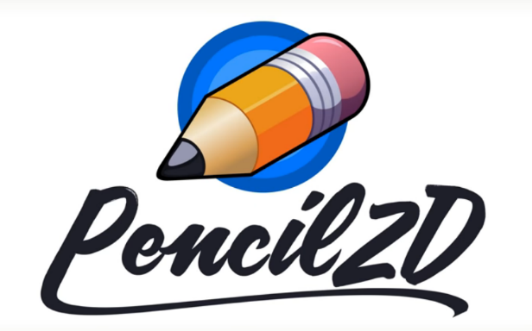
Introduction :
Pencil 2d is an open source software with latest versions 0.6.1
It can be used to make: Drawing, painting, editing pictures (animating).
It is open source software and gives permission to modify and distribute under some restriction.
Pencil 2d software was created By “Patrick Corrieri”in 2005
Develepors : Paul Nelson ,Oluseyi Sonaiya & Lan Moore.
“Pencil Planner” was the name given by creator Patrick after then devl Paul helson gave it name “Pencil2D .
Software Developed by : Qtp.

Slide 3

What problems does it solves ?
As “Pencil 2D” software is in open source system we can use it with freedom.
There is No cost problem as it is Free thus making it available for General class people.
It has simple interface so easy to use and with new release 0.6 Version ,the memory usage (RAM) issue has solved from 1.8 Gb usage to now not more than 400 mb in 700 frames.
Source code is available on website so experts can advise.
It can run on Windows , linux & macosx(Common platforms) .

Slide 4

Which License does it uses ?
2
It is licensed under GNU GPL 2 License(General Public License).
Terms of GPL 2 License are : we can copy, distribute and modify the software as long as We track changes/dates of in source files and keep modifications under GPL., but We must also provide the source code.

Slide 5

Idea behind making of Software?
Pencil was created by Patrick corriere in 2005 named “Pencil planner” on open source sytem.
Pencil planner was a simple Pencil line tester with some tools.
When Developer Paul Nelson watched the software he thought of changing it to an animating software.
Thus idea of “Pencil 2D” animation software
came in Paul helson.

Slide 6

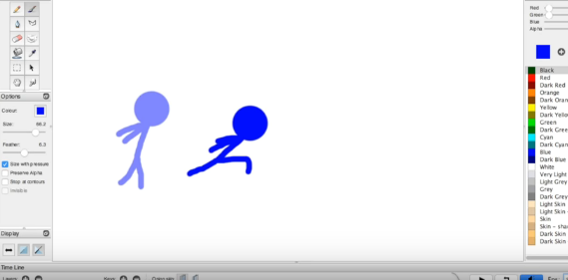
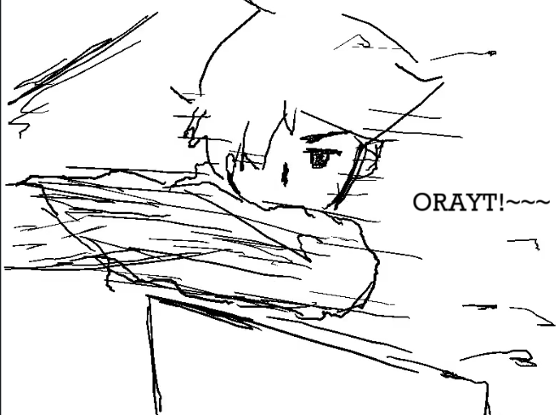
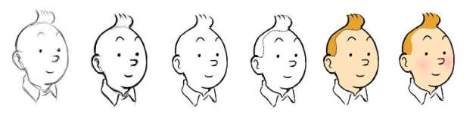
How does it works?
This software works as combination of sketches, images, colour and frames and output looks as moving character .
It works by adding sketches in frames one by one with time ,so each frame is different and output looks as animation.
We can Add Colour, images & back ground music/sounds .
Examples :-

Slide 7
Intention behind making software Open Source?
To make it available for every body .
To make an software that is available to learn animation at free of cost.
Cost of other animation softwares were high.
As other Softwares Not available / affordable to the general class of users.

Slide 8
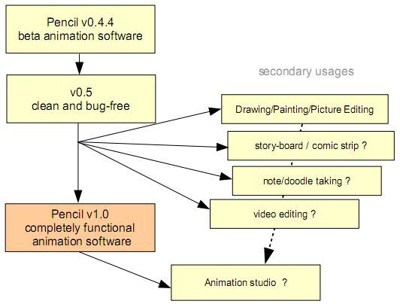
Advantage & Disadvantages
Advantages:
Being in open source category it gets available for everybody.
Source code is available so expert can suggest for improvements
A Good software for beginners to learn Animation.
Disadvantages:
As it is open source bugs can be fixed but it is has not released a fully stable version .
As Developers fix or develops software in their spare time its not developing fast.
It is not the best animation software as it has less features compared to costly softwares.

Slide 9
Popularity & Impact
As first released version 0.1 & 0.2 got attention of develeoper paul he thought of changing it to even better software with more tools.
He & Patrick developed till 0.3 & 0.4b, huge developments in this software which can do decent animation but still laggy and unsatisfactory results so with less time for Patrick he kindly gave administration rights to Paul.
By release of new version 0.4.4 (released in end of 2008) to 2010 it got popular & almost got 1000 download per day as per as Source Forge Statistics.
Due to this huge impact & popularity new developer Oluseyi Sonaiya came to help him.

Slide 10

Monetization method?
As it is open source software it is free to use thus no earning from this software .
There are no option for donations .
Maybe or not (Personal opinion) options can be created afterwards for donations .
It is Free and Open source software as per websites so No Monetization Method .

Slide 11

Github Link : Pencil 2d
https://github.com/pencil2d/pencil
2

Slide 12
THE END
Thank you for your patience.

Slide 13
Public domain
Kismet (1943) - The India Public Domain Movie Project Kismet (1943) is Indian cinema's first blockbuster movie. Released in 1943, the movie is therefore now out of copyright according to Indian and copyright laws.
Raja Harishchandra 1913 The India Public Domain Movie Project
INDIAN BRAVES COMIC BOOK: MAY 1951 - PUBLIC DOMAIN
Author’s work that came under Public domain :
Amarlal Hingorani (1907-1956) ,Anantram Kandukuri (Karuna Kumara) (1901-1956)
Bal Sitaram Mardhekar (1909 – 1956) , Baishnaba Pani (1882–1956)
Har Datt Sharma (1890-1956) , Manik Bandyopadhyay (1908-1956)
Munsif Nachiket Drupadlal (pseudonym Ketan Munsi) (1930-1956
Sitaramacandra Rao, Oddiraju (1887-1956) , Virumal Begraj (1874-1956)
Indian public domain images(To be double checked): https://en.wikipedia.org/wiki/Category:Indian_public_domain_photographs

