Slide 1
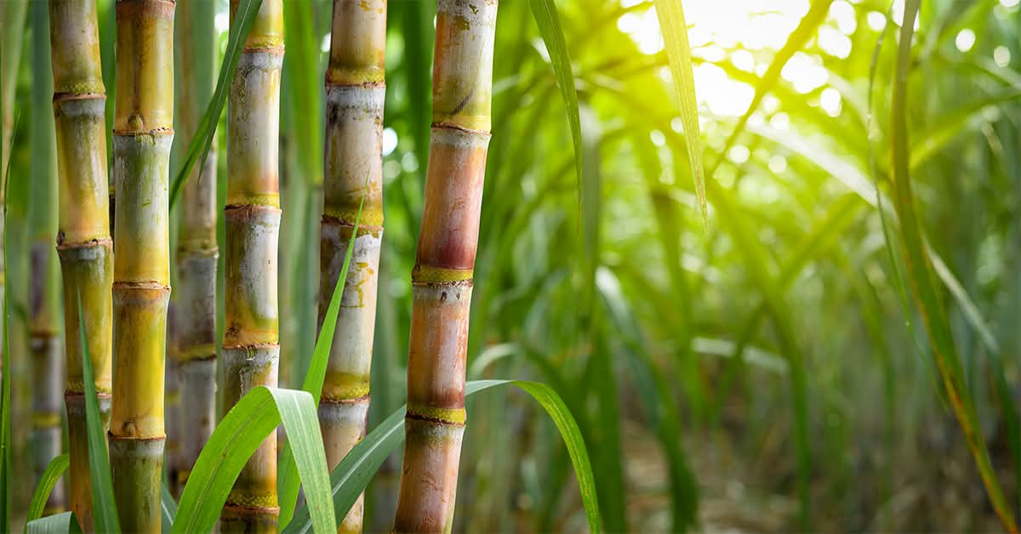

Sugarcane
Disease Detection And Fertilizer Recommendation
Guide Name
Dr. Vishal B. Waghmare.
Project By
Shivraj V. Patil.
Sanskar S. Parit.

Slide 2
Project Objective
The main objective of Sugarcane AI is to provide farmers with a digital platform for sugarcane disease detection and fertilizer recommendation. The system aims to make agricultural information simple, accessible, and easy to understand.
Identify possible sugarcane diseases from leaf images using AI.
Provide information about detected diseases and their symptoms.
Help farmers understand NPK and other nutrient requirements.
Make agricultural information simple and accessible for farmers.
Support farmers in making informed crop-management decisions.

Slide 3
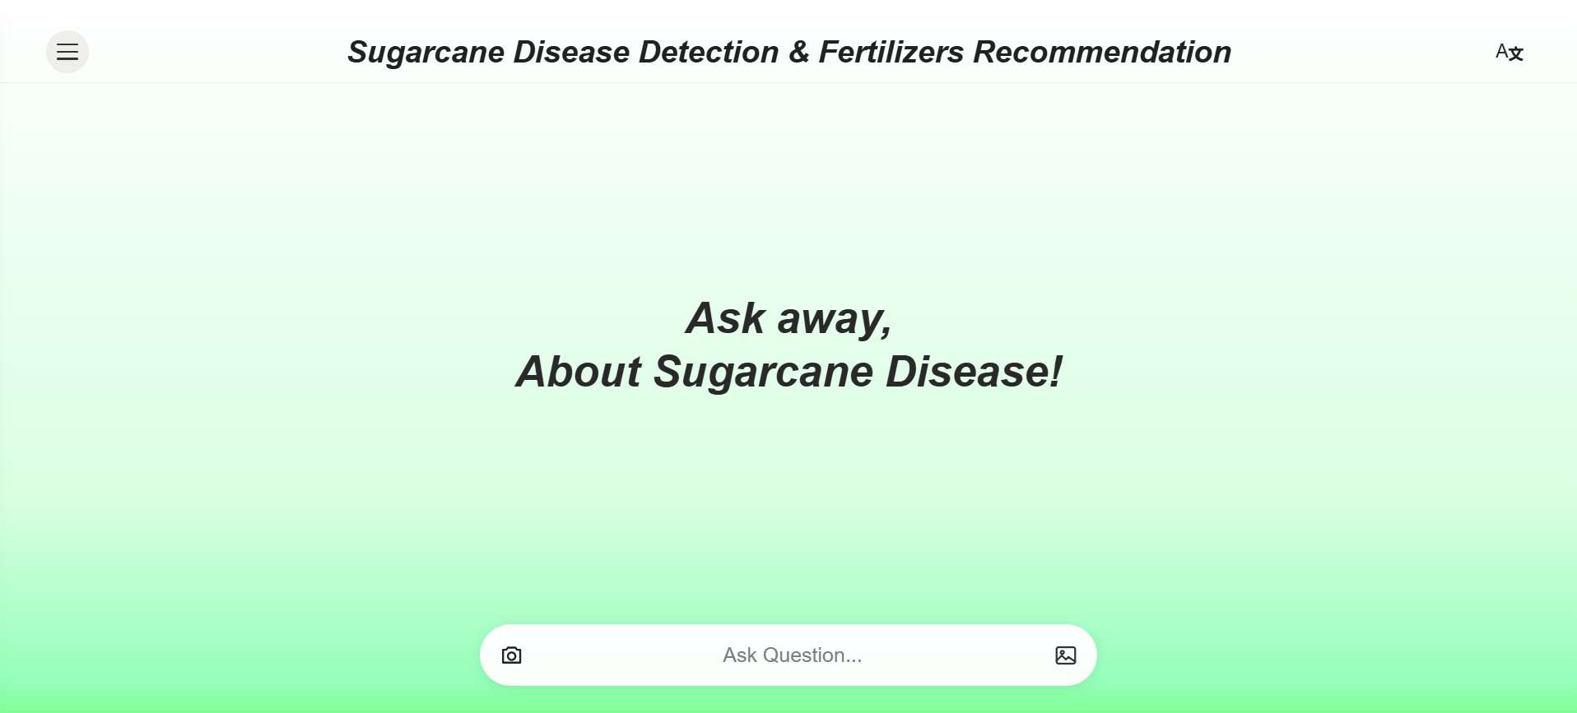
.
.
.

Slide 4
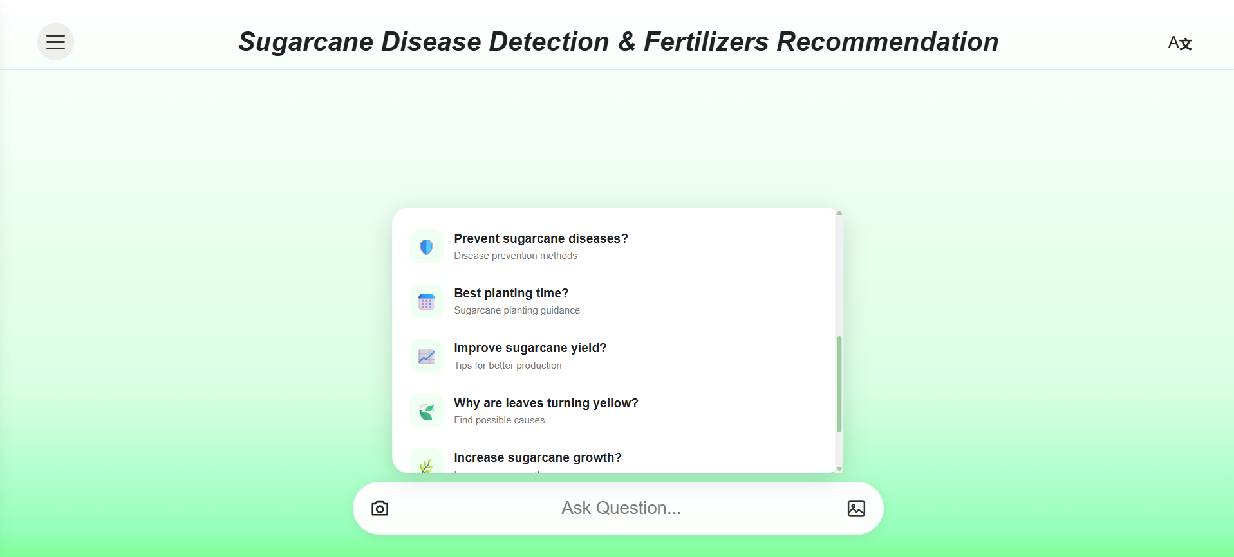
.

Slide 5
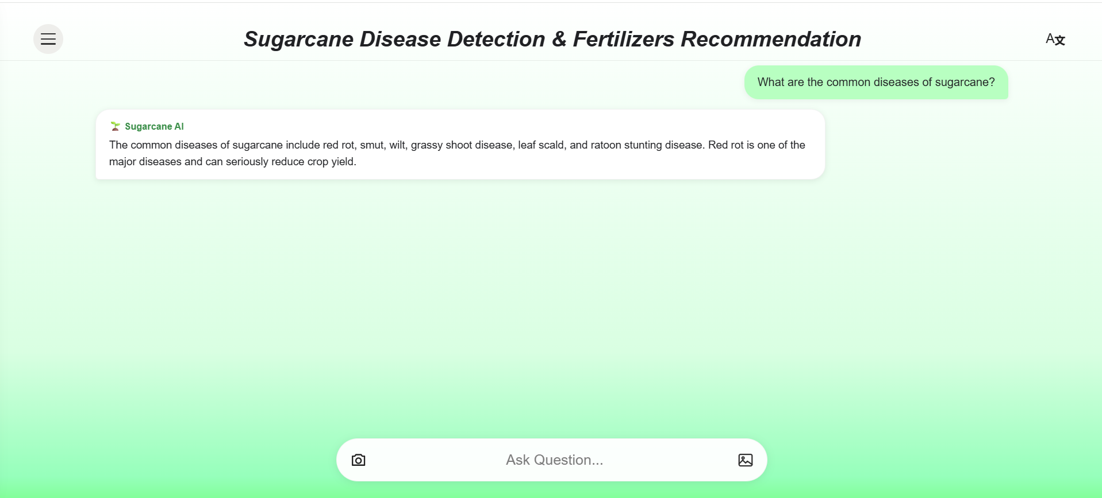
.

Slide 6
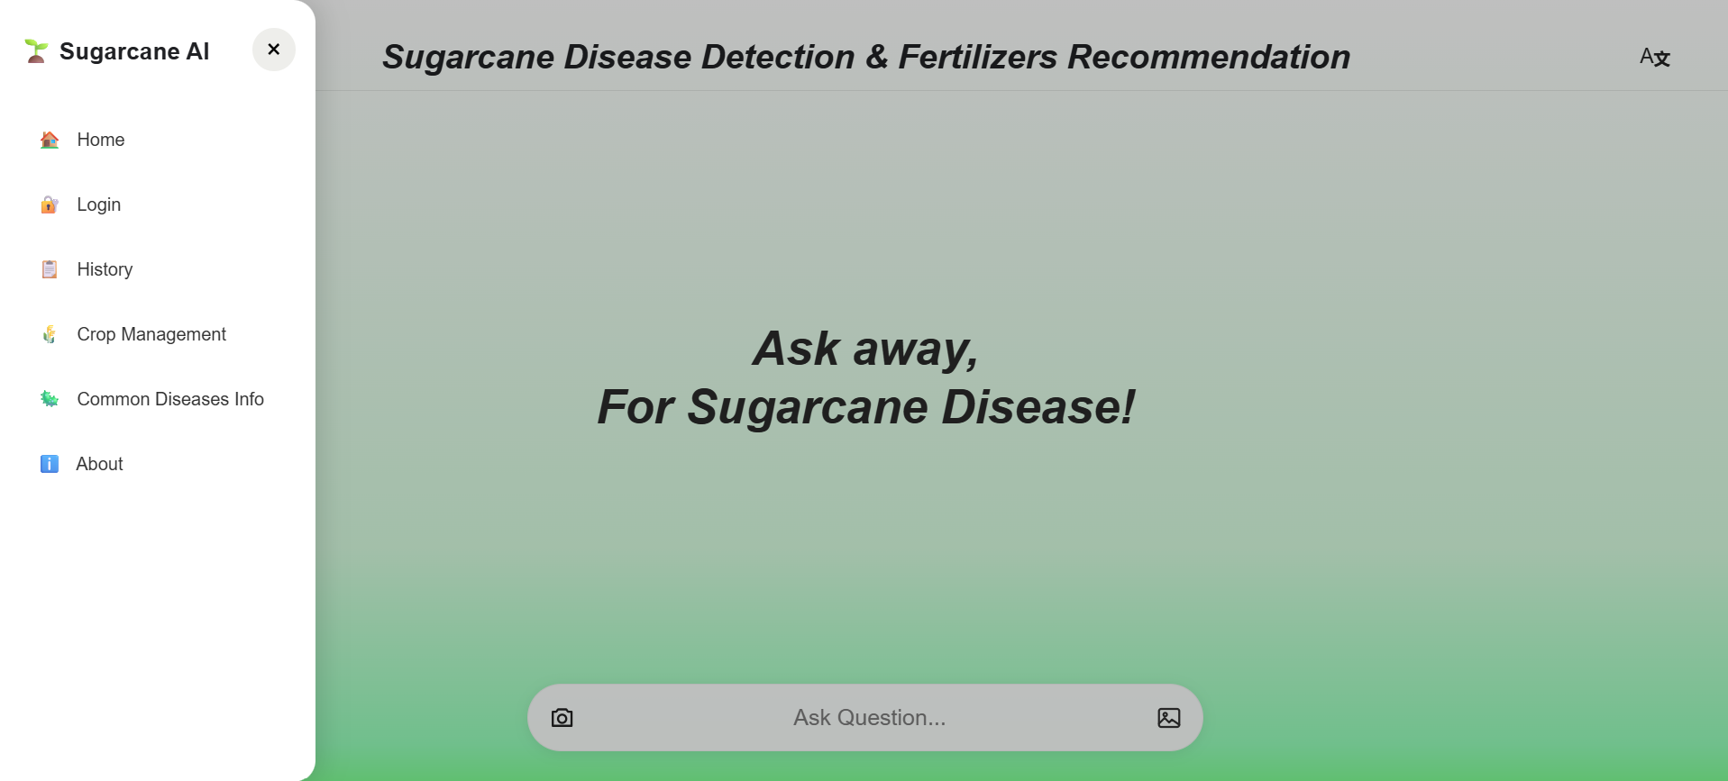
.
.
.

Slide 7
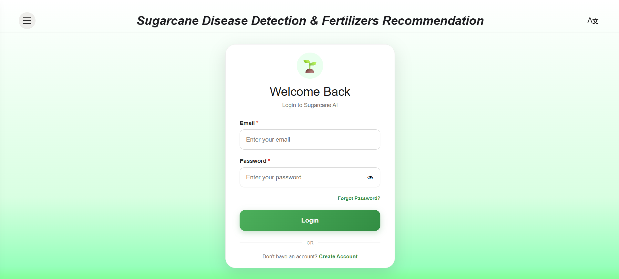
.
.
.
.

Slide 8
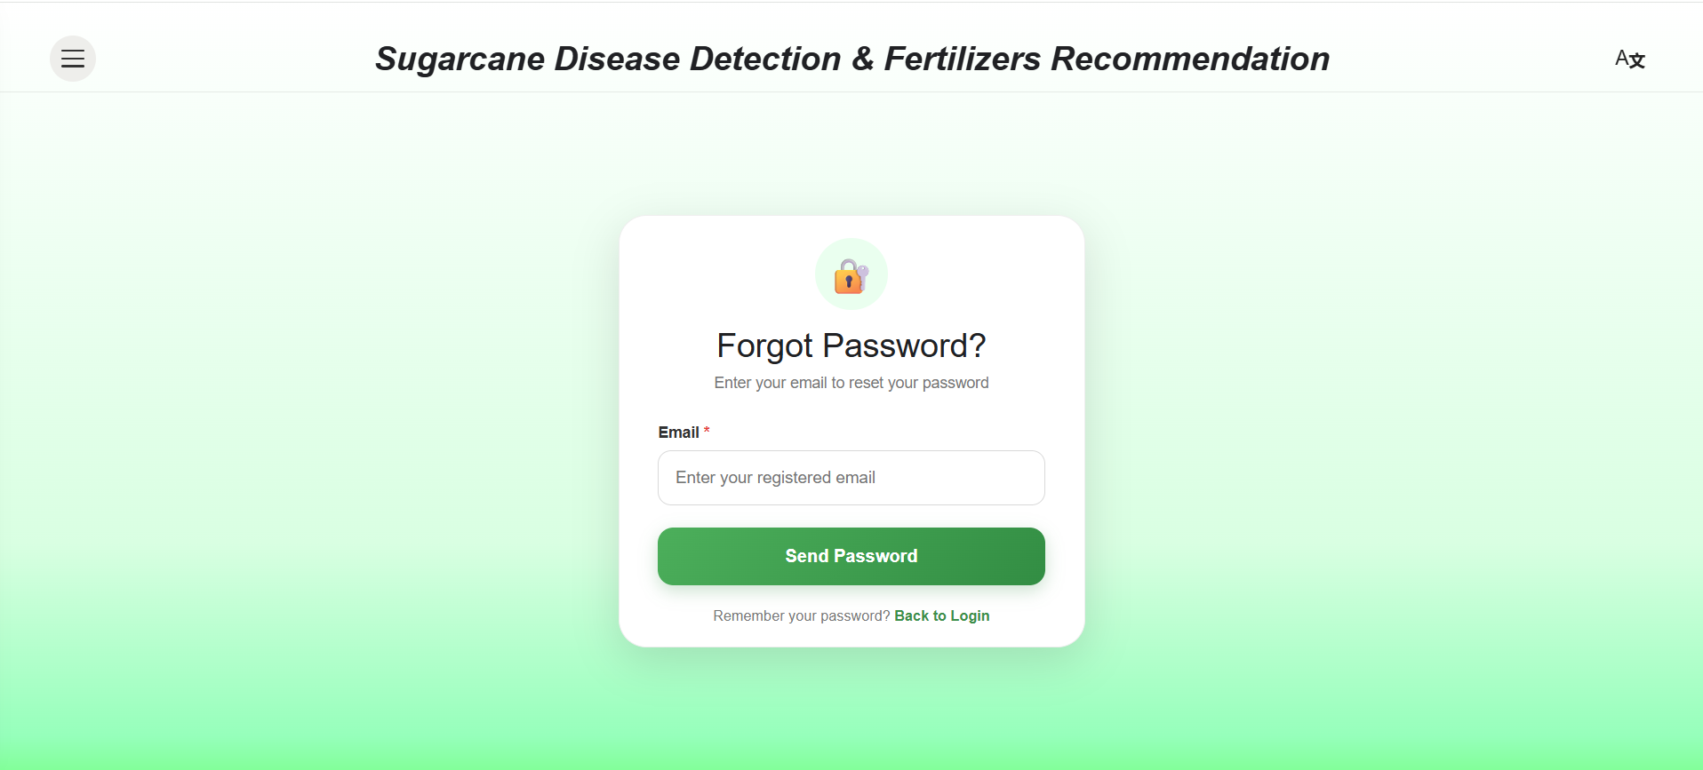
.

Slide 9
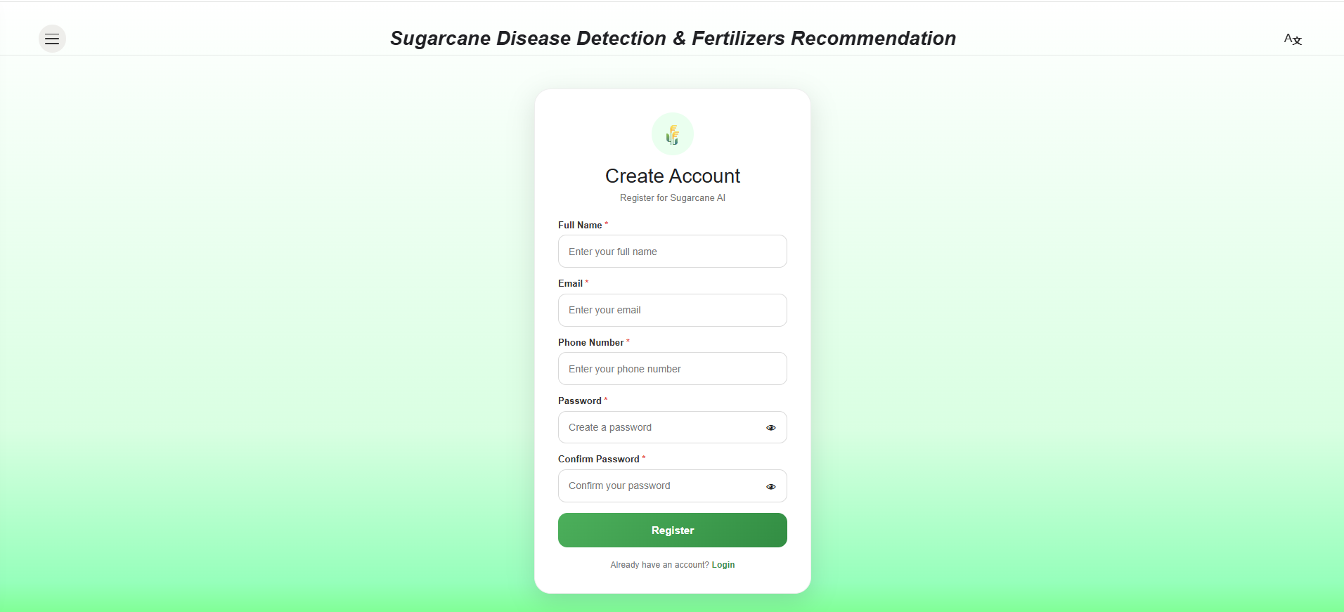
.
.

Slide 10
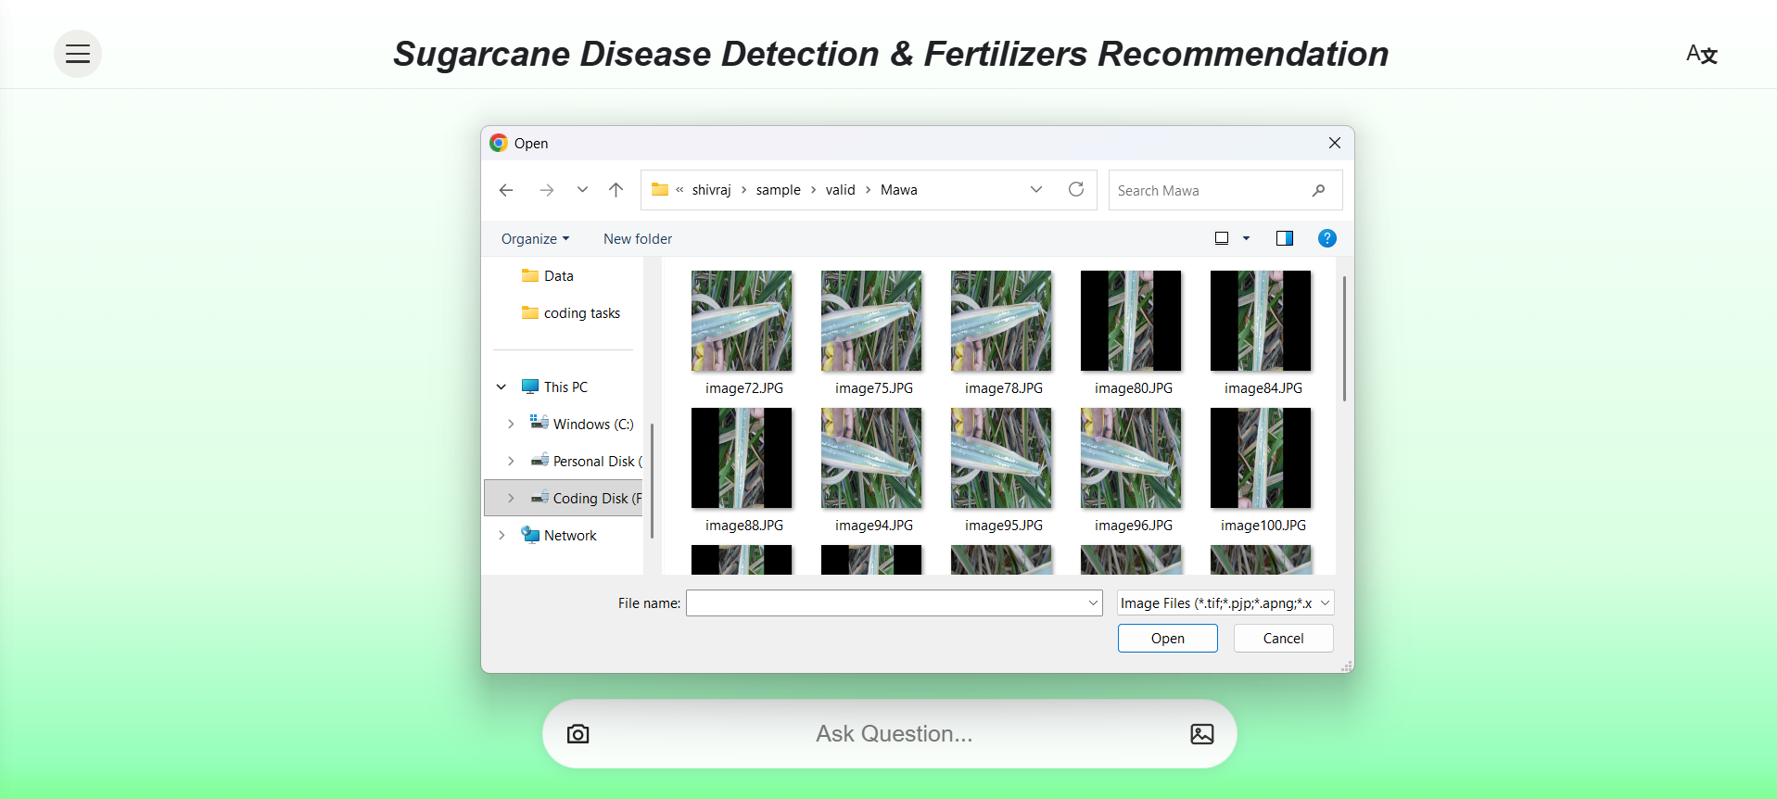
.

Slide 11
