Slide 1
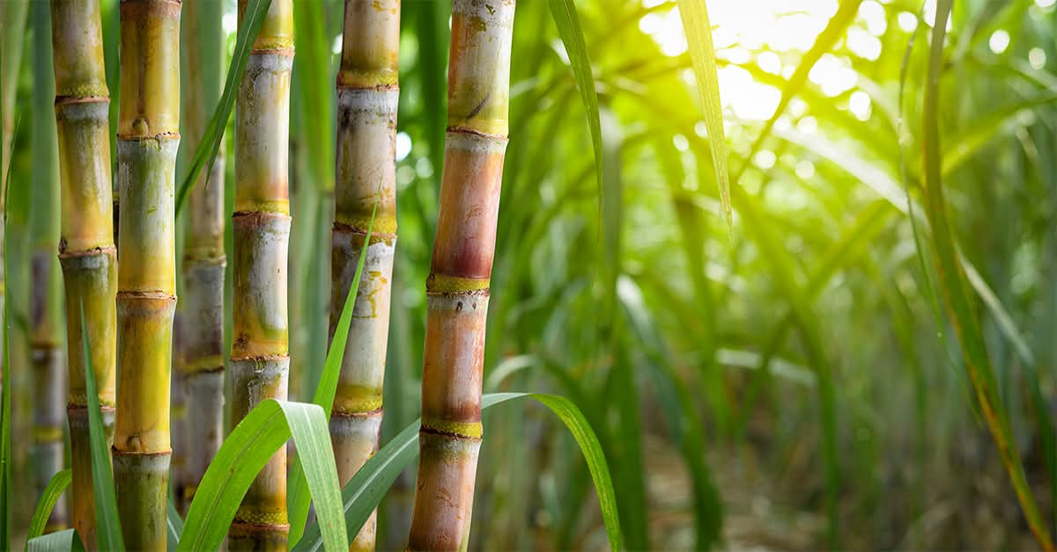

Sugarcane
Disease Detection And Fertilizer Recommendation
Guide Name :Dr. Vishal B. Waghmare.
Project By
Shivraj V. Patil.
Sanskar S.Parit.

Slide 2

Introduction
This project, "Sugarcane Disease Detection and Fertilizer Recommendation" aims to provide an intelligent and user-friendly solution for farmers. By analyzing images of sugarcane leaves, system can accurately detect diseases and recommend suitable fertilizers and water management plans. The application also provides detailed disease information, growth guidance, a chatbot for farmer queries, and the option to generate a PDF report, helping farmers make informed decisions and improve crop productivity.

