Slide 1

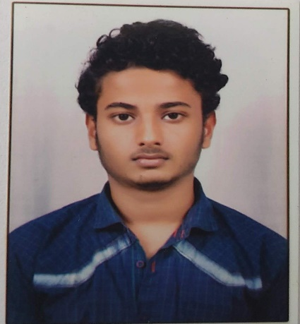



Shivraj Rajendra Ahirekar
Education
Bachelor of Engineering, Mechanical Engineering : 2017 - 2020
Skills
Analyst/Software Engineer
Base Location: Mumbai
Email ID: SHIVRAJ.RAJENDRA-AHIREKAR@CAPGEMINI.COM
Mobile No: +919921375337
Grade: A4
java | java, OOPS, Collections, Array, Loops, Exceptions.
Database | PostgreSQL
UI Tech | HTML 5 & CSS3, JavaScript, Typescript, Bootstrap
Tools | Git & GitHub, Eclipse, Swagger, Visual Studio Code, SQL shell.
Strengths
Full Stack Developer
Hands on experience on Core java, PostgreSQL.
Proficient in creating Single page Web Application in Angular with Authentication with routing.
Hands on experience in developing web pages using HTML5, CSS3, Object TypeScript.
Ready to learn new technologies and implement them for the Future Knowledge improvement.
Achievement
Incentive System for Car Dealer
Case study of Incentive System for Car Dealers along with Swagger, responsive UI with HTML5, CSS3, Bootstrap and ANGULAR used as User Interface.
https://github.com/ShivrajCG/one-page-resume.git
Presentation Title | Author | Date © Capgemini 2017. All rights reserved | 1

