Slide 1

A Presentation On
“ NEED FOR SPEED ”
Presentation by
Mr. Shivraj B. Mohite
Mr. Vikas V. Aswale
Mr. Sarvesh S. Gawas
Mr. Ranjeet R. Thorat
Under the guidance of
Asst.Prof. Miss Jadhav P.S.
D.Y.PATIL TECHNICAL CAMPUS FACULTY OF ENGINEERING,TALSANDE.
(SE-CSE)

Slide 2
Outline
Introduction
Objective’s
Need of Project
Literature Review
Requirement
Problem Statement
Example
Implimentation & Result
Conclusion
Future Work
References

Slide 3
Introduction
In this ‘Need For Speed’ problem we have to given a fix distance and a particular time, we need to calculate the exact speed of the vehicle.
Catch about this problem is that the needle of the speedometer is broken.
With the help of this implementation, we have to check exact speed of an vehicle from given input

Slide 4
Objectives
➢To calculate the exact speed covered by that vehicle for a given segment.

Slide 5
Need Of Project
➢It helps to calculate error of that speedometer.
➢Using this code we can find difference between actual speed and the one display by the speedometer when needle of the speedometer fell off.

Slide 6
Literature Of Survay
ACM-ICPC Contest Archive Volume :- Year 2017
From Wikipedia, the free encyclopedia

Slide 7
Requirements
Software requirement
Operating system: Windows 7 or above versions
Programming Language used: C++
Hardware requirement
Processor: Intel core i3 or above
Hard disk: 500 GB
RAM: 2GB

Slide 8
Problem Statement
The needle of speedometer has placed in wrong direction. So that the speedometer reads wrong speed.

Slide 9
Example
We have to check the difference between actual speed and the one display by the speedometer.
For this, we have to know sections(N) and total time(T) to complete the distance.
For example:
    We take N=3 & T=5
    For each section we have to know distance and speed.
    i.e. Here 3 sections are there so 3 different distance and speed are required.
    d1= 4, d2= 4, d3= 10, s1= -1, s2= 0, s3= 3
    By calculating this, we get exact speed.
      i.e. Exact speed = 3.000000

Slide 10
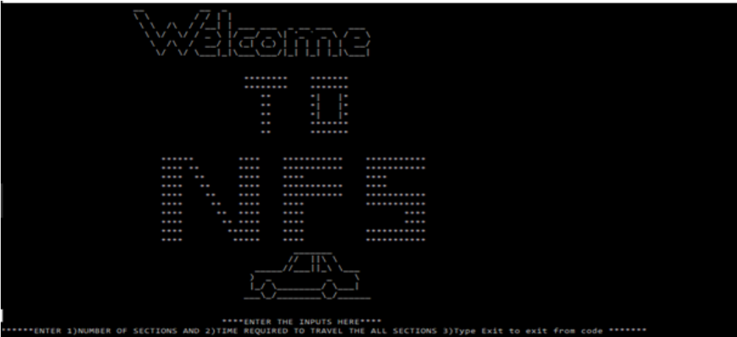
Implimentation & Result
.
Figure 1. Start-up Window
This is the first output of the project when we execute the code. Then this output will print on the terminal. In this window the welcome window is appear and input window is appeared.

Slide 11
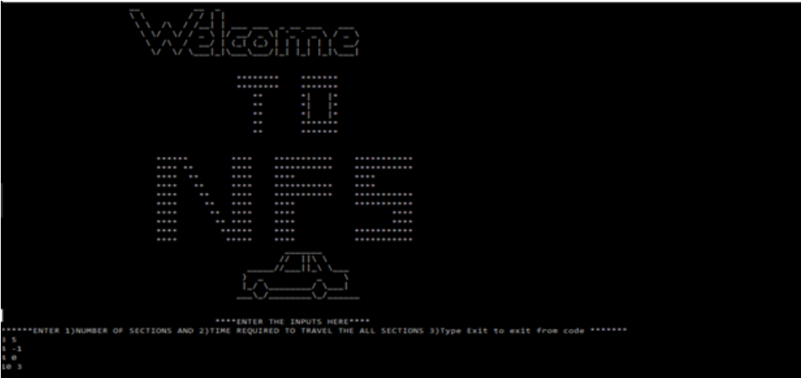
Implimentation & Result
.
Figure 2.Input Window
In this window we insert the input no of sections and the total time required to travel the section

Slide 12
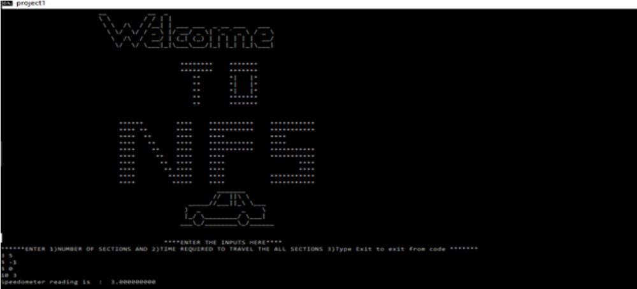
Implimentation & Result
Figure 3.Output Window
In this window output appear while inserting input is shown.

Slide 13
Algorithm
• Step 1: Start
• Step 2:- Set Number of section “N” and total time “T”.
• Step 3:- Set minimum value and maximum value for the range of “t”.
• Step 4:- Set distance for “N” sections.
• Step 5:- Set Speed for “N” sections.
• Step 6:- For(mx-mn> 1e-6),Repeat step 7
• Step 7 :- Calculate t by using the initially set formulae
Set initially t = 0;
t = d[i] / s[i] + c;
If (t<T), mx = c;
If (t>T), mn = c;
• Step 6:- Display (mx+mn/2)

Slide 14
Conclusion
▪By this Mini project we successfully calculated the difference between actual speed and the one display by the speedometer.
▪Thus we conclude how to find error of speedometer.

Slide 15
Future Scope
▪To get accuracy in industrial work where speedometer is used.
▪Using this project, we calculate Time error and Speed Error.

Slide 16
References
ACM ICPC Problem -E 2017
www.mathc.com
www.mathword.com
https://icpc.baylor.edu/worldfinals/problems/icpc-solutions2017

Slide 17
Thank You!!!

