Slide 1

Blinkit Grocery Sales Dashboard
A Power BI project analysing 500 grocery orders across Mumbai's Andheri region — turning raw transactional data into actionable business intelligence for managers and decision-makers.
POWER BI PROJECT
MUMBAI · ANDHERI

Slide 2

Project Purpose
From Raw Data to Clear Decisions
The Blinkit Grocery Sales Dashboard converts 500 order records into an interactive, easy-to-understand Power BI dashboard that supports data-driven decisions across sales, operations, and management.
Analyse
Compare
Act
Sales, profit, quantity, and order trends
Outlet-wise and category-wise performance
Deliver insights that drive faster decisions

Slide 3

Dataset at a Glance
500
Grocery Orders
Complete sales records from the Andheri region
5
Key Dimensions
Outlet, Category, Payment, Delivery, Date
4
Core KPIs
Sales, Profit, Orders, and Quantity
1
Region
Mumbai — Andheri

Slide 4
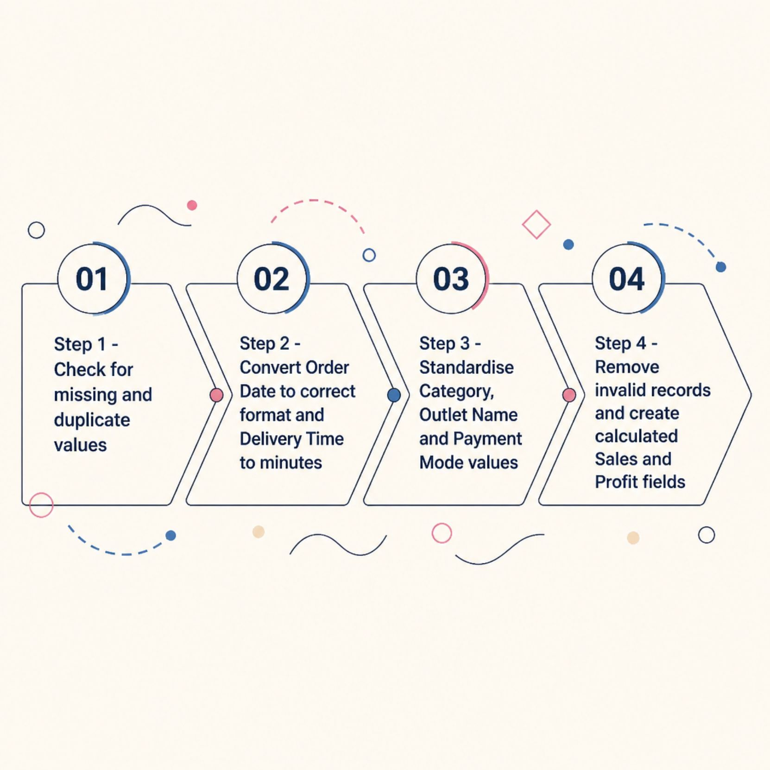
Data Preparation
Cleaning & Preparing the Dataset
Before visualisation, the dataset was thoroughly validated and standardised to ensure accuracy and consistency across all analysis dimensions.
Missing values and duplicates identified and resolved
Numeric columns (Sales, Profit, Quantity) verified and corrected
Categorical fields standardised for reliable filtering
Calculated fields created for KPI measures

Slide 5
Technology Stack
Tools & Techniques Used
Microsoft Power BI
Excel / CSV
Dashboard creation, interactive visuals, and report publishing
Data storage, initial preparation, and exploratory analysis
Power Query
DAX Measures
Data transformation, cleaning, and shaping before loading
Custom KPI calculations for Sales, Profit, and Delivery metrics

Slide 6
Dashboard Features
🏠 Welcome Page
📊 Executive Dashboard
Project introduction and dashboard overview
Overall business KPIs at a glance
📈 Sales Analysis
🏪 Outlet Performance
Trends and category-wise performance
Sales, profit, and orders by outlet
🚚 Delivery Analysis
🎛️ Interactive Slicers
Delivery time and status monitoring
Date, Outlet, Category, Payment, Status

Slide 7

Key Performance Indicators
What the Dashboard Measures
Total Sales
Total Profit
Total Orders
Revenue generated across all orders
Net profitability after costs
Count of all grocery transactions
Total Quantity
Avg. Delivery Time
Units sold across all categories
Mean delivery duration in minutes

Slide 8






Who It's For
Target Users
Business Managers
Outlet Managers
Sales & Marketing
Operations Teams
Monitor overall sales and profit performance
Compare outlet-wise sales and profitability
Analyse product categories and sales trends
Monitor delivery time and service status
Business Analysts
Decision Makers
Explore data and uncover business insights
Use dashboard insights for strategic planning

Slide 9

Project Deliverables
Files Included
The complete project package includes all assets required to review, replicate, and present the dashboard.
01
02
03
Dataset (.csv)
Power BI Dashboard (.pbix)
Project Presentation (.pptx)
500-row grocery sales dataset
Interactive, fully functional report
Overview, objectives, and conclusions
04
05
Documentation (.docx / .pdf)
Dashboard Screenshots (.png)
Methodology and project details
All visualisation pages captured

Slide 10


Key Takeaways
Clear Performance View
A single dashboard tracks Sales, Profit, Orders, and Quantity across all outlets
Outlet & Category Insights
Identify high-performing outlets and top-selling product categories
Delivery Monitoring
Track delivery time and status to maintain service quality
Faster Decisions
Interactive slicers enable stakeholders to explore data from any angle
This dashboard empowers Mumbai (Andheri) operations teams to make faster, data-driven decisions — from daily outlet management to strategic planning.

