Slide 1

HACKATHON
MIT BITCOIN PROJECT
BITCOIN DONATION EXTENSION

Slide 2

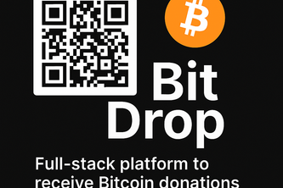
BITCOIN DONATION EXTENSION
TEAM MEMBERS
AMIT KUMAR YADAV K
SHIVRAM NEKKANTI
ISHAN BISWAS
SRI SAI CHARAN YARLAGADDA
SRI SAI TEJA METTU SRINIVAS

Slide 3

CONTENTS
01
02
03
INTRODUCTION
GOALS AND INTENT
KEY FEATURES
04
05
06
ARCHITECTURE
SETUP AND USE
CONCLUSION

Slide 4
01
INTRODUCTION

Slide 5

BITCOIN DONATION EXTENSION
BitDrop is a cross-browser Bitcoin donation extension designed for Chrome and Safari. It allows content creators to seamlessly generate Bitcoin addresses, display QR codes, and monitor incoming transactions.
BitDrop combines privacy, simplicity, and open-source accessibility to enable decentralized donations—directly from the browser.

Slide 6
02
GOALS AND INTENT

Slide 7
BITCOIN DONATION EXTENSION
1
2
BitDrop is developed to democratize digital donations by giving creators a seamless way to receive Bitcoin directly in their browser
BitDrop eliminates intermediaries, respects user privacy, and enhances accessibility—especially for developers, artists, activists, and independent publishers.
1
2

Slide 8
03
KEY FEATURES

Slide 9
BITCOIN DONATION EXTENSION
ADDRESSES
QR DISPLAY
Bitcoin Address Generation
QR Code Display for easy donations.
KEY FEATURES
WALLET
TRANSACTIONS
Transaction Tracking for incoming donations through testnet faucets
Real-Time Wallet Balance in BTC or satoshis

Slide 10
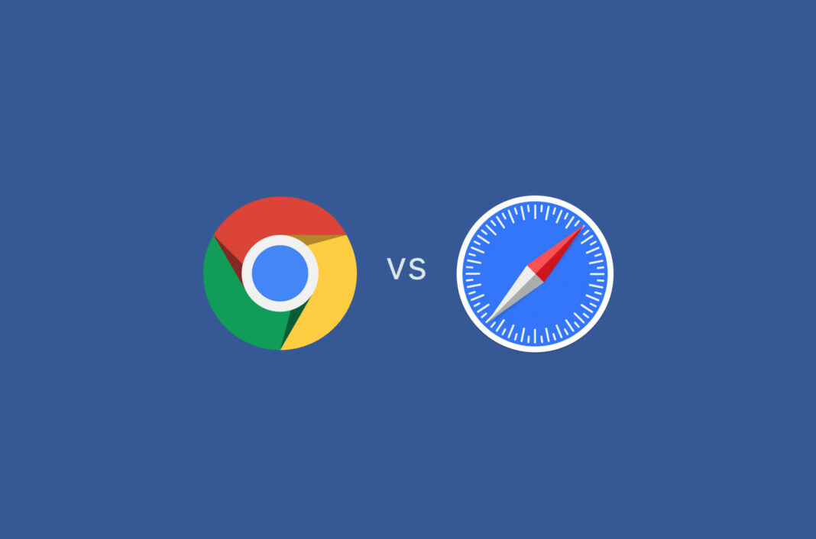
BITCOIN DONATION EXTENSION
CHROME EXTENSION
A user-friendly donation tool that works with a small background service. It generates Bitcoin addresses, shows QR codes, and tracks donations—all through a simple popup in your browser. Ideal for creators who want full control with minimal effort.
SAFARI EXTENSION
The Safari extension lets you generate a new Bitcoin address with one click, display a QR code for easy sharing, and safely accept donations. It’s a simple, private way to collect Bitcoin tips directly from your browser.

Slide 11
04
ARCHTECTURE

Slide 12
BITCOIN DONATION EXTENSION
CHROME
SAFARI
Backend API via Flask (bitcoinlib or bit) generates and stores addresses, returns balances and transaction history.
UI connects via REST endpoints like /generate-address, /transactions, /wallet-balance.
Uses qrcode.min.js for dynamic QR code generation.
Purely client-side using bitcoinjs-lib for address generation.
Leverages public APIs (BlockCypher, Mempool.space) for balance and transactions.
Saves addresses in browser storage; QR codes via api.qrserver.com.

Slide 13
05
SETUP AND USE

Slide 14
BITCOIN DONATION EXTENSION
CHROME
SAFARI
Run app2.py or app.py in the Flask backend
Load unpacked extension from Chrome_Extension/bitcoin-donation-extension
Enable extension in Safari Preferences
For macOS app, open .xcodeproj in Xcode and build/run

Slide 15
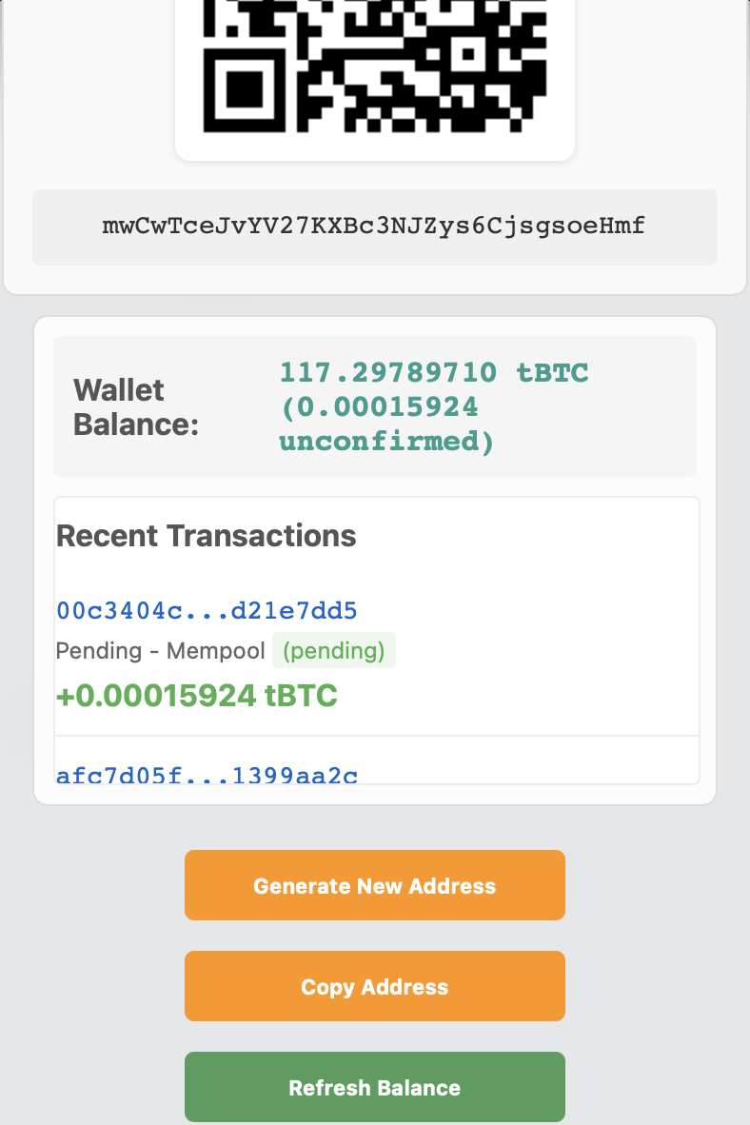
BITCOIN DONATION EXTENSION
HOW TO USE
1
Click “Generate New Address”
2
Copy or scan the QR code and share with your supporters
3
Track balance and transactions in real-time in the wallet

Slide 16
06
CONCLUSION

Slide 17
BITCOIN DONATION EXTENSION
BitDrop offers a robust and privacy-first solution for crypto donations. Whether you're a creator looking to accept tips or a developer wanting to build on top of a secure Bitcoin integration, BitDrop provides a fully functional, cross-platform donation system with no compromises on control, transparency, or usability. With full testnet support and future extensibility, BitDrop is a meaningful step toward open, decentralized digital support systems.

Slide 18
YOR LOGO
03
THANK YOU

