Slide 1
Project Title & Problem Context
Project Title:
Data-Driven Decision Making in an Organization
Using Big Data Technologies
Name & USN: ____________________ | ____________________
Domain: Big Data Analytics & Organizational Decision Intelligence
Problem Statement:
Organizations generate vast operational data but lack integrated
pipelines to convert it into high-quality decisions. Poor data quality,
high error rates, and fragmented analytics reduce decision
effectiveness by up to 40%.
Target Users: C-suite executives | Department heads | Data analysts | HR managers

Slide 2
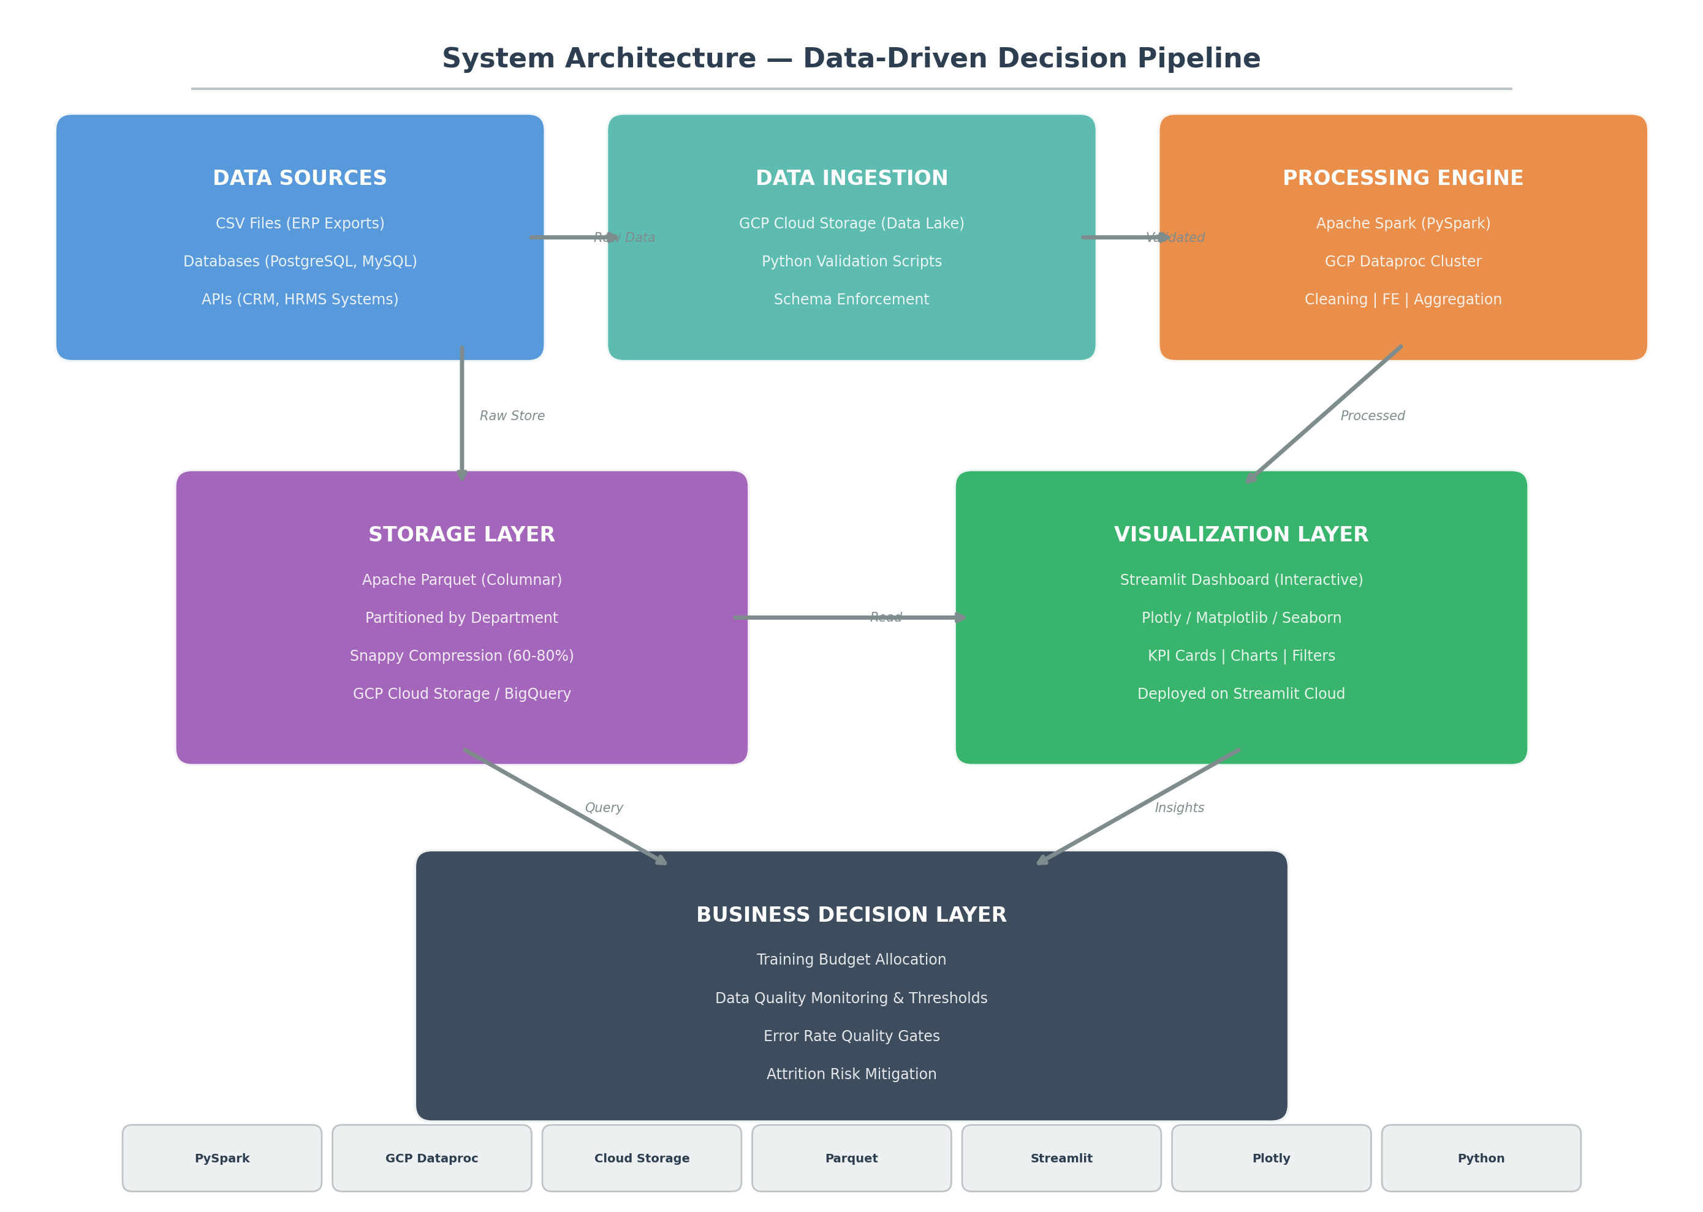
System Architecture
Tools: PySpark | GCP Dataproc | Cloud Storage | Parquet | Streamlit | Plotly | Python

Slide 3
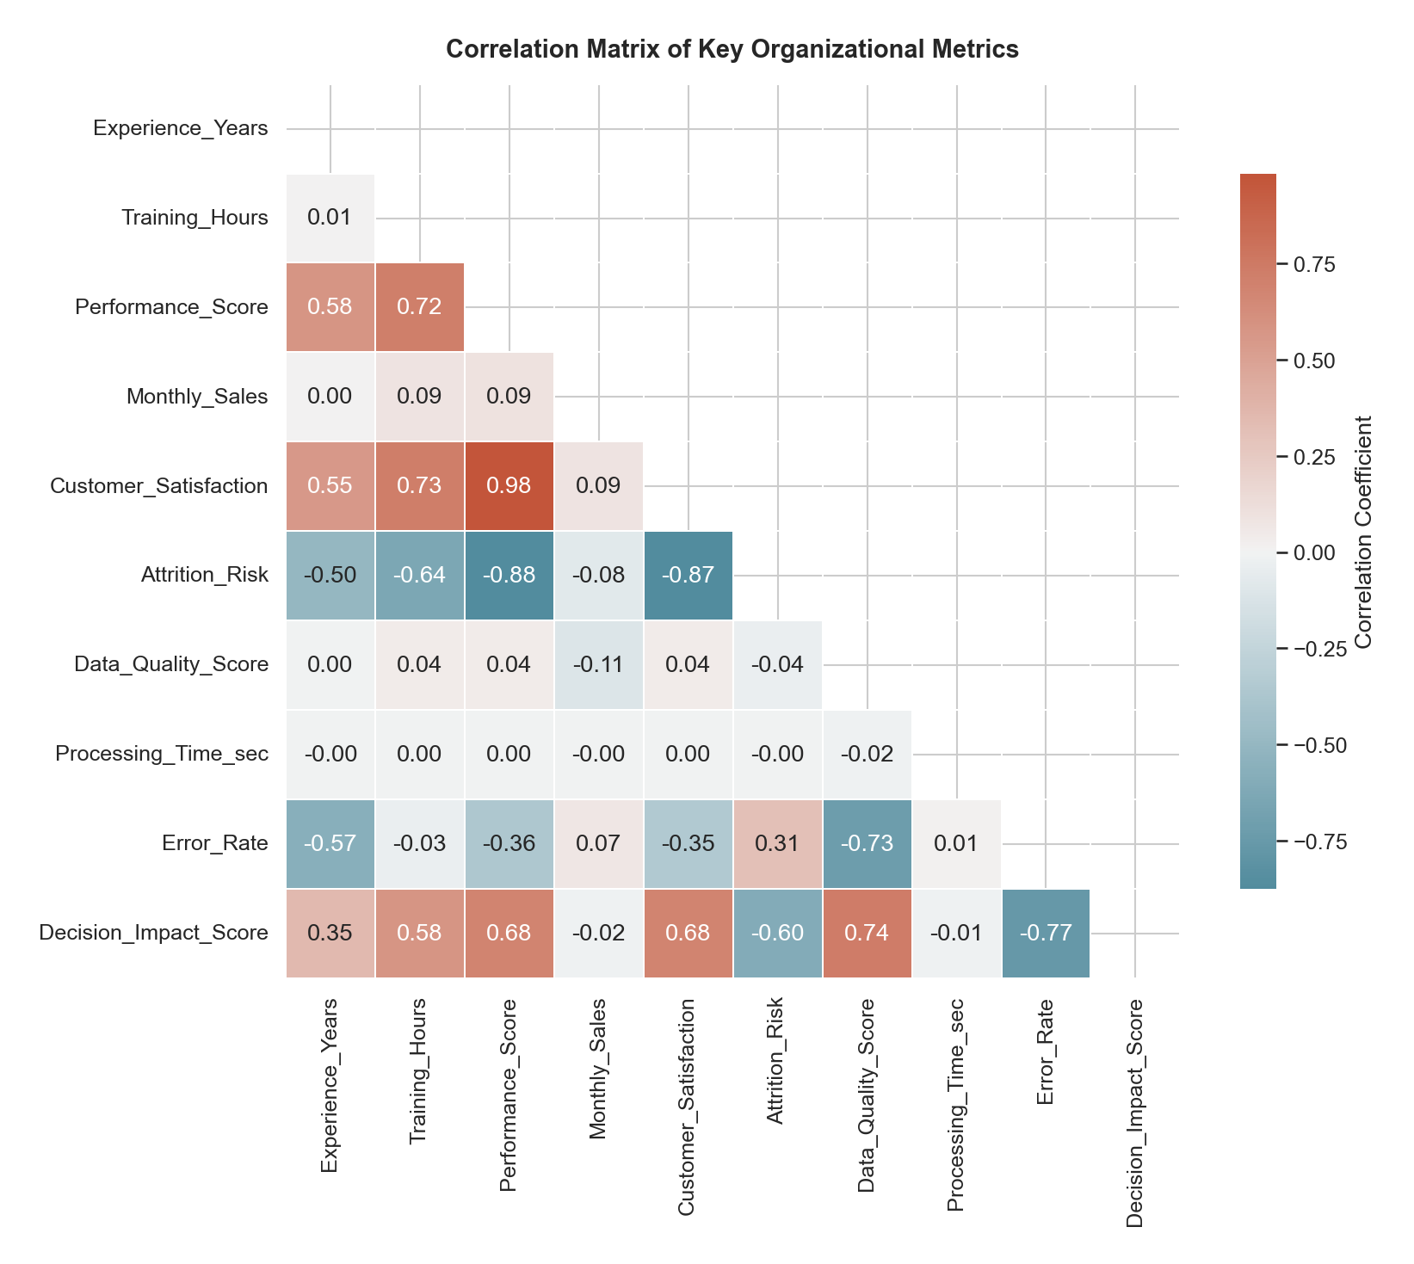
PySpark Implementation
Dataset: 123,847 rows × 15 columns
Period: Jan 2024 – Dec 2025
Key Operations:
• Null Imputation (median)
• Duplicate Removal
• Outlier Capping (IQR method)
• Feature Engineering (9 new features)
• Dept/Region Aggregations
Code Snippet:
df = spark.read.csv(path, schema=schema)
df = df.dropDuplicates()
df = df.withColumn('Efficiency_Score',
col('Perf')/(col('Time')+1))
df.write.partitionBy('Department')
.parquet('processed_data/')
Output: 24 cols, Parquet, partitioned
Correlation Matrix of Key Variables

Slide 4
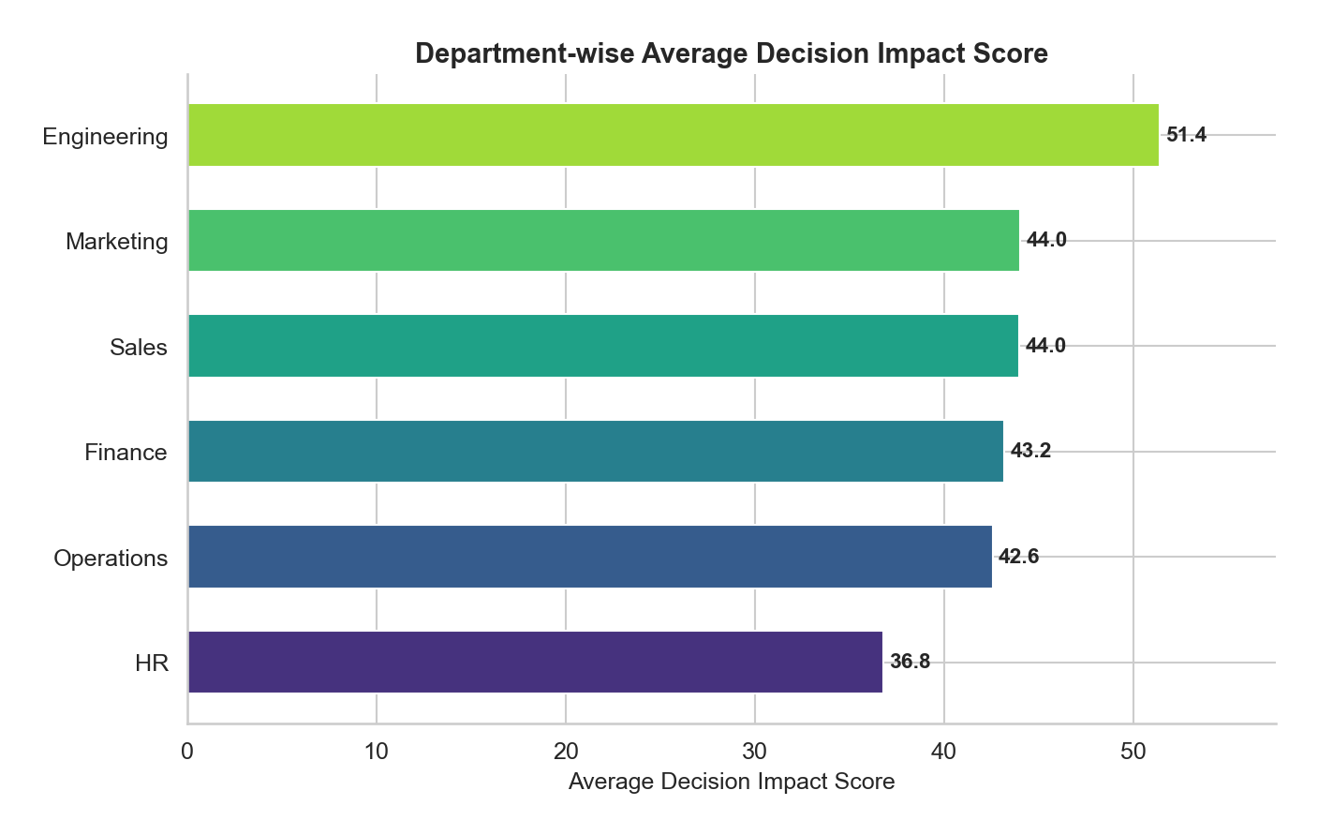
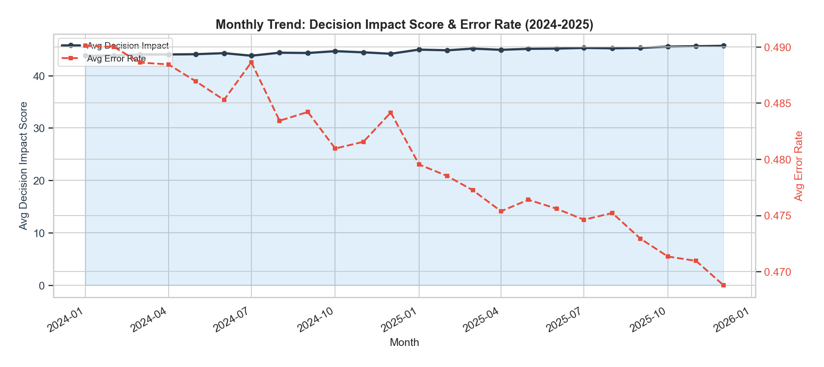
Dashboard & Insights
Key Business Insights:
• Insight 1: Data Quality is the strongest predictor of Decision Impact (r = 0.736)
• Insight 2: Training >40 hrs/yr yields 27% higher performance (4.76 vs 3.76)
• Insight 3: Error rates >15% cause 43% drop in Decision Impact (77.7 → 44.6)
• Insight 4: Engineering leads Impact (+40% vs HR) — best data quality + training
• Insight 5: Attrition Risk ↔ Satisfaction feedback loop (r = –0.875)

Slide 5
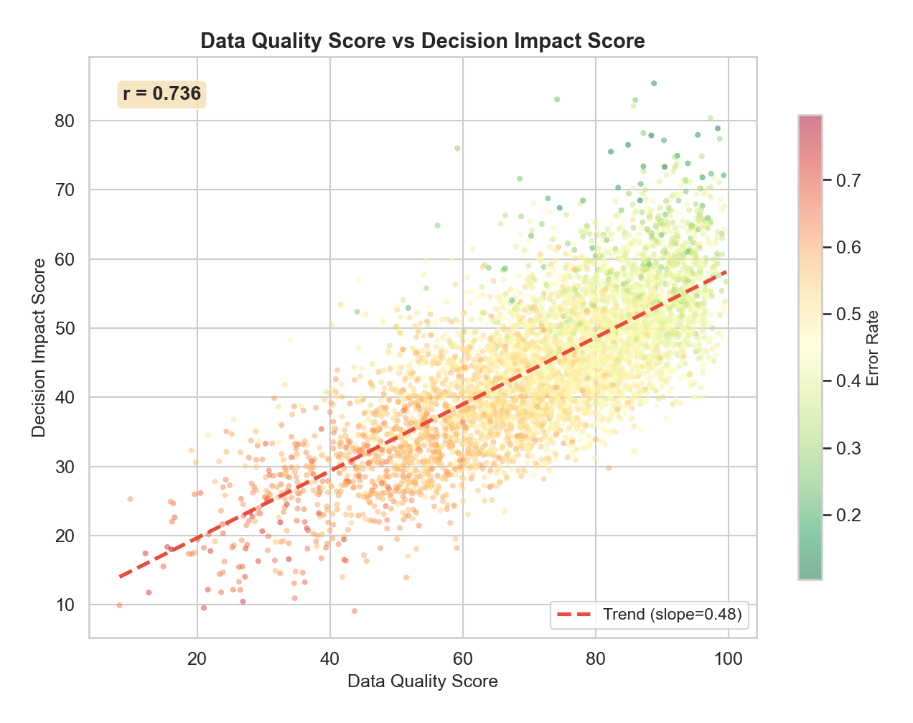
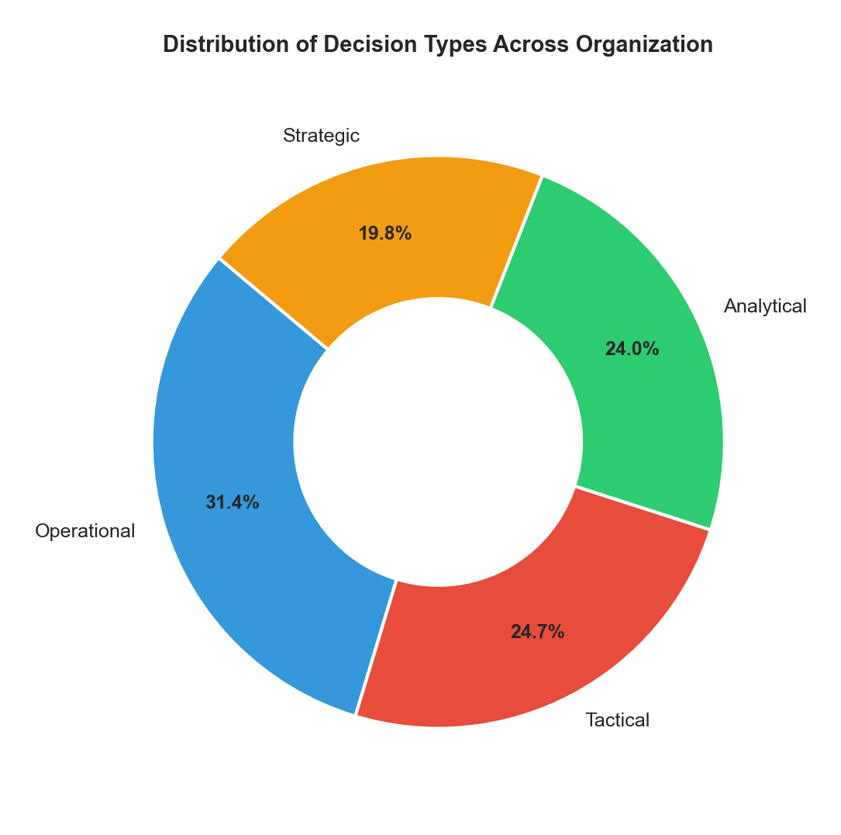
Real-World Application
Real-World Applications:
• Consulting — Client decision quality analysis
• Healthcare — Clinical error monitoring
• Retail — Regional decision optimization
• Finance — Error-rate quality gates
Scalability:
• GCP Dataproc: 10–100 node clusters
• Parquet + Snappy: 60–80% compression
• Delta Lake for ACID transactions
Future:
• Spark Structured Streaming (real-time)
• ML models: predict Decision Impact
• Automated threshold alerts

Slide 6
Conclusion & Questions
Summary:
Problem:
Organizations fail to leverage data for high-quality decisions
due to poor data quality, fragmented pipelines, and lack of insights.
Solution:
Complete big data pipeline: PySpark + GCP + Streamlit
123,847 records → Clean → Transform → Parquet → Dashboard
Outcome:
Data Quality (r=0.74) and Error Rate (r=–0.77) identified as top drivers.
5 actionable decisions projected to improve quality by 18–25%.
Thank You

