Slide 1

Presentation on Automated Farm Security System DEPARTMENT OF INFORMATION TECHNOLOGY
UNDER THE GUIDANCE : MR. SANTOSH KUMAR ASSISTANT PROFESSOR Information Technology | PRESENTED BY : PRATYUSH PRAJAPATI (1907350130049) SHIVAM BARANWAL (1907350130057) NITIN KUMAR GHANSURYA (2007350139004)

Slide 2
INDEX
INTRODUCTION
LITERATURE SURVEY
COMPONENTS REQUIRED
BLOCK DIAGRAM
FLOW CHART
WORKING OPERATION OF FARM SECURITY SYSTEM
APPLICATIONS & ADVANTAGES
CONCLUSION & FUTURE SCOPE
REFERENCE’S

Slide 3
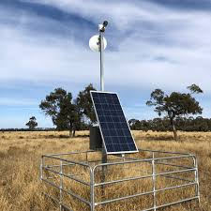
INTRODUCTION
Farm Security System helps farmers to detect the intruders.
Farm Security System is smart way to protect the farm.
This device maintaining farm security digitally.
It assures minimal physical efforts of farmer in farm security.
This system provides security on the basis of surveillancing.

Slide 4
LITERATURE SURVEY
S.No. | Paper Name | Objectives | Strength | Limitations
1. | Security systems for remote farm | Focuses on the application of machine learning for pattern recognition of captured CCTV videos used in farm security. | Security system for remote farms. Real time monitoring and notifications in smart farming. Image Processing and pattern recognition detected through surveillance system of smart farms. | The proposed solution is not scalable. It is not clear how multiple images from several cameras can be processed and analyzed in parallel in order to satisfy the real time property of the proposed system.
2. | Security in Agri-Food Sector | Discusses data security challenges within the agrifood sector. | Provides use cases showing the increase of data in the agrifood sector and their need of data security measurements. Interviewed companies about their cybersecurity concerns. | No security solutions. Limited scope to data security.

Slide 5
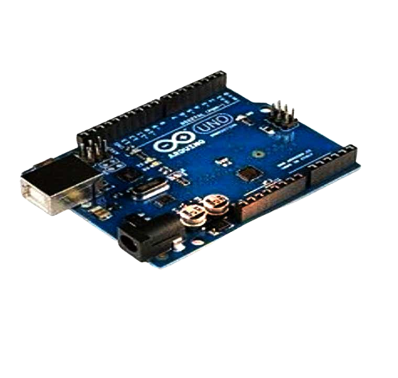
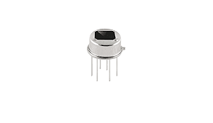
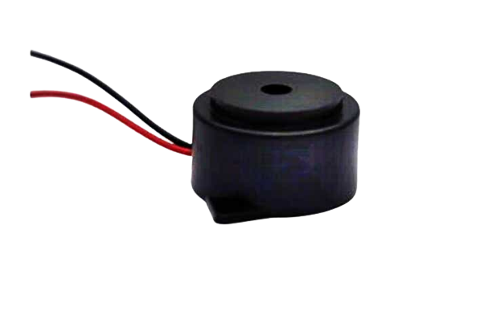
COMPONENTS REQUIRED
Arduino UNO
PIR Sensor
Ultrasonic Sensor
Buzzer
ESP32 Cam
LDR Sensor
Servo Motor
Power Supply

Slide 6
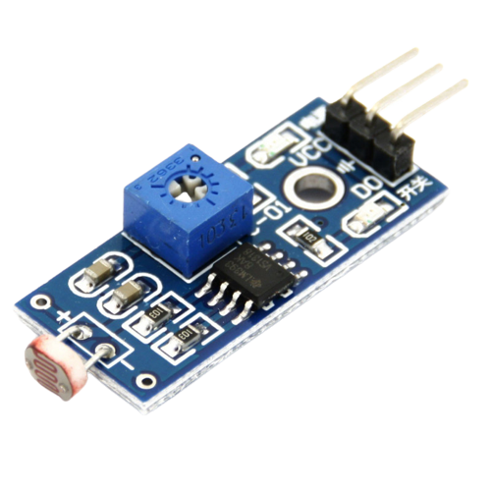
Component Name | Image | Specifications
Arduino UNO |  | Microcontroller - ATmega38P Operating Voltage - 5V, 3.3V Recommended I/P Voltage - 7 to 12V Input Voltage Limits - 6 to 20V Analog Input Pins - 6(A0-A5) Digital I/O Pins -14 pins
LDR Sensor |  | Light Resistance - 50-100 K Ohms Rated Power - 200 W Diameter - 3-20 mm Application - Photoresistor

Slide 7
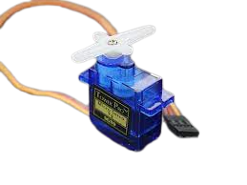
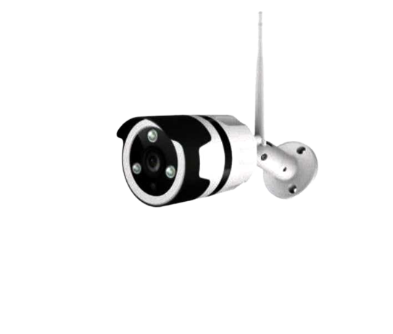
Servo Motor |  | Dimension: 39.5mm x 20.5mm x 40.7mm. Stall Torque: 9.4kg/cm (4.8v); 11kg/cm (6v) Op. speed: 0.20sec/60degree (4.8v); 0.16sec/60degree (6.0v)
Buzzer |  | Frequency - 3,300Hz Operating Temp. - 20°c to 60°c Operating Voltage - 3V to 24V DC Sound pressure - 85dBA or 10cm Supply current -15mA
Camera |  | Image output format - JPEG Spectrum range- 2412 MHz to 2484MHz Antenna form - PCB antenna Transmit power - 11to 54Mbps

Slide 8
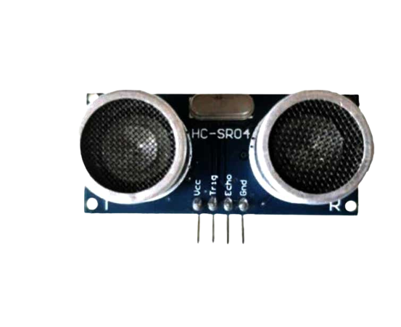
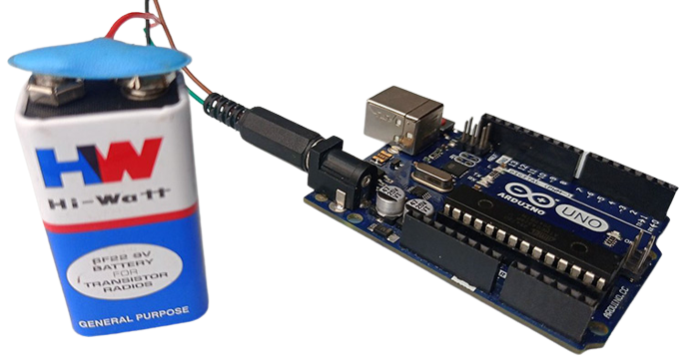
Ultrasonic Sensor |  | Power Supply - DC 5V Working Current -15mA Working Frequency - 40Hz Ranging Distance - 2cm – 400cm/4m Resolution - 0.3 cm
PIR Sensor |  | Voltage - 4.8V to 20V Current (idle) - <50 µA Logic output - 3.3V/0V Delay time - 0.3 s to 200 s Lock time - 2.5 s (default)
Power Supply |  | Line regulation Load regulation Ripple and noise Temperature stability Stability with time

Slide 9
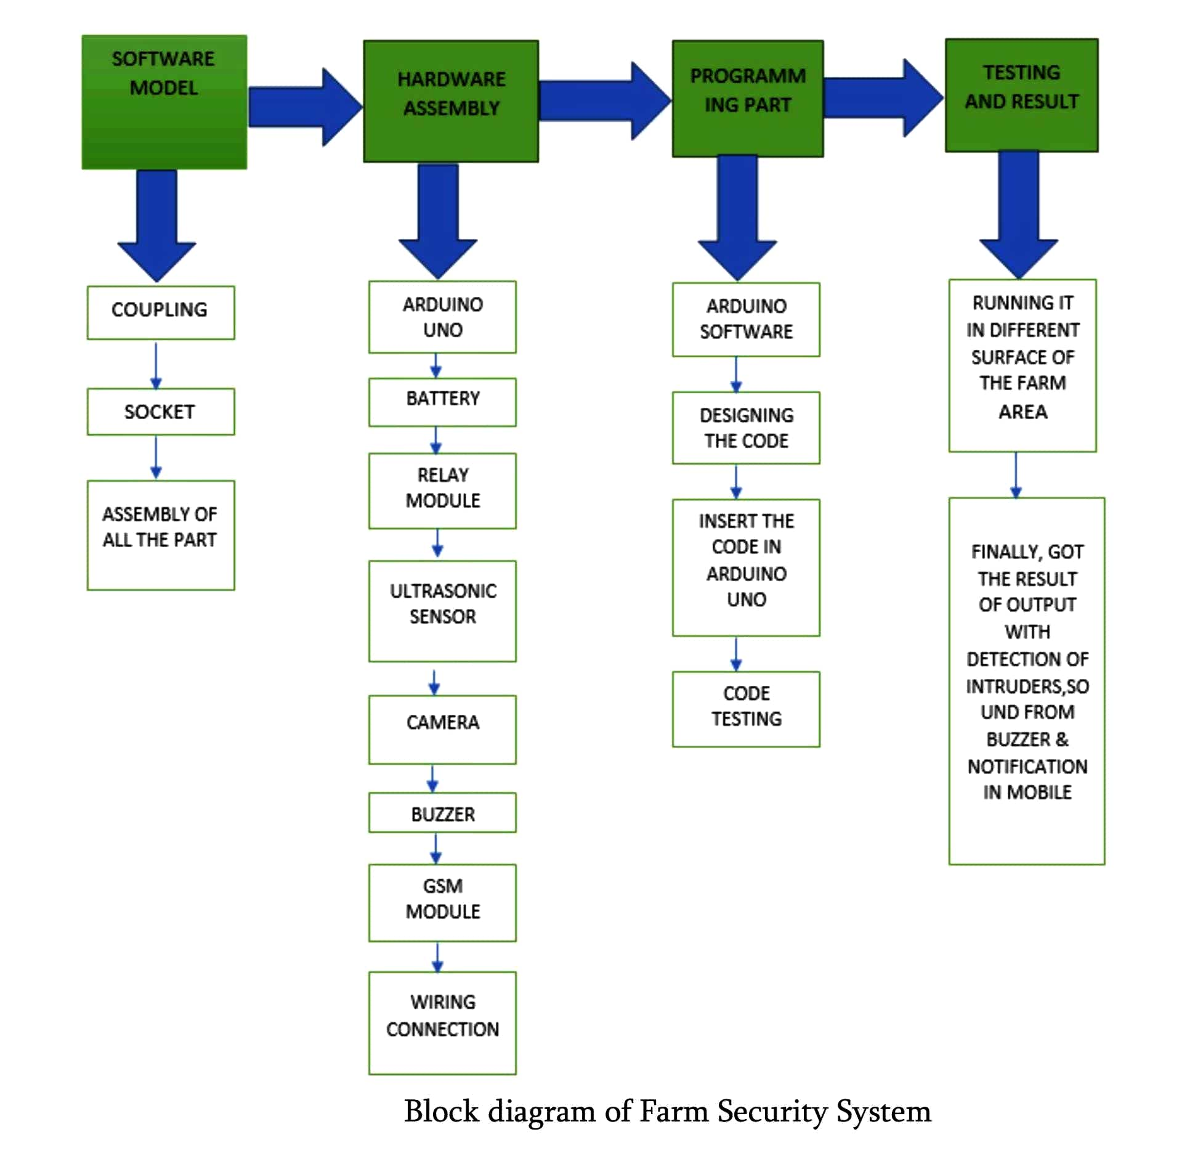
BLOCK DIAGRAM

Slide 10
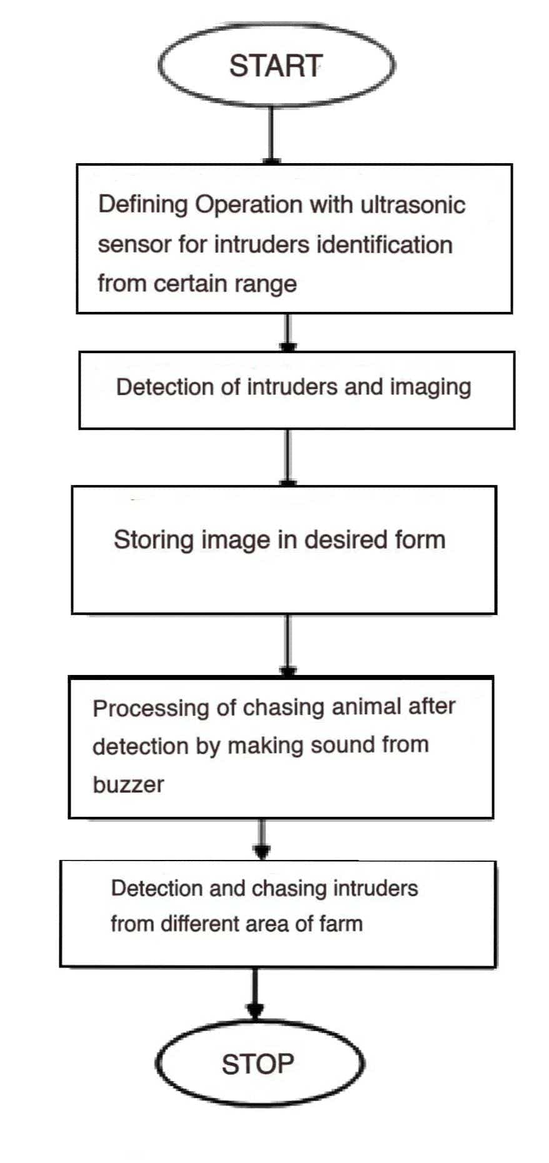
FLOW CHART

Slide 11
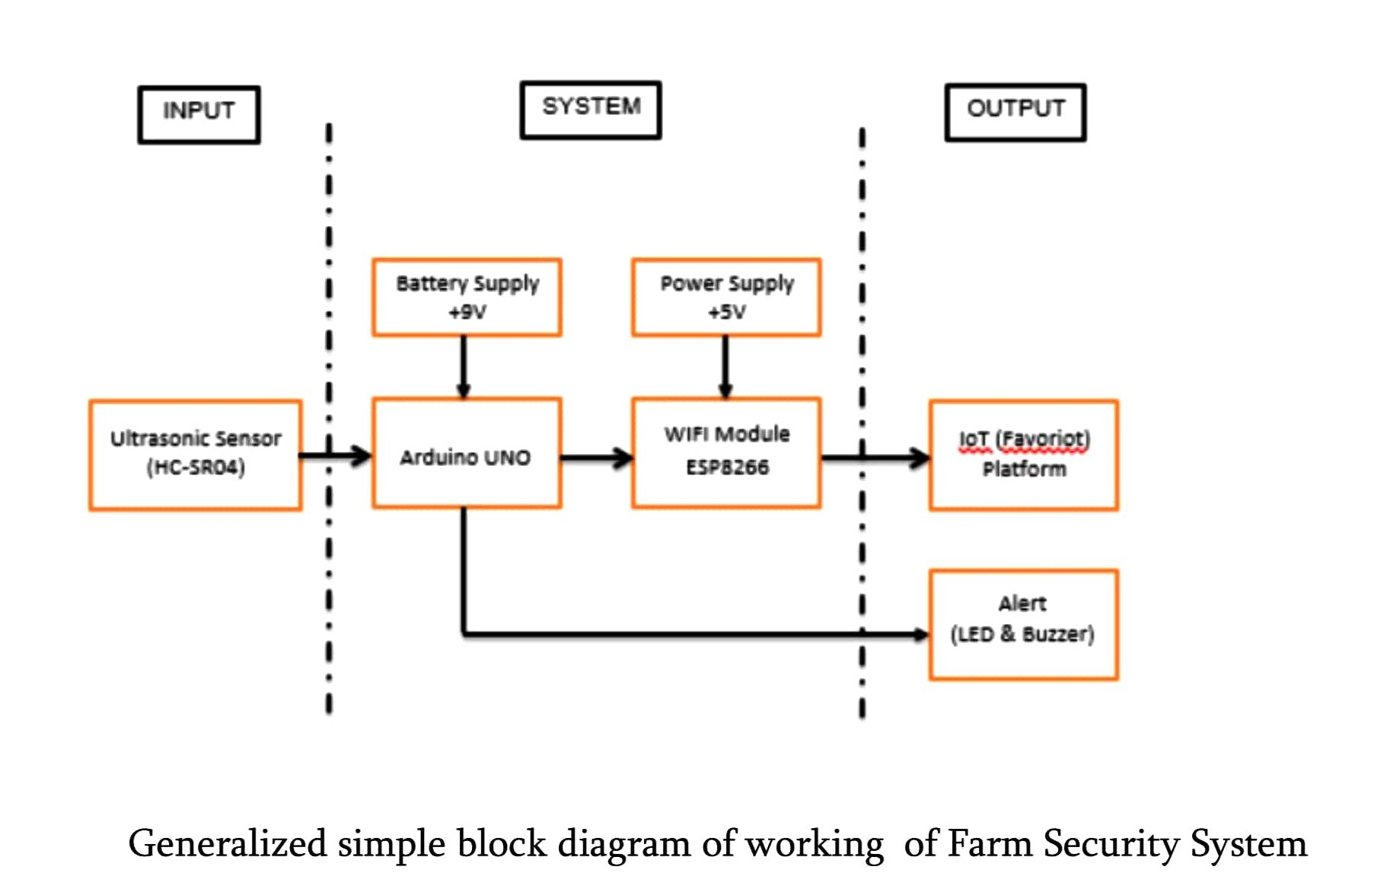
WORKING

Slide 12
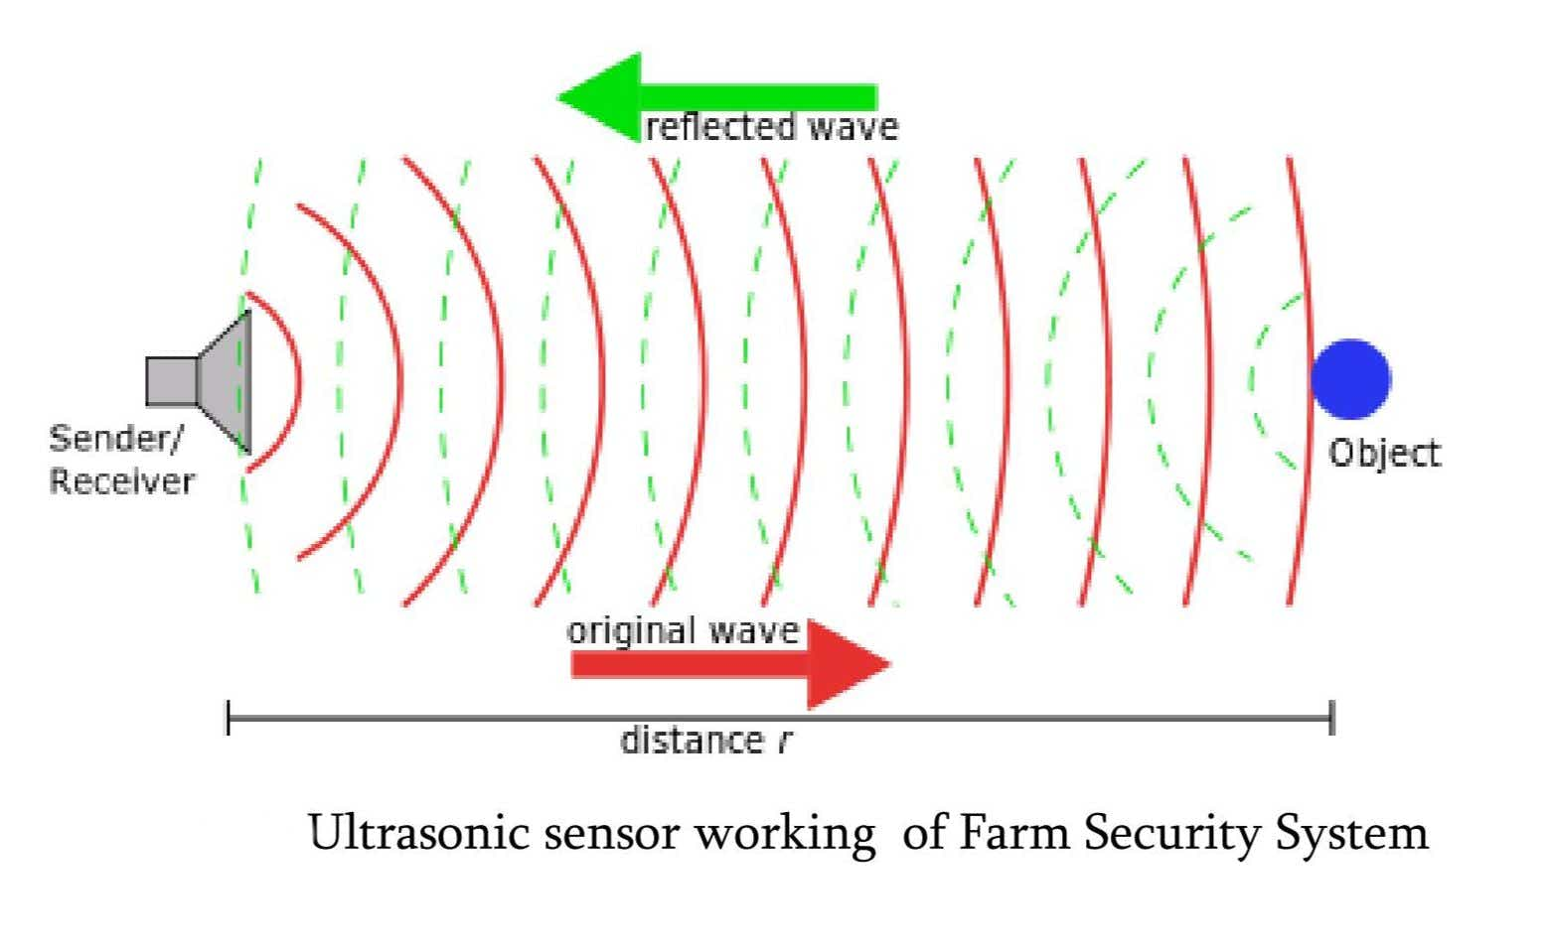

SENSOR WORKING
Work same as radar system.
Convert electrical energy into acoustic waves and vice versa.
The acoustic wave signal is an ultrasonic wave traveling at a frequency above 18kHz.
Distance = $\frac{Time taken X Speed of time}{2}$

Slide 13
APPLICATIONS
ACCESS CONTROL
VIDEO SURVEILLANCEING
REMOTE SECURITY
PANIC AND FIRE ALARMS

Slide 14
CONCLUSION & FUTURE SCOPE
The model could be carried commercially a minimal amount of operating cost and production. Thus, the farm of the very vast field can be make safe easily without human effort.
It is much portable and can be directed with smart phone so, one can easily operate it with their hand set.
This project is environmentally safe because it has been operated by ecofriendly components, In future more research would be possible to development with different features.

Slide 15
REFERENCES
Security and Privacy in Smart Farming Challenges and Opportunities https://www.researchgate.net/publication/3393 72082
Security and Privacy in Smart Farming: Challenges and Opportunities https://ieeexplore.ieee.org/stamp/stamp.jsp?arn umber=9003290
Design and Implementation of an Advanced Security System for Farm Protection from Wild Animals and Implementation of an Advanced Security System for Farm Protection from Wild Animals https://www.academia.edu/38456268/Design
Animal detection system in farm
areashttps://ijarcce.com/upload/2017/march17/IJARCCE%20137.pd
Farm security administration project
http://www.ulib.iupui.edu/collections/IFSAP
Farm security system time and benefit
https://www.farmpractices.com/farm-securitysystem-types-and-their-benefit

Slide 16
THANKS FOR LISTINING US

