Slide 1

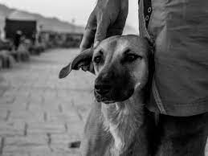

Basic Details of the Team and Problem Statement
Ministry/Organization Name/Student Innovation:
Student Innovation
PS Code: SIH1492
Problem Statement Title: Providing nourishment and healthcare using app and website for animals
Team Name: AniLove
Team Leader Name: Kumari Shivyanshi
Institute Code (AISHE): C-1319
Institute Name: Acharya Institute of Technology
Theme Name: Medtech/Healthtech/Biotech

Slide 2
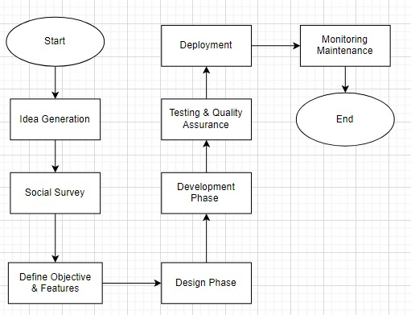

Idea/Approach Details
Flow Chart :
Describe your idea/Solution/Prototype here:
Idea: Empower the community provides a platform that empowers individuals to take an active role in improving the lives of street animals. The idea proposes the creation of a platform that allows individuals to enroll themselves as volunteers interested in helping animals in need.
Solution: Pawsitive Connections is a groundbreaking project aimed at utilizing technology to improve the well-being of street animals. By creating a user-friendly platform, individuals can easily contribute to the welfare of these animals by capturing their photos or videos and providing relevant location details.
Prototype: User Registration, Map Integration, Animal Rescue Requests, Donations and Fundraising, Adoption Listings, Medical Records and Health Tracking, Lost and Found, Chat and Communication. User Profiles: Volunteer and shelter profiles showcasing their experience, reviews, and availability, User badges and recognition for active participants. Feedback and Ratings
Describe your Technology stack here:
Front-End Development: JavaScript, HTML/CSS
Framework/Library: React Native Or Flutter
User Interface (UI) Design: Figma, Android Studio
Back-End Development: Node.js, Python
Framework: Express.js
Database: MongoDB, MySQL or PostgreSQL
Cloud Services: Amazon Web Services (AWS) or Google Cloud Platform (GCP)

Slide 3
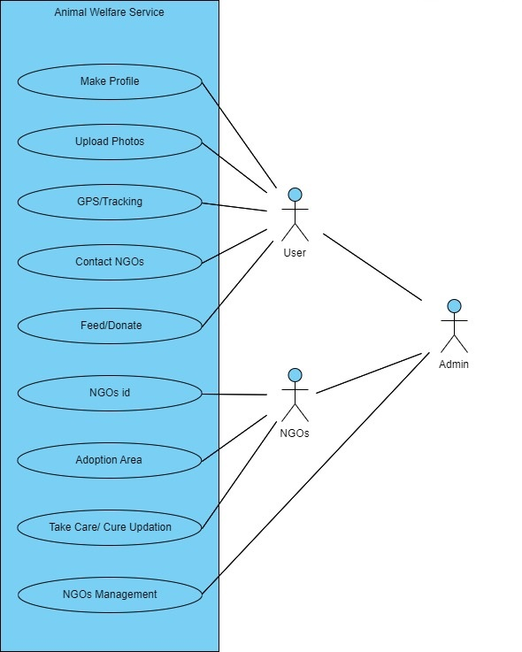

Idea/Approach Details
Use Cases:
Describe your Dependencies / Show stopper here
Dependencies:
Financial Resources, User Engagement, Data and Content, Legal and Regulatory Compliance, Partnerships, Technology Infrastructure
Show Stoppers:
Lack of Funding, Low User Adoption, Data Inaccuracy, Legal Issues, Technical Failures, Resistance from Stakeholders, Ethical Considerations

Slide 4
Team Member Details
Team Leader Name: Kumari Shivyanshi
Branch: MCA Stream: MCA Year :I
Team Member 1 Name: Manyatha P
Branch: MCA Stream :MCA Year : I
Team Member 2 Name: Kumari Divyanshi
Branch : MCA Stream :MCA Year :I
Team Member 3 Name: Ashok R K
Branch :MCA Stream :MCA Year :I
Team Member 4 Name: Amit C Naik
Branch :MCA Stream :MCA Year :I
Team Member 5 Name: Punu N Gowda
Branch :MCA Stream :MCA Year :I
Team Mentor 1 Name: Sheela Maharajpet
Category (Academic/Industry): Academic Expertise (AI/ML/Blockchain etc): ML Domain Experience (in years): 3
Team Mentor 2 Name: Manish Kumar Thakur
Category (Academic/Industry):Academic Expertise (AI/ML/Blockchain etc): CV, DS,AI,ML Domain Experience (in years): 13

Slide 5
Important Pointers
Please ensure below pointers are met while
Kindly keep the maximum slides limit to 4 pages
All the topics should be utilized for description of your idea
Try to avoid paragraphs and post your idea in points
Keep your explanation precisely and easy to understand
Idea should be unique and novel. If it has a business potential more weightage will be given.
Apart from this PPT abstract of your idea will be asked separately while submitting
You need to save the file in PDF and upload the same on portal. No PPT, Word Doc or any other format will be supported
You can delete this slide (Important Pointers) when you upload the details of your idea on SIH portal.

