Slide 1
Back End Engineering-I Project
Blog Management System
TEAM DETAILS:
SHIWANGI (TEAM LEADER) 2310992210(G-25) shiwangi2210.be23@chitkara.edu.in
RAMANJOT KAUR 2310992189 (G-25) ramanjot2189.be23@chitkara.edu.in
SAHIRA 2310992199 (G-25) sahira2199.be23@chitkara.edu.in
ISHITA 2310990777 (G-25) ishita0777.be23@chitkara.edu.in
Supervised By Batch-2023; G-25; Semester - IV
Internal Faculty: Dr. Shikha Project Id: 5
External Faculty: Mr. Aditya Kaushik
:
Chitkara University Institute of Engineering and Technology,
Chitkara University, Punjab

Slide 2
Table of Contents
Introduction
Technical Details
Code Snippets
Output
Project Github Link

Slide 3
Introduction
Project Overview:
The Blog Management System is a backend project designed to handle CRUD (Create, Read, Update, Delete) operations for managing blog posts efficiently. It provides APIs that allow users to add, edit, delete, and retrieve blog titles and descriptions. The system ensures seamless data handling, making it easy for users to manage their blogs dynamically.
Purpose:
The purpose of this project is to provide a seamless backend system for managing blog posts with CRUD operations. It enables users to create, update, delete, and retrieve blog titles and descriptions efficiently through well-structured APIs. The system ensures secure and scalable blog management for smooth user experience.
Key Technologies Used:
Frontend: HTML, CSS, JavaScript
Backend: Node.js, Express.js, EJS (for server-side templating), File System (for storing data in JSON format)
Communication: Fetch API for data exchange between frontend and backend

Slide 4
Technical Details
Frontend:
HTML & CSS: Creates a simple and user-friendly UI for managing blogs.
JavaScript (Fetch API): Sends and receives data from the backend.
DOM Manipulation: Updates the blog list dynamically when adding, editing, or deleting posts.
Backend:
Node.js & Express.js: Handles API requests for CRUD operations.
EJS (Embedded JavaScript Templates): Generates dynamic HTML pages server-side.
File System (fs): Stores blog data in a JSON file instead of a database.
JSON File: Maintains structured blog data (array of objects)
HTTP Requests:
POST: Adds a new blog post (title & description).
GET: Retrieves all blog posts or a specific one.
PUT: Updates an existing blog post.
DELETE: Deletes a blog post from the JSON file

Slide 5
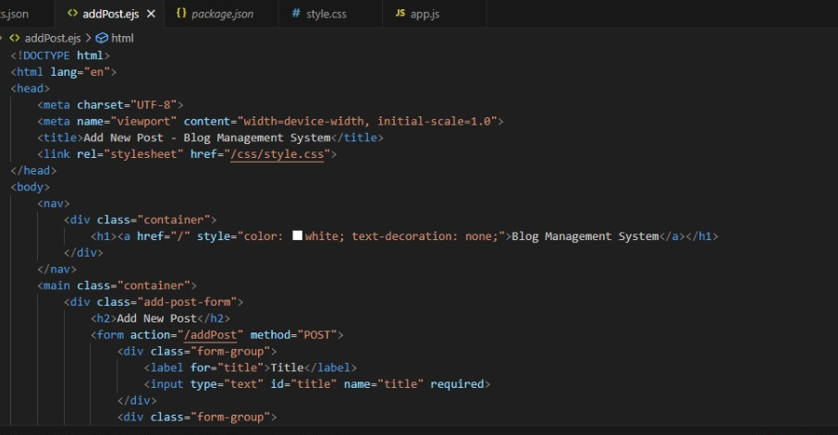
Code Snippets

Slide 6
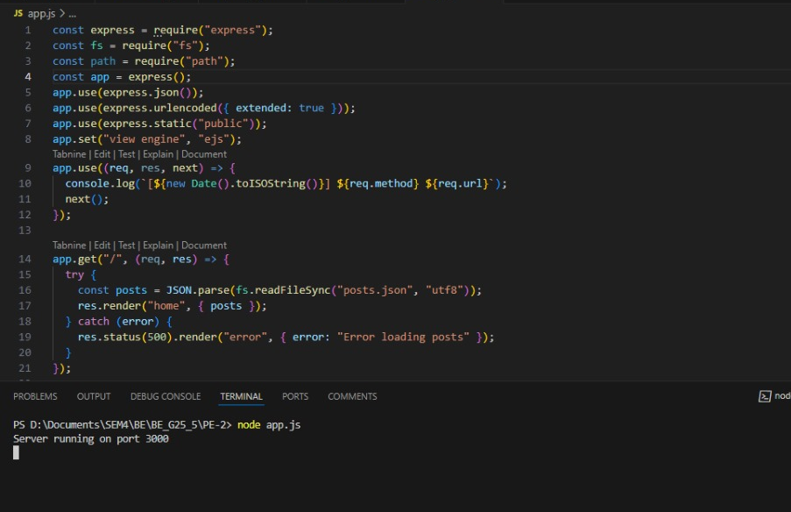
Code Snippets

Slide 7
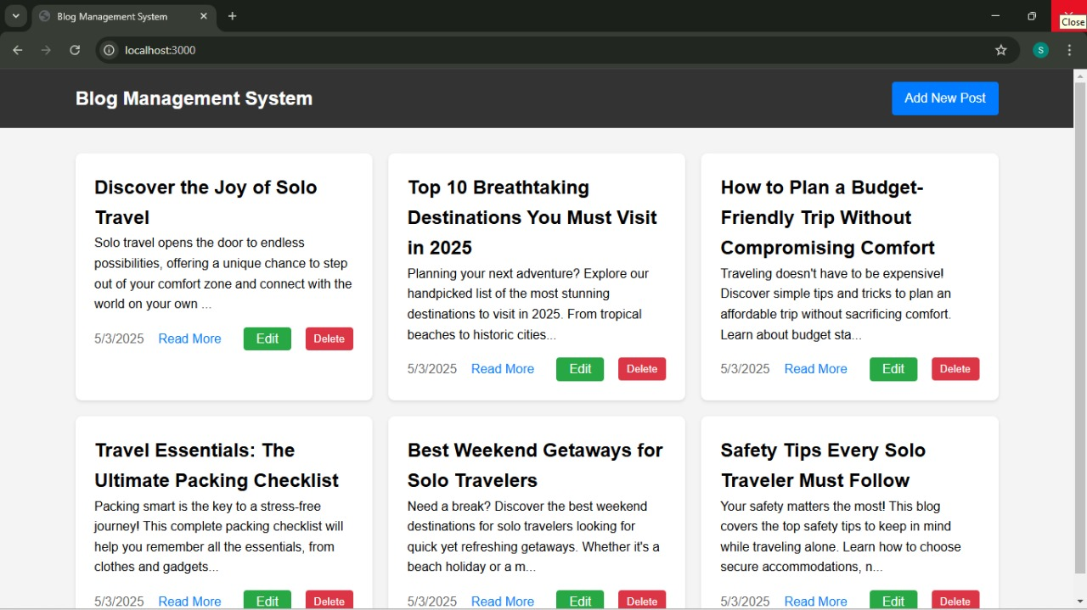
Output

Slide 8
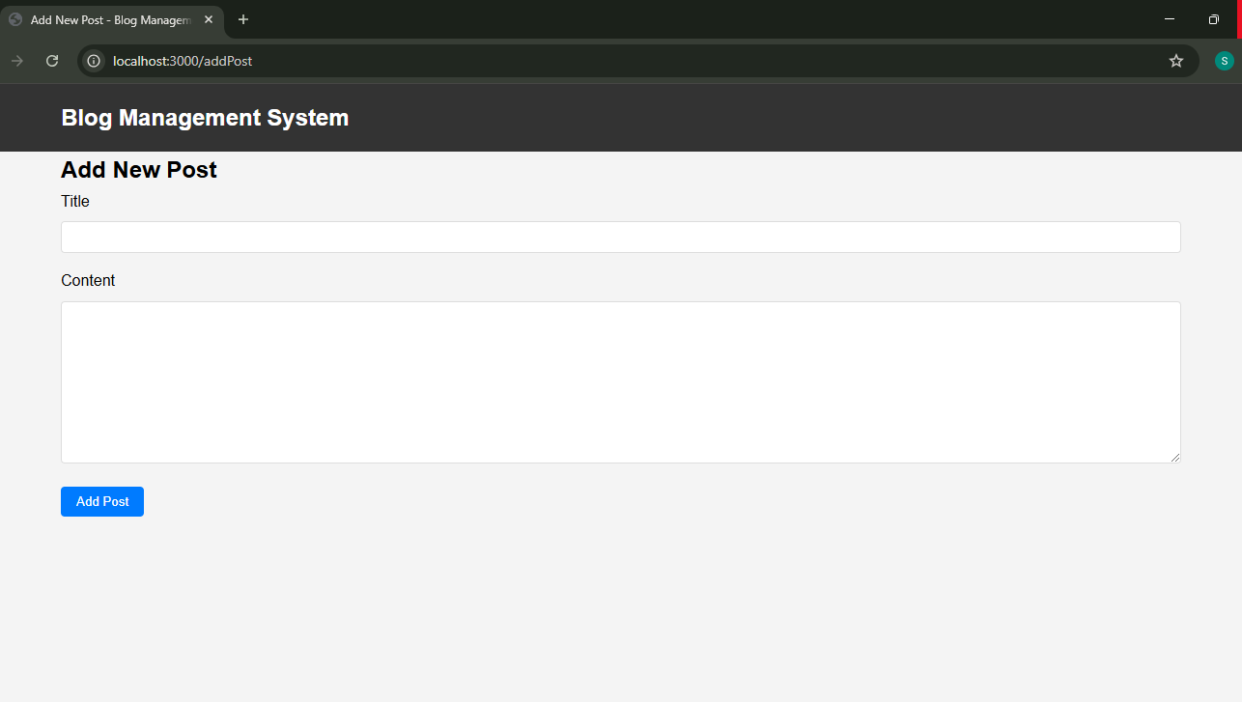
Output
Add:

Slide 9
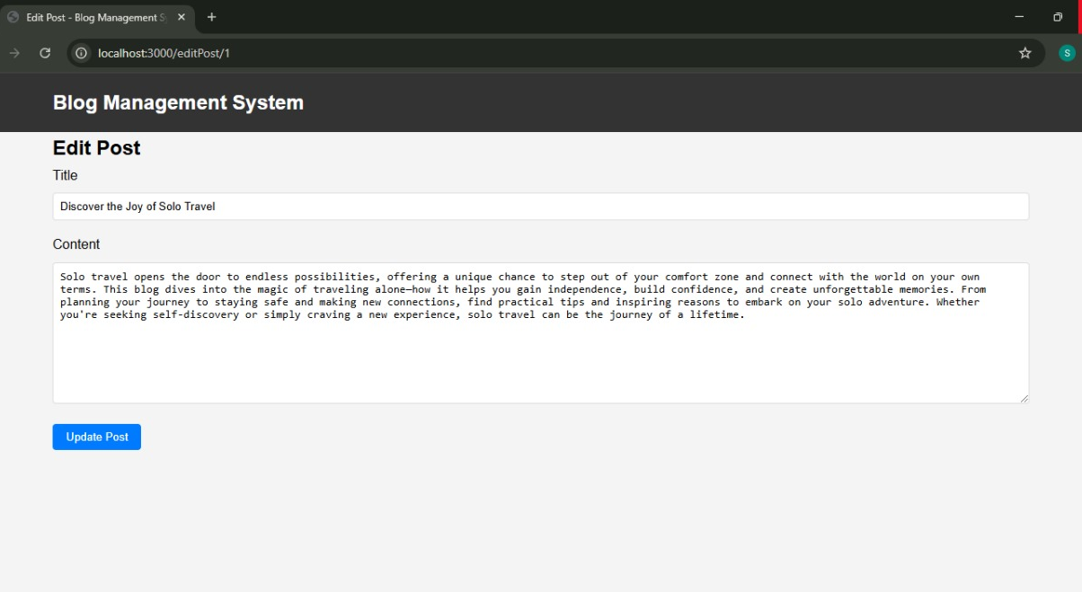
Output
Edit:

Slide 10
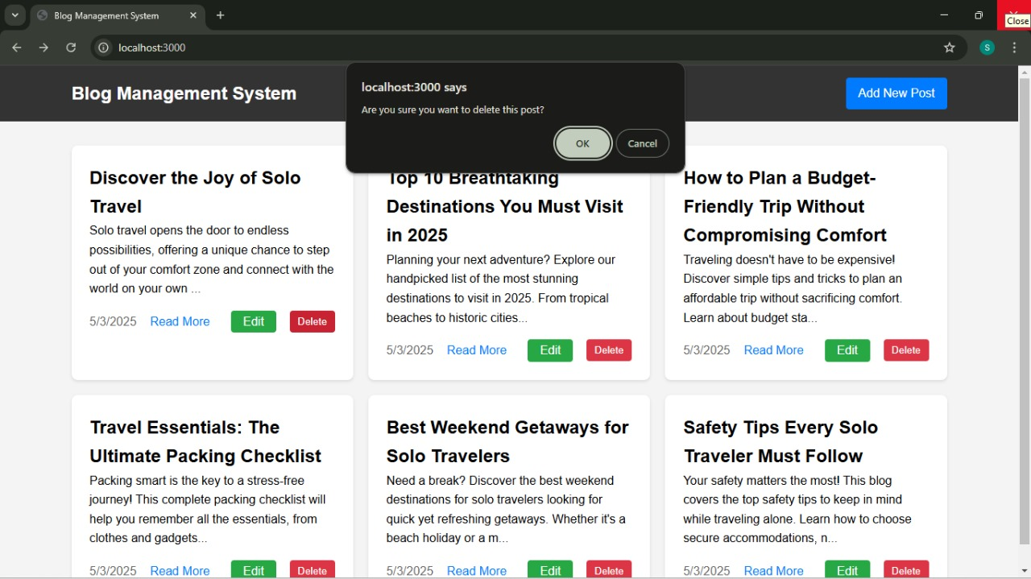
Output
Delete:

Slide 11
Project Github Link
Link: https://github.com/Shiwangikhanna349/BE_G25_5

