Slide 1

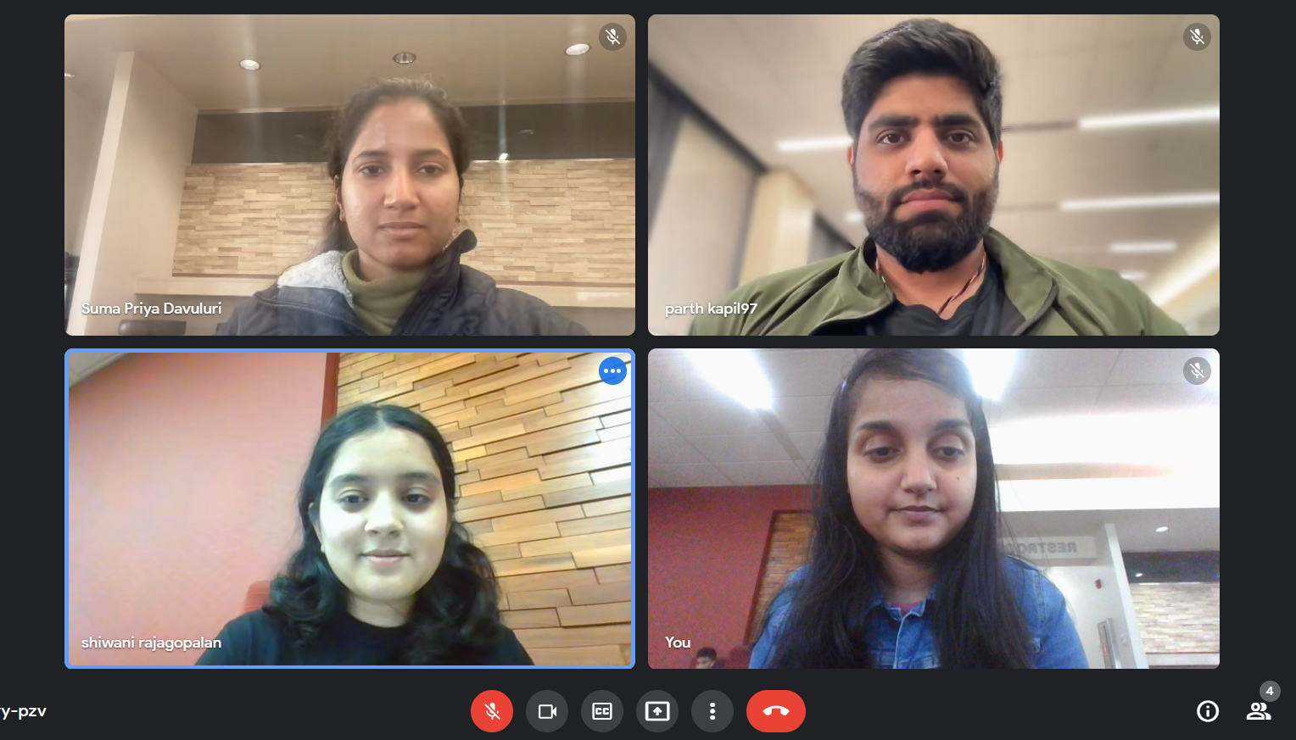
Group-30 Home Credit Default Risk Project

Slide 2
Past
Formulated basic idea of the project
Described about the dataset we are going to work on.
Machine learning algorithms that are going to be used as part of the project and the metric to evaluate the performance.
Overall view of the machine learning pipeline.
Deadlines for each task and assigning team members modules of projects to work on.

Slide 3
Present
Performed Exploratory Data Analysis (EDA) on each of the csv files within the dataset.
Merged data with respect to the order in which is given in the picture in next slide.
Built 2 baseline pipelines: Naïve Bayes and Logistic Regression.
Found Accuracy, ROC/AUC, F1 score, Precision, Recall, Log-Loss for both the pipelines during training and testing phase.
A comparison of the above mentioned metrics for the 2 baseline pipeline was done.

Slide 4
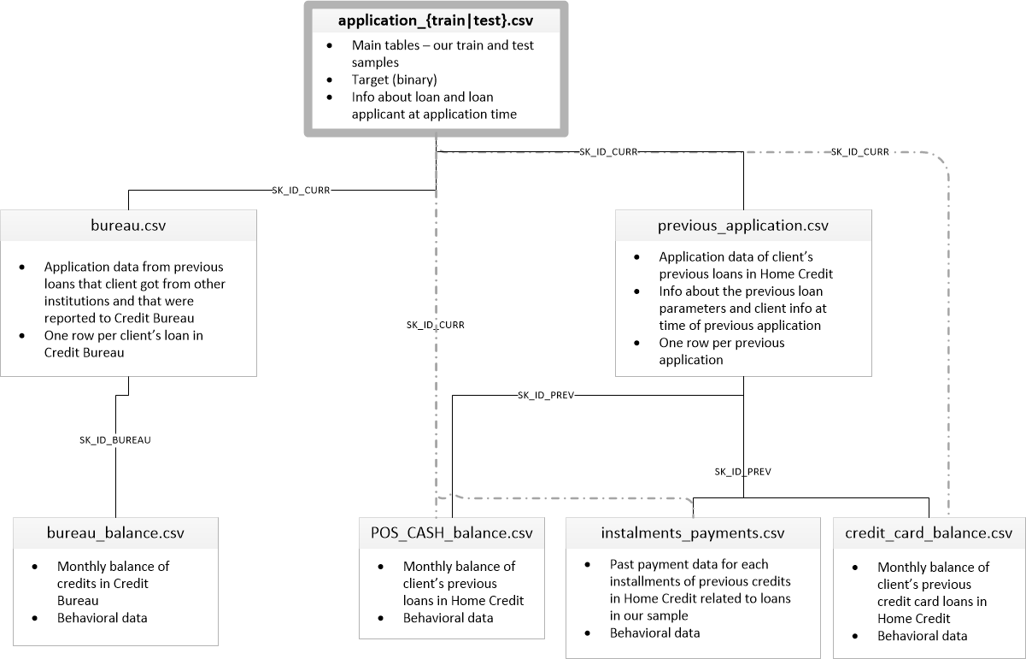
Merge data

Slide 5
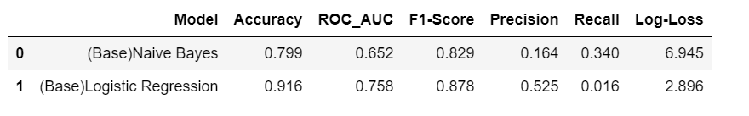
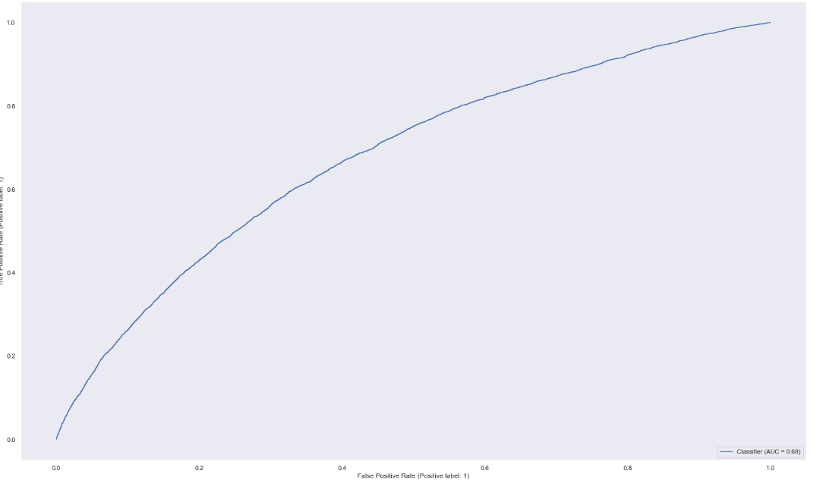
Our Results for baseline pipelines: Naïve Bayes and logistic regression
ROC curve for Naïve Bayes

Slide 6
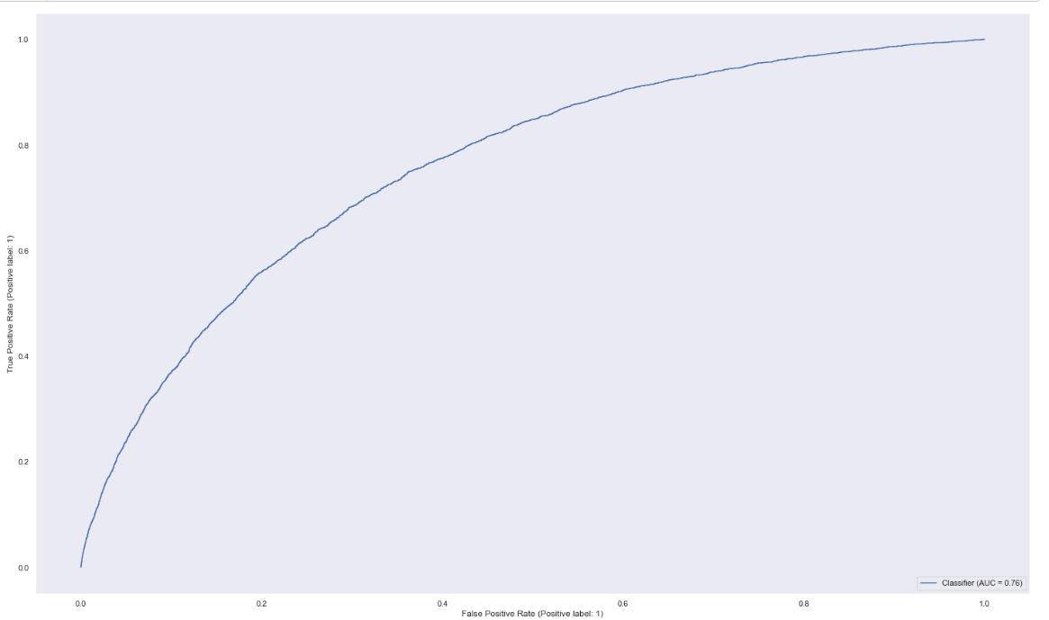
ROC curve for Logistic Regression

Slide 7
Proposed
We are planning to do feature engineering by one-hot encoding all the categorical features in the dataset.
Build the Machine Learning pipelines SVM (Support Vector Machine), Random Forest, XG-Boost and MLP (Multi Layer Perceptron) using Pytorch.
Hyperparameter tuning of the above mentioned models using GridSearchCV.
Observe the performance of all the models mentioned using different metrics.

Slide 8
Problems:
Large dataset
There were lot of missing values in each sub-datasets.
data was imbalanced

