Slide 1
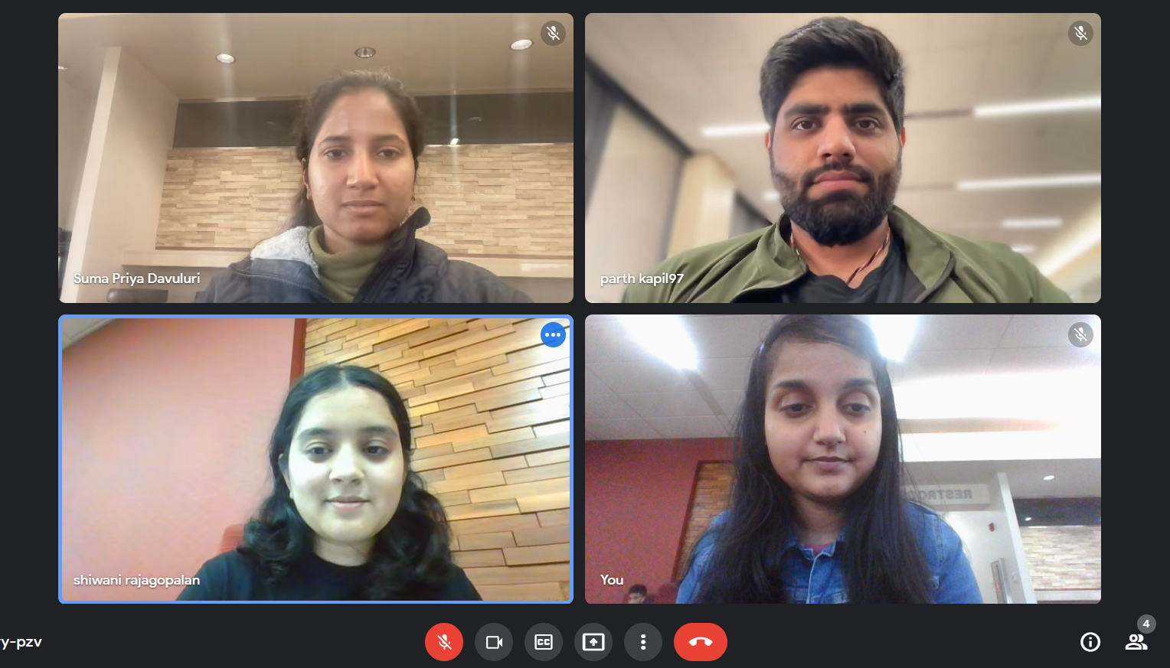
Group-30 Home Credit Default Risk Project
Team Members:
Parth Kapil, Shiwani Rajagopalan, Shubhangi Mishra, Suma Priya Davuluri

Slide 2
Contents
Past - Phase 1
Present - Phase 2
Feature Engineering
Hyper parameter Tuning
Proposed - Phase 3
Problems

Slide 3
Past – Phase 1
Performed Exploratory Data Analysis (EDA) on the dataset.
Found the missing features, features: numerical and categorical.
Merged data in the order that was described in the Kaggle dataset description.
Built 2 baseline models: Naïve bayes and Logistic regression.
Made a comparison of the 2 models based on the metrics: ROC/AUC, F1 score, Precision, Recall, Log-Loss.
Logistic regression performed well and was taken as the baseline model.

Slide 4
Present- Phase 2 (Feature Engineering)
-Perform one hot encoding
-Performed feature engineering on different datasets to create new features.
-Checked correlation, maintain high correlation between newly created features and target variables.
-Merged all datasets where feature engineering was performed.
-Missing data to be handled during feature engineering by replacing infinity with null values.
-Dropped features which have more than 60% of null data.
-Imputed median for features with less than 60% of null data.
-Data standardized using min-max scaler.

Slide 5
Present- Phase 2 (Hyper-Parameter Tuning)
Logistic Regression:
Parameter: Penalty, C value.
best parameter:{'lr__penalty': 'l2', 'lr__C': 1000}
ROC/AUC score: 0.77
SVM:
Parameter: C value, kernel, gamma, and degree (as polynomial is used as a kernel).
best parameter:{'svm__kernel': 'rbf', 'svm__gamma': 0.01, 'svm__degree': 2, 'svm__C': 1}
ROC/AUC score: 0.75
Random Forest:
Parameter: estimators, max_features, max_depth, criterion
best parameter:{'rf__n_estimators': 500, 'rf__max_features': 'log2’, 'rf__max_depth': 5, 'rf__criterion': 'entropy'}
ROC/AUC score: 0.73

Slide 6
Present- Phase 2 (Hyper-Parameter Tuning)
XGBoost
Parameter: xgb__learning_rate, xgb__max_depth, xgb__min_child_weight.
Best parameter: {'xgb__min_child_weight': 1, 'xgb__max_depth': 7, 'xgb__learning_rate': 0.1}
ROC/AUC: 0.77
XGBoost
Parameter: alpha
Best parameter: {'nb__alpha': 1}
ROC/AUC: 0.65
Compared the models mentioned above using the metric: ROC/AUC, F1 Score, Log-Loss, Precision and Recall.
XGBoost performed well when the ROC/AUC score was compared for all the models used.

Slide 7
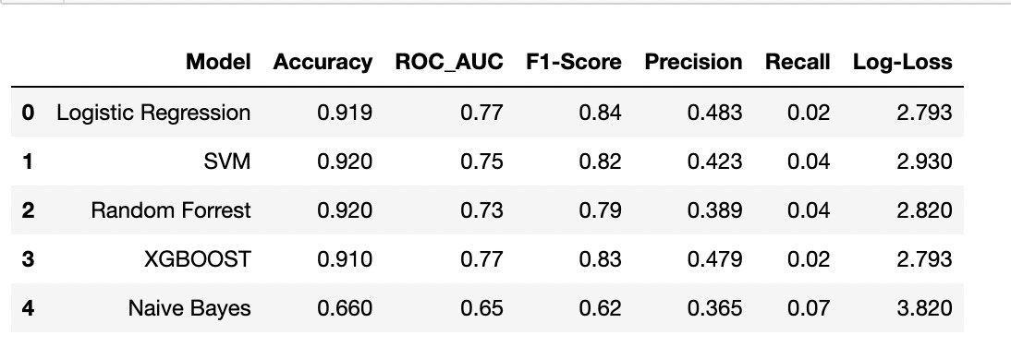
Results

Slide 8
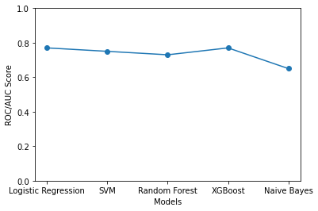
ROC/AUC Score

Slide 9
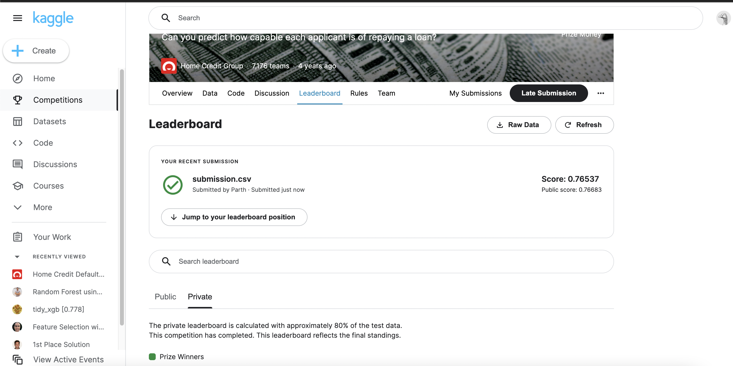
Kaggle Submission

Slide 10
Proposed - Phase 3
Perform Multi-Layer Perceptron Implementation.
Use the metrics described in the previous slides to find how MLP performs overall.
Visualize results using tensor board.
Comparison of performance of previous models and MLP model with pytorch.
Prepare final findings of the results in the report.

Slide 11
Problems
Dataset size was huge.
Certain algorithms like XGboost took more than 2 hours to execute due to vast dataset.
There were issues in running time with the number of parameters specified for each of the models.
We are planning to keep all of these issues into concern when we build our MLP model.

