Slide 1
Sentimental Analysis on Covid Vaccine Data
CSCI B565 - Data Mining
Shiwani Rajagopalan (srajago@iu.edu)
Meet Jatin Shah (meetshah@iu.edu)
Ayush Sanghavi (sanghavi@iu.edu)
INDIANA UNIVERSITY BLOOMINGTON

Slide 2
Motivation
SECTION 1

Slide 3
Motivation to implement this project
We know that Covid cases are linearly dropping down day by day as more and more people are getting vaccinated.
Given the popularity of vaccines, our main aim was to check how people reacted to the vaccines on Twitter. (January 1st 2020 to June 30th 2020).
We performed sentimental analysis on the tweets we extracted from Twitter given the query as the vaccine name.
With the help of a labelled dataset and some machine learning algorithms, we could find out which tweet could be classified as positive or negative.
Some Data Visualization was performed to display the result we captured.

Slide 4
Problem Statement
SECTION 2

Slide 5
Problem Statement
We are using a dataset of Tweets’ sentiment labelled as positive or negative (Link to dataset)
We perform data preprocessing on this dataset, split the dataset into training (80%) and testing data (20%).
We then implement Logistic regression, K- Nearest Neighbors, Support Vector Machine, Adaboost and Bagging on the training data and check the accuracy of the same.
Further, we select the best algorithm that gives us the maximum accuracy, in this case (SVM) and then our model is ready.
We then scrape tweets from Twitter using the snscrape library of Python.
Query all tweets that contain the keyword, "Pfizer", "Moderna", "Johnson&Johnson" between January 01 2020 to June 30 2020.
This will then be our testing dataset, we then apply our model to this data to gauge the sentiment of tweets containing the respective keywords.
Lastly, we perform some data visualization and infer some insights as to which vaccine had positive and/or negative tweets, getting the frequency of words.

Slide 6
Data Preprocessing
SECTION 3

Slide 7
Data Preprocessing
Data preprocessing is performed on the labelled dataset in order to then run our model to output high accuracy.
The data is cleaned by the removing the following :
Stop words
Usernames (words that start with @ on Twitter)
Punctuation
URLs
Numbers
All the above do not contribute to sentimental analysis.
We then perform tokenization of tweets and create a list of words separated by comma in order to then perform lemmatization. We run the TF-IDF algorithm, to get the frequency of the used words and how important the word is.
Once, the data preprocessing is done, our dataset is ready to be fed into the models that will run on the rest of the 20% testing dataset to calculate the accuracy.

Slide 8
Model evaluation
SECTION 4

Slide 9
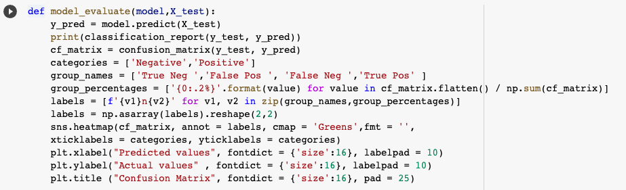
This is our model evaluation function, where we predict the model performance on the 20% test set by comparing the labels our model generates with the original labels.

Slide 10
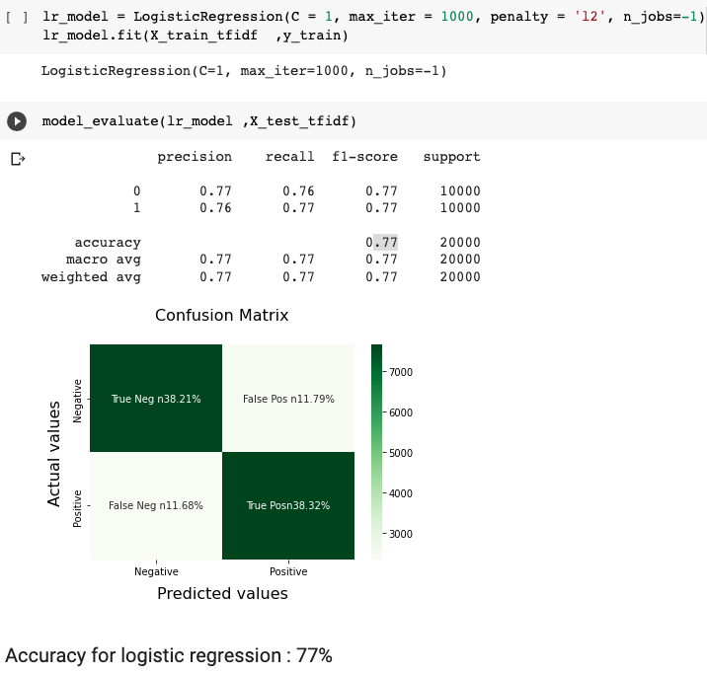
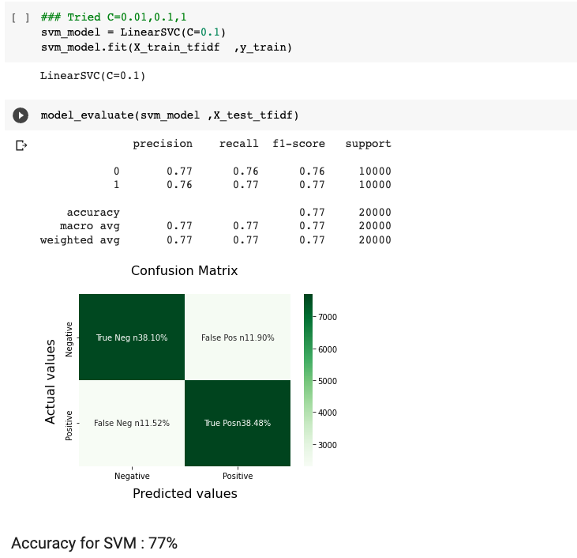
Logistic Regression
Support Vector Machine

Slide 11
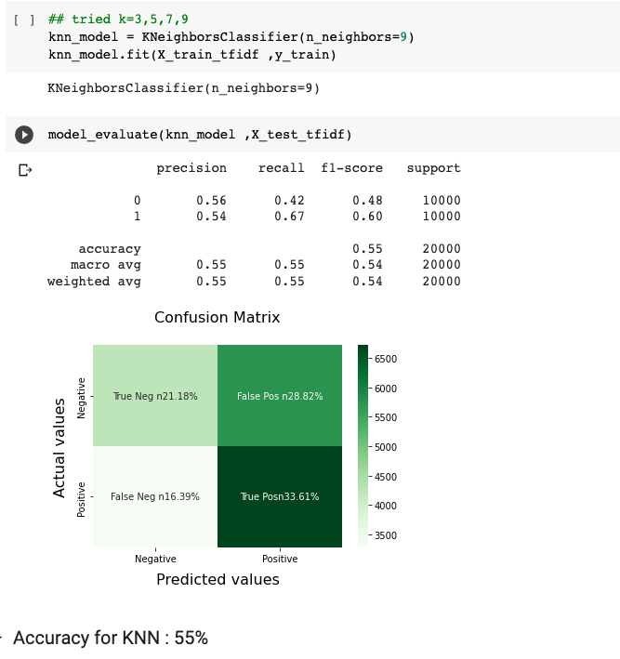
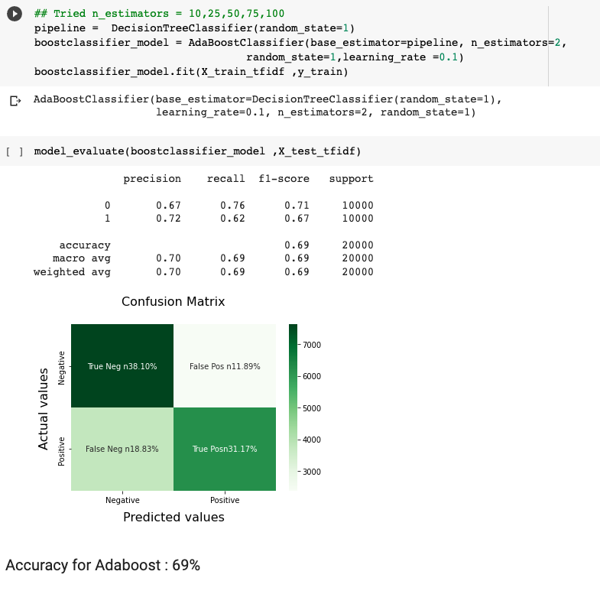
K - Nearest Neighbors
AdaBoost Classifier

Slide 12
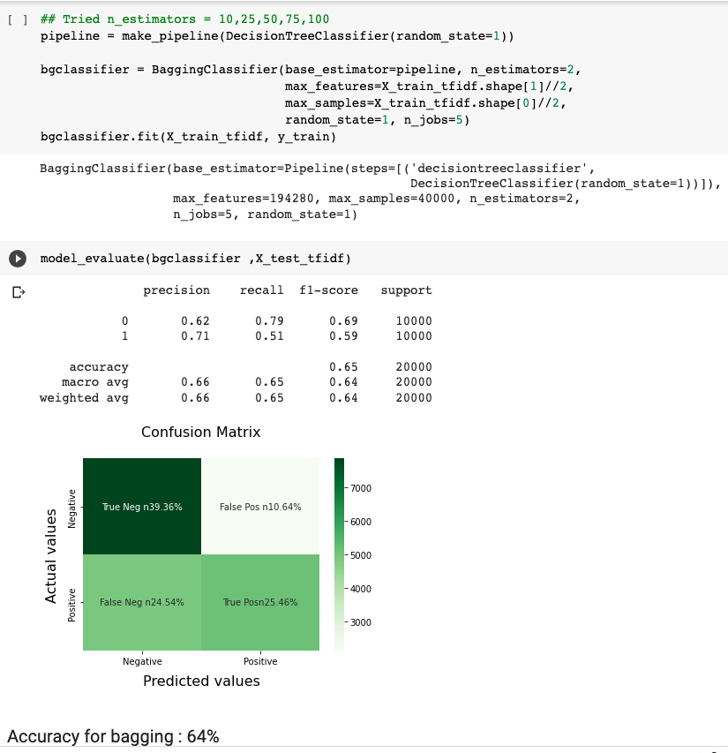
Bagging

Slide 13
Scraping Twitter data
SECTION 5

Slide 14
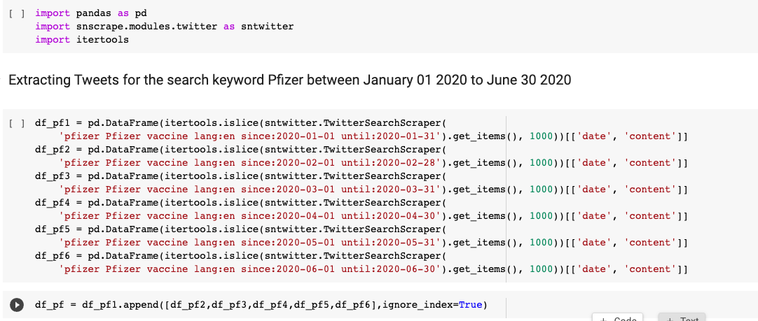
Scraping of Tweet data
1) To analyze the sentiment of Covid Vaccine tweets, we first scrape the tweets from the Twitter using Python’s “snscrape” package.
2) We give a keyword, say “Pfizer” and give a date range.
3) We collect tweets in 6 different dataframes concatenate them and then find label the dataset using our model.
4) Below is the technique, we have used to scrape data for the keyword “pfizer”, the same has been implemented similarly for Moderna and Johnson&Johnson

Slide 15
Results and Discussion
SECTION 6

Slide 16
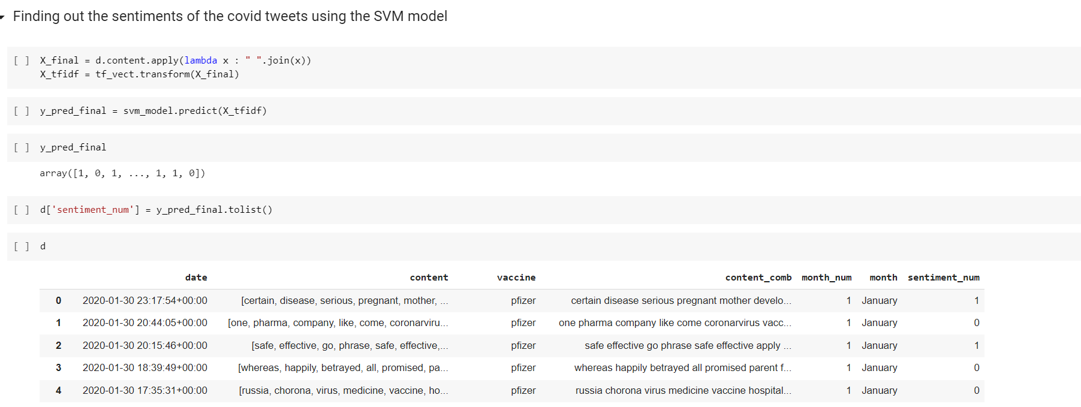
Results and Discussions

Slide 17
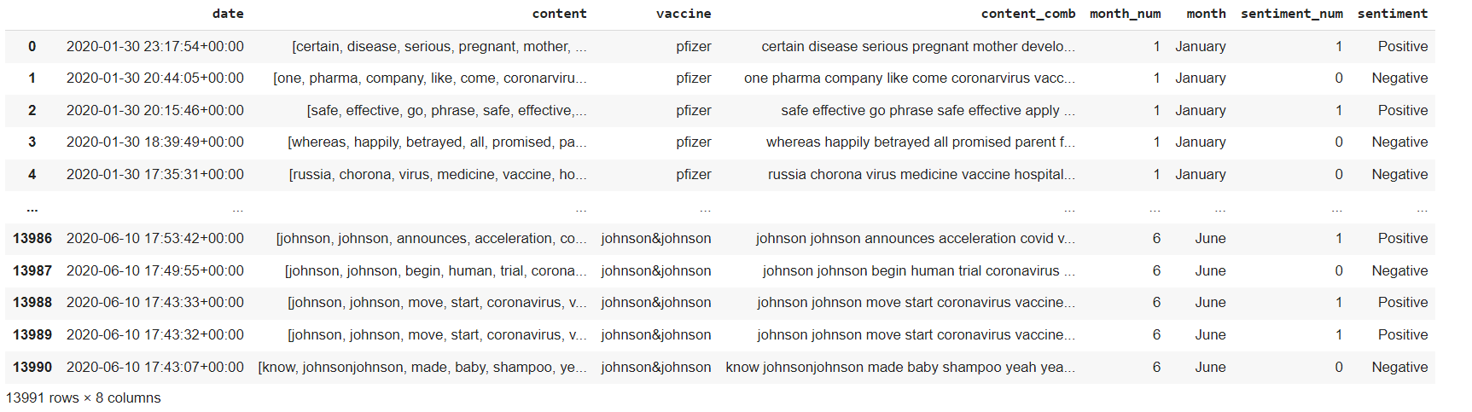
Results and Discussions
SVM Results for dataset that was labelled after testing on the pre-trained model

Slide 18
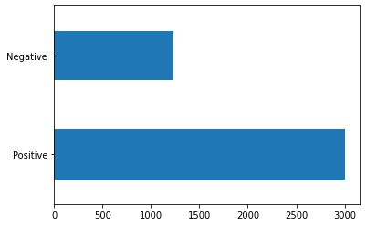
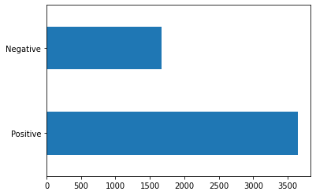
Results and Discussions
Number of Positive and Negative tweets across the keyword pfizer.
Positive : 3003
Negative : 1233
Number of Positive and Negative tweets across the keyword moderna.
Positive : 3648
Negative : 1674

Slide 19
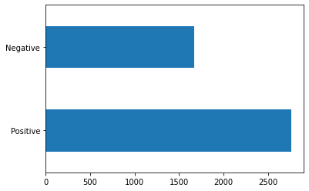
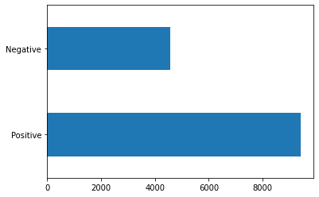
Results and Discussions
Number of Positive and Negative tweets across the keyword johnson and johnson.
Positive : 2761
Negative : 1672
Number of Positive and Negative tweets across the all vaccines (Pfizer, Moderna, Johnson&Johnson)
Positive : 9412
Negative : 4579

Slide 20
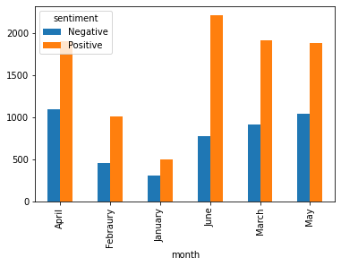
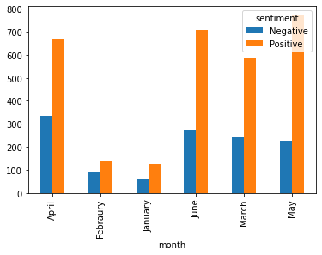
Results and Discussions
Overall Sentiment Distribution over months for all vaccines
Overall Sentiment Distribution over months for Pfizer

Slide 21
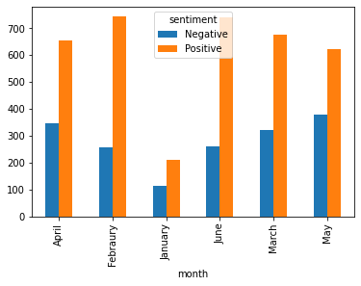
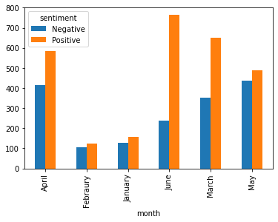
Results and Discussions
Overall Sentiment Distribution over months for Moderna
Overall Sentiment Distribution over months for J&J

Slide 22
Conclusion
SECTION 7

Slide 23
Conclusion
We performed sentimental analysis on covid vaccine tweets data to find the vaccines that were most popular from January 2020 to June 2020.
Split the process into 3 parts where the first part was data preprocessing, second part was model evaluation on pre-labelled kaggle dataset, and finally we did model evaluation by adding labels from the results of the models.
We used 5 models for model evaluation: Logistic regression, Support Vector Machine, KNN, Adaboost, and Bagging Classifier.
After training and testing on these models, we found that SVM performed better with an accuracy score of 77%
Additionally, we scrapped tweets about Pfizer, Moderna, and Johnson&Johnson to create a dataset which was tested on the pre-trained model to get labels.
Finally, We visualized the results obtained to find the vaccines that had most number of positive tweets.

Slide 24
Thank you

