Slide 1

Harmonized Document Handling at BHC
“Doc41 / BDS”
Eduard Müller, BHC O&I, Frank Wiesen, BBS ITO MS eCP
2018-07-13

Slide 2
Agenda
Auf einen Blick – was ist Doc41/ BDS?
Architektur
Generelle Funktionen BDS
Integration Doc41/BDS
Online Demo

Slide 3
Auf einen Blick – was ist Doc41/ BDS?
Repository / Archiv - no DMS (kein approval, kein workflow)
Harmonisiertes, funktionsübergreifendes Konzept – keine Stand-Alone L.
Standards definiert durch GPORs (Doc Types; Funktionen; Integration)
Unterstützt unterschiedliche Anwenderfunktionen/-gruppen
Modulares Rechtekonzept, sehr anpassungsfähig
Globale Dokumenten Suche (Typ übergreifend)
Differenzierung nach Dokumenten-Typen und -Klassen
Notes:
Doc41 provides a standard repository for documents to all processes in BHC ERP, currently focusing on P2R.
Doc41 follows the BHC IT Strategy and Doc41 follows the Go4One Program
Harmonization and standardization of the handling of documents within the ERP landscape
Storage and supply of documents to the corresponding processes
Archiving, retrieval and gaining access via Web Interface
Single point of document access
No business process but cross functional standard
Logical concept, no separate physical system
Enlargement of existing KGS store archive for further functional requirements
Ensures consistent system integration and enhancement inside the existing environment
Coordinate “Doc41.n” projects for integration of further processes
Ensure knowledge transfer and handover to process teams for global roll outs and roll back

Slide 4




Architektur Dco41/BDS
External User Internet Access
GxP
validated
Internet
DMZ
IBM WebSeal Internet Security Proxy
BBS Environment for Public Pages
(Admin)
Spediteur
Portal
Bayer Document Storage
(Doc41 Web UI)
Doc41 Web client
Rest Service
Download /
Upload SD Docs
Websphere
Apache/Tomcat
BHC Portal
Bayer User
Search for Doc ID
BW
DB
SAP BW
Intranet
User Data,
Role Data,
Document Types
-> Access Definitions
Oracle DB
Archive Link
Doc41
Document Upload,
Call of Doc41 RFCs,
Document Download
per Doc41 URL
P2R
KGS Store
DVS
BOE Hosting Environment DE
SAP R/3
Notes:
Doc41 documented in SSM - Project P2R
Doc41 Web UI documented in SSM - Project EXT_ACC
Doc41 web client documented in SMP
In planning:
Connect SharePoint for frequent batch processing (upload); connect SNC; MatrixOne
Enable “Global BHC Intranet Search” to retrieve centrally stored documents (Doc41-Attributes (Meta data) and full text search in PDFs which are stored in KGS).

Slide 5
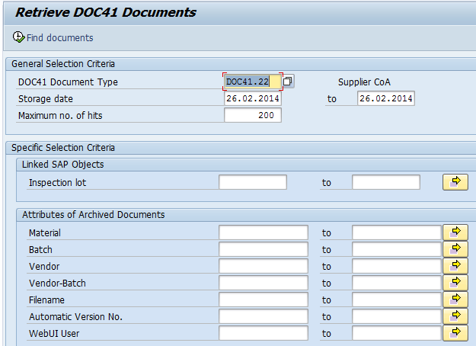
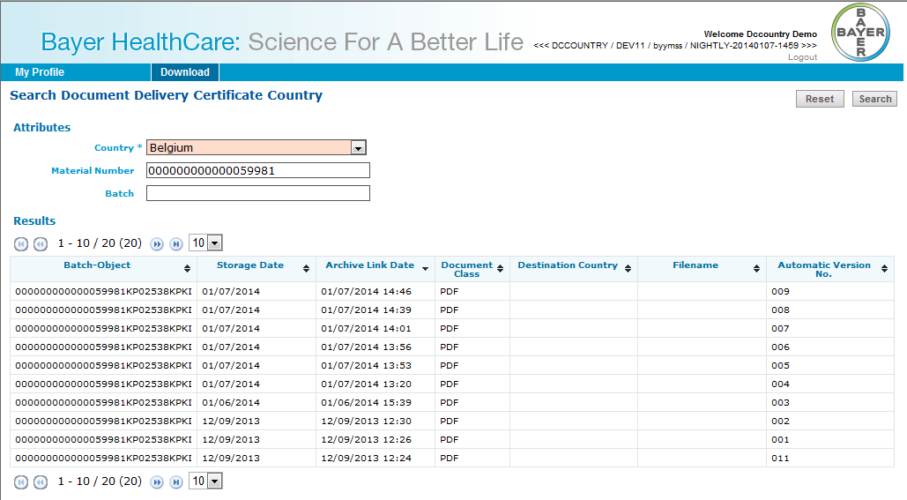
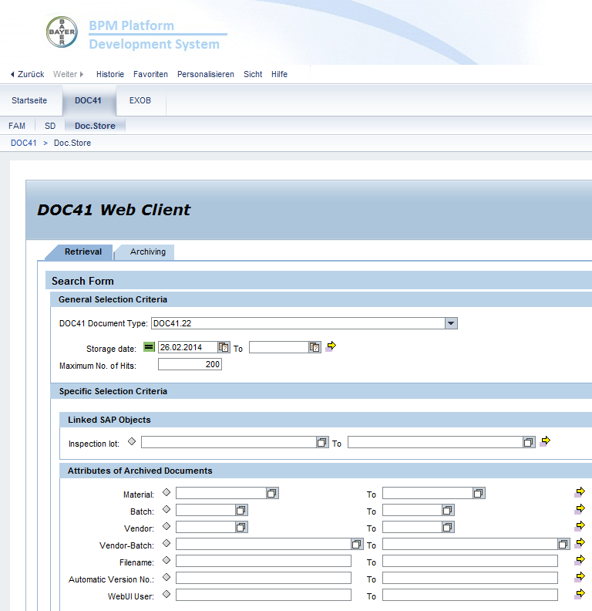
Generelle Funktionen BDS
Download / Retrieval
Single Document
Document-Archives (zip)
DocType specific security
Multiple Profiles/Functions
Upload
Single Document
DocType specific security
User Management
Mass Registration
Webservices
Upload/Download
Machine/personalzed Auth.
Page 5
Notes:
Details:
Automatized archiving (OMS connection / Streamserver
Batch processing (Migration, Connecting SharePoint / SNC)
Additional functionalities:
SD Document flow
FAM Navigation tree
Attribute editor & audit trail
Scanning function via [oawd]

Slide 6

Integration Doc41/BDS
Internet
Intranet
P2R
Doc41
Procurement
Data Collection*
Sales & Distribution
Change Management*
KGS
Quality Mgmt.
Packaging
Facility & Asset Mgmt.
ACF*
EH&S*
Page 6
Notes:
In planning:
Batch Release Cockpit connection
Connect SharePoint for frequent batch processing (upload); connect SNC;
Enable “Global BHC Intranet Search” to retrieve centrally stored documents (Doc41-Attributes (Meta data) and full text search in PDFs which are stored in KGS).
EH&S Safety Data Sheets as information corner
Interface with Layout-Tools (e.g. AtlasX)

Slide 7
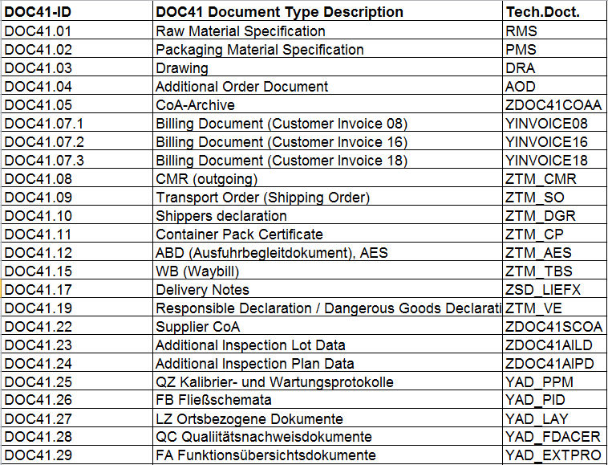
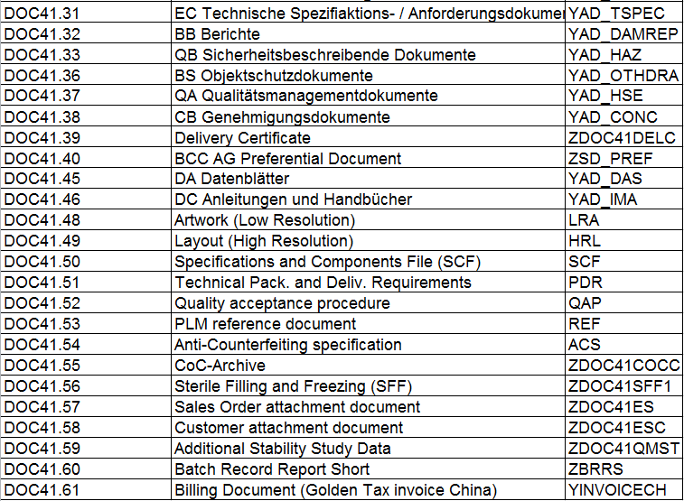
Doc41: actual 49 Document types

Slide 8
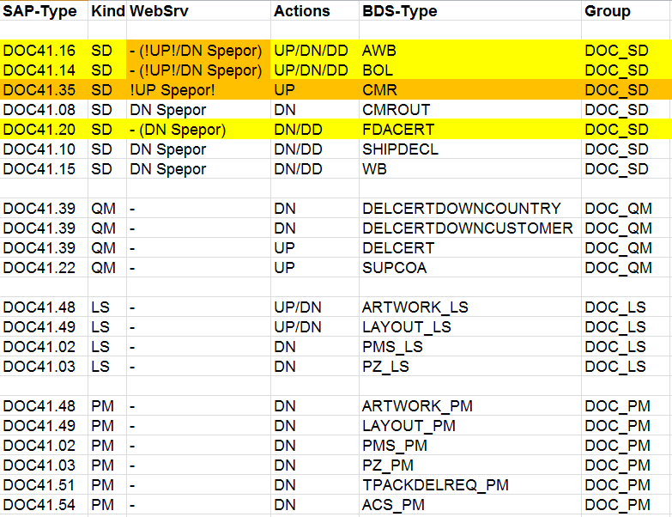
BDS: actual 17 Document types, 9 in use
6 PM Document types by 260 external Users
80.000 downloads since 06/2016
3 SD Document types via Spediteur Portal WS
100 since 06/2016
SELECT data2 downl_type, MAX(created) downl_last, max(created_m) dounl_last_mon, count(*) FROM (
select users, created, actiontype, data1, data2, data3, data4, data5, created_m from DOC41WEB_FDT.WEBMETRIX where actiontype like '%DOWN%' /*and users = 'DS_CARR'*/ order by created desc
) group by data2
order by 1

Slide 9
Online Demo
DEV User: ptglo, BASF, 8150815 (download)
User: imwif (Usermgmt)
Page 9
Notes:
Web UI Online Demo: Download Delivery Certificate
URL: http://doc41-dev.bayer-ag.com/userprofile/myprofile
Username: DCCOUNTRY
Passwort: bla
Country: Belgium
Material: 000000000000059981
DeliveryCertificate Customer
User: DCCUSTOMER
PW: bla
Partner Number: 381810
Country: Germany
DeliveryNumber: 80401210
MaterialNumber: 217542

Slide 10

Thank you!
Page 10

Slide 11
Thank you!
Page 11

Slide 12
EH&S*
Page 12
Notes:
In planning:
Batch Release Cockpit connection
Connect SharePoint for frequent batch processing (upload); connect SNC;
Enable “Global BHC Intranet Search” to retrieve centrally stored documents (Doc41-Attributes (Meta data) and full text search in PDFs which are stored in KGS).
EH&S Safety Data Sheets as information corner
Interface with Layout-Tools (e.g. AtlasX)

Slide 13
P2R Transactions
SAP/R3 – Transactions:
/BAY0/GZ_D41AR Store DOC41 Documents & Create Links
/BAY0/GZ_D41RE Retrieve DOC41 documents
/BAY0/GZ_D41ED DOC41 Attribute Editor Transaction
/BAY0/GZ_D41AUT DOC41 Display Attribute Change History
/BAY0/GZ_D41MAINTATT Maintain DOC41 Attributes
/BAY0/GZ_D41MAINTATX Maintain DOC41 Attribute Texts
/BAY0/GZ_D41MAINTCAT Maintain DOC41 Storage Categories
/BAY0/GZ_D41MAINTDOC Maintain DOC41 Document Types
/BAY0/GZ_D41MAINTDTX Maintain DOC41 Doc.Type Texts
/BAY0/GZ_D41MAINTVAL Maintain DOC41 Predef. Attr. Values
/BAY0/GZ_D41MAINTVTX Maintain DOC41 Attr. Value Texts
Web client: http://by-dcdpm.bayer-ag.com:50000/irj/portal
Web UI: http://doc41-dev.bayer-ag.com/userprofile/myprofile
User Transaction
Expert Transaction
Customizing Transaction
Page 13

Slide 14
General Objectives
Initial Business Requirements:
One global concept for handling of documents used by various process standards implemented in P2R; it must be referenced to unique SAP identifiers
One unique physical document repository
Controlled storage of documents with access for BHC individuals and externals
Evolving Requirements:
Access via Web
Include externals
Single & mass upload
Interfaces (to source systems)
Attributes for structured storage (incl. attribute change)
Full audit trail
Integration of automatically created documents (StreamServe)
Notes:
Initial Business Requirements: Extract from the initial meeting on this topic end 2011. GPORs from QM, PROC, FAM attending.
Result today: “We store documents centrally, enhance them with Attributes and make them globally available - considering authorization rules.”

