Slide 1
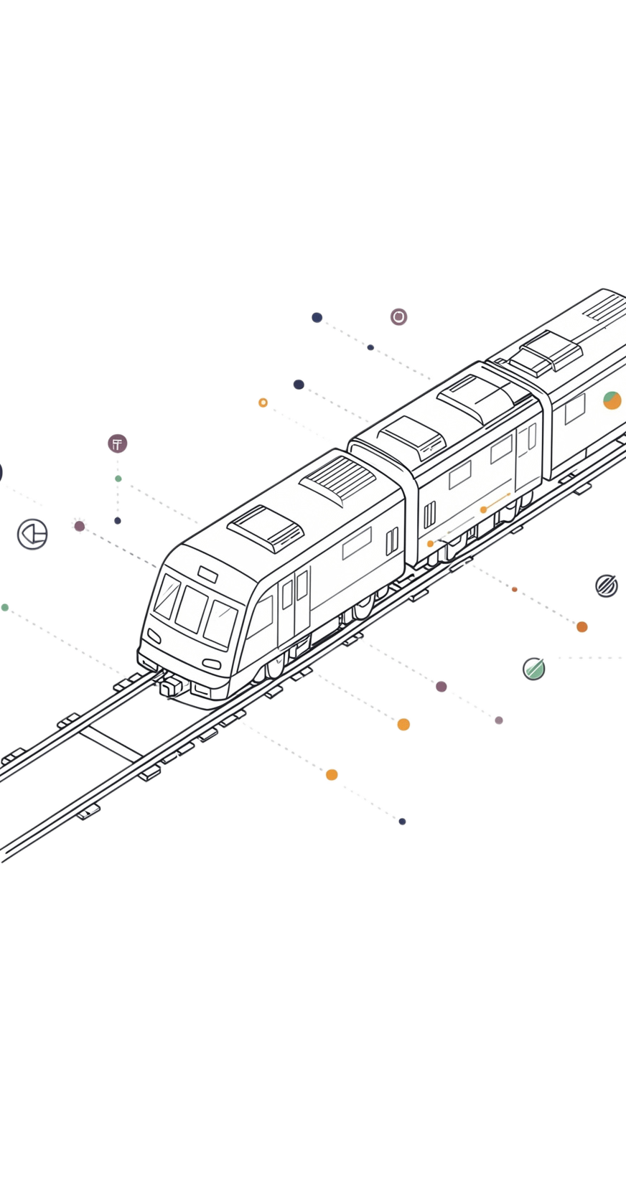
Context-Aware Digital Twin for Train Vibration Monitoring & Control
12-831 Final Project · Abby, Shiwei, Dharun, Saera
This project develops a context-aware monitoring and control system that distinguishes between normal and anomalous operating conditions of a model train.
M1
M2
M3
M4
Abby Albrecht
Shiwei Jiang
Dhuran Muthaiah
Saera Park
Data Discovery & Signal Alignment
Window Features & Digital Twin
AI Classification & Decision Logic
End-to-End Evaluation
108
4,239
2
12
RUNS
WINDOWS
MATERIALS
CONDITIONS
Notes:
Today we're presenting our final project a context-aware digital twin for train vibration monitoring and control. Our system uses Arduino telemetry and DAQ accelerometers to build a baseline model for expected vibration, detect anomalies through residuals, and make real-time control decisions. The project spans 108 experimental runs, over 4,200 windows, and 12 operating conditions across two materials.

Slide 2
SYSTEM OVERVIEW
2 / 8
How the Full Pipeline Works
INPUT
MEMBER 1 · ABBY ALBRECHT
MEMBER 2 · SHIWEI JIANG
MEMBER 3 · DHURAN M.
MEMBER 4 · SAERA PARK
Raw Sensor Data
Signal Alignment
Digital Twin
Classification
Evaluation
Arduino (pos, vel, phase)
+ DAQ g4 & g5 at 1000hz
→
Discover 108 runs
Parse labels
Align to 25hz timeline
→
1-sec windows
6 features
RF regressor + residuals
→
Condition classifier
Decision thresholds
continue/adjust/stop
→
Metrics
Findings
Limitations
108/108
106,986
4,239
Alum. + Steel
Runs aligned
Sensor rows
Windows evaluated
Two materials
The pipeline closes the loop: from raw sensors → aligned data → expected vibration → classification → control action.
Notes:
Here's how the full pipeline works. Raw sensor data from the Arduino and DAQ feeds into a signal alignment stage, which discovers and aligns all 108 runs onto a common 25 Hz timeline. That aligned data is then sliced into 1-second windows, and a digital twin regressor is trained to predict expected vibration from operating context alone. Residuals from that model feed into a classifier that decides whether the train should continue, adjust speed, or stop. These four stages close the loop from raw sensors to control action.

Slide 3
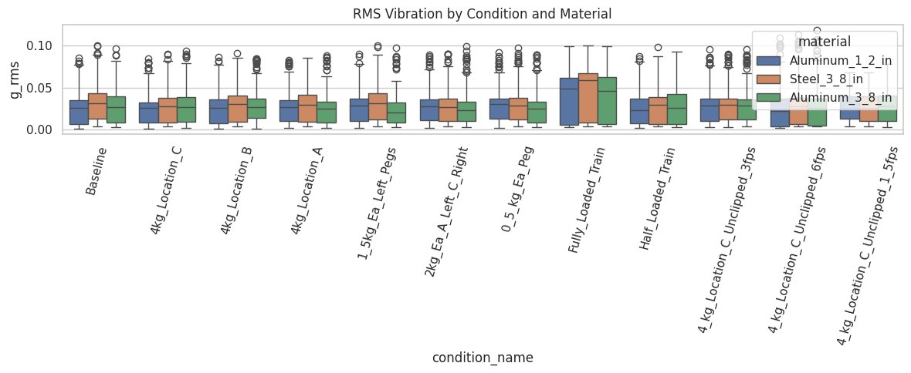
MEMBER 1 · ABBY ALBRECHT
3 / 8
Data Discovery & Signal Alignment
Discovered all 108 runs organized as material / condition / run_id folder structure
Parsed folder names to extract: material type, thickness, load weight, placement, and speed
Two sensor streams per run: Arduino at variable hz + DAQ accelerometers at 1000hz
Aligned both onto a single 25hz timeline using linear interpolation
Zero broken runs — all runs successfully aligned with no missing files
RMS vibration across all 12 conditions and 3 materials. Fully_Loaded_Train shows highest vibration as expected — confirming clean aligned data.
108/108
25 Hz
0 broken
Runs aligned
Timeline
Out of 108
Notes:
Starting with data discovery and alignment. All 108 runs were organized by material, condition, and run ID, and folder names were parsed to extract metadata — speed, load weight, placement, and material type. Each run contained two sensor streams: Arduino at variable frequency and DAQ accelerometers at 1,000 Hz. Both were aligned onto a single 25 Hz timeline using linear interpolation. The result was zero broken runs — 100% alignment success — with clean exported files ready for the rest of the pipeline

Slide 4
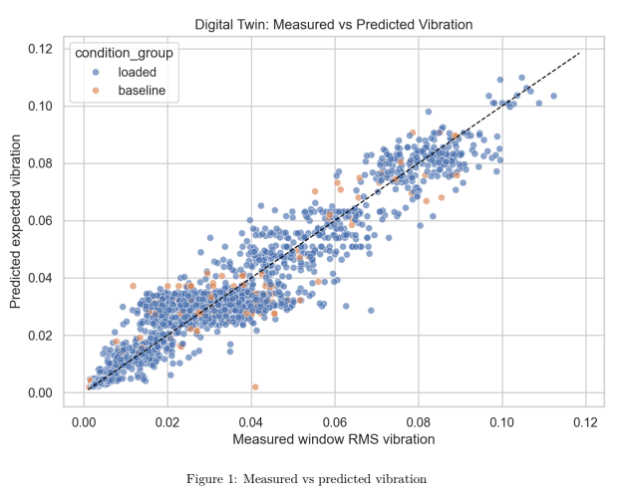
MEMBER 2 · SHIWEI JIANG
4 / 8
Window Features & Digital Twin Regression
Sliced aligned data into non-overlapping 1-second windows (25 samples each at 25hz)
6 summary features per window: mean, std, RMS, peak-to-peak, dominant frequency, spectral centroid
Random Forest regressor trained on operating context only — not vibration itself
Residual = actual g_rms − expected_vibration, quantifying how surprising the vibration is
GroupKFold cross-validation grouped by run_id — prevents data leakage between runs
R² = 0.91
MAE 0.005
Bias = 0.000
Overall fit ✓
g-units error
Unbiased model
Measured vs predicted window RMS vibration. Points cluster tightly along the perfect-prediction line — confirming R²=0.91 with no systematic bias.
Notes:
Next, the digital twin. Aligned data was sliced into non-overlapping 1-second windows, and 6 features were extracted per window — including RMS, spectral centroid, and dominant frequency. A Random Forest regressor was then trained on operating context alone, without seeing vibration directly. The residual — actual minus expected RMS — quantifies how surprising any window is. Using GroupKFold cross-validation to prevent data leakage, the model achieved an R² of 0.91, an MAE of 0.005 g-units, and zero systematic bias.

Slide 5
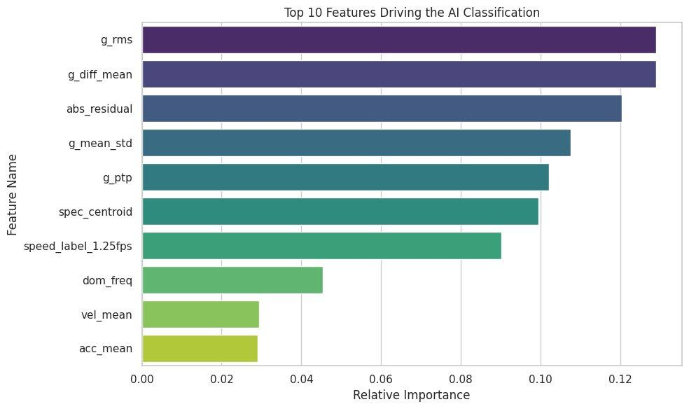
MEMBER 3 · DHURAN MUTHAIAH
5 / 8
AI Classification & Decision Logic
Random Forest classifier: baseline vs loaded per 1-second window
Balanced class weights + 15% probability threshold to catch more baseline windows
Fine-grained multi-class classifier for exact condition_name (12 classes)
Warning threshold = 95th pct of baseline residuals = 0.01625
Critical threshold = 99th pct of baseline residuals = 0.03024
DECISION LOGIC PER WINDOW
abs_residual > 0.030 →
STOP
abs_residual > warning + predicted = loaded →
ADJUST SPEED
abs_residual > warning + predicted = baseline →
STOP
Top 10 features driving AI classification. g_rms and g_diff_mean dominate, followed by abs_residual.
else →
CONTINUE
Notes:
From there, the residuals feed into the classification and decision logic layer. A Random Forest classifier distinguishes baseline from loaded conditions per window, with balanced class weights and 15% probability threshold. The decision logic is simple: if the critical threshold is exceeded, stop; if the warning threshold is hit alongside a loaded prediction, adjust speed; otherwise, continue operating

Slide 6
MEMBER 4 · SAERA PARK
6 / 8
Evaluation Findings
Finding 1 — Digital Twin Prediction is Excellent
The model predicts expected vibration from operating context alone with exceptional accuracy. Consistent across all 108 runs and both materials — the strongest result in the pipeline.
Finding 2 — Residuals Cannot Detect Anomalies
Baseline windows had higher residuals than loaded ones — the opposite of our assumption. The ~80% accuracy is misleading due to 11:1 class imbalance. Balanced accuracy is near-random.
Finding 3 — Speed Detectable, Placement Not
Changing speed alters vibration frequency, clearly captured. Moving a weight between locations barely changes vibration at the sensor level. Physical sensor limitation.
Notes:
Now for the evaluation. Three key findings emerged.
First, the digital twin prediction is excellent also consistent across all 108 runs and both materials.
Second residuals cannot reliably detect anomalies. Counter to our assumption, baseline windows had higher mean residuals than loaded ones. p val was 0.97, meaning no statistically significant separation. The binary classifier's ~80% accuracy is misleading due to an 11-to-1 class imbalance, balanced accuracy was just 55.2%. Third, speed is perfectly detectable at 100% F1, but weight placement achieves only 7–14% F1

Slide 7
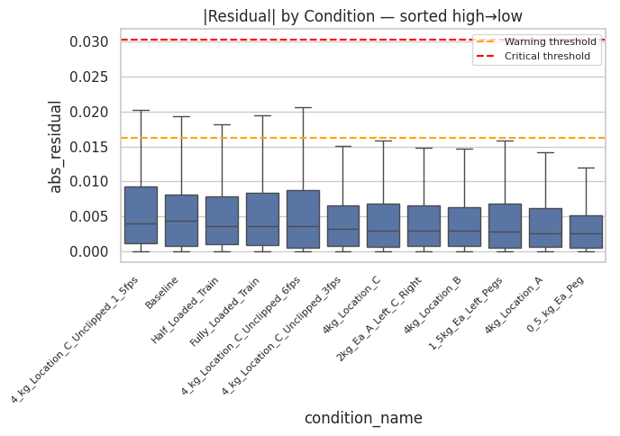
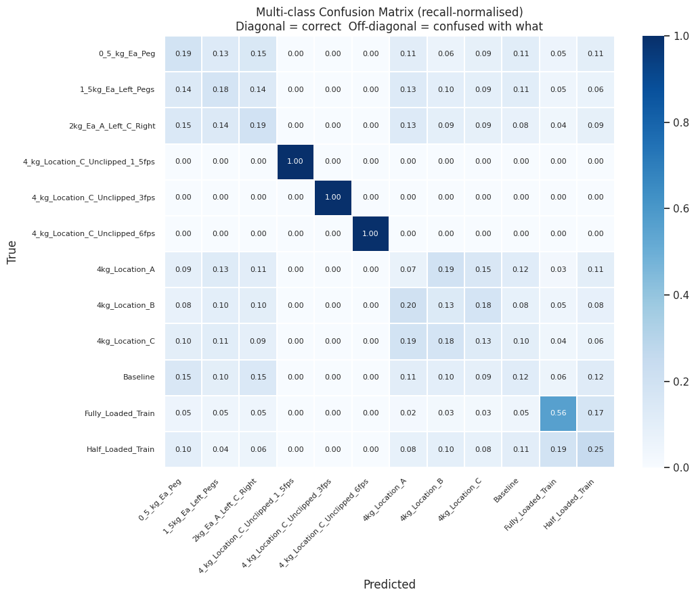
MEMBER 4 · SAERA PARK — EVIDENCE
7 / 8
The Evidence Behind the Findings
FINDING 2 — RESIDUAL SIGNAL
FINDING 3 — CLASSIFICATION LIMITS
Sorted high→low. Baseline sits 2nd — noisier than most loaded conditions. All conditions well below warning threshold.
Speed tests show perfect 1.0 F1 (dark diagonal squares). Location A/B/C rows are diffuse — model is guessing.
Baseline mean = 0.00558 · Loaded mean = 0.00469 · Mann-Whitney p = 9.71e-01 · False alarm rate = 5.1% · Critical residuals → STOP = 100%
Speed tests: 100% F1 · Location A/B/C: 7–19% F1 · Multi-class accuracy: 40.6% · Binary accuracy: 79.7% (misleading) · Balanced accuracy: 55.2% · MCC: 0.077 · Baseline recall: 25.7% · Loaded recall: 84.6%
Notes:
Here's the evidence behind those findings. The residual bar chart shows baseline sitting second-highest ,noisier than most loaded conditions, which explains why residuals fail as an anomaly signal. All conditions fall well below the warning threshold, so the system almost never triggers an alert. The confusion matrix reinforces this: speed conditions show perfect diagonal squares, while the location rows are diffuse, the model is essentially guessing on weight placement

Slide 8
SUMMARY
8 / 8
Recommendations
Key Takeaway
Two components worked well, the digital twin regression and speed detection, both performing excellently. However residual-based anomaly detection and placement classification fell short due to an imbalanced dataset.
Collect More Baseline Data
Problem: 11:1 imbalance (3,889 loaded vs 350 baseline) prevents learning.
Current metrics: Recall 25.7%, F1=0.173.
Equal class representation would likely fix binary classification.
Introduce Genuine Anomalies
Constraint: All 108 runs currently consist of normal experiments.
Anomaly detection needs data where something actually goes wrong.
Use Speed as Primary Signal
Result: Speed achieves 100% F1.
Frequency-domain analysis should be the primary detection mechanism.
Notes:
To summarize, the digital twin regression and speed detection both performed excellently. However, anomaly detection and placement classification fell short due to an imbalanced dataset. Going forward, we recommend collecting more baseline data, introducing genuine anomalies for better training, and prioritizing speed as the primary detection signal. Thank you.

