Slide 1
Constraint-Aware Fitness Planner (Track B)
Problem, target user, and why a coordinated agentic workflow is needed.
Target user
Core problem
Users who want realistic non-clinical diet + workout planning under constraints.
The hard part is not producing text. It is deciding when to clarify, stop, escalate, revise, or adapt.
•
symptom-trigger history and food restrictions
ask
stop
escalate
revise
•
schedule, budget, equipment, and adherence limits
•
needs revision after real-world execution feedback
Project contribution: a runnable Track B artifact with visible coordination, state, saved traces, and evaluation evidence.
Notes:
Time: 0:00-0:35
【画面停在 PPT Slide 1，鼠标指向标题 Constraint-Aware Fitness Planner。】
Hi everyone. My project is Constraint-Aware Fitness Planner, a non-clinical planning system for users who want realistic diet and workout guidance under real-world constraints.
【鼠标移到左侧 Target user 区域，慢慢扫过 food restrictions / symptom-trigger / schedule / budget 这些关键词。】
The target user is someone who may have food restrictions, symptom-trigger history, schedule limits, budget limits, limited equipment, or adherence challenges.
【鼠标移到右侧 Core problem 区域，指向 ask / stop / escalate / revise 四个标签。】
In this setting, the hard problem is not simply generating a fitness plan. The hard problem is deciding when the system should ask for clarification, stop for safety, escalate tradeoffs back to the human, revise a draft, or adapt after feedback.
【鼠标指向底部 contribution 句子。】
So the main goal of this project is to make fitness planning more constraint-aware, stateful, and auditable.

Slide 2
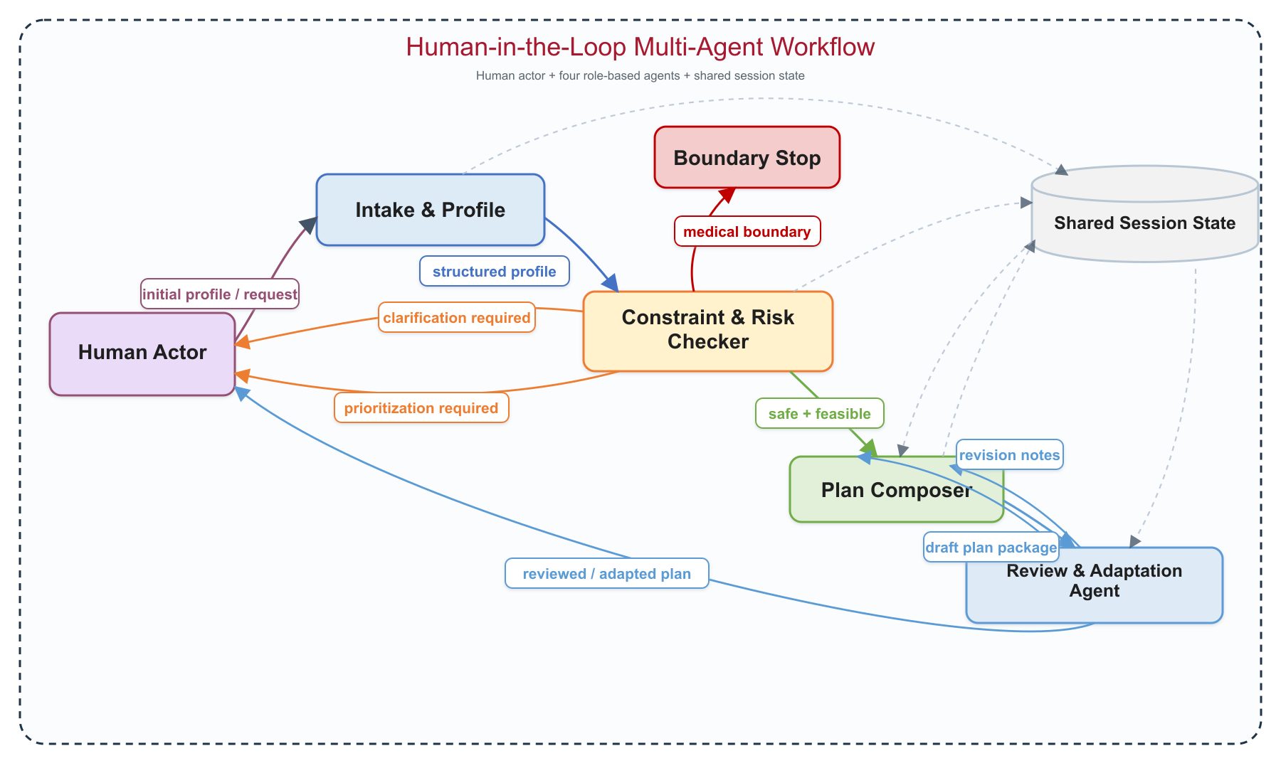
Architecture: Four Agents + Human-in-the-Loop + Shared State
Quick map before showing the actual workflow.
What to point out
•
Intake structures raw user input into a profile packet.
•
Constraint checker gates ambiguity, conflict, and boundary risk before planning.
•
Plan composer drafts only after safe / feasible routing.
•
Review agent creates a visible revise/adapt loop.
•
Human actor resolves missing info, tradeoffs, acceptance, and feedback.

Slide 3
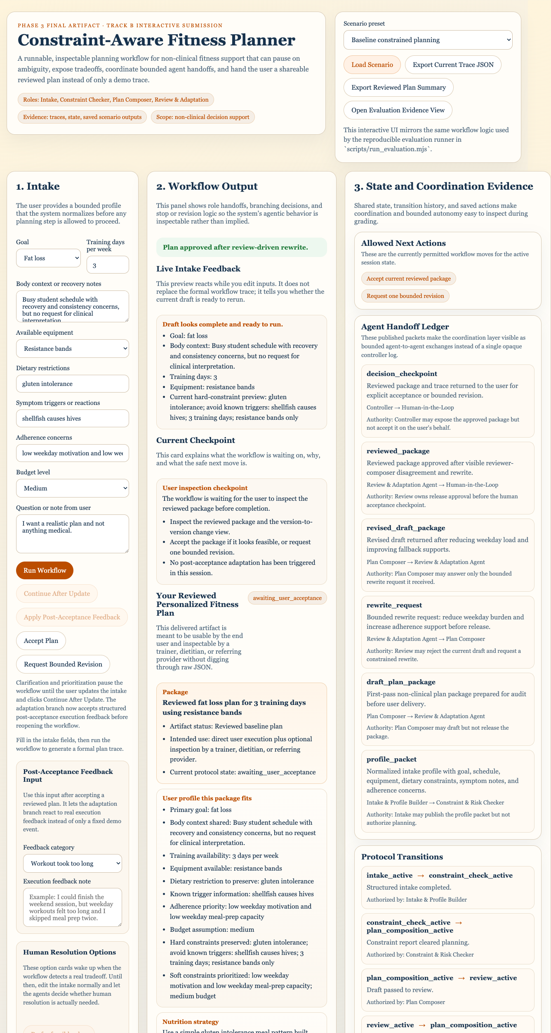
Actual Artifact: Main Workflow from Intake to Reviewed Plan
Show the running app here: baseline scenario -> Run Workflow -> Accept Plan.
Rubric coverage
main workflow
final output
•
Input panel contains profile, constraints, symptom context, and planning notes.
•
Workflow output shows the reviewed plan package instead of raw generation.
•
Right panel exposes state, handoff ledger, agents transitions, and raw trace JSON.
the app is the final artifact

Slide 4
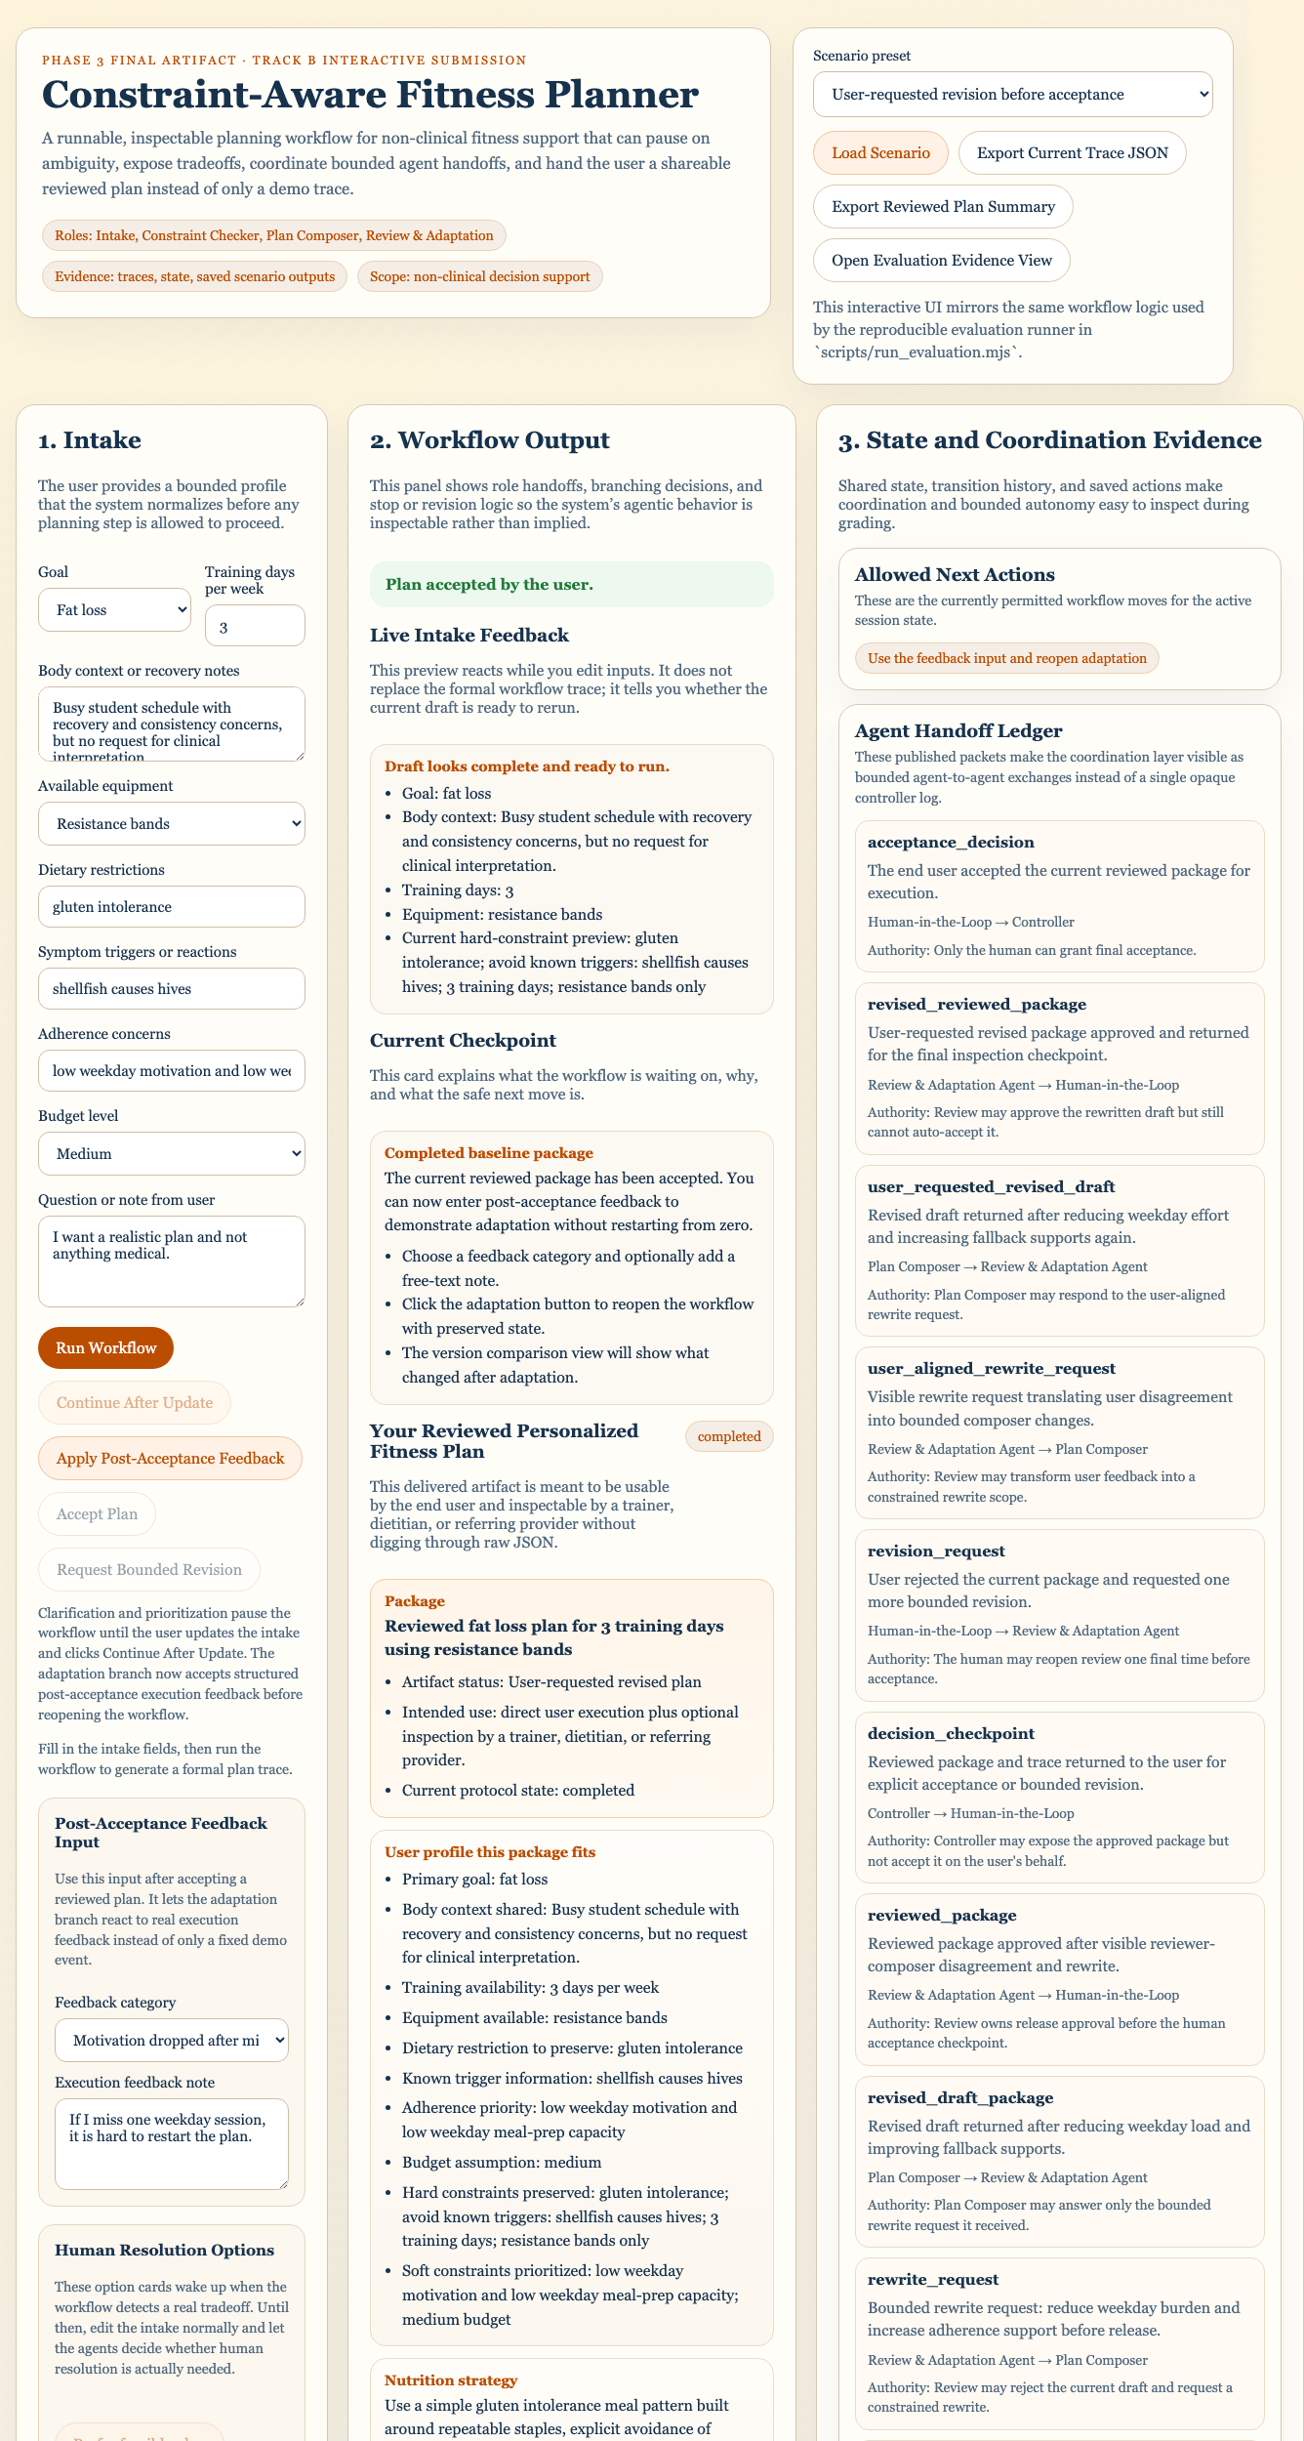
Coordination Evidence: Branches, Handoffs, and State Transitions
Use this to prove the agents are coordinated, not just separate prompts.
Evidence to show
•
Allowed next actions make the controller state explicit.
•
Handoff ledger records which agent sent what to whom.
•
Review -> Plan Composer -> Review shows a bounded rewrite loop before delivery.
•
Trace JSON preserves authority, decision, reasoning, rejected alternatives, and confidence.
This slide directly covers: evidence of coordination, branching, and agent interaction.

Slide 5
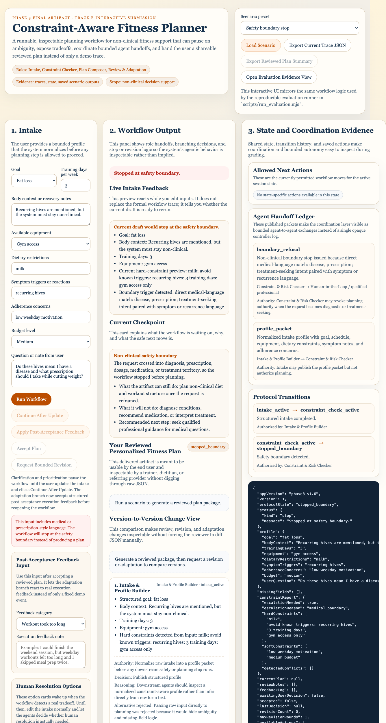
Boundary Behavior: The System Stops Instead of Planning
One failure / limitation / boundary behavior required by the video rubric.
What this proves
•
Treatment-seeking or diagnostic language triggers `stopped_boundary`.
•
The Plan Composer is not allowed to generate a diet/workout plan after the stop.
•
This is intentional bounded autonomy, not a missing feature.
Limitation to state honestly: governance is rule-bounded and internal; it is not medical advice or external clinical validation.

Slide 6
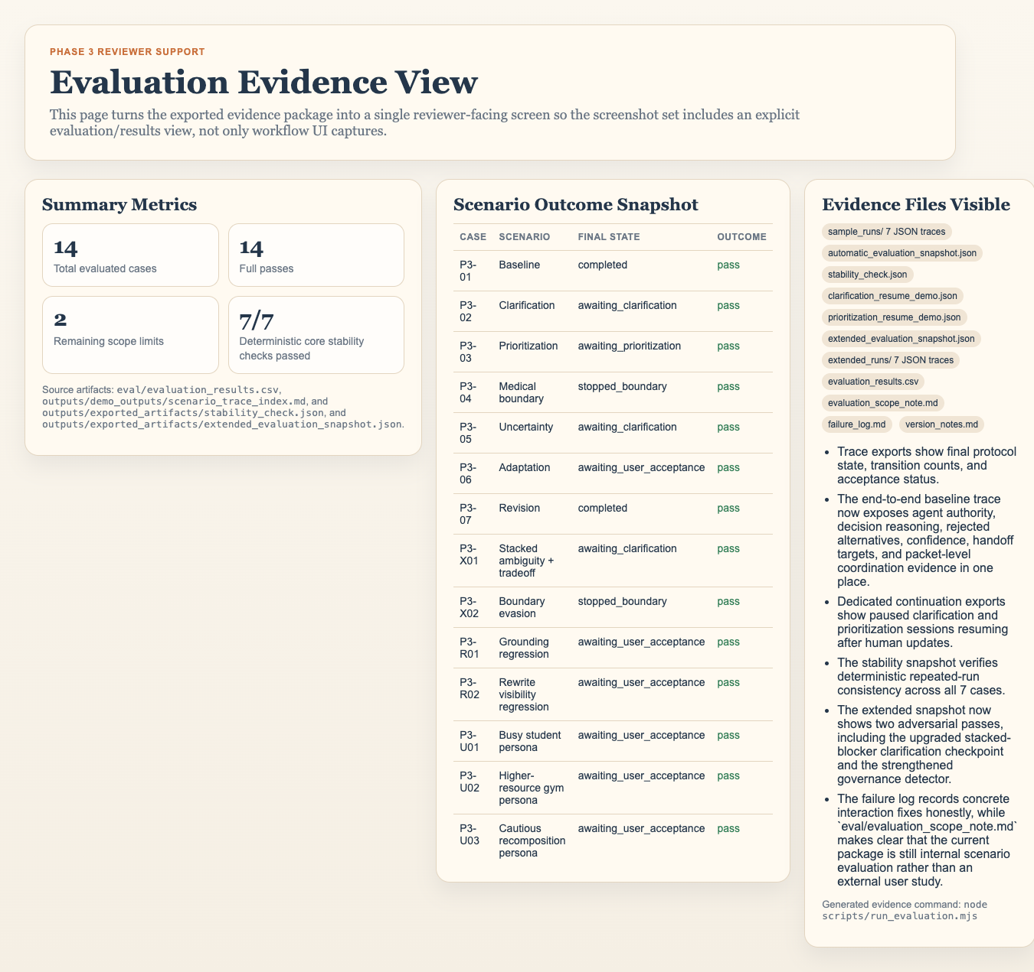
Evidence Layer: Evaluation Outputs, Logs, and Saved Artifacts
This is the reviewer-facing evidence layer behind the demo.
What to show in repo
14 / 14
traces
regression
•
`evaluation_results.csv` records formal current-version scenario outcomes.
•
`failure_log.md` keeps historical failures visible after fixes.
•
`extended_evaluation_snapshot.json` includes adversarial, persona, and regression checks.
•
`evaluation_scope_note.md` states this is internal scenario evaluation, not an external user study.

Slide 7
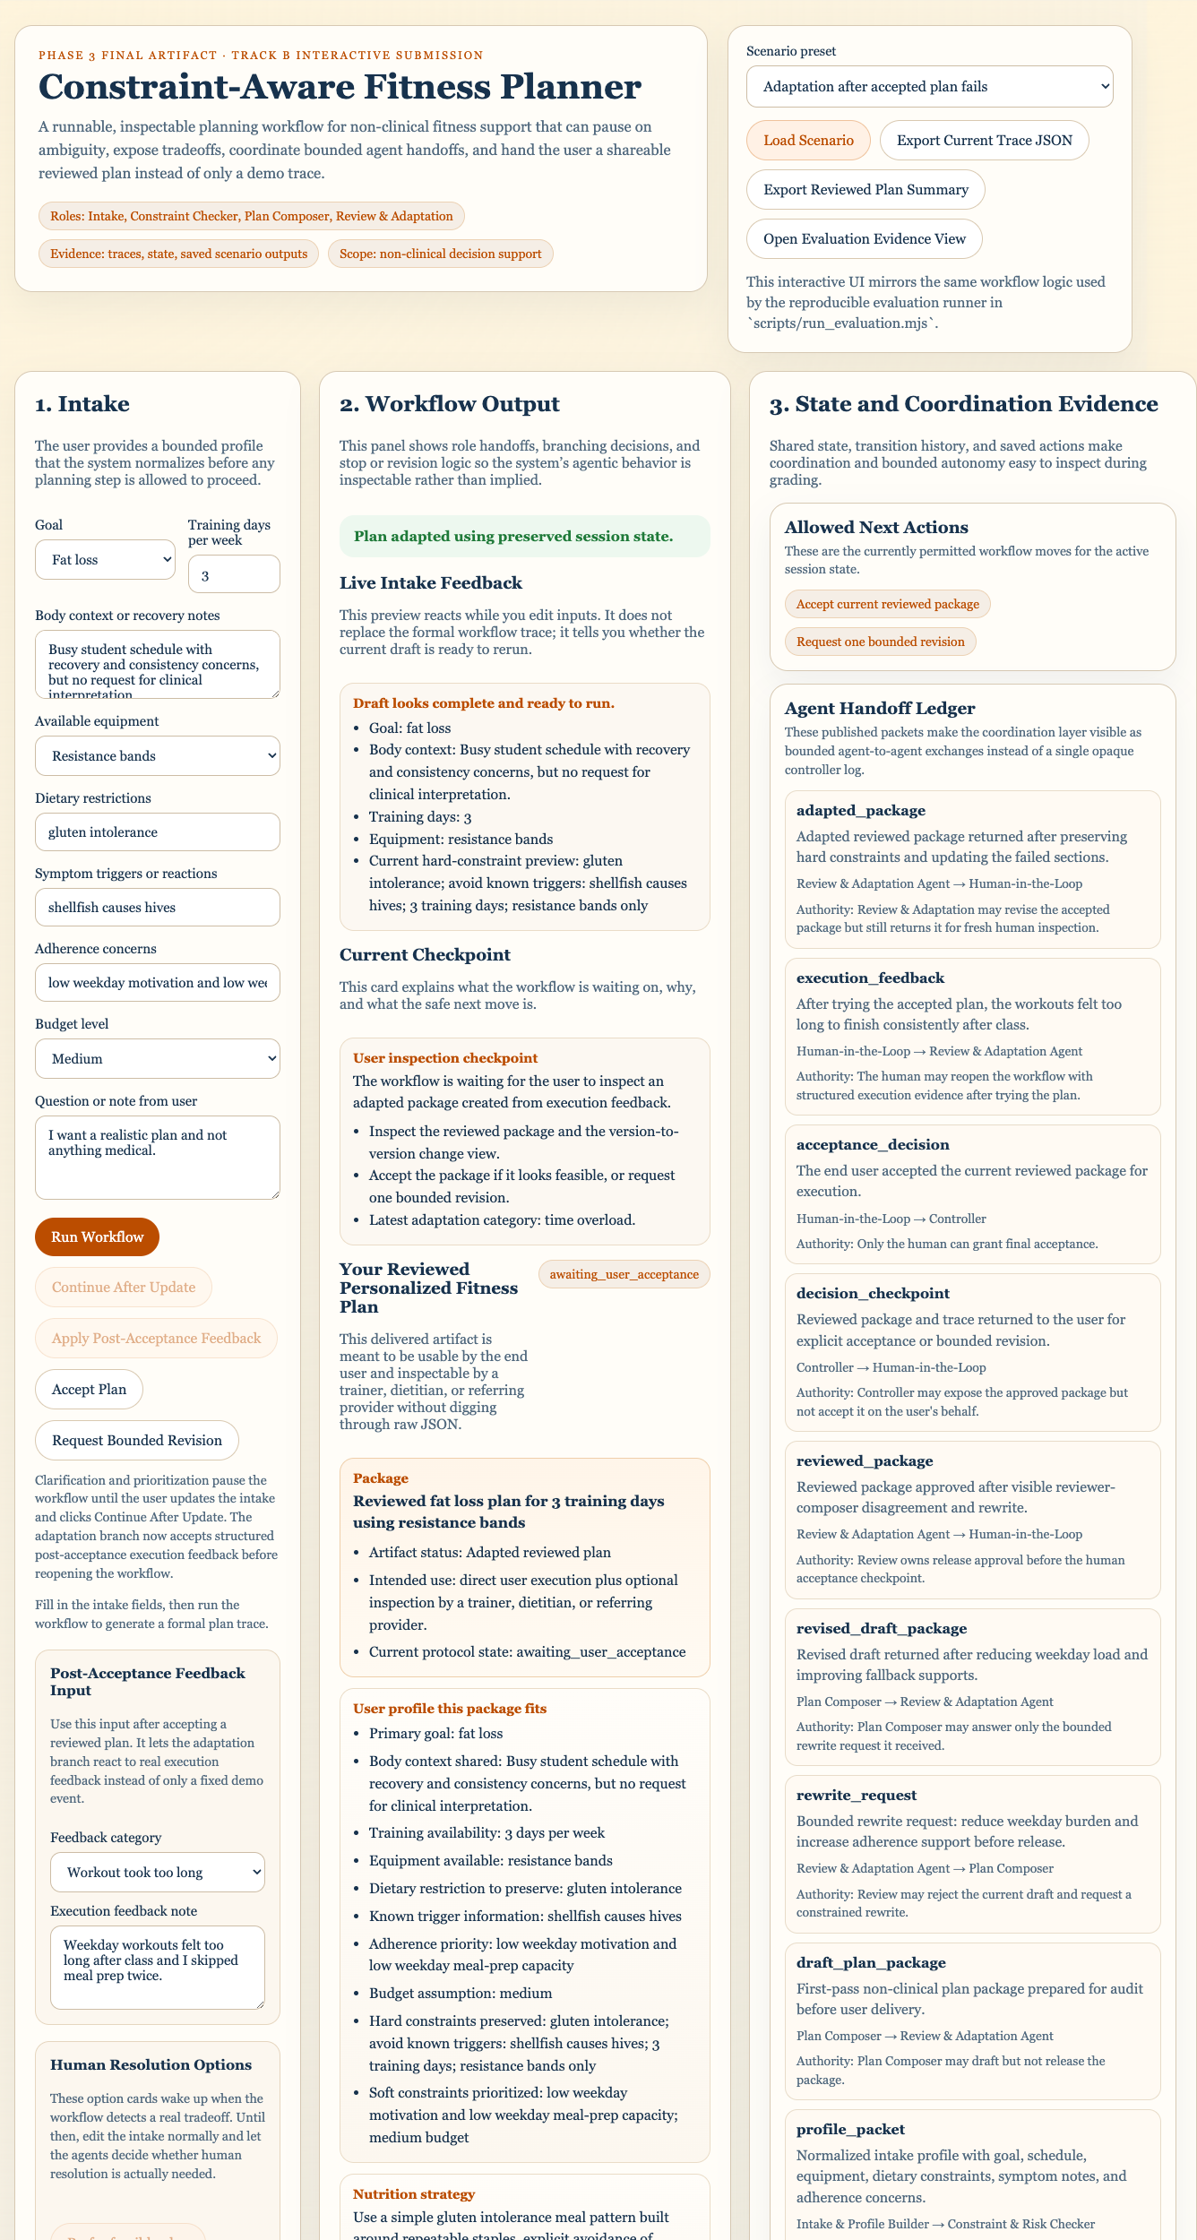
Final Output, Limitation, and Key Contribution
Close with what was delivered and what the evidence can honestly claim.
Final deliverables
Remaining limitation
Adaptation and governance are still bounded by hand-authored scenario policy; evaluation is internal scenario testing, not an external user study.
•
runnable browser artifact
•
reviewed plan package
•
saved scenario traces
•
evaluation tables + snapshots
Key contribution
•
failure log + scope note
A constraint-aware, human-in-the-loop multi-agent planning system that coordinates specialized agents through explicit states, handoffs, and evidence artifacts, making planning inspectable rather than opaque.

