Slide 1
Constraint-Aware Fitness Planner: Multi-Agent Planning System
A non-clinical planning workflow for diet + workout support under real-world constraints.
What I Did / Project Goal
Why Multi-Agent
Built a constraint-aware fitness planning system focused on diet + workout planning under real-world constraints.
Single Agent
Separated Roles
•
health conditions / symptom triggers such as urticaria
•
food restrictions, schedule limits, budget limits
•
Intake != constraint checking != planning != review
•
adherence challenges and post-acceptance replanning
•
state machine decides when to clarify, stop, revise, adapt
•
auditable traces support process-based evaluation
Key idea:
decide feasibility, safety, and sustainability before planning.
Final evidence: 14/14 latest-version passes · 7/7 stability reruns · saved traces + failure log

Slide 2
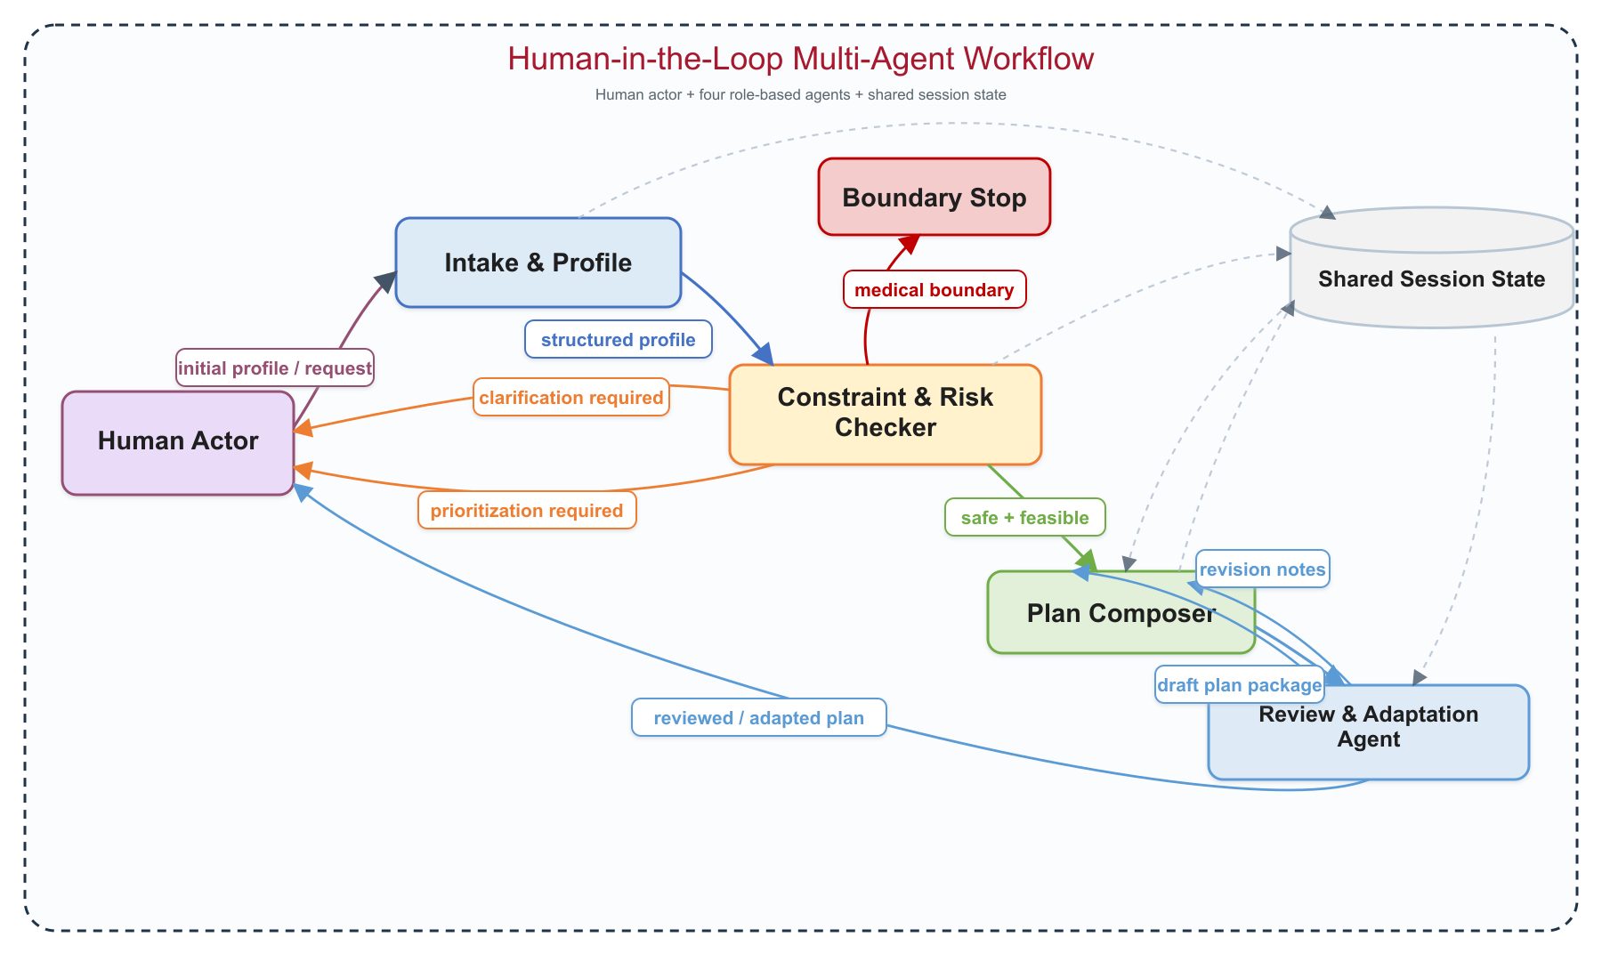
System Architecture and Workflow
Agents coordinate through structured artifacts and state transitions. The human-in-the-loop provides missing information, preference signals, and real-world feedback, which the system uses to guide safe, constraint-aware planning and adaptation.

Slide 3
Key Insights / What I Learned
Multi-agent value came from coordination logic, not from simply using more prompts.
01
Agent != multiple prompts
needs explicit roles, handoffs, and decision authority
02
State machine is critical
enables clarification loops, safe stopping, and adaptation
03
Constraints are the core difficulty
vague inputs, conflicting goals, and unrealistic plans must be checked before planning
04
Human-in-the-loop is necessary
the system should not guess preferences or resolve tradeoffs automatically
05
Evaluation must be process-based
did it clarify, detect conflict, respect safety, and preserve state?
Final evidence lens
workflow correctness + trace evidence + failure analysis,
not only output quality
Process-based evidence from the final artifact:
branch correctness · safety boundary behavior · human handoff visibility · state preservation · exported traces

