Slide 1
Bioinformatics （生物信息学） BME1063.01
张力烨

Slide 2

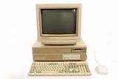
Introduction about myself
2003-2007 SJTU, Biotechnology (B.S.)
2007-2012 PSU, Cell and Developmental Biology (Ph.D)
2012-2017 BUMC, Computational Biomedicine (Postdoc)

Slide 3
Introduction about 助教
戴晓敏
吕婧雯
OFFICE HOUR:
2 TIMES PER WEEK (1 HOUR), ROOM: L516
Time announced this week/next week
 | 1 | 2 | 3 | 4 | 5
9-10
10-11
1-2
2-3
3-4

Slide 4
Introduction about yourself (around the table for registered student only)
Introduce your name?
Why you select this class?
What you want to get from this class?

Slide 5
week1.class1
1. Introduction about the scoring system
2. Introduction about the project
3. class organization
4. Introduction about the course outline

Slide 6
Introduction about Scoring system overall
45% Project (one project per student )
30% final Exam (开卷）
20% Homework (5 times）
5% Class Participation

Slide 7
Introduction about Scoring system for Project (45%)
15% Project reports (manuscript format not a report)
Abstract, Introduction, results, discussion, method, reference
10% by the evaluation of PI you worked with [You will not see the final score for this section]
20% by the evaluation of your presentation
10% of scoring by the evaluation of the class [we will not see this]
10% of scoring by me & teaching assistant

Slide 8
Rationale about Scoring system for Project (45%)
15% [Practice Writing Skills]
10% [Practice working within a lab]
20% [Practice presentation skills]
10% by peers (Practise how to judge other people’s work)
10% by me & teaching assistant

Slide 9
Introduction about Scoring system for Final Exam (30%)
10% Solve problem
(with coding)
10% Solve problem
(with coding) [Will be related to Homework]
10% [Open question]
Research strategy proposal (for 2 problems) you just need to write down what is your plan to solve the problems
+5% bonus questions (you will see)

Slide 10
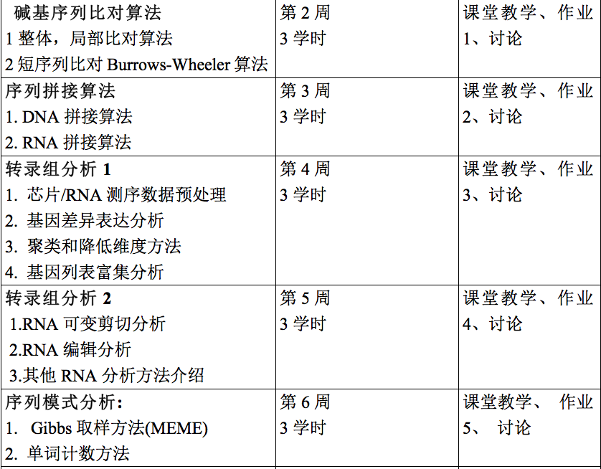
Introduction about Scoring system for Homework (20%)
5 Homework (the top four of five scores will be used, and you can just do 4 homework if you want)
Submit code/
Commands to TA
Can reproduce your
work
Each Homework
is due in one week
12:59pm Wed

Slide 11
Introduction about Scoring system for Homework (5%)
Correct results (3%)
Code style/description (2%)
Novelty/Creativity (bonus up to 5%)

Slide 12
Introduction about Scoring system for Class Participation (5%)
Ask a decent question & add a decent comment/answer (0.5%)
Ask a good question & comment & answer (1.0%)
Total up to 10% to promote active participation

Slide 13
week1.class1
1. Introduction about the scoring system
2. Introduction about the project
3. class organization
4. Introduction about the course outline

Slide 14
13 individual projects
1. You will need to do it by yourself
2. You can discuss your project with others (outside of the PI lab) if the PI thinks it is ok, but you can always discuss about the technical details
3. You can come to office hours, class break and practice time for help and you can also ask help from the lab

Slide 15
13 individual projects (how to decide the project you will work with)
1. 双向选择 （确定课程项目）
2. 导师给我发邮件确定,cc确定的学生，然后学生也给我发邮件确认

Slide 16
For the students who audit the class
Contact me for project if interested
No office hour support provided

Slide 17
week1.class1
1. Introduction about the scoring system
2. Introduction about the project
3. class organization
4. Introduction about the course outline

Slide 18
3 class organization
Class 1: Lecture
Class 2: (2 types)
Practice & Help Trouble shooting problems
Students Presentation/Journal Club
Class 3: Lecture

Slide 19
week1.class1
1. Introduction about the scoring system
2. Introduction about the project
3. class organization
4. Introduction about the course outline

Slide 20
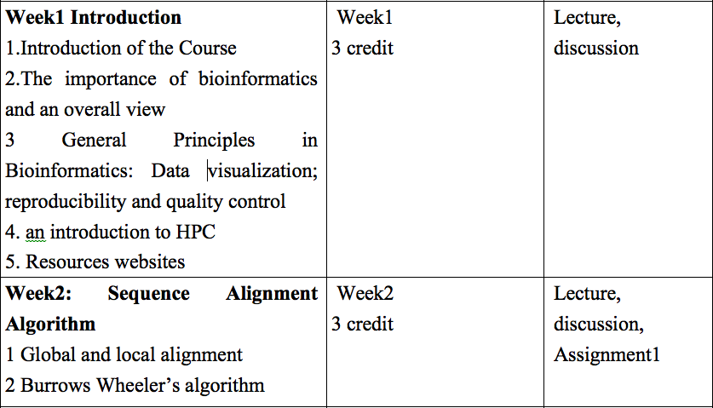
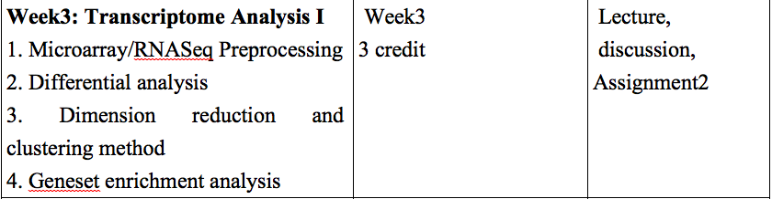

Slide 21
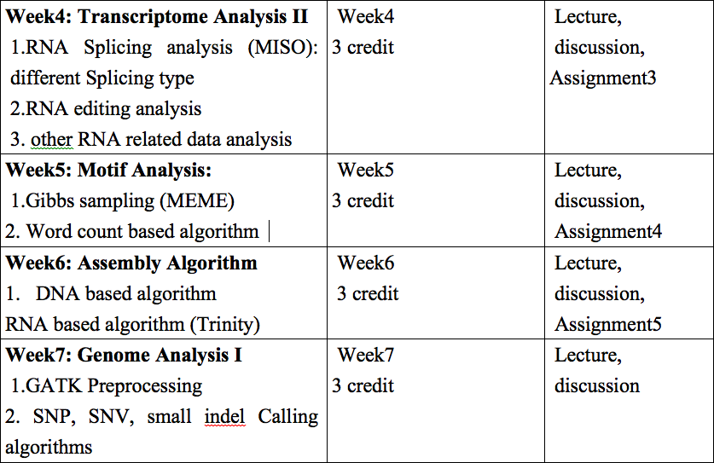

Slide 22
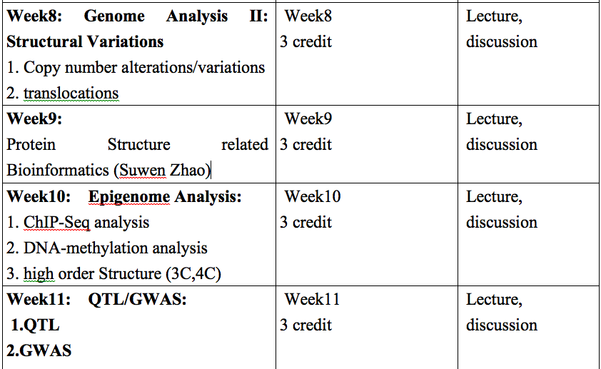

Slide 23
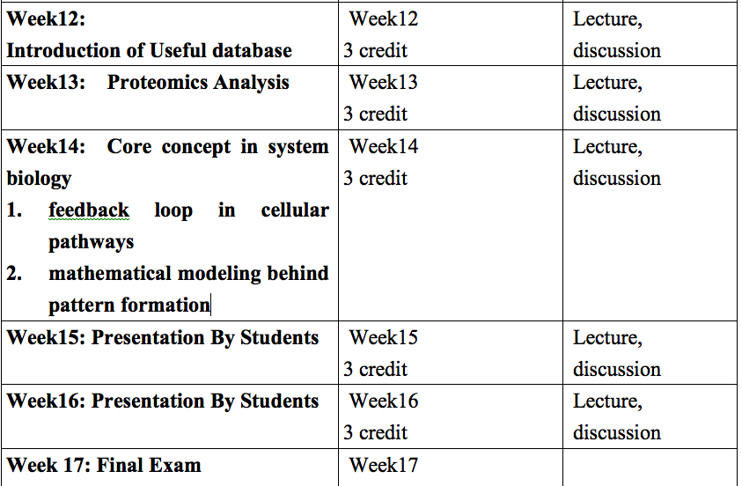

Slide 24
reference
书名：Bioinformatics and functional genomics 3rd edition
作者：Jonathan Pevsner
ISBN：ISBN-13: 978-1118581780
出版时间：2015年10月 [Taobao available]
书名：Practical computing for biologist 1sth edition
作者：Haddock Dunn
ISBN：ISBN-13: 978-0878933914
出版时间：2010年11月
1.1 MIT 课程 https://ocw.mit.edu/courses/electrical-engineering-and-computer-science/6-047-computational-biology-fall-2015/index.htm

