Slide 1
Bioinformatics （生物信息学） BME1063.01
张力烨

Slide 2
week1.class2
1. Introduction about the Computing Cluster

Slide 3
Why you need a computing cluster
Personal Computer can not handle the task
Centralized computer cluster is more Cost-effective

Slide 4
about your School Cluster account
8 cores (32 threads)
204G memory (total)
500G (if pass this limit, you need to contact PI to get more space) [it-support@shanghaitech.edu.cn]
Account will be terminated by the end of this semester

Slide 5
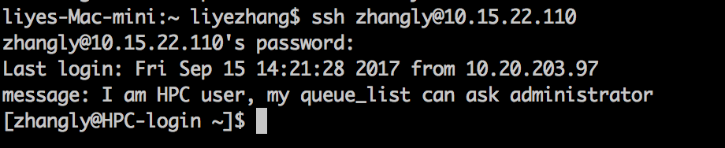
How to use Computer Cluster
1 login to the server using SSH in Mac&Linux

Slide 6
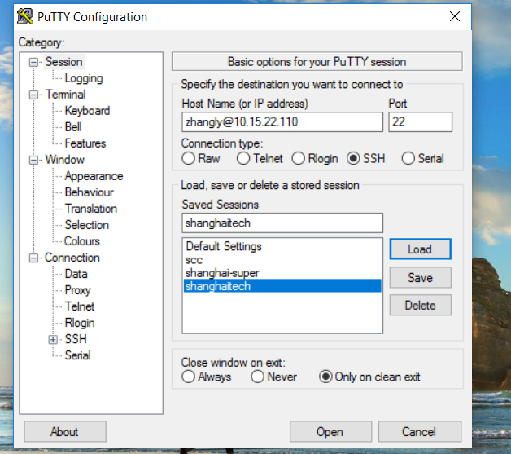
How to use Computer Cluster
1 login to the server using putty in Windows

Slide 7
Linux Command key commands
cd : control where you are
ls : see what is in there
mkdir : create a folder
rm : delete a file/folder
mv : move a file or a folder
cp : copy a file or a folder
more/less : view a text file
vi/nano : edit a text file
chmod: set permission open to different levels

Slide 8
Do it Yourself
1. create a folder named : “class1” and “shared” under your home folder, which is /public/home/xx/
2. enter the class1 folder you created
3. create a text file named by “your name”.txt
4. copy the file /public/home/zhangly/class/class1/SRR5120801.fastq to your class1 folder
5. edit the text file (created in step3) to include a favorite English quotes you have
6. copy the text file to /public/home/zhangly/class
7. delete your original text file in your folder
8. rename your folder name “class1” to “class1_#yourfullname#”
9. move your folder “class1_#yourfullname#” into /public/home/zhangly/class/class1
10. set your permission of the “shared” folder so that everyone can see it/read it/run it but not write it.
11. figure out how much space you have used? (figure out which command you should use)

Slide 9
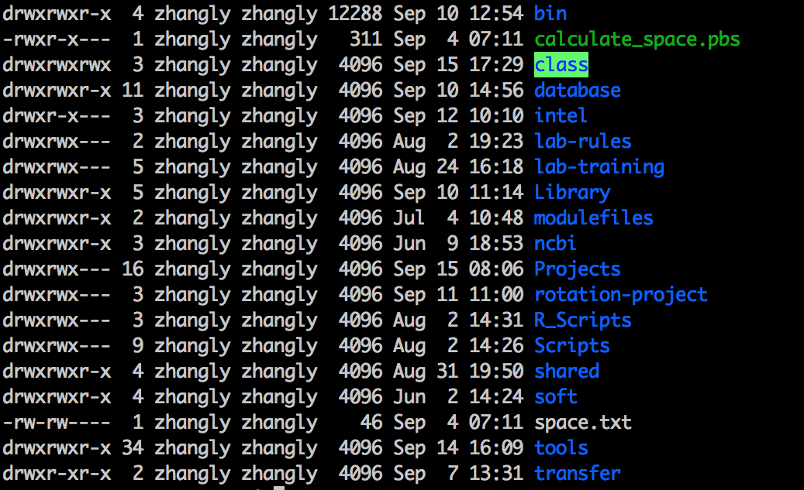
Different levels of permission for different data

