Slide 1
Bioinformatics （生物信息学） BME1063.01
张力烨

Slide 2
week1.class2
1. Introduction about the Computing Cluster:
Setting up the environmental variable

Slide 3

Start to run programs on the Server
When you type in a command, the system looks for the files to execute the command in your “environmental variables”
Try to type in : fastqc

Slide 4
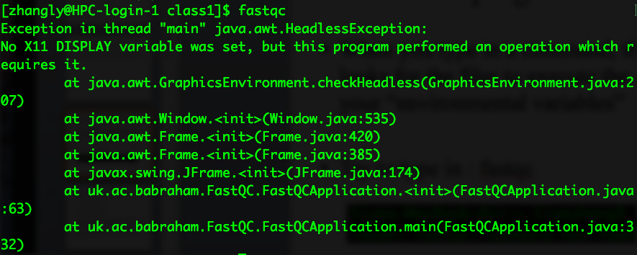
If fastqc (or program X) in your environmental variable path

Slide 5
Your task is to setup your environmental variable path
1. You need to add /public/home/zhangly/bin
into your environmental variable so that you can run fastqc directly on your command line
( .bash_profile)
2. finish running fastqc on the fastq file you copied from the last section.

