Slide 1
Bioinformatics （生物信息学） BME1063.01
张力烨

Slide 2
week1.class3
1. Introduction about the Computing Cluster:
File transfer: Ftp

Slide 3
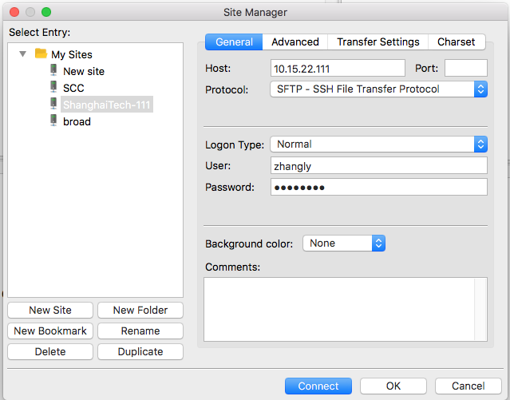
Common ftp softwares
FileZilla
Resume
function

Slide 4
Do it yourself
1. transfer the fastq file you copied to your folder to your own computer

Slide 5
week1.class3
1. Introduction about the Computing Cluster:
Qsub system

Slide 6
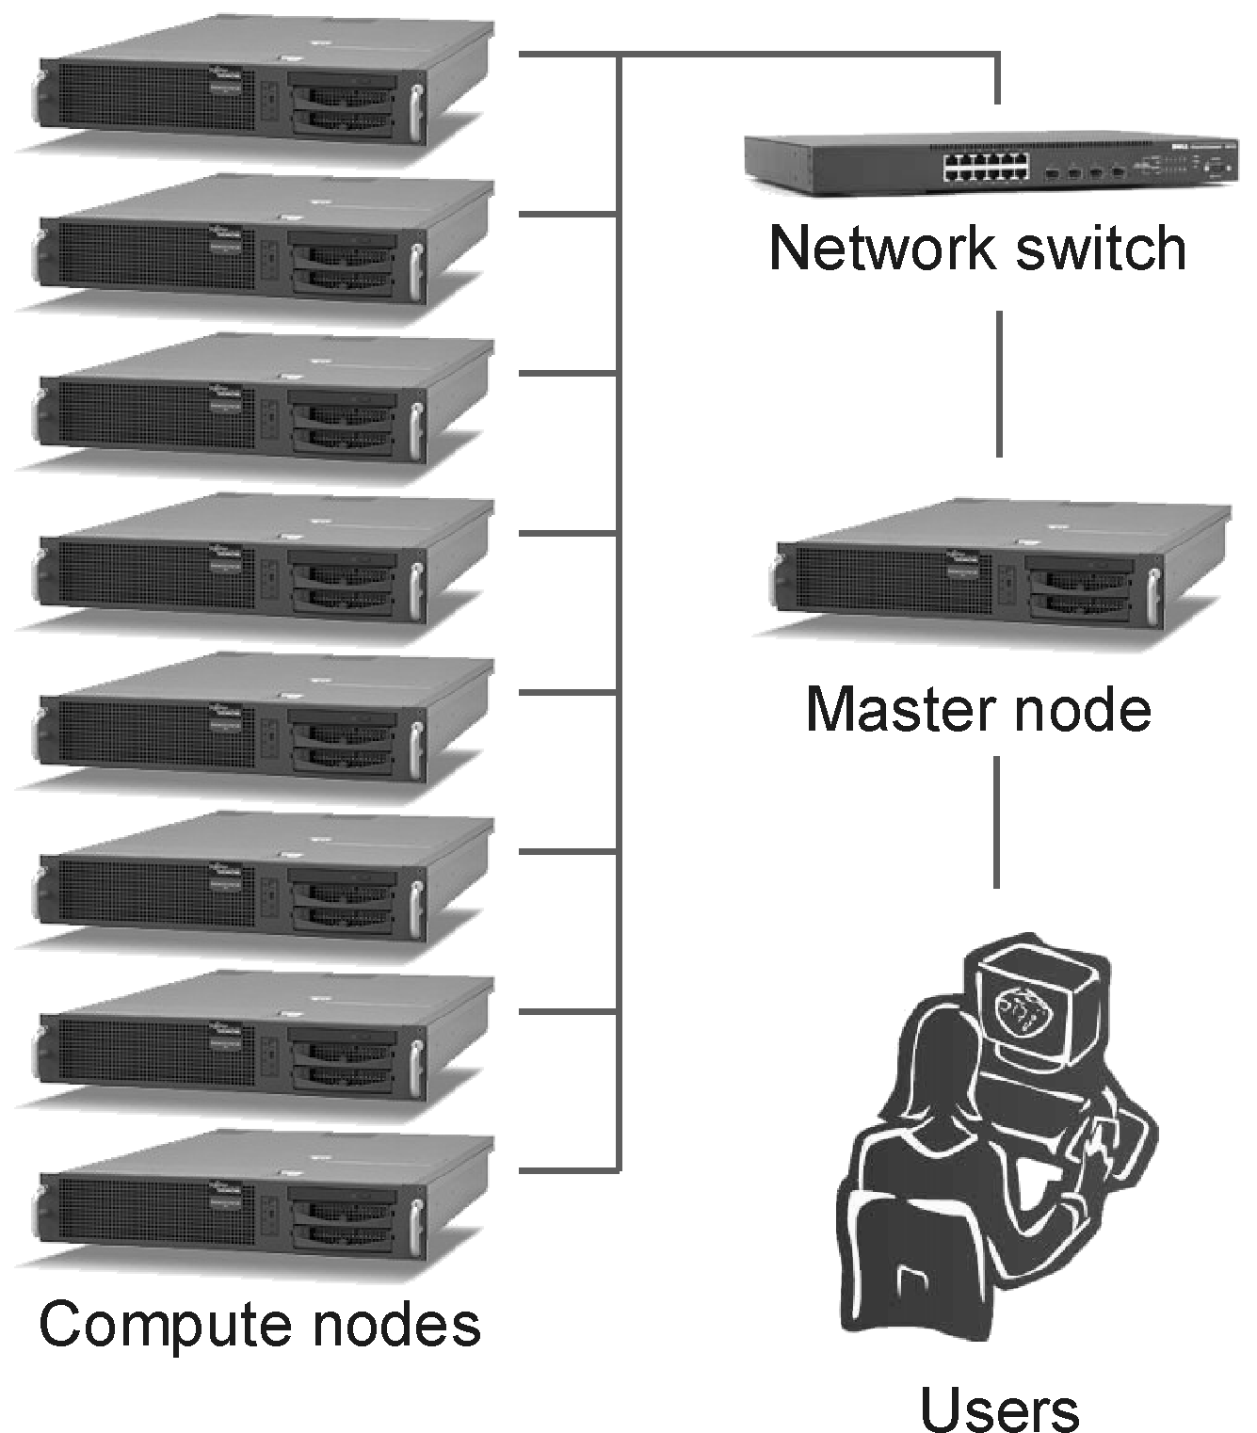
Why do we need a qsub queue system?

Slide 7
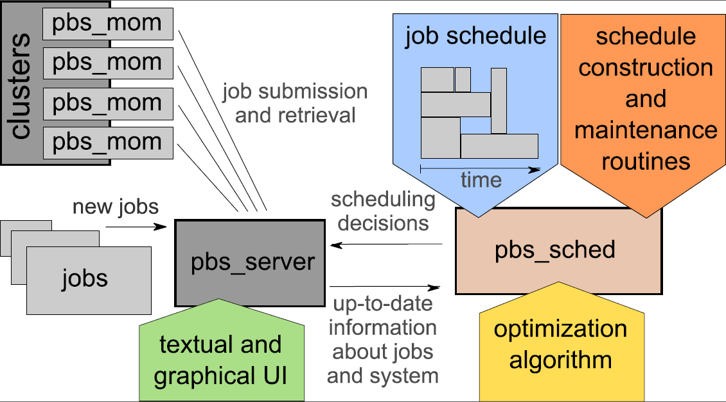
qsub queue system optimize the usage

Slide 8
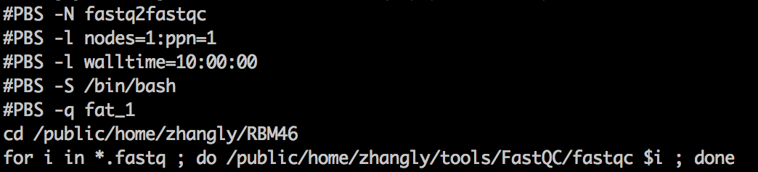
How to generate a qsub file
-N (the name of qsub job)
-l nodes=1:ppn=X (multiple threads,parallel)
-l walltime=HH:MM:SS (hour;minute;second), upper bound time for your qsub job
-S /bin/bash (just use this)
-q swxx_1 (this is your queue type you belong)

Slide 9
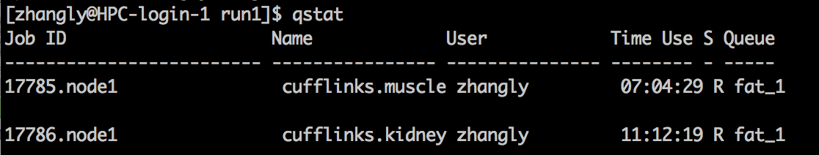
How to check the status of your job
Submit a job:
qsub your_job.pbs
Delete the job you do not want:
qdel XX(JobID, for example: 17785.node1 in here)

Slide 10
Do it yourself
1. run the fastqc on the fastq file using the qsub system

