Slide 1
Bioinformatics （生物信息学） BME1063.01 Lecture2 Class3 (Hands on)
张力烨
Notes:
Note: do not distribute the slides

Slide 2
week2.class3
1. qsub system
2. how to install software on the server
3. download data directly to the server or upload data directly from server
3. samtools
4. bwa alignment/Blast
5.

Slide 3
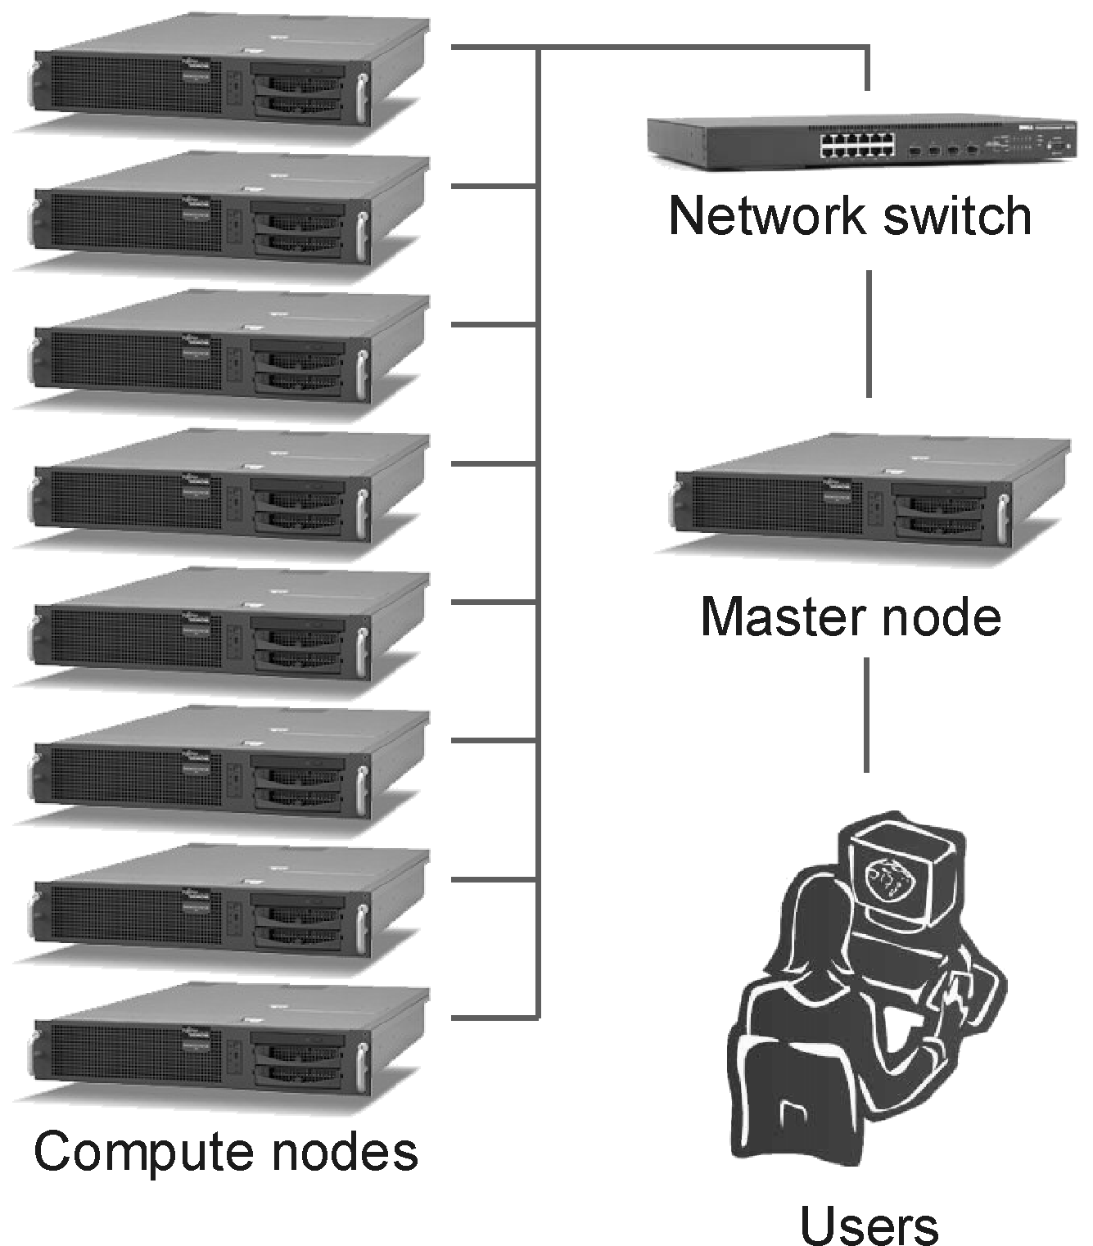
Why do we need a qsub queue system?
Notes:
Multiple users have to use it, you need to coordinate

Slide 4
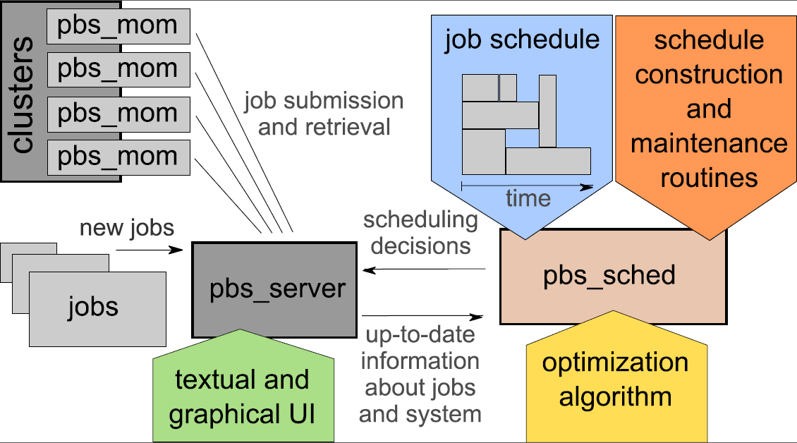
qsub queue system optimize the usage
Notes:
1. Why you can specify the time will be important

Slide 5
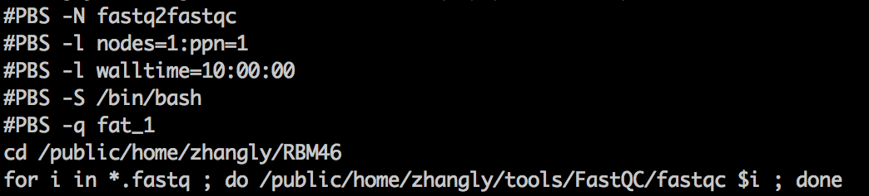
How to generate a qsub file
-N (the name of qsub job)
-l nodes=1:ppn=X (multiple threads,parallel)
-l walltime=HH:MM:SS (hour;minute;second), upper bound time for your qsub job
-S /bin/bash (just use this)
-q swxx_1 (this is your queue type you belong)
Notes:
1. There are some apps can work on multiple cores as well.

Slide 6
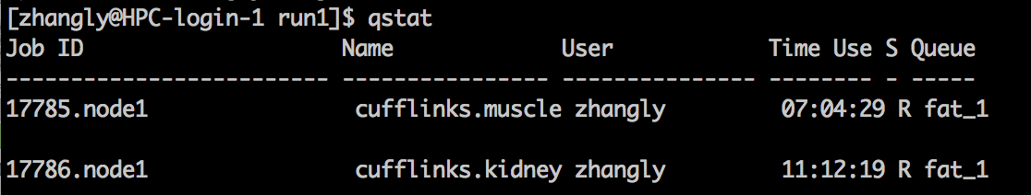
How to check the status of your job
Submit a job:
qsub your_job.pbs
Delete the job you do not want:
qdel XX(JobID, for example: 17785.node1 in here)

Slide 7
Trouble shooting your qsub job
Two output will be generated:
Qsub_name.oXXXXX
Qsub_name.eXXXXX
If everything OK
Qsub_name.eXXXX is empty
Qsub_name.oXXXX will record what will be shown in the screen when you run the commands
Otherwise:
The error message can be output into the Qsub_name.eXXXX file

Slide 8
Do it yourself
1. run the fastqc on the fastq file using the qsub system

Slide 9
week2.class3
1. qsub system
2. how to install software on the server
3. download data directly to the server or upload data directly from server
3. samtools
4. bwa alignment/Blast
5.

Slide 10
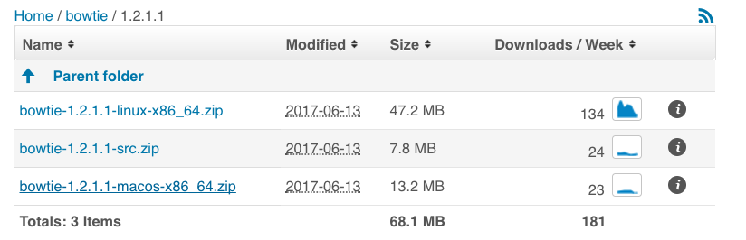
Download pre-compiled version if available
1. this is the case for several cases
For example:
Notes:
Which version you should use? Concern: what is already processed.. // general the later the better. // Also the annotation files has to be consistent.
If all your data is processed in one version and you try to use processed data from another version.

Slide 11
Compile the program if needed (common 三板斧）
./configure (generate the make file based on your software environment, sometimes optional) [use prefix to specify installation path]
make (compile the code to executable files)
make install [Optional] (sometimes, you can just copy the compiled file to your folder)
Notes:
Which version you should use? Concern: what is already processed.. // general the later the better. // Also the annotation files has to be consistent.
If all your data is processed in one version and you try to use processed data from another version.

Slide 12
Install the Python based Tools
In Python2.7.10+ you can use pip to install package
pip install *** --prefix=/Python_Library_path
In my case: the path is /public/home/zhangly/Library/Python2.7/
Under this folder: the bin subfolder contain executable files
Under this folder: the lib subfolder contains the python modules in py code
My PYTHONPATH includes: /public/home/zhangly/Library/Python2.7/lib/python2.7/site-packages
Check your PYTHONPATH: echo $PYTHONPATH
Notes:
Which version you should use? Concern: what is already processed.. // general the later the better. // Also the annotation files has to be consistent.
If all your data is processed in one version and you try to use processed data from another version.

Slide 13
Install the R package
You can install them directly as R will install the packages to your local path
Notes:
Which version you should use? Concern: what is already processed.. // general the later the better. // Also the annotation files has to be consistent.
If all your data is processed in one version and you try to use processed data from another version.

Slide 14
Install Programm todo1
1. compile the samtools 0.1.9 and run it
2. Install a Python module that you might need to use. (Hints: You need to set your python path properly, try to install MISO: http://miso.readthedocs.io/en/fastmiso/ if you have no idea what to install)
3. Install a R package of your choice (try to install DESeq2 if you have no idea which to install)
Notes:
Fig. 1. (A) Precision and recall by amount of variation for 4 datasets, by polymorphism: (number of SNPs, Indel size). (X, Y): reads/read pairs containing X SNPs, where the larges indel is of size Y, as well as errors. (B) Running times (in min) of each tool on 6 × 10<sup>6</sup> reads from each dataset while utilizing an 8 core 3.0 GHz Intel Xeon machine with 16 GB RAM.
14

Slide 15
week2.class3
1. qsub system
2. how to install software on the server
3. download data directly to the server or upload data directly from server
3. samtools
4. bwa alignment/Blast
5.

Slide 16
wget: try to download software/data directly to your server without going through ftp
Notes:
Fig. 1. (A) Precision and recall by amount of variation for 4 datasets, by polymorphism: (number of SNPs, Indel size). (X, Y): reads/read pairs containing X SNPs, where the larges indel is of size Y, as well as errors. (B) Running times (in min) of each tool on 6 × 10<sup>6</sup> reads from each dataset while utilizing an 8 core 3.0 GHz Intel Xeon machine with 16 GB RAM.
16

Slide 17
week2.class3
1. qsub system
2. how to install software on the server
3. download data directly to the server or upload data directly from server
4. samtools
4. bwa alignment/Blast
5.

Slide 18
Samtools todos
1. use samtools view to check the any alignment results from toy.bam
2. try to understand cigar string and flag
3. use online version of Blast to see if the alignment was perform correctly
4. use samtools tview to view the data on the gene “CTCF”
Notes:
18

Slide 19
week2.class3
1. qsub system
2. how to install software on the server
3. download data directly to the server or upload data directly from server
4. samtools
5. bwa alignment/Blast

Slide 20
Do it yourself BWA/samtools
Generate a qsub file to run BWA alignment against mm10/hg38 based on the BWA description and generate a sorted BAM and SAM file, based on alignment statistics tell me the data is from which species
Hits: use multiple threads to speed up the process
Notes:
Fig. 1. (A) Precision and recall by amount of variation for 4 datasets, by polymorphism: (number of SNPs, Indel size). (X, Y): reads/read pairs containing X SNPs, where the larges indel is of size Y, as well as errors. (B) Running times (in min) of each tool on 6 × 10<sup>6</sup> reads from each dataset while utilizing an 8 core 3.0 GHz Intel Xeon machine with 16 GB RAM.
20

Slide 21
Do it yourself blastn
Use “head” command to extract first 3 sequencing reads and use local blastn to perform blast against hg38 (database ready)
Notes:
21

Slide 22
Backup Slides

Slide 23
Install the Python based Tools
For all Python2 you can use pip to install package
python setup.py build
Python setup.py install –prefix=//
Notes:
Which version you should use? Concern: what is already processed.. // general the later the better. // Also the annotation files has to be consistent.
If all your data is processed in one version and you try to use processed data from another version.

