Slide 1
Bioinformatics （生物信息学） BME1063.01 Lecture3 Class1
张力烨
Notes:
Note: do not distribute the slides

Slide 2
week3.class1
1. Introduction about the transcriptome
2. Introduction about the alignment algorithm

Slide 3
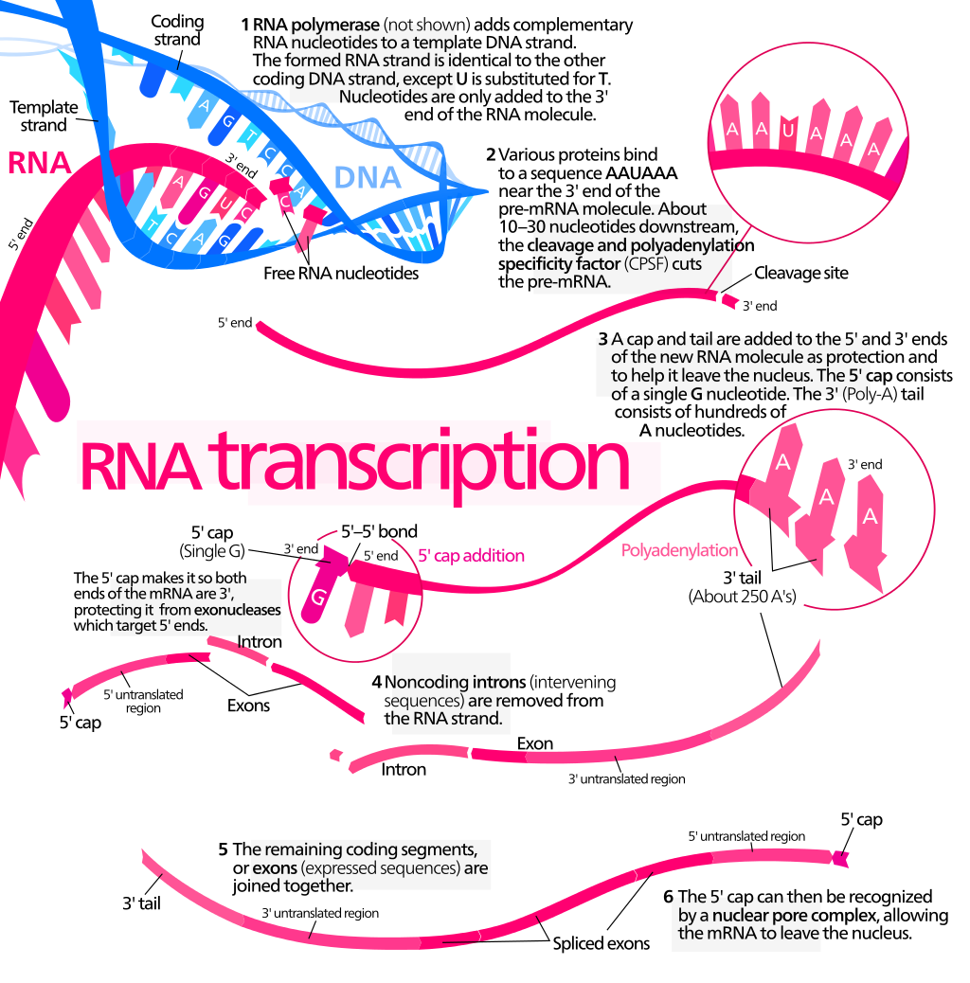
Classical mRNA transcription
From wiki

Slide 4
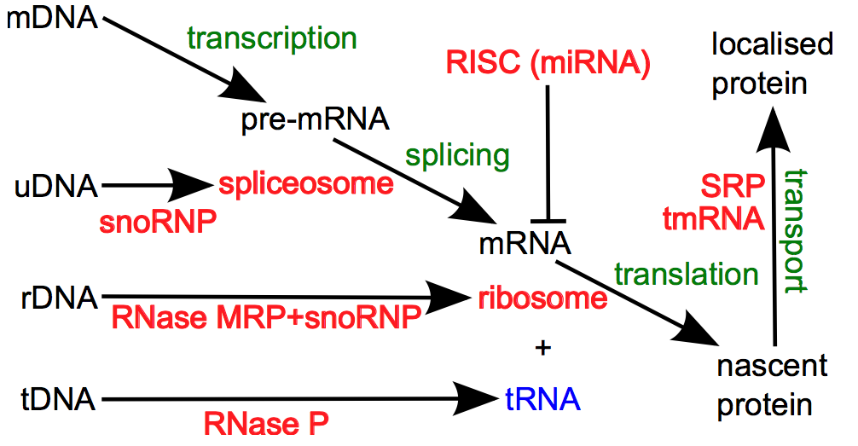
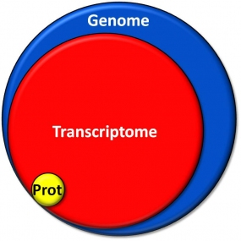
Complexity in transcriptome universe
From dkfz.net
From wiki

Slide 5
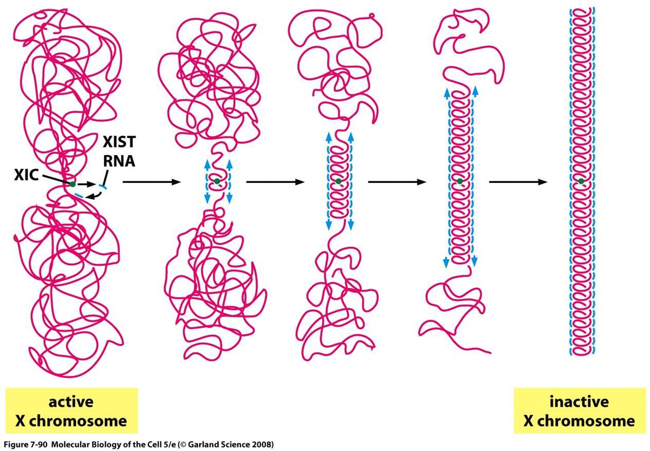
Power of non-coding RNA(Xist as an example)

Slide 6
week3.class1
1. Introduction about the transcriptome
2. Introduction about the array and sequencing platform

Slide 7
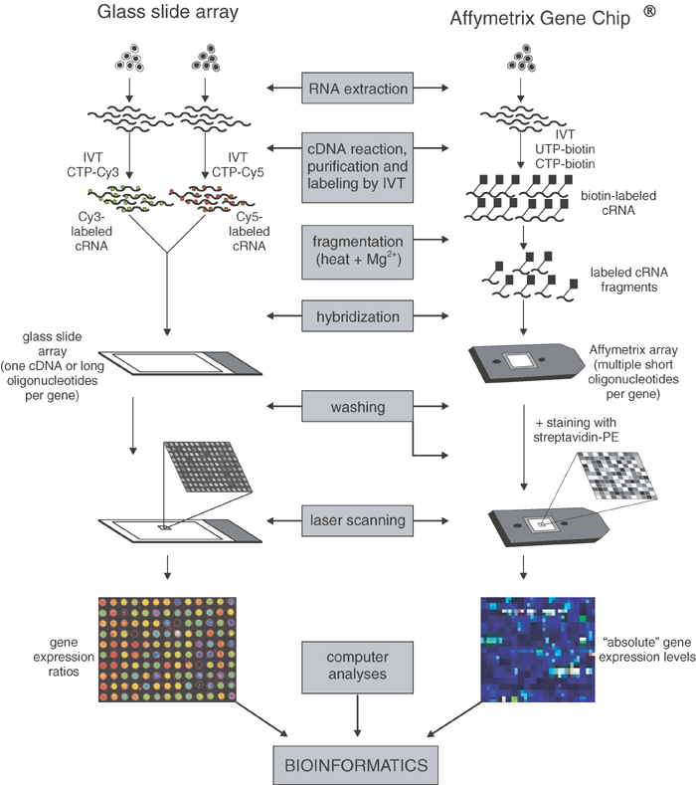
Different versions of microarray
Staal et al. Leukemia 2003
Notes:
The major problem with dye swap techonology

Slide 8
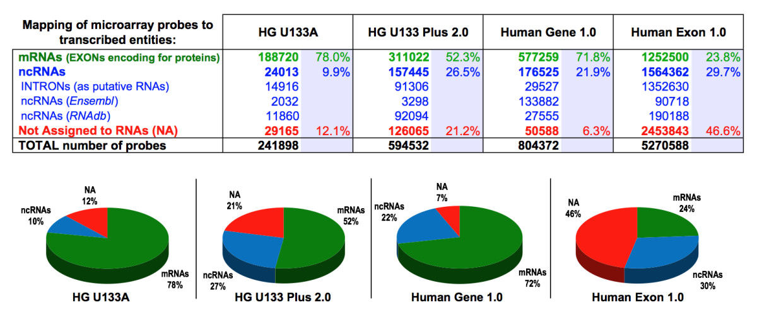
Key question: match probe to genes
Risueno et al, BMC Bioinformatics 2010
Notes:
4 bits (coding) can we have just 2 bits (A-T or C-G?) and why?
Too unstable or too stable (potential problem) ? G-quadruplex
The DNA is similar to 1,2,3,4 but keep in mind there its physical/chemical properties

Slide 9
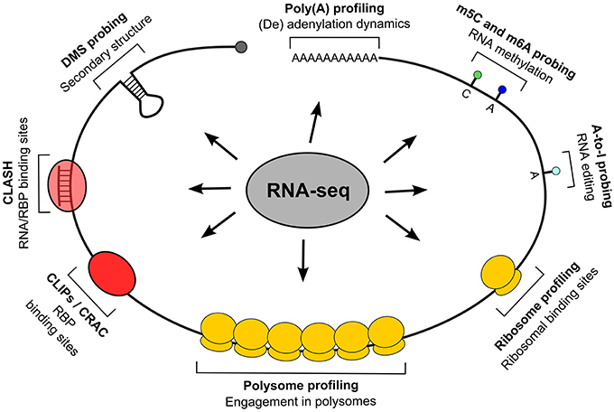
Customized to examine different aspects of transcriptome
Dassi et al, frontier in Cell and Developmental Biology 2014
Notes:
4 bits (coding) can we have just 2 bits (A-T or C-G?) and why?
Too unstable or too stable (potential problem) ? G-quadruplex
The DNA is similar to 1,2,3,4 but keep in mind there its physical/chemical properties

Slide 10
nanoString platform
Notes:
4 bits (coding) can we have just 2 bits (A-T or C-G?) and why?
Too unstable or too stable (potential problem) ? G-quadruplex
The DNA is similar to 1,2,3,4 but keep in mind there its physical/chemical properties

Slide 11
week3.class1
1. Introduction about the transcriptome
2. Introduction about the array and sequencing platform
3. Common Preprocessing of microarray data

Slide 12
What is Microarray data pre-processing and why we need to do it
Normalize the probe signal intensity
Background correction
Normalization (across arrays)
Probe level intensity calculation
Probe set summarization

Slide 13
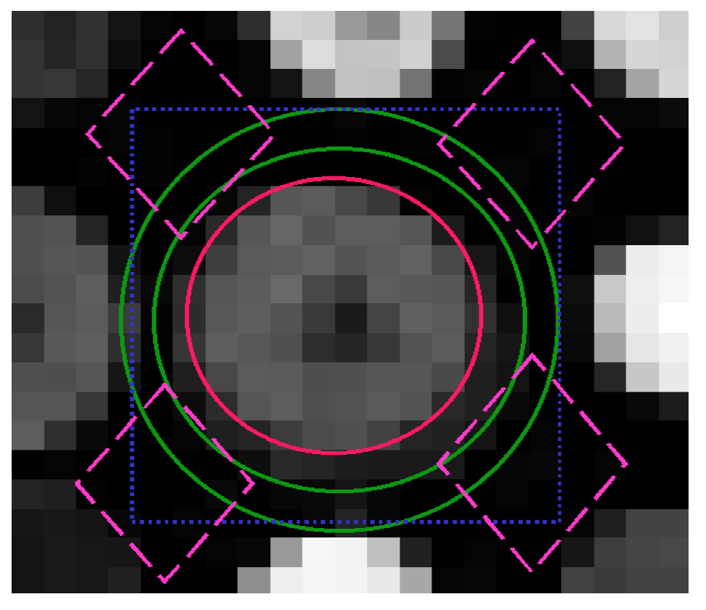
Local background
Slides from Benno Putz

Slide 14
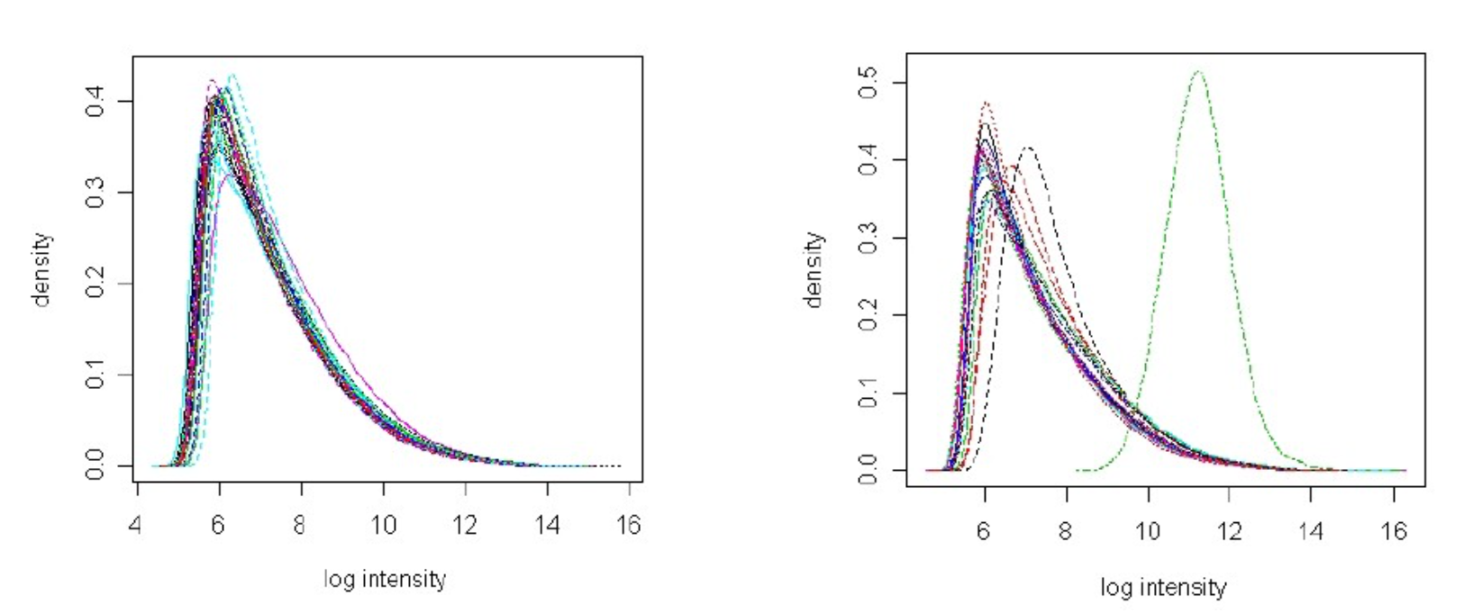
Signal intensity can vary across arrays

Slide 15
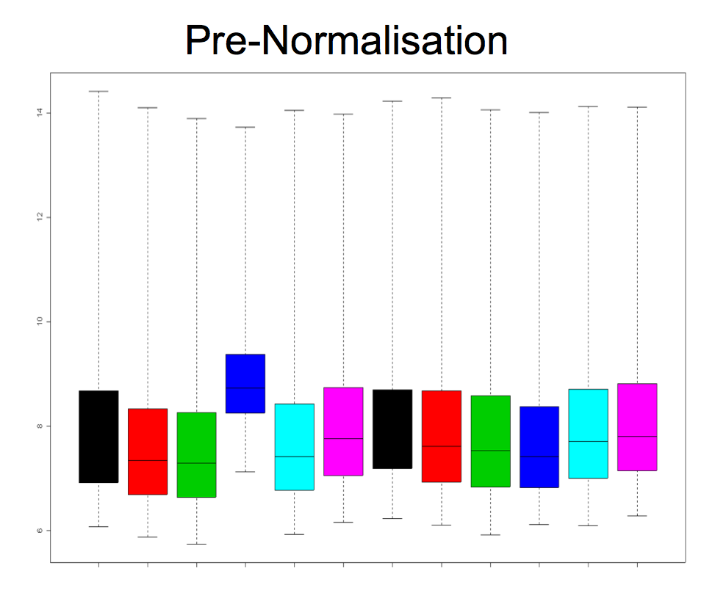
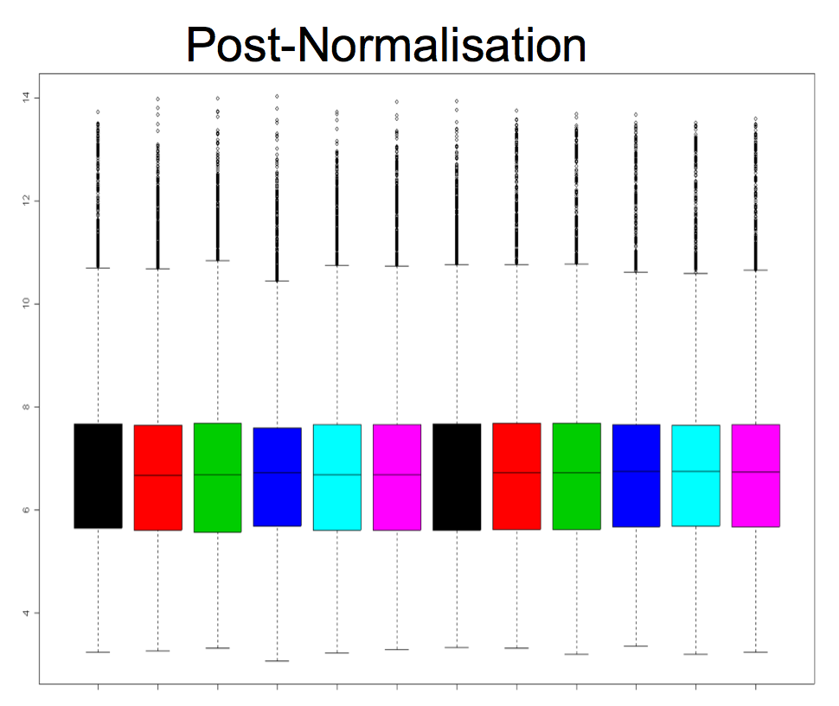
Normalization across arrays

Slide 16
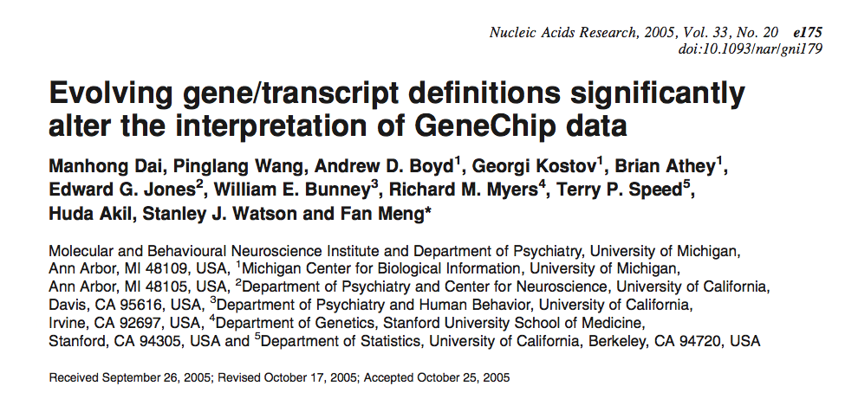
Probe set summarization
Affy’s probe-gene mapping
Custom cdf probe-gene mapping from a lab in michigan
http://brainarray.mbni.med.umich.edu/brainarray/

Slide 17
week3.class1
1. Introduction about the transcriptome
2. Introduction about the array and sequencing platform
3. Common Preprocessing of microarray data
4. RNA-Seq alignment tools and normalization

Slide 18
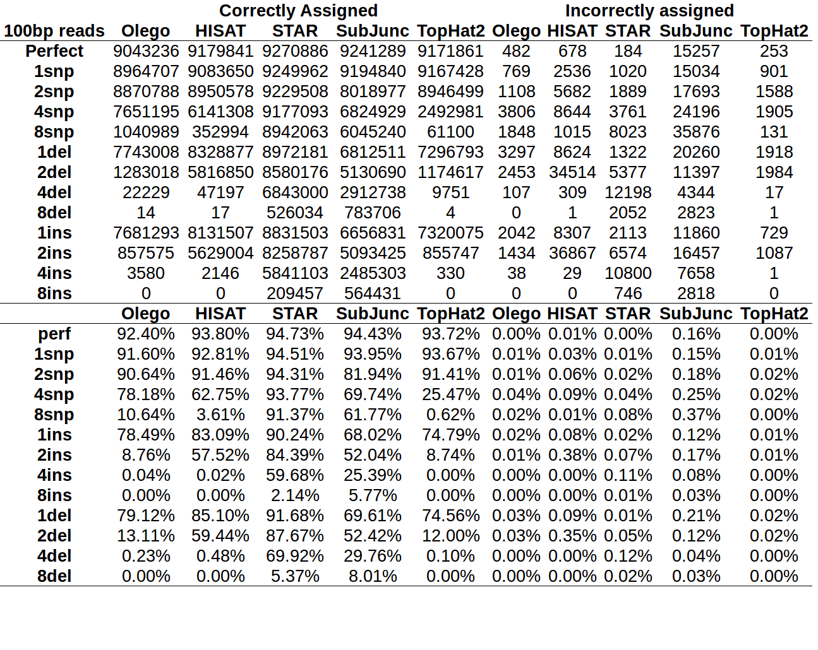
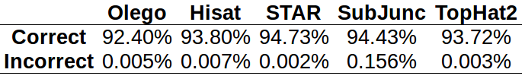
Few choices
http://genomespot.blogspot.com/2015/03/hisat-vs-star-vs-tophat2-vs-olego-vs.html

Slide 19
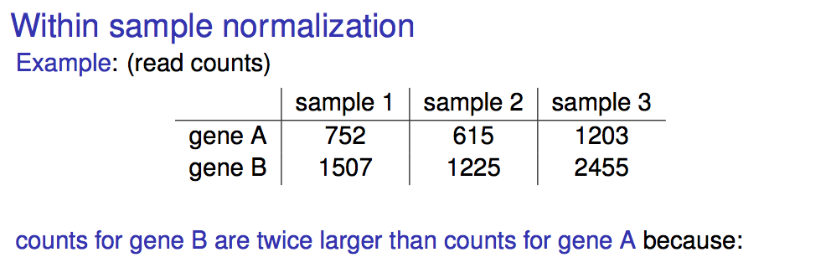
Normalization strategies for RNA-Seq
Slides from Nathalie Villa-Vialaneix(INRA,MIAT)

Slide 20
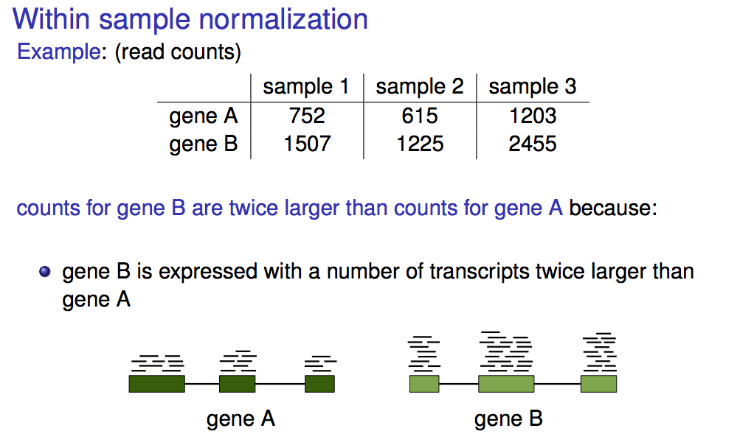
Normalization strategies for RNA-Seq
Slides from Nathalie Villa-Vialaneix(INRA,MIAT)

Slide 21
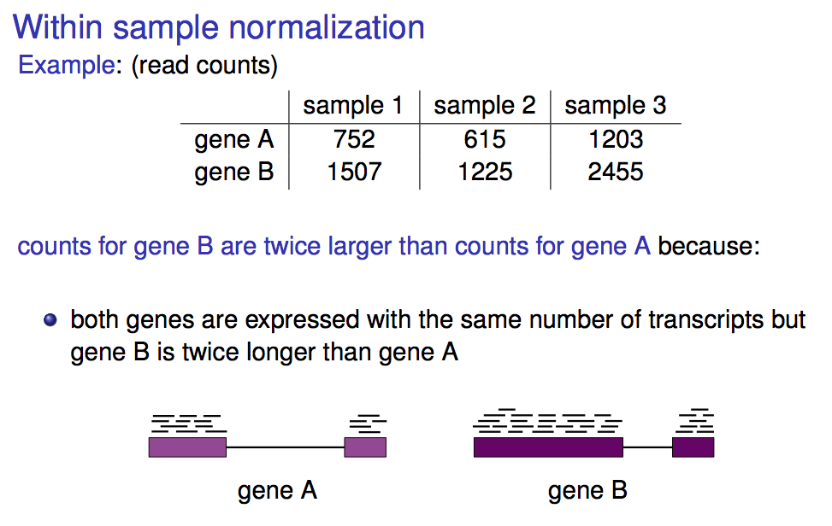
Normalization strategies for RNA-Seq
Slides from Nathalie Villa-Vialaneix(INRA,MIAT)

Slide 22
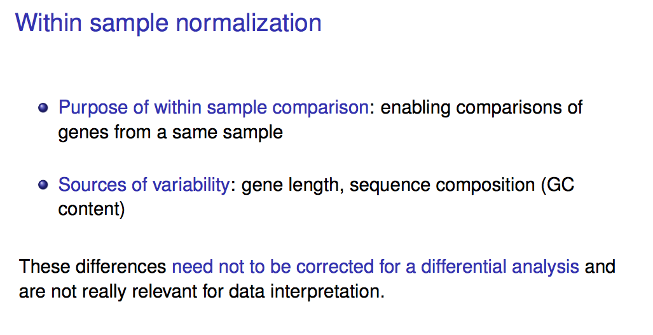
Normalization strategies for RNA-Seq
Slides from Nathalie Villa-Vialaneix(INRA,MIAT)

Slide 23
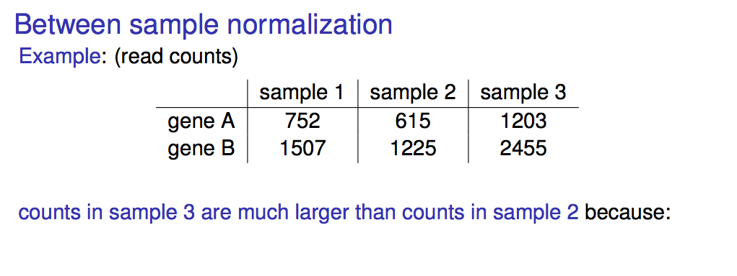
Normalization strategies for RNA-Seq
Slides from Nathalie Villa-Vialaneix(INRA,MIAT)

Slide 24
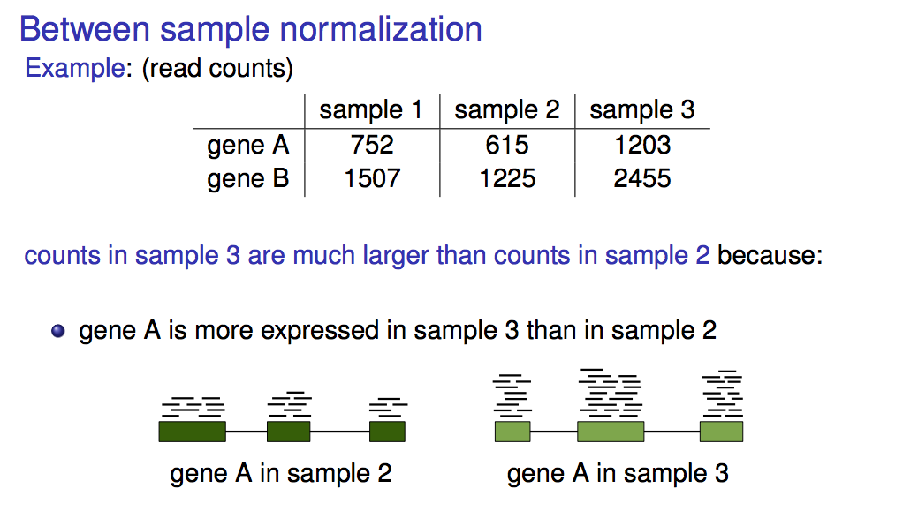
Normalization strategies for RNA-Seq
Slides from Nathalie Villa-Vialaneix(INRA,MIAT)

Slide 25
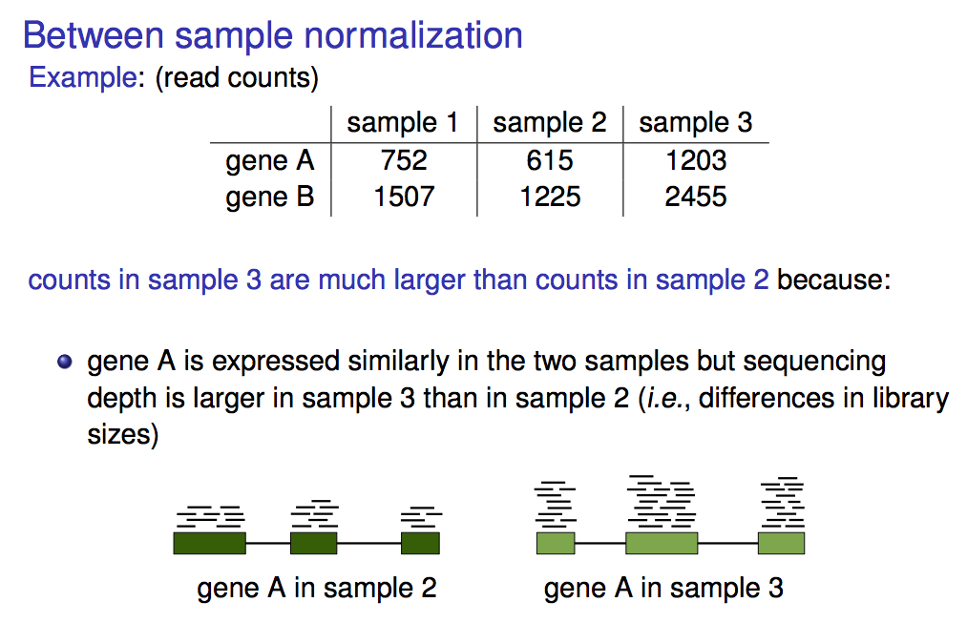
Normalization strategies for RNA-Seq
Slides from Nathalie Villa-Vialaneix(INRA,MIAT)

Slide 26
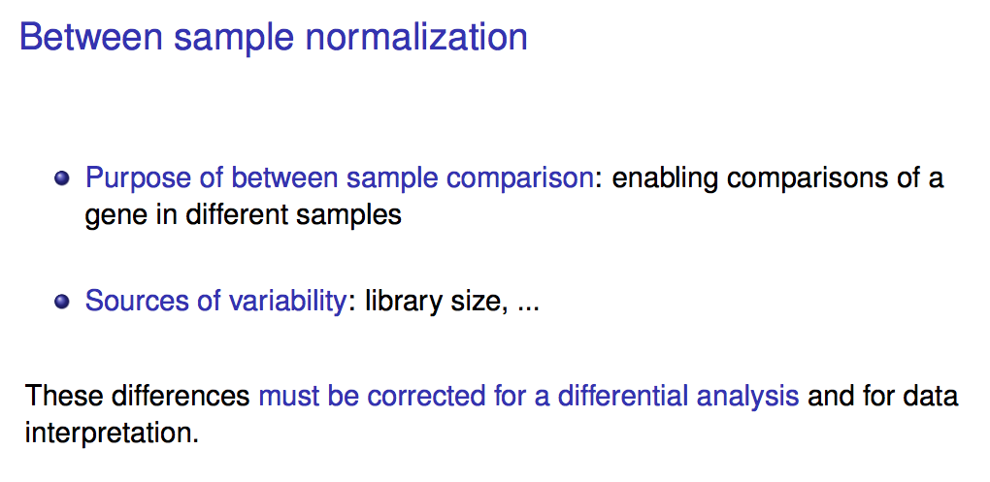
Normalization strategies for RNA-Seq
Slides from Nathalie Villa-Vialaneix(INRA,MIAT)

Slide 27
Tools to perform within/between sample normalization (FPKM adopted by Cufflinks)
 |  |  |  | FPKM-1 |  | FPKM
GENE_ID | Length | Sample1 | Sample2 | S1 | S2 | S1 | S2
A | 100 | 100000 | 200000 | 100000 | 100000 | 1000 | 1000
B | 50 | 200000 | 600000 | 200000 | 300000 | 4000 | 6000
C | 500 | 500000 | 400000 | 500000 | 200000 | 1000 | 400
D | 1000 | 100000 | 500000 | 100000 | 250000 | 100 | 250
E | 200 | 100000 | 300000 | 100000 | 150000 | 500 | 750
Total |  | 1000000 | 2000000 | 1000000 | 1000000 | 6600 | 8400

Slide 28
Tools to perform within/between sample normalization (FPKM adopted by Cufflinks)
 |  |  |  | FPKM-1
GENE_ID | Length | Sample1 | Sample2 | S1 | S2
A | 100 | 100000 | 200000 | 100000 | 100000
B | 50 | 200000 | 600000 | 200000 | 300000
C | 500 | 500000 | 400000 | 500000 | 200000
D | 1000 | 100000 | 500000 | 100000 | 250000
E | 200 | 100000 | 300000 | 100000 | 150000
Total |  | 1000000 | 2000000 | 1000000 | 1000000

Slide 29
Tools to perform within/between sample normalization (FPKM adopted by Cufflinks)
 |  |  |  | FPKM-1 |  | FPKM
GENE_ID | Length | Sample1 | Sample2 | S1 | S2 | S1 | S2
A | 100 | 100000 | 200000 | 100000 | 100000 | 1000 | 1000
B | 50 | 200000 | 600000 | 200000 | 300000 | 4000 | 6000
C | 500 | 500000 | 400000 | 500000 | 200000 | 1000 | 400
D | 1000 | 100000 | 500000 | 100000 | 250000 | 100 | 250
E | 200 | 100000 | 300000 | 100000 | 150000 | 500 | 750
Total |  | 1000000 | 2000000 | 1000000 | 1000000 | 6600 | 8400

Slide 30
Tools to perform within/between sample normalization (TPM adopted by RSEM)
 |  |  |  | TPM-1
GENE_ID | Length | Sample1 | Sample2 | S1 | S2
A | 100 | 100000 | 200000 | 1000 | 2000
B | 50 | 200000 | 600000 | 4000 | 12000
C | 500 | 500000 | 400000 | 1000 | 800
D | 1000 | 100000 | 500000 | 1000 | 5000
E | 200 | 100000 | 300000 | 5000 | 1500
Total |  | 1000000 | 2000000 | 12000 | 21300

Slide 31
Tools to perform within/between sample normalization (TPM adopted by RSEM)
 |  |  |  | TPM-1 |  | TPM
GENE_ID | Length | Sample1 | Sample2 | S1 | S2 | S1 | S2
A | 100 | 100000 | 200000 | 1000 | 2000 | 83.3 | 93.9
B | 50 | 200000 | 600000 | 4000 | 12000 | 333.4 | 563.5
C | 500 | 500000 | 400000 | 1000 | 800 | 83.3 | 37.6
D | 1000 | 100000 | 500000 | 1000 | 5000 | 83.3 | 234.8
E | 200 | 100000 | 300000 | 5000 | 1500 | 416.7 | 70.4
Total |  | 1000000 | 2000000 | 12000 | 21300 | 1000 | 1000.2
Notes:
How to decide which method to use, by checking Broad or big consortion

Slide 32
Take home messages for this class
1. general ideas about microarray, and sequencing technologies
2. how expression level is extracted from microarray raw data
3. common RNA-Seq alignment tool to use
4 how the normalization should be performed in microarray and RNA-Sequencing

Slide 33
Backup slides

Slide 34
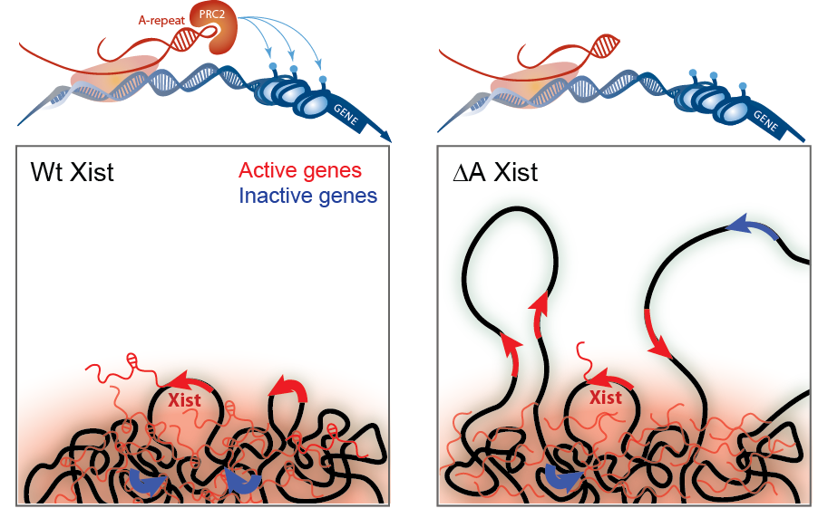
Mechanism of Xist mediated inactivation
http://guttmanlab.caltech.edu/research-prev.php

