Slide 1
Bioinformatics （生物信息学） BME1063.01 Lecture3 Class2
张力烨
Notes:
Note: do not distribute the slides

Slide 2
week3.class2
1. omics-experimental design
2. Introduction about the alignment algorithm

Slide 3
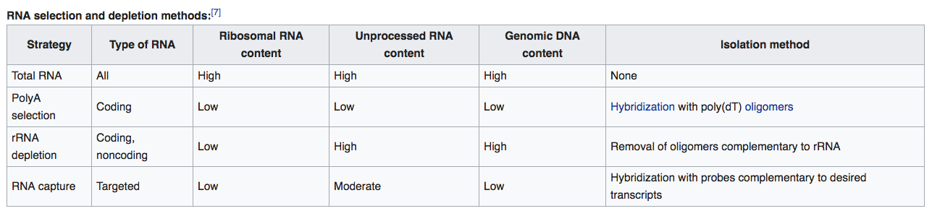
Key components in the design
How many biological replicates?
For microarray: which array platform?
For sequencing: which generation of sequencing? Read length? Single/paired End? polyA enriched? Stranded or not
From wiki

Slide 4
week3.class2
1. omics-experimental design
2. Differential expression basic

Slide 5
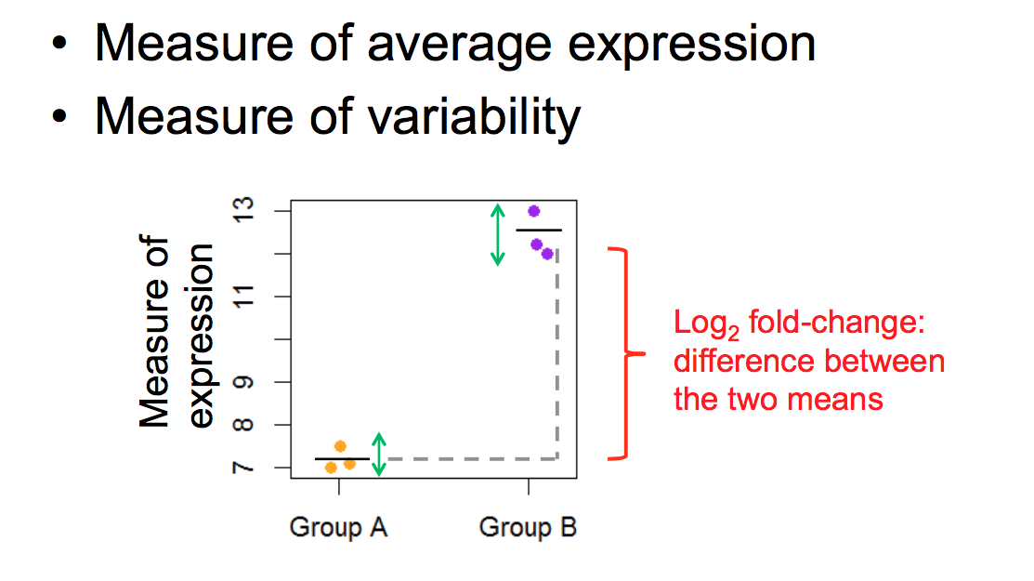
What do we need to perform a statistical test
From Combine RNA-Seq workshop

Slide 6
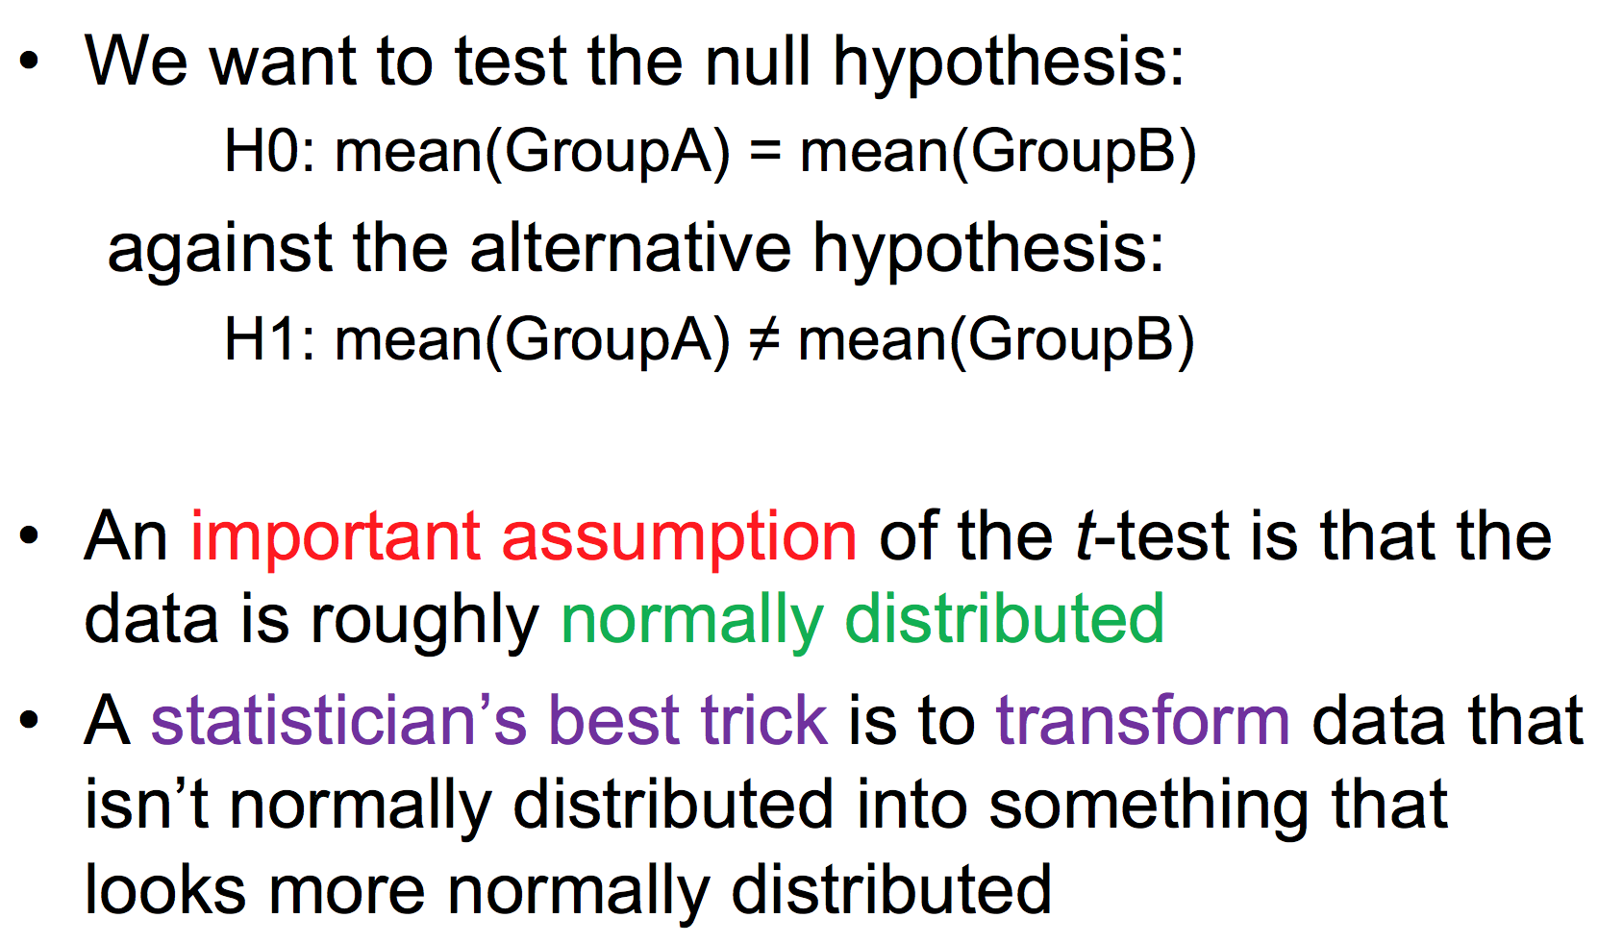
Common t-test

Slide 7
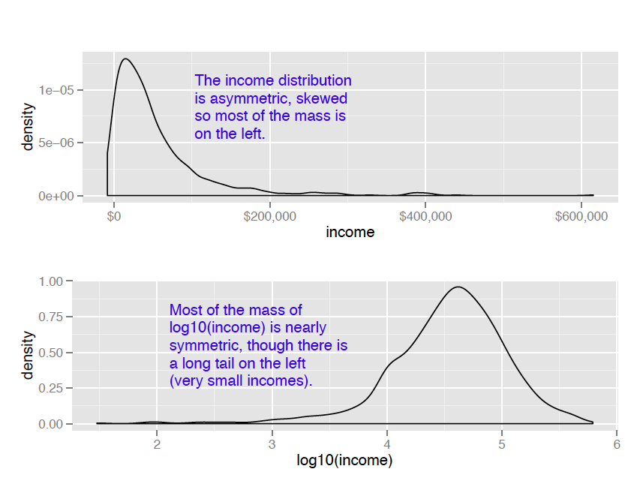
Log2 data transformation

Slide 8
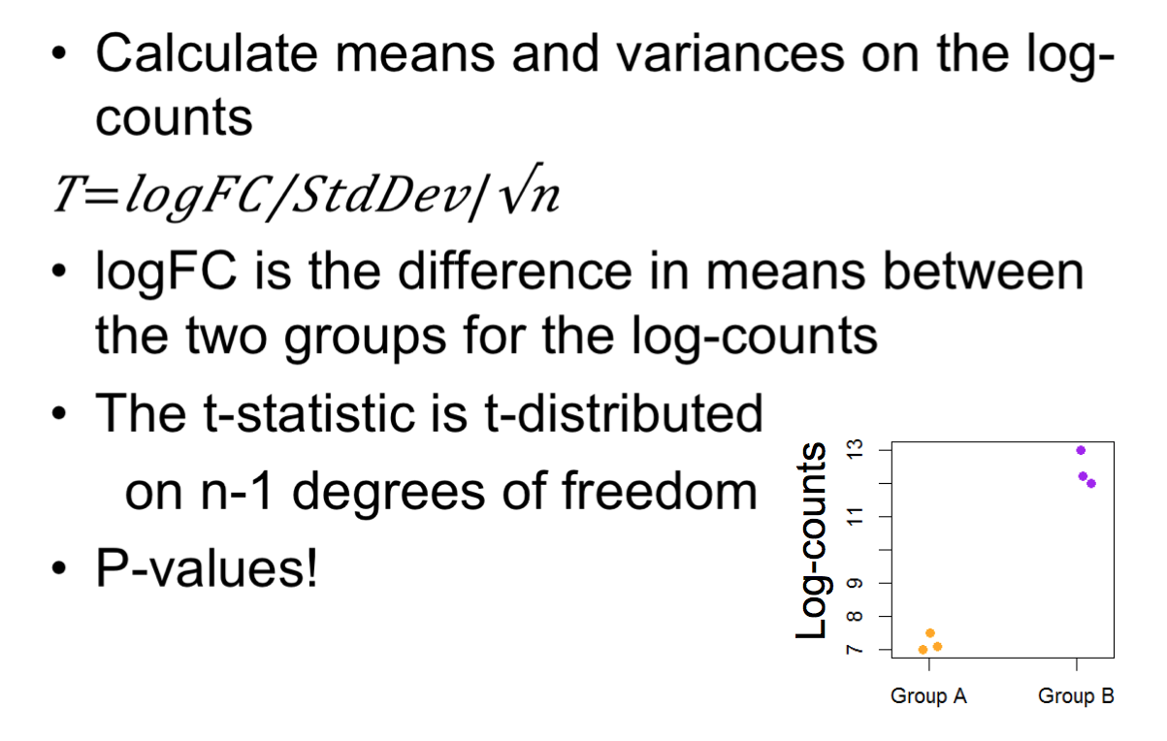
Continue on t-test

Slide 9
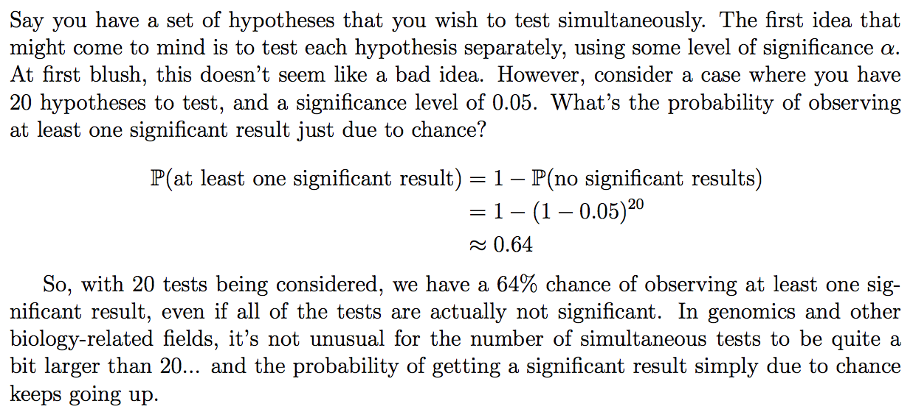
Problem of multiple hypothesis testing
From Lecture Notes Megan Goldman
Notes:
Explain the distribution

Slide 10
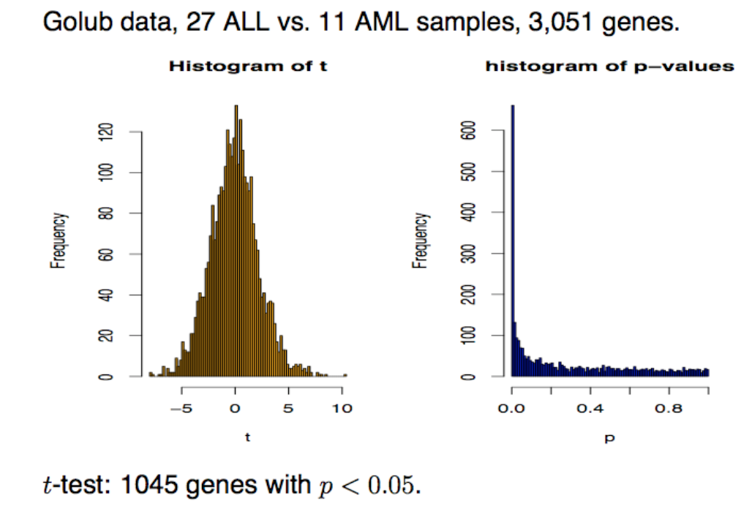
multiple hypothesis testing correction
From Slides Denise Scholtens
Notes:
Explain the distribution

Slide 11
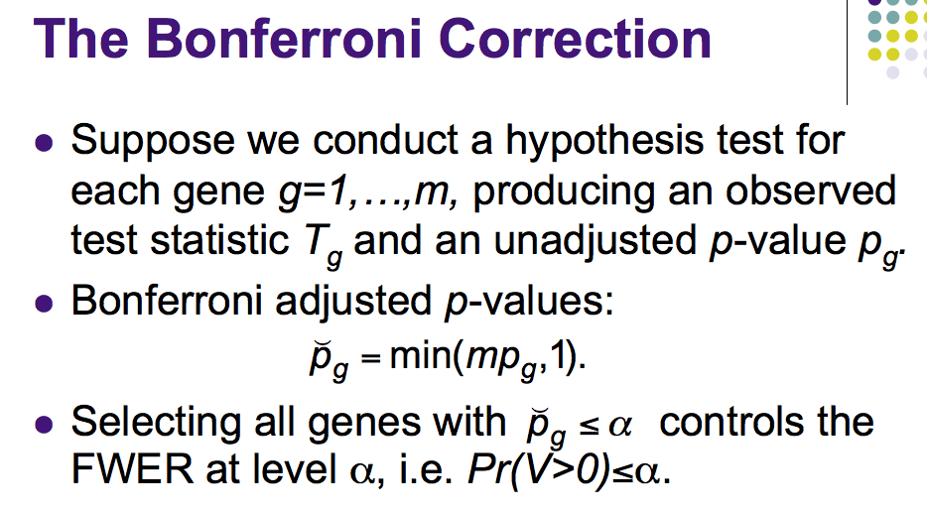
From Slides Denise Scholtens
Notes:
Explain the distribution

Slide 12
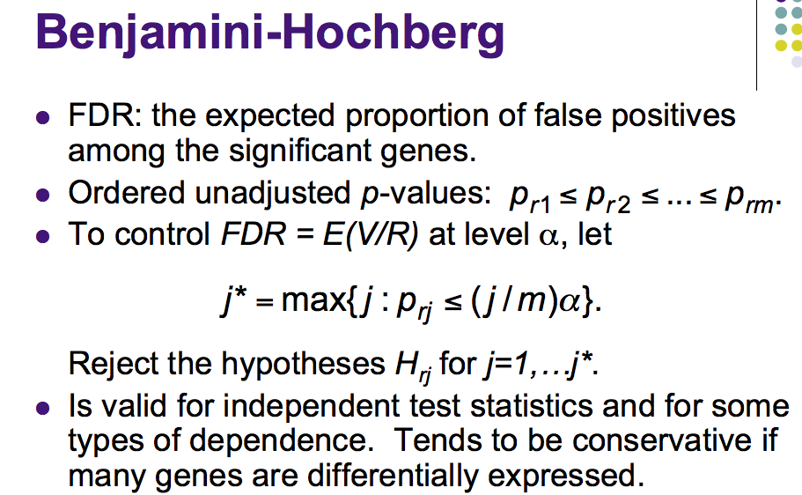
From Slides Denise Scholtens
Notes:
Explain the distribution

Slide 13
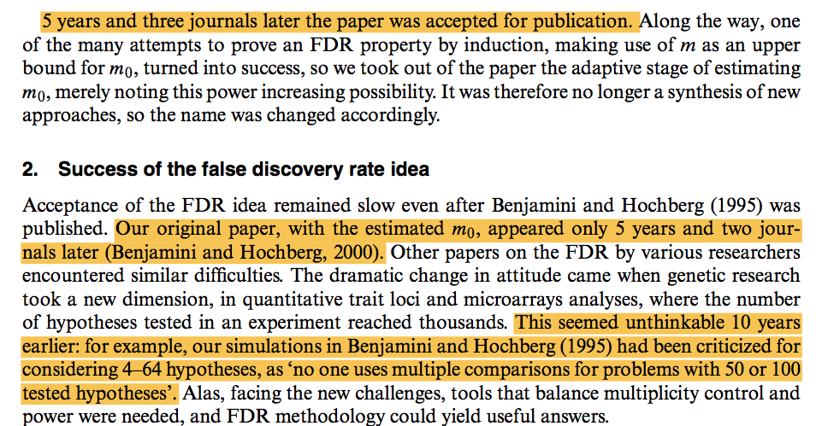
How hard (5 years) it is get a most cited paper published

Slide 14
multiple hypothesis testing correction comparison
Method | Number of significant genes
No-adjustment | 1045
B (FWER) method | 98
BH (FDR) method | 681
Notes:
Explain the distribution

Slide 15
Suggested tools for differential
Platform | Method
Microarray | limma
RNA Sequencing | DESeq
Other technology | Software goes with their own technology
Notes:
Explain the distribution

Slide 16
week3.class2
1. omics-experimental design
2. Differential expression basic
3. dimension reduction methods

Slide 17
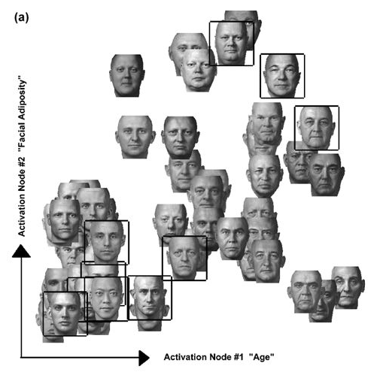
Why dimension reduction
simplify multiple dimensional data into key dimensions/properties/features
From Padhraic Smyth, UC Irvine
Notes:
Explain the distribution

Slide 18
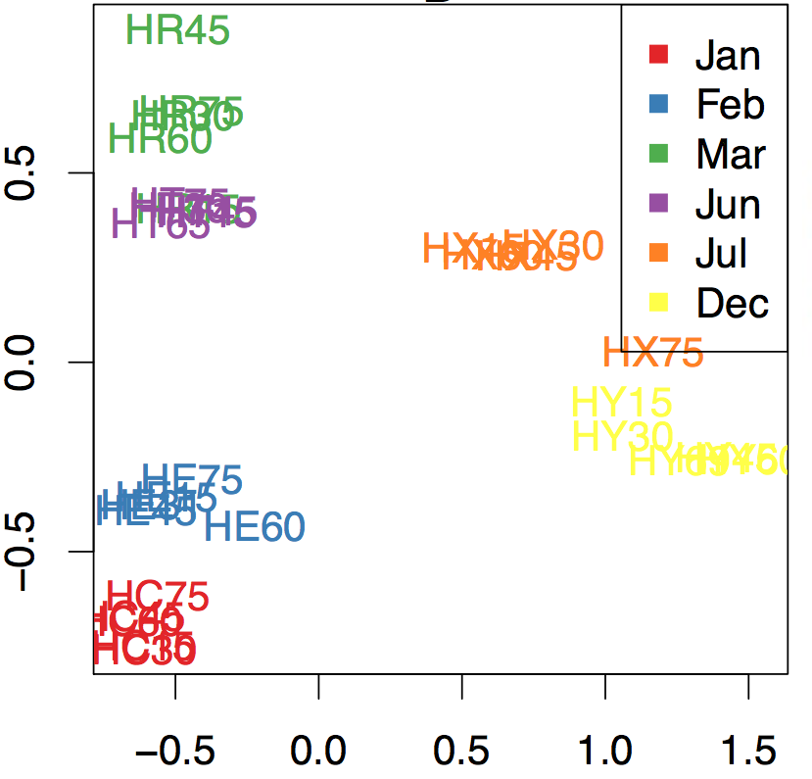
Application on quality QC: dimension reduction
Notes:
Explain the distribution

Slide 19
Common dimension reduction algorithm
Method | PCA | T-SNE
Reproducibility | 100% | linear
Relationship captured | Not 100% | All
Interpretation | Easy | Not straighforward
https://distill.pub/2016/misread-tsne/
Notes:
Explain the distribution

Slide 20
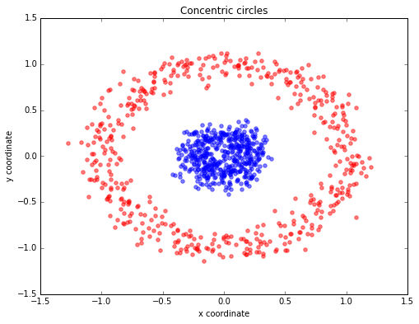
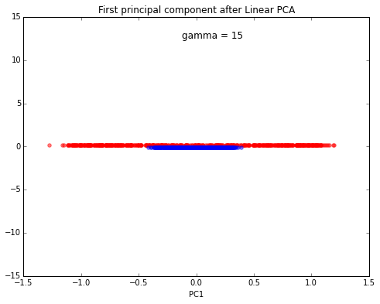
Limitation of linear PCA
http://sebastianraschka.com/Articles/2014_kernel_pca.html
Notes:
Explain the distribution

Slide 21
week3.class2
1. omics-experimental design
2. Differential expression basic
3. dimension reduction methods
4. clustering method

Slide 22
Commonly used clustering methods
1. hierarchical clustering
2. K-mean clustering

Slide 23
Commonly used clustering methods
1. hierarchical clustering
2. K-mean clustering
(to be continued)

Slide 24
Take home messages for this class
1. general ideas about omics-experiment design
2. basic ideas about the differential expression analysis
3. dimension reduction methods
4. K-mean and hierarchical clustering

Slide 25
After class reading (optional)
1. fdr video
2. fdr paper personal account
3. comparision between FPKM/RPKM/TPM http://www.rna-seqblog.com/rpkm-fpkm-and-tpm-clearly-explained/

Slide 26
Pre-class reading
None

Slide 27
Backup slides

Slide 28
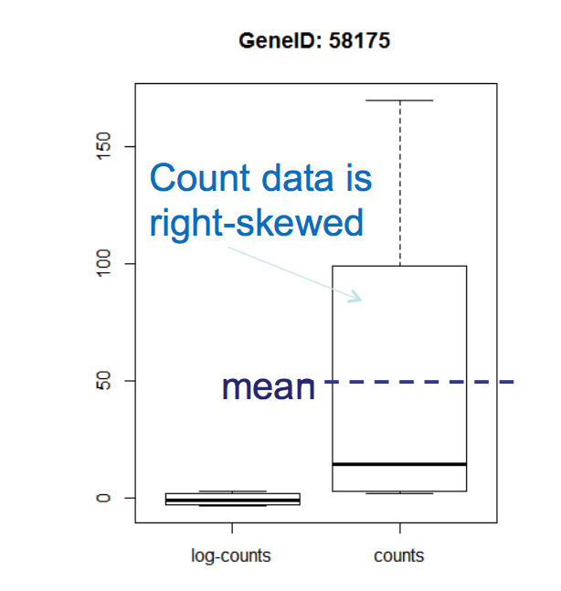
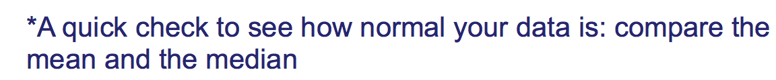
Tips on test how normal you data is

Slide 29
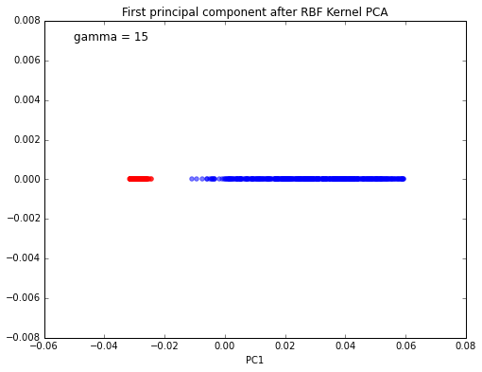
Kernel PCA
http://sebastianraschka.com/Articles/2014_kernel_pca.html
Notes:
Explain the distribution

