Slide 1
Table S1
Tool |  | Sigflow | SigProfiler | SomaticSignatures | MutationalPatterns | deconstructSigs
Support signature type | SBS | Yes | Yes | Yes | Yes | Yes
 | DBS | Yes | Yes | No | No | Yes
 | INDEL | Yes | Yes | No | No | No
 | CN | Yes | No | No | No | No
 | SV | No | Yes | No | No | No
Has CLI |  | Yes | No | No | No | No
Platform |  | R | Python | R | R | R
Analysis features | Manual extraction | Yes | No | Yes | Yes | No
 | Auto extraction | Yes | Yes | No | No | No
 | Refit after extraction | Yes | Yes | No | No | No
 | Reference signature fitting (efficiency) | Yes (fast) | No | No | Yes (fast) | Yes (slow)
 | Batch signature fitting | Yes | No | No | Yes | No
 | Visualization | Yes | Yes | Yes | Yes | Yes
Extensible |  | Yes | Yes | No | No | No
Core methods |  | NMF/Bayesian NMF/QP/NNLS | NMF/NNLS | NMF/PCA | NMF/NNLS | NNLS
Signature quantification | Relative exposure | Yes | No | No | Yes | Yes
 | Absolute exposure | Yes | Yes | No | Yes | No
Input format |  | VCF/MAF/CSV/EXCEL | VCF/MAF/CSV | VCF/R matrix/R Vranges object | VCF/R matrix | Custom mutation file
Software URL |  | https://github.com/ShixiangWang/sigminer.workflow | https://github.com/AlexandrovLab/SigProfilerExtractor | https://github.com/juliangehring/SomaticSignatures | https://github.com/UMCUGenetics/MutationalPatterns | https://github.com/raerose01/deconstructSigs
Abbr.: SBS for single base substitution; DBS for doublet base substitution; INDEL for short insertions and deletions; CN for copy number; SV for structure variation; CLI for command line interface; NMF for non-negative factorization; QP for quadratic programming; NNLS for nonnegative least square; PCA for principal component analysis; VCF for variant call format; MAF for mutation annotation format
Table S1. Feature comparison of Sigflow and some common used mutational signature analysis tools.

Slide 2
Figure S1
A
B
1bp Deletion
1bp Insertion
>1bp Deletion at Repeats
>1bp Insertion at Repeats
Microhomology (Deletion)
SBS
ID
C
D
DBS
CN
Fig. S1. Example signature profile generated by Sigflow. First 3 signatures for three types of mutational signatures including (A) SBS, (B) ID and (C) DBS catalogued in COSMIC signature v3 database (https://cancer.sanger.ac.uk/cosmic/signatures). (D) Profile of two copy number signatures extracted from 10 TCGA samples. Abbr.: SBS, single base substitution; DBS, doublet base substitution; ID: insertion and deletion.

Slide 3
Figure S2
A
B
C
D
E
Fig. S2. Performance comparison of SBS signature extraction and fitting between Sigflow and some common used approaches in 214 PCAWG breast tumors. Distribution of (A) error and (B) cosine similarity between observed and reconstructed sample 96 motif mutation spectrum from de-novo extraction. Based on 13 SBS signatures are detected in PCAWG breast tumors (Nature 2020 paper), here all approaches but Sigflow:BayesianNMF were used to de-novo extract 13 signatures and compute and reconstructed mutation spectrum for each tumor. Bayesian NMF approach was started from initial signature 20 and 13 signatures were automatically selected and extracted (see Fig. S3). The de-novo signature extraction is time consuming, so no speed comparison is evaluated here. Distribution of (C) error and (D) cosine similarity between observed and reconstructed sample 96 motif mutation spectrum from reference signature fitting. Reference signatures are all SBS signatures from COSMIC signature v3 database (https://cancer.sanger.ac.uk/cosmic/signatures). Distribution of fitting time for single sample is shown in (E). The computation was repeated by 100 times and recorded by R package microbenchmark. Here, Sigflow takes extra time to print verbose information, so the speed is slower than MutationalPatterns.

Slide 4
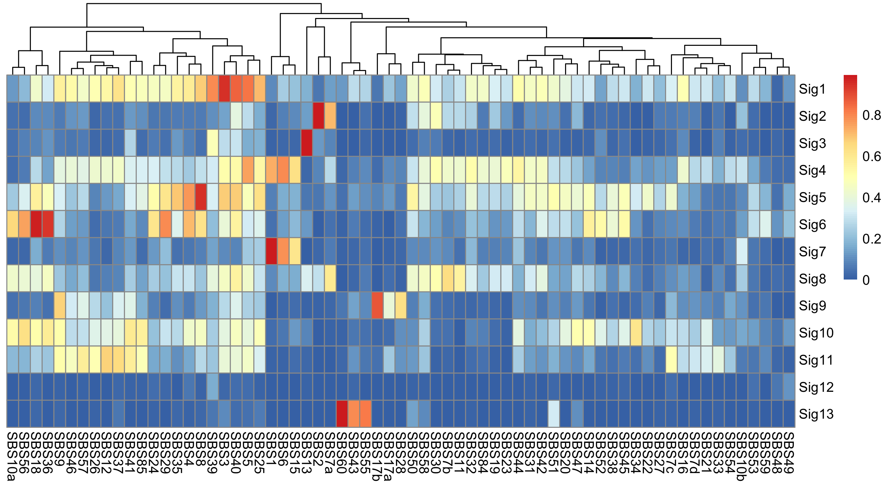
Figure S3
A
Run | Signature number | Posterior
20 | 13 | -13481.43071975890
14 | 13 | -13482.900913046700
3 | 14 | -13879.256323790000
8 | 14 | -13980.186397149100
18 | 15 | -14208.742754524600
12 | 15 | -14212.198381532200
13 | 15 | -14218.327880046800
9 | 15 | -14221.33654585160
10 | 15 | -14221.74220450850
2 | 15 | -14229.04225343580
11 | 15 | -14232.707494554600
5 | 15 | -14235.023136448400
6 | 15 | -14238.73360582180
1 | 15 | -14259.25965695080
7 | 15 | -14334.513048630400
15 | 16 | -14603.115175310500
19 | 16 | -14712.99807645120
4 | 16 | -14732.01230457900
17 | 17 | -15098.230327010300
16 | 17 | -15122.315211541100
B
Fig. S3. Sigflow Bayesian NMF approach automatically extract 13 signatures from 214 PCAWG breast tumors with 20 runs and initial signature number 20. (A) Bayesian NMF run summary, the run no.20 is selected as the optimal solution due to its maximum posterior. Here 15 signatures should also be considered as a stable solution it is most frequent in 20 runs. (B) The cosine similarity between extracted 13 signatures and SBS signatures from COSMIC signature v3 database (https://cancer.sanger.ac.uk/cosmic/signatures).

Slide 5
Figure S4
A
B
C
Fig. S4. Signature instability analyses for SBS mutations from 214 PCAWG breast tumors, an illustration for using signature exposure bootstrapping analysis. (A) Comparison of signature exposure instability between contributed signatures in all SBS signatures measured as MRSE between exposures in 100 bootstrap samples and exposures in the original samples for each tumor. (B) Distribution of bootstrapping signature exposure of all SBS signatures for SP117933, a selected tumor sample from the 214 PCAWG breast cohort. (C) Reconstruction error distribution of 100 bootstrapping samples for SP117933. The triangles indicate signature exposures or reconstruction errors obtained from original catalogues of this tumor. Abbr.: QP, quadratic programming; MRSE, mean root squared error.

