Slide 1
Business Problem
How to capitalize on the facilities of Big Mountain?
Increase the ticket price
Consider number of changes to cut the cost
Both option 1 and 2

Slide 2
Business Problem
Criteria of Success:
Achieve at least 5% of revenue growth
Constraints of Solution Space:
Achieve the goal of revenue growth by the end of this year
No increasing or cutting the cost

Slide 3
Key Finding
The modeled price of Big Mountain is $94.22, $10.39 higher than the actual price
The ticket of Big Mountain is the highest in Montana
Closing Runs of the facilities would lead to revenue generally
Increasing the vertical drop supports the ticket price by $1.99
Adding snow making area and increasing the long run do not help the revenue growth.

Slide 4
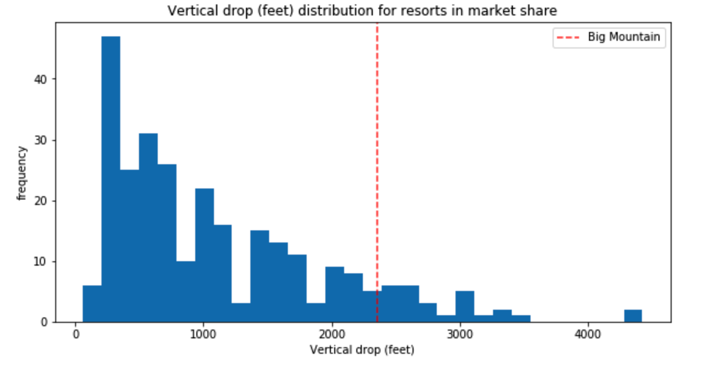
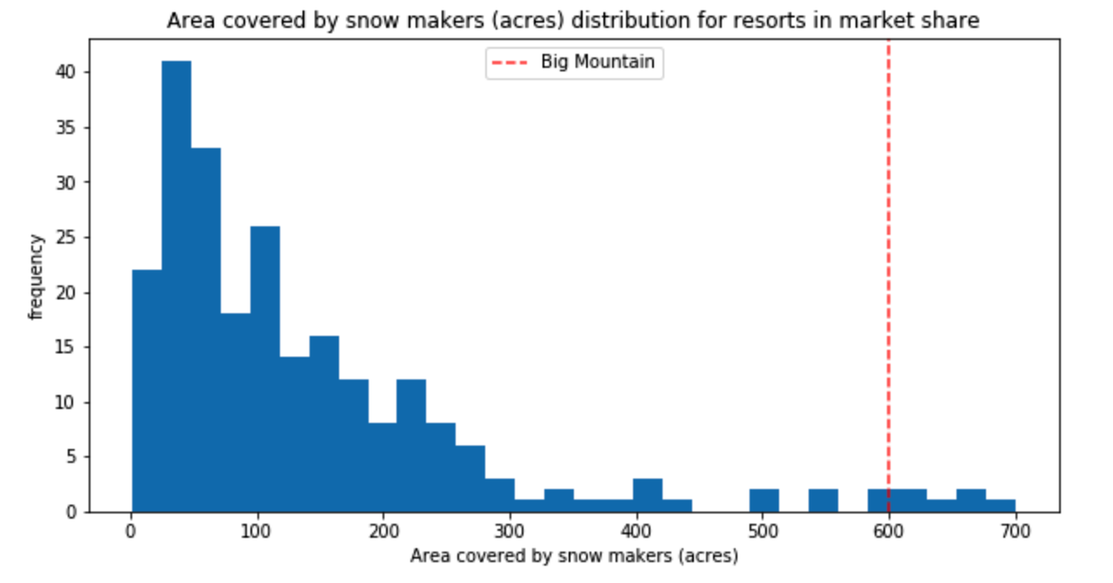
Modeling Result and Analysis
Feature of Vertical Drop is better than most of the resort in the US
Feature of area covered by snow maker is leading the market segment

Slide 5
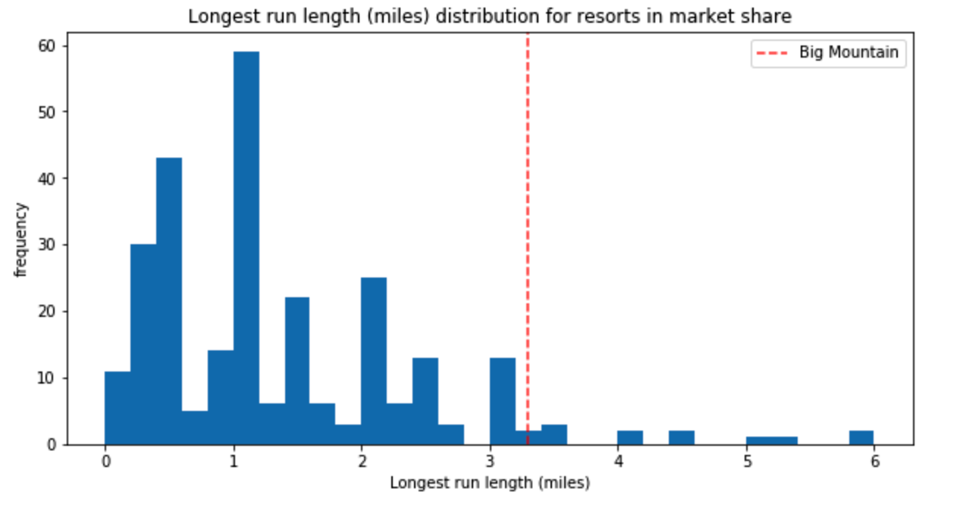
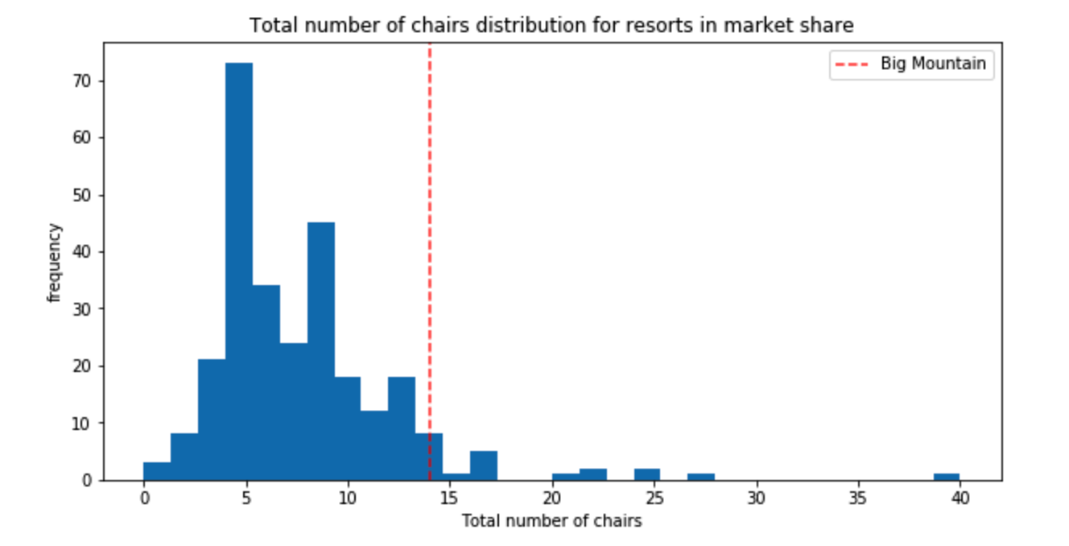
Modeling Result and Analysis
Feature of longest run is leading the market segment
Feature of total number of chair is better than most of the company

Slide 6
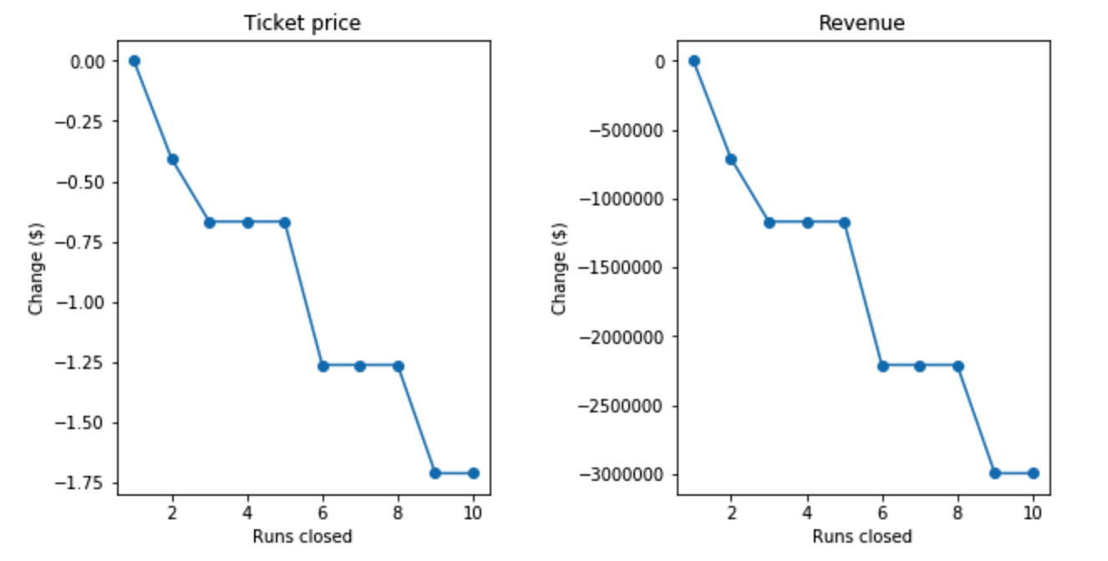
Modeling Result and Analysis
Generally, closing runs would lead to total revenue decrease.

Slide 7
Conclusion
Big Mountain have a space of $10.39 for increasing the ticket price
Big Mountain can cut cost by decreasing the snow making area

