Slide 1

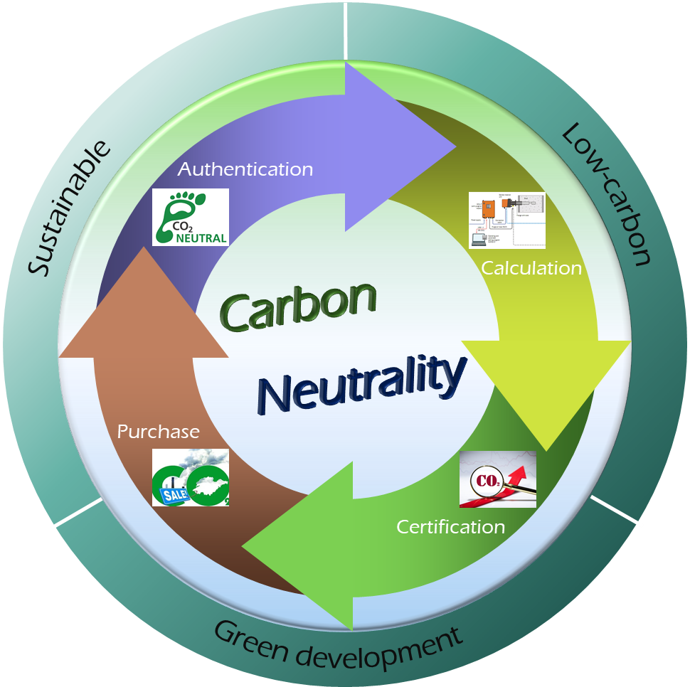
IEEE Technical Committee on Carbon Neutrality

Slide 2

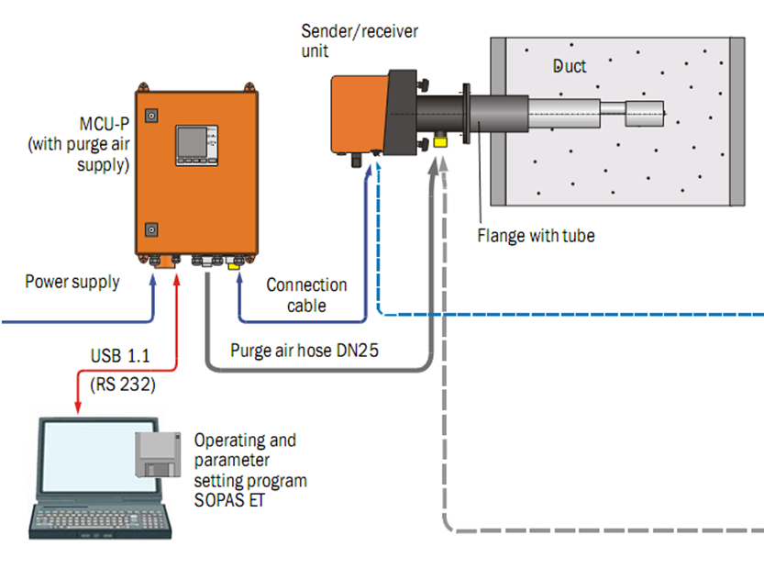

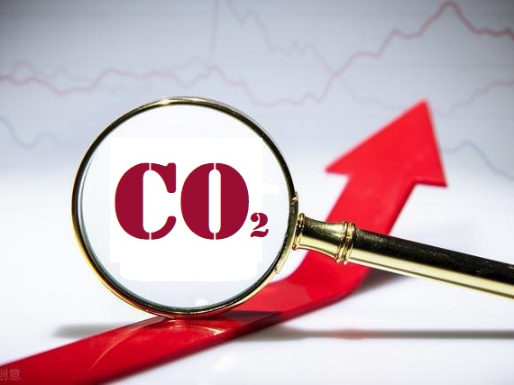
Low-carbon
Sustainable
Authentication
Green development
Calculation
Carbon
Neutrality
Purchase
Certification

