Slide 1
Literature Review
Shiyan Miao

Slide 2
Introduction
Hi!

Slide 3
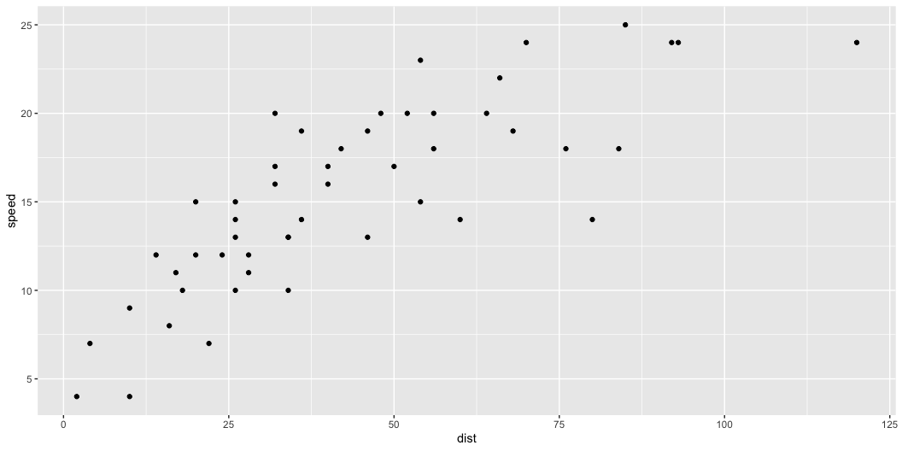
What is QTL?
I am using R Core Team (2025) to do my analysis.
I am also using Wickham et al. (2019) to do a lot of my data analysis.
Figure 1 demonstrates my usage of ggplot2 package.
Figure 1: This is my first scatter plot.

Slide 4
Reference
R Core Team. 2025. R: A Language and Environment for Statistical Computing. Vienna, Austria: R Foundation for Statistical Computing. https://www.R-project.org/.
Wickham, Hadley, Mara Averick, Jennifer Bryan, Winston Chang, Lucy D’Agostino McGowan, Romain François, Garrett Grolemund, et al. 2019. “Welcome to the tidyverse.” Journal of Open Source Software 4 (43): 1686. https://doi.org/10.21105/joss.01686.

