Slide 1
Commonly used statistical models in QTL
Presenter: Shiyan Miao
Notes:
Good morning, everyone. Today we will connect different ways of selection to the commonly used statistical methods in Quantitative trait loci. My goal is to give you an end-to-end intuition from selection basics to linkage and recombination, through single and multiple marker models and finally how can we choose a suitable model.

Slide 2

Introduction of myself
I am Shiyan Miao a third-year student in Bachelor of Science, major in Statistics and minor in Mathematics.
I used to study Finance in SUIBE, and then I transfer to ANU to change my major.
Notes:
Then, let me introduce myself. I am Shiyan Miao, a third-year undergraduate student of Bachelor of Science, major in statistics and minor in mathematics. I initially a finance background in Shanghai, I transfer to ANU this year doing statistics.

Slide 3
Selection in Biology
Notes:
At the beginning, we will talk about selection in biology.

Slide 4
What is “selection”?
Idea: Reproduction is a relay race. We want the baton of good traits to pass to the next generation.
Selection = choose the best to be parents, useful traits.
Natural selection: the environment “scores” survival and reproduction.
Artificial selection: breeders “score” and choose the parents.
(Falconer & Mackay, 1996.)
Notes:
The first question comes to us is “What is selection?”
“Think of reproduction as a relay race. Each generation runs and passes a baton that is our traits to the next. Selection decides who carries it, which means choose the best to be the parents. Natural selection: the environment keeps score—heat, hunger, predators, disease. If your traits help you survive and have babies, your baton moves on. Over many laps, those traits spread. Artificial selection: people keep score. Breeders pick the parents—sweeter fruit, faster horses, calmer dogs. Same relay, just a human coach.

Slide 5
Traditional ways to select
Phenotypic selection: “pick what you can see.”
Progeny testing: “judge by the children.”
Backcross breeding: “move a good gene into a good variety.”
We’ll look at each and why they can be slow or imprecise.
Notes:
There are three classical approaches: phenotypic selection, which means “pick what you see” , progeny testing which means “judge by the children”, and backcross breeding which means “move a good gene into a good variety”. Each has value, but each can be slow or imprecise. Keep these in mind as baselines. We will talk these three approaches first. After that, we will introduce a more efficient method, which is marker assisted selection.

Slide 6
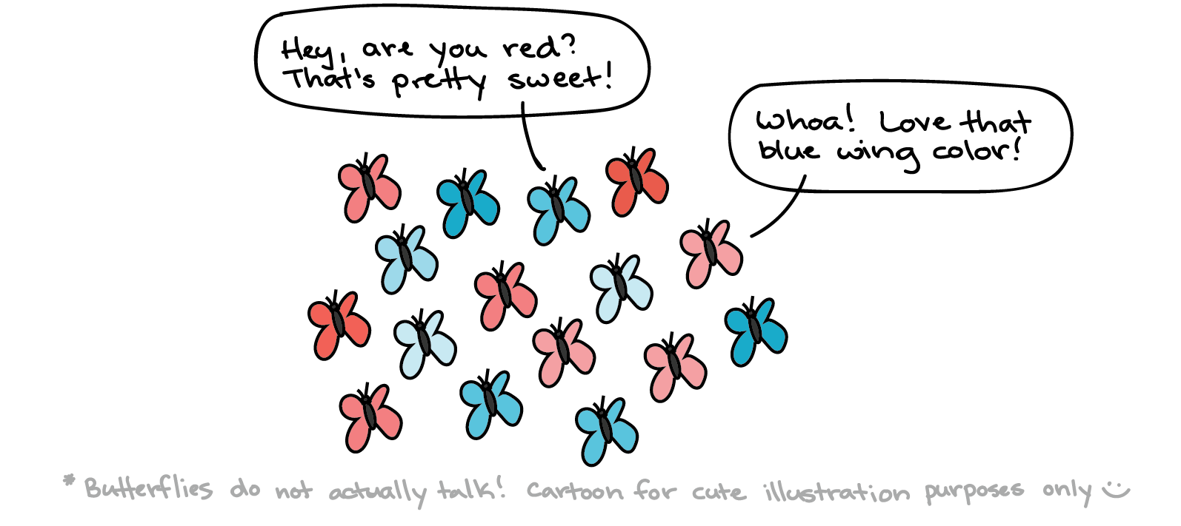
Phenotypic selection
How it works - Choose plants/animals with better appearance or performance.
Limitations - Need many locations & seasons to separate genetics from weather and soil.
(Khan Academy Darwin-evolution-natural-selection)
(Collard et al., 2005.)
Notes:
How does phenotypic selection work? By choosing plants or animals with better appearance or performance. Let’s look at the illustrator, butterflies’ wings have different colours. Why the pink butterfly said “Whoa! Love that blue wing colour!” Because the blue butterfly can hide itself and avoid attack form predator when it lay on a blue pond. But it also have limitations, this selection method need many locations and seasons to sperate genetics from weather and soil.

Slide 7
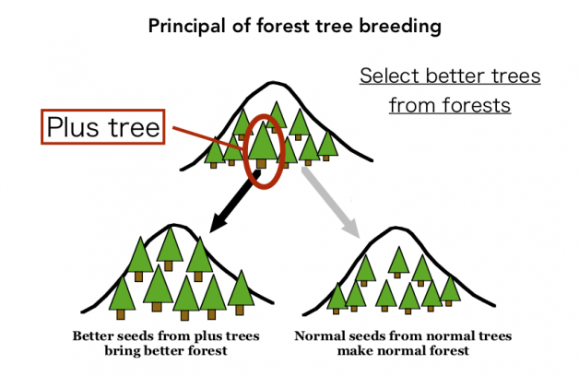
Progeny testing
How it works - Some traits can’t be judged in the parent. Therefore, we look at offspring performance.
Limitations - Slow, expensive, resource-hungry.
(https://www.ffpri.go.jp/hokuiku/en/research/plustree_progeny.html,
Hokkaido Regional Breeding Office, Forest Tree Breeding Center)
(Falconer & Mackay, 1996.)
Notes:
Some traits cannot be judged in the parent, such as maternal traits or recessive resistance. Therefore, we look at offspring performance. From the illustrator, we can see in natural forests, we pick likely “plus trees”, collect their seeds, grow the offspring side-by-side, and compare families. Trees whose offspring do best become the selected parent. Seeds from proven plus trees make better forest. Meanwhile, normal seeds make normal forest. But this method is slow, expensive and resource-intensive.

Slide 8
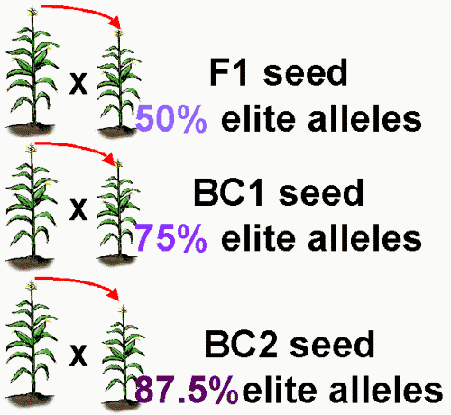
Backcross breeding
How it works - Bring a useful gene from a donor into an elite variety you already like.
Limitations - 6–8 backcross generations
(https://passel2.unl.edu/view/lesson/c55bd4193305/3 ，Plant and Soil Sciences eLibrary 2025)
(Wu, Ma, & Casella, 2007.)
Notes:
The last one we will talk about is backcross breeding, which bring a useful gene from a donor into an elite variety you already like. From the illustrator, it shows that as we backcross again and again, the share of the “good” genome keeps rising and getting closer to 100%. But it is time-consuming, in general, backcross breeding method will take 6 to 8 backcross generations.

Slide 9
Why traditional methods are often inefficient
Environment gets in the way
Time and money
Late or hard-to-measure traits
Low-heritability traits
Linkage drag
So we need faster, more precise tools (Marker-assisted selection)！
(Collard et al., 2005.)
Notes:
To put it into summary. First, environment gets in the way. Weather, soil and management can hide the genetics, so the plants that look best this year might just be in a better spot. Second, time and money. You need multiple seasons and sites to be sure, which is costly and slows progress. Third, some traits are late or hard to measure—wood quality, disease durability, grain quality—so you must wait years or run expensive tests. Fourth, some targets have low heritability. Most of what you see is environment, so selecting on looks barely shifts the genetics. Finally, linkage drag. When you bring in a ‘good’ gene from a donor, you often drag along nearby ‘bad’ genes, hurting yield or quality.

Slide 10
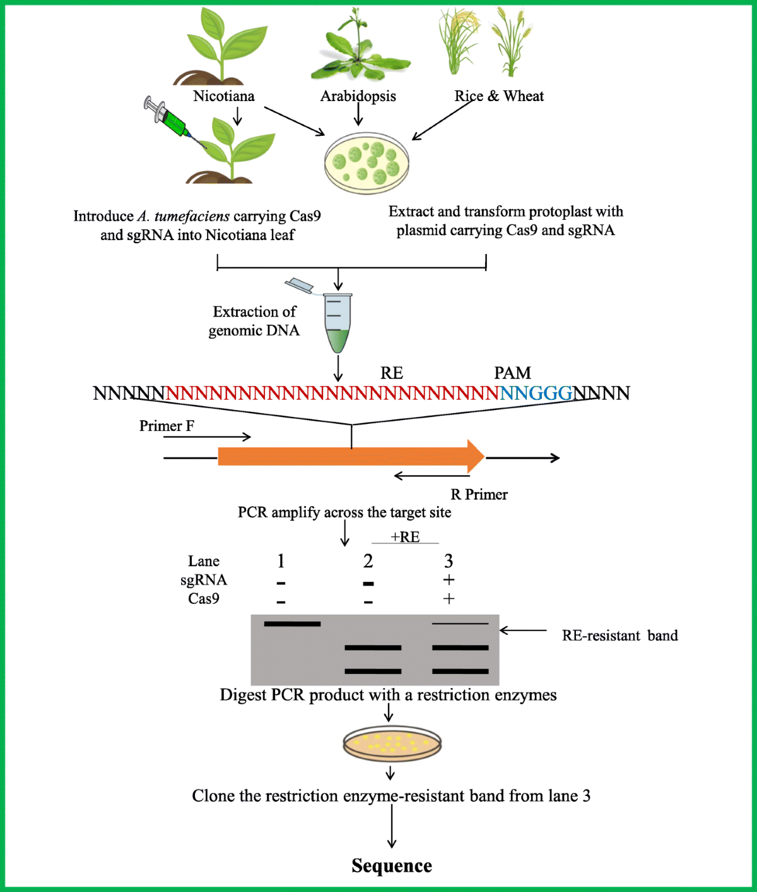
Marker-assisted selection
Core idea - Don’t wait for traits to show up. Look at genetic markers！
If a marker sits very close to a functional gene and is rarely separated by reshuffling, seeing the marker ≈ having the useful piece.
Hasan, N., Choudhary, S., Naaz, N. et al. Recent advancements in molecular marker-assisted selection and applications in plant breeding programmes. J Genet Eng Biotechnol 19, 128 (2021). https://doi.org/10.1186/s43141-021-00231-1
(Collard et al., 2005.)
Notes:
That is why marker-assisted selection shines. The core idea for marker-assisted selection is don’t wait for traits to show up. We turn to look at genetic markers. If a marker sits very close to a functional gene and is rarely separated by reshuffling, seeing the marker equally meaning having the useful piece. We will quantify “rare” with the recombination fraction c and see how c feeds directly into the statistical we use in the statistical model part.

Slide 11
Why MAS helps?
Earlier screening
More stable than visible performance
Stack multiple good genes
Cheaper for certain traits
(Collard et al., 2005.)
Notes:
There are four wins for the marker-assisted selection. The first win is earlier screening, you can select seeds, which shorten the breeding cycles. The second win is stability that is more stale than visible performance, containing less weather or soil noise. The third win is stacking, which combines multiple loci rationally. The last one is cost, which should be taken into consideration in practice. Marker-assisted selection is cheaper for the traits who is difficult to measure.

Slide 12
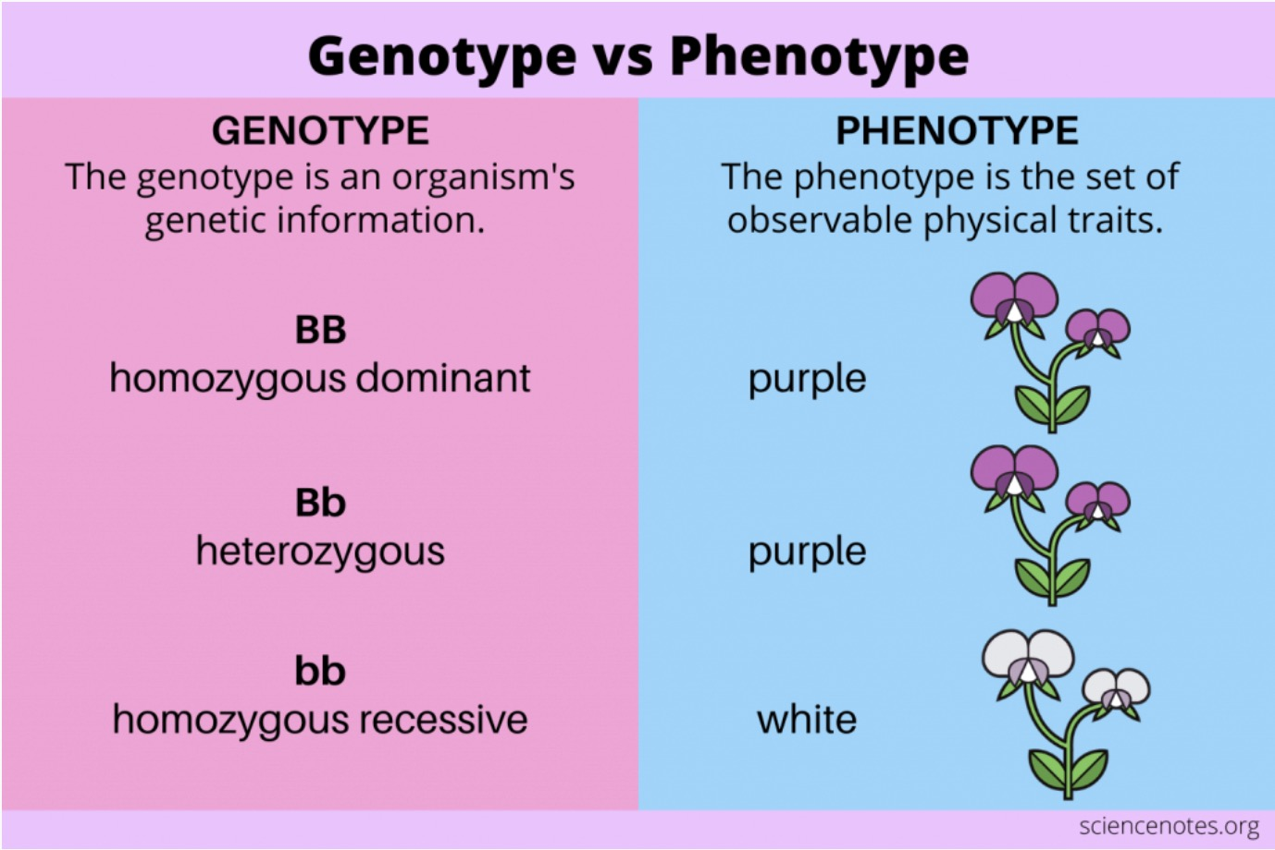
Connect phenotype and genotype
(https://sciencenotes.org/genotype-vs-phenotype-definitions-and-examples/, Science Notes and Projects)
(Mackay et al., 2009.)
Notes:
From the perspective of definition, genotype is an organism’s genetic information and phenotype is the set of observable physical traits. Capital B and capital B represents for homozygous dominant which decides the flower color to be purple. And capital B and lowercase b represents for heterozygous. In this situation, capital B take the effect of dominance, so the flower is purple. Meanwhile, lowercase b and lowercase b represents for homozygous recessive that lowercase b decides the flower color to be white. So we can deem that this B is the marker of flower color.

Slide 13
Quantitative trait loci (QTL)
Notes:
Then, let’s move to the next part----Quantitative trait loci

Slide 14
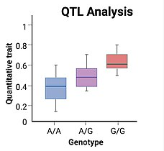
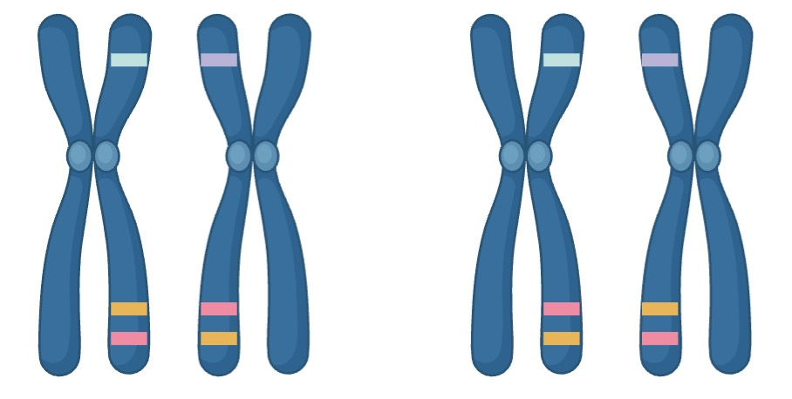
What is a QTL?
A stretch of DNA that control the quantitative trait.
To find QTL:
A/A, A/G, G/G
Sequence “markers”
Statistical analysis of marker – trait variation
(Mackay et al., 2009.)
Notes:
When we introduce a new terminology in, the first question comes to us is what is quantitative trait loci (QTL). It is a stretch of DNA that control the quantitative trait. After we known what is quantitative trait loci, the next step is How can we find QTL? We will sequence markers first. A sequence marker is a small genomic position with detectable variation—like the blue tick on the chromosome at left. At the same locus, some individuals are A/A, others A/G or G/G. The locus itself may not be the causal gene, but if it lies near the true QTL, different genotypes will typically show different trait distributions. The next step is the statistical analysis of marker–trait variation. For example, if the G/G box in the box plot sits much higher than the A/A box, the marker shows a stronger association with the trait. Finally, use ANOVA to test significance and decide whether this is a useful mapping signal.

Slide 15
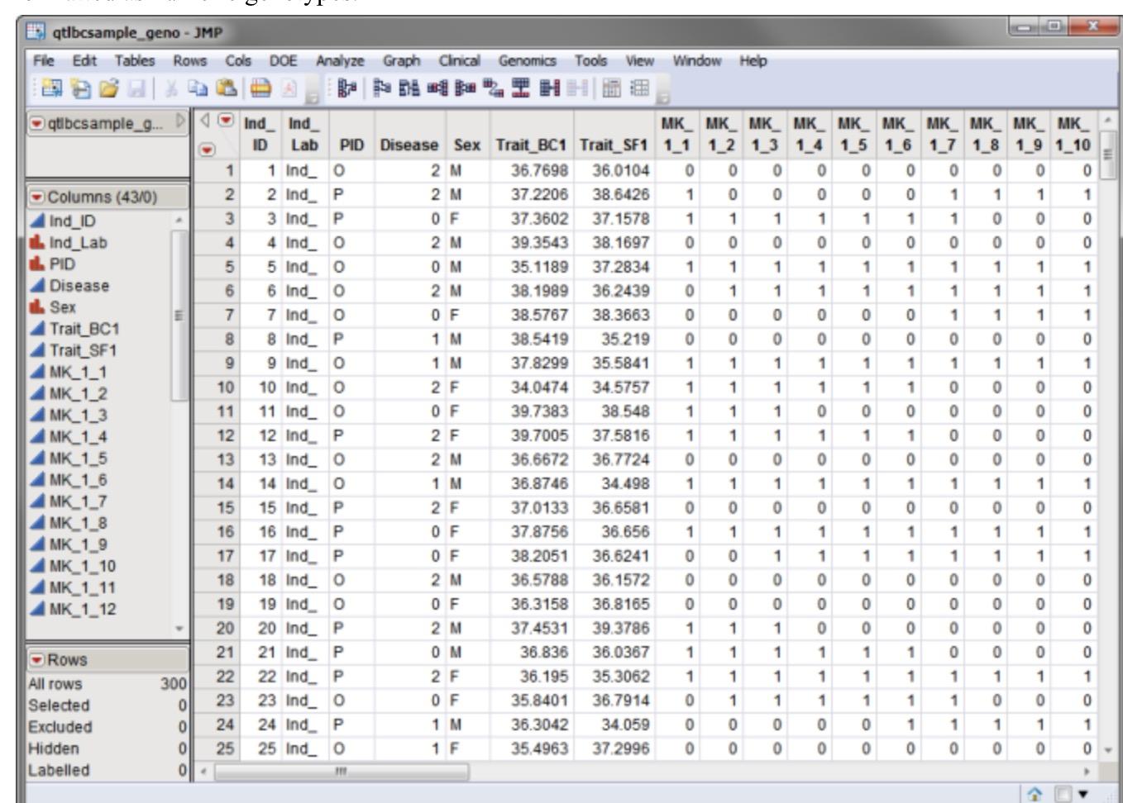
QTL data
Phenotype
Genotype are encoded as 0 or 1
0: AA
1: GG
Marker genotype
(Mackay et al., 2009.)
(https://www.jmp.com/support/downloads/JMPG101_documentation/Content/JMPGUserGuide/PR_G_GN_0048.htm)
Notes:
After we have a brief concept of quantitative trait loci, we may be curious about what is the QTL data looks like? Phenotype consists of a list of different numbers and the marker genotype are encoded as 0 or 1. Here, 0 represents for capital A and capital A, meanwhile, 1 represents for capital G and capital G.

Slide 16
What if a marker is not on a QTL?
Due to financial reason, we can’t sequence the entire genome
We can still make inference of QTL based on sequenced markers due to linkage between them
Sequenced marker
QTL (not sequenced)
(Mackay et al., 2009.)
Notes:
Due to financial reason, we cannot sequence the entire genome. From the the chromosome at right, the orange tag represents for sequenced marker and the pink one is for quantitative trait loci that hasn’t be sequenced. We can see from the chromosome that the orange tag lays very close to the pink one, which means there exists linkage between them. Therefore, we can still make inference of QTL based on sequenced marker due to linkage between them.

Slide 17
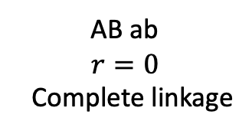
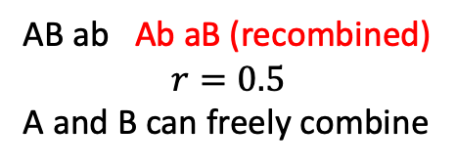
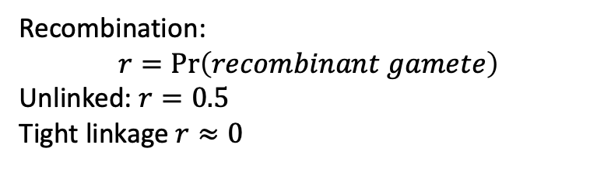
Linkage & Recombination frequency
Linkage = two loci on the same chromosome tend to be inherited together because crossovers between them are infrequent.
Recombination:
$$r=\operatorname{Pr}\left(recombinant gamete\right)$$
Unlinked: $r=0.5$
Tight linkage $r≈0$
A
B
a
b
A
B
a
b
AB ab
$$r=0$$
Complete linkage
AB ab Ab aB (recombined)
$$r=0.5$$
A and B can freely combine
Notes:
At the previous slide, we have mentioned the linkage. Here, we will introduce the concept of linkage. Linkage is two loci on the same chromosome tend to be inherited together because crossovers between them are infrequent. Because the orange marker sits very close to the pink QTL on the chromosome, they are linked. During meiosis, a crossover rarely happens between them, so they usually travel together into the same gamete and are inherited together. By contrast, the blue locus is far from the orange marker. Crossovers often occur between them, so when the orange segment is swapped, the blue one doesn’t go along—they are inherited separately.
Then, let’s move to the concept of recombination. Here, “r” is the probability of recombination gamete. Look at the left one. If loci A and B sit close together on the same chromatid, a crossover between them appears seldomly. The whole segment is passed on intact, so meiosis can only transmit the two parental haplotypes: AB or ab. No Ab or aB is created. Recombination fraction here is r = 0, which means complete linkage. Look at the right one. If A and B are on different chromosomes, they assort independently. Each chromatid combination is equally likely, giving four gamete types: AB, ab (parental) and Ab, aB (recombinant). Each occurs about 25%, so parental = 50%, recombinant = 50%. The recombination fraction is r = 0.5, and we say there is no linkage.

Slide 18
Statistical model for detecting QTL
(Foster, 2006.)
Notes:
Now, we move to the most essential part of this presentation. tistical model for detecting QTL.

Slide 19

Phenotype factor decomposition
Full model: $P=G+E+G×E+residual$
Simplified model:
$$P=G+residual$$
Phenotype
Genetic effect
Environment effect
Co-effect of genome and environment
Phenotype
Genetic effect
Everything else
(Falconer & Mackay, 1996.)
Notes:
In the full model, phenotype equals to genetic effect plus environmental effect plus the co-effect of genome and environment. But in this presentation, we will simplify the model into phenotype equals to genetic effect plus everything else, which can help us focus on the genetic effects and understand the model more easily.

Slide 20
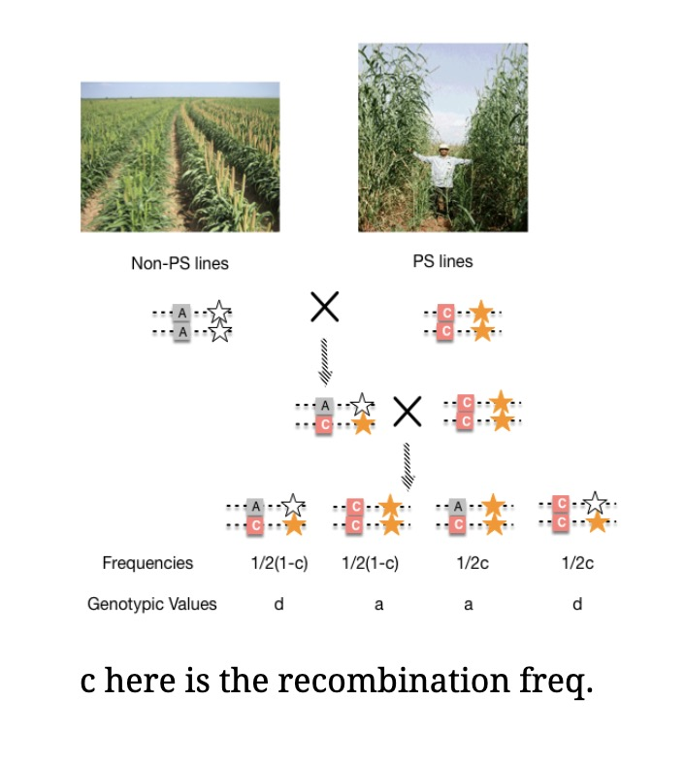
Experimental population
Intercross (F2 X F2) is another frequently used population
Backcross: The target locus is known, markers are well defined, and the aim is to rapidly import and retain the recipient parent background. Advantages: fast controllable genetic background. Disadvantages: not suitable for accumulating many small-effect loci.
(https://www.vedantu.com/biology/test-cross, Vedantu)
(Collard et al., 2005. Foster, 2006.)
Notes:
In the experiment, we usually use backcross. The left illustrator is an example of backcross. In the backcross, the target locus is known, markers are well defined, and the aim is to rapidly import and retain the recipient parent background. The advantage of backcross is fast controllable genetic background. But it is not suitable for accumulating many small-effect loci. Meanwhile, inter-cross is another frequently used population, but due to the limitation of times, we won’t mention the inter-cross for its complexity.

Slide 21
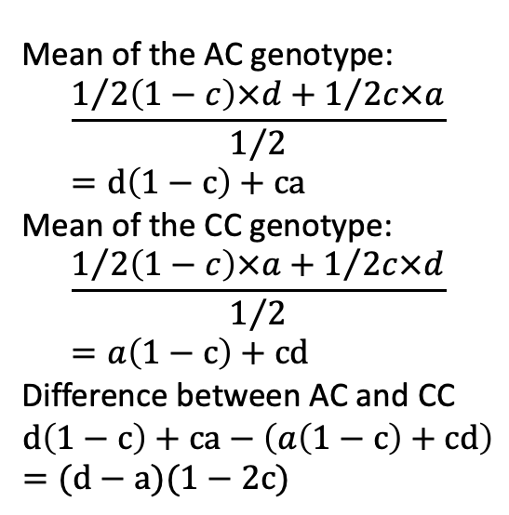
Single marker model
Mean of the AC genotype:
$$\frac{1/{2\left(1−c\right)×d+1/{2c×a}}}{1/2}=d\left(1−c\right)+ca$$
Mean of the CC genotype:
$$\frac{1/{2\left(1−c\right)×a+1/{2c×d}}}{1/2}=a\left(1−c\right)+cd$$
Difference between AC and CC
$$d\left(1−c\right)+ca−\left(a\left(1−c\right)+cd\right)=(d−a)(1−2c)$$
P
F1
F2
(https://jyanglab.com/slides/2024-agro931/week15/w15_c1.html#20 Jyang Lab)
Notes:
Let‘s explain the left illustrator first. The left-side parent has the gamete of A-white star and A-white star. The right-side parent has the gamete of C-yellow star and C-yellow star. The first offspring’s gamete is A-white star and C-yellow star. Then, it backcross with the right-side parent. In the second generation, there are four different gamete, A-white star and C-yellow star, C-yellow star and C-yellow star, A-yellow star and C-yellow star, C-white star and C-yellow star. We will take A-white star and C-yellow star and, A-yellow star and C-yellow star as example and explain them detailed. First, let look at how to produce this gamete and why the frequencies is one over two times one minus c. A-white star comes from the left-side F1, which doesn’t have recombination. So, it is one minus c. And C-yellow star comes from right-side F1, which has half of chance. Therefore, the frequencies of gamete A-white star and C-yellow star is one over two times one minus c. Compared with the first example, in the situation of A-yellow star and C-yellow star. There is a recombination in left side F1 to produce the gamete A-yellow star, so the frequency is c. And C-yellow star comes from right-side F1, which has half of chance. Therefore, the frequencies of gamete A-yellow star and C-yellow star is one over two times c.
Then, let’s turn to the mean of different gamete. In the mean of the AC genotype, we first talk about the numerator, the frequencies times genotypic value is the probability. Then, the ½ in the dominator means the total probability of observing the AC marker genotype in the offspring. And the mean of the CC genotype is the same logic. Therefore, the result of it is a times one minus c and plus c times d.
At last, we want find the difference between AC and CC. So we use the mean of the AC genotype to minus the mean of CC genotype. The result is d minus a times one minus 2c.

Slide 22
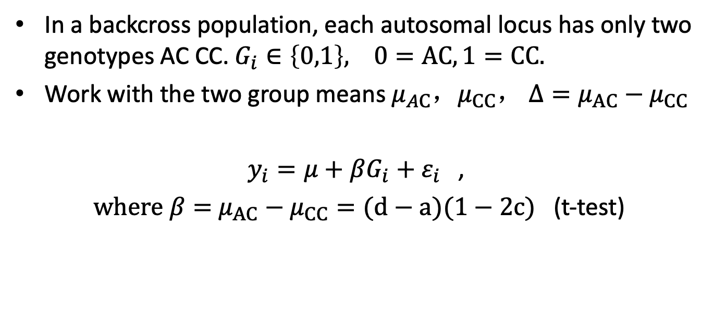
Single Marker Model in Backcross
In a backcross population, each autosomal locus has only two genotypes AC CC. $G_{i}∈\left\{0,1\right\}, 0=AC, 1=CC.$
Work with the two group means $μ_{AC}，μ_{CC}， Δ=μ_{AC}−μ_{CC}$
$y_{i}=μ+βG_{i}+ε_{i}$ ,
$where β=$ $μ_{AC}−μ_{CC}=(d−a)(1−2c)$ (t-test)
(Foster, 2006.)
Notes:
In a backcross population, each autosomal locus has only two genotypes AC CC. And Gi belongs to 0 and 1. Here, we use 0 to represent AC and 1 for CC. The linear model is y_i equals mu plus beta times G_i plus empoison_i. To work with the two group means we have this formular. And we can use t-test to test this formular is equal zero or not. The null hypothesis is mu_AC minus mu_CC equals to 0.

Slide 23
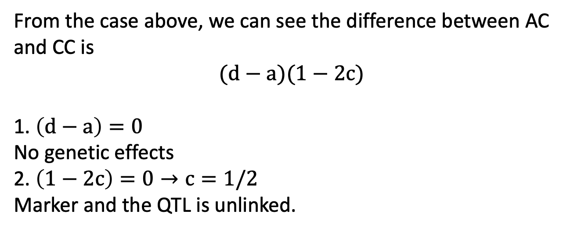
Recombination Frequency
From the case above, we can see the difference between AC and CC is
$$(d−a)(1−2c)$$
1. $\left(d−a\right)=0$
No genetic effects
2. $\left(1−2c\right)=0→c=1/2$
Marker and the QTL is unlinked.
Notes:
From the case above, we can see the difference between AC and CC is $(d−a)(1−2c)$. If this formula equals to zero. The first situation is d minus a equals to zero, which means there isn’t any genetic effects. The other situation is one minus 2c equals 0, here the recombination frequency c is one over two, which means marker and the QTL is unlinked.

Slide 24
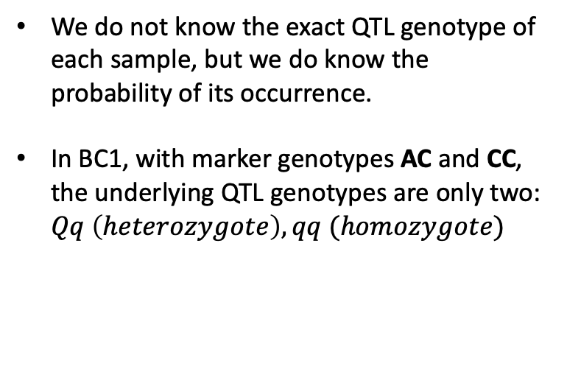
Mixture Distribution
P
We do not know the exact QTL genotype of each sample, but we do know the probability of its occurrence.
In BC1, with marker genotypes AC and CC, the underlying QTL genotypes are only two: $Qq \left(heterozygote\right), qq (homozygote)$
BC1
(Foster, 2006.)
Notes:
In some cases, we do not know the exact QTL genotype of each sample, but we do know the probability of its occurrence. In BC1, with marker genotypes AC and CC, the underlying QTL genotypes are only two: 𝑄𝑞 (ℎ𝑒𝑡𝑒𝑟𝑜𝑧𝑦𝑔𝑜𝑡𝑒), 𝑞𝑞 (ℎ𝑜𝑚𝑜𝑧𝑦𝑔𝑜𝑡𝑒).

Slide 25
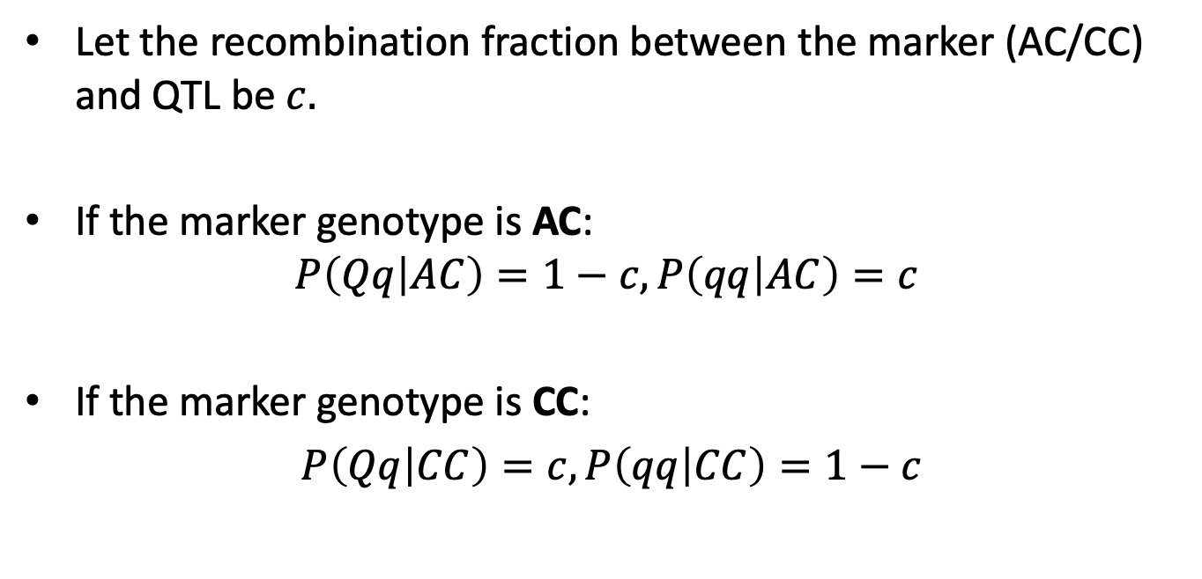
Conditional Probabilities & Mixture Density Function
Let the recombination fraction between the marker (AC/CC) and QTL be $c.$
If the marker genotype is AC:
$$P\left(Qq | AC\right)=1−c, P\left(qq | AC\right)=c$$
If the marker genotype is CC:
$P\left(Qq | CC\right)=c, P\left(qq | CC\right)=1−c$
(Foster, 2006.)
Notes:
Let the recombination fraction between the marker (AC/CC) and QTL be 𝑐. If the marker genotype is AC, the probability of capital Q and lowercase q under the condition of AC is one minus c. The probability of lowercase q and lowercase q under the condition of AC is c. If the marker genotype is CC, the probability of capital Q and lowercase q under the condition of AC is c. The probability of lowercase q and lowercase q under the condition of CC is one minus c.

Slide 26
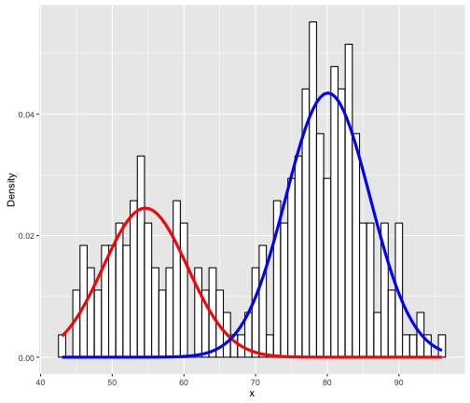
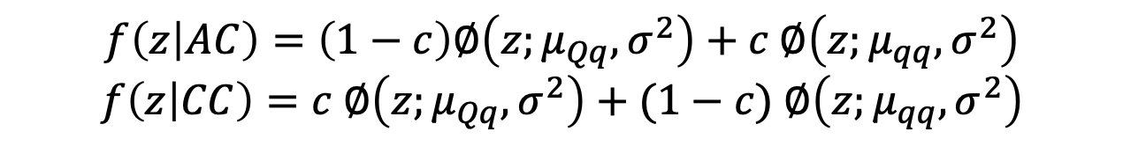
Mixture Distribution
The overall phenotypic distribution (ignoring markers) is a two-component normal mixture:
$$f\left(z | AC\right)=\left(1−c\right)∅\left(z;μ_{Qq},σ^{2}\right)+c ∅\left(z;μ_{qq},σ^{2}\right)$$
$$f\left(z | CC\right)=c ∅\left(z;μ_{Qq},σ^{2}\right)+(1−c) ∅\left(z;μ_{qq},σ^{2}\right)$$
(Foster, 2006.)
Notes:
From the illustrator, we can see the overall phenotypic distribution (ignoring markers) is a two-component normal mixture. The density function of z given the condition of AC is one minus c times the normal distribution whose mean is mu Capital Q lowercase q and variance is sigma square plus c times the normal distribution whose mean is lowercase q lowercase q. Meanwhile, the density function of z given the condition of CC is c times the normal distribution whose mean is mu Capital Q lowercase q and variance is sigma square plus one minus c times the normal distribution whose mean is lowercase q lowercase q.

Slide 27




Multiple markers model
Goal: consider multiple markers simultaneously for a continuous trait, rather than analysing one marker at a time.
$y_{i}=μ+\sum_{j=1}^{p}{x_{ij}β_{j}+ε_{i}}$, $ε_{i}\sim N(0,σ^{2})$
Phenotype of the $i−th$ individual
The effect size of marker $β_{j}$
The numeric coding of marker $j$ for individual $i$
(Foster, 2006.)
Notes:
Then, we move to multiple markers model. The main goal of this model is to consider multiple markers simultaneously for a continuous trait, rather than analysing one marker at a time. From the regression equation, we can see that phenotype of the i-th individual equals the grand mean plus the sum of numeric coding of marker j for individual I times beta_j and plus eposilon_i.

Slide 28
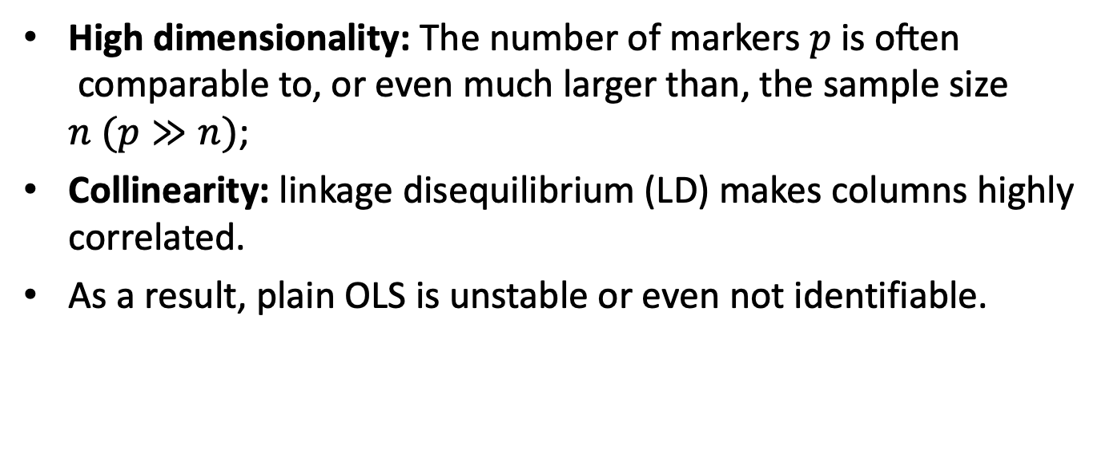
Limitation in Multiple Marker Model
High dimensionality: The number of markers $p \text{is} \text{often} \text{comparable} \text{to}\text{, }\text{or} \text{even} \text{much} \text{larger} \text{than}\text{, }\text{the} \text{sample} \text{size}$ $n (p≫n)$;
Collinearity: linkage disequilibrium (LD) makes columns highly correlated.
As a result, plain OLS is unstable or even not identifiable.
Notes:
The first disadvantage is High dimensionality. The number of markers 𝑝 is often comparable to, or even much larger than, the sample size 𝑛. And the second disadvantage is collinearity. Linkage disequilibrium makes columns highly correlated. Therefore, as a result, plain OLS is unstable or even not identifiable.

Slide 29
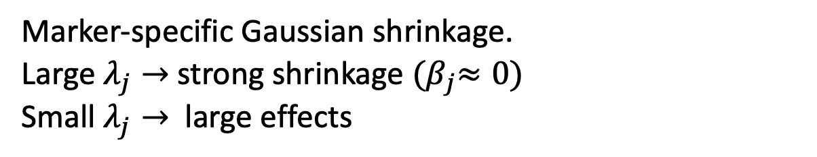
Strategies for Multiple Marker Model
1、Stepwise selection
simple but unstable under high dimension; ignores model uncertainty.
2、Bayesian shrinkage
$$β_{j}∣σ^{2},λ_{j}∼𝒩​\left(0, \frac{σ^{2}}{λ_{j}}\right), λ_{j}∼Gamma\left(α,θ\right)$$
Marker-specific Gaussian shrinkage.
Large $λ_{j}→$ strong shrinkage ${(β}_{j}≈0)$
Small $λ_{j}→$ large effects
(Foster, 2006.)
Notes:
Due to the limitation of multiple marker model, we propose three strategies to solve this problem. The first one is stepwise selection. We adopt AIC or BIC selection to choose the model whose AIC or BIC score is the lowest. Stepwise selection is simple but unstable under high dimension. Meanwhile, it ignores model uncertainty. The second method is Bayesian shrinkage. For each marker coefficient beta_j, we assign a zero-mean normal prior with variance sigma square over lamda_j. Then, we place a Gamma prior on lamda_j. This is the normal-gamma structure. Larger lamda_j leads to smaller prior variance sigma square over lamda_j, which means stronger shrinkage and beta_j is pulled toward 0. Smaller lamda_j leads to larger prior variance, which allows larger effects. In effect, each marker gets its own shrinkage strength, achieving adaptive sparsity: most noise markers are heavily shrunk, while a small set of true signals is allowed through.

Slide 30
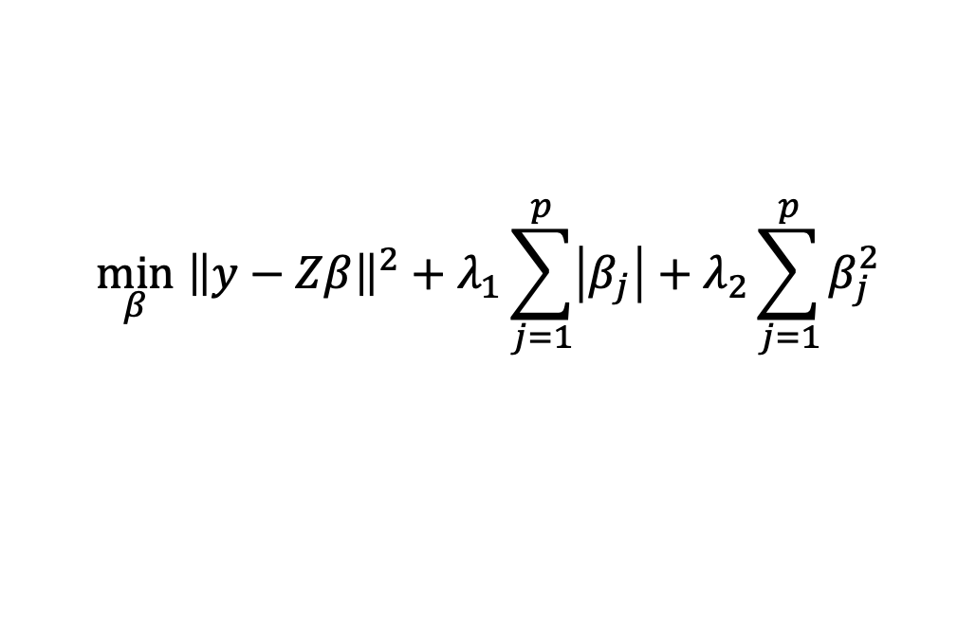
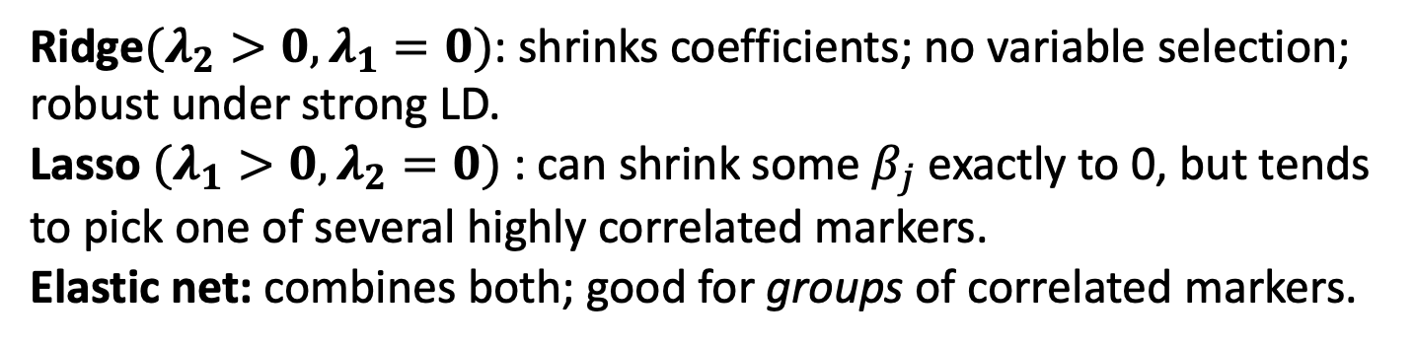
3、Penalized regression-Elastic Net
$$\min_{β} {\left\|y−Zβ\right\|}^{2}+λ_{1}\sum_{j=1}^{p}{\left|β_{j}\right|+λ_{2}\sum_{j=1}^{p}{β_{j}^{2}}}$$
Fitting residuals
L1 penalty
L2 penalty
Ridge$(λ_{2}>0,λ_{1}=0)$: shrinks coefficients; no variable selection; robust under strong LD.
Lasso $(λ_{1}>0,λ_{2}=0)$ : can shrink some $β_{j}$ exactly to 0, but tends to pick one of several highly correlated markers.
Elastic net: combines both; good for groups of correlated markers.
(Foster, ch. 1, citing Hoerl & Kennard, 1970a, 1970b; Lindley & Smith, 1972; Frank & Friedman, 1993; Breiman, 1995; Tibshirani, 1996; Fu, 1998; Zou & Hastie, 2005)
Notes:
For ridge, lamda_2 greater than zero and lamda_1 equals 0 using L2 shrinkage only: all coefficients are shrunk but not to zero, so no variable selection. It is stable under strong correlation (strong LD) and won’t arbitrarily pick one of several correlated variables. For Lasso, lamda_1 greater than zero and lamda_2 equals 0 using L1 shrinkage can push some beta_j exactly to zero, which leads to variable selection. But it also has limitations. It often keeps just one and drops the rest, making the solution unstable. Therefore, we use elastic net, which combines L1 plus L2. L2 yields a grouping effect, which means highly correlated variables tend to leave together; L1 keeps sparsity, which can zero out irrelevant variables. Elastic net method is especially suitable for cluster markers in LD.

Slide 31
Recommendation for the models
Single-Marker Model: Few QTLs with moderate–large effects; quick screening on backcross.
Multiple-Marker Model: Many small/medium effects; need conditional effects while controlling other loci.
Elastic Net Strategy: Combines sparsity + grouping of correlated markers → stable selection; Controls overfitting with shrinkage.
Notes:
If there is a few QTLs with moderate to large effects and need a quick screening on backcross, we recommend to choosing single marker model. Multiple marker model is suitable for many small to medium effects, which need conditional effects while controlling other loci. If the multiple marker model needs strategy to improve, we will adapt elastic net strategy, which combines sparsity and grouping of correlated markers, leading to a stable selection. Besides, it also controls overfitting with shrinkage.

Slide 32
What we will do in the future
Develop an interactive R shiny app, which will allow user to simulate quantitative traits.
Sample size calculation to save the cost of sequencing markers when handle with large sample size.
Notes:
The last part is what we will do in the future. We will develop an interactive R shiny app, which will allow user to simulate quantitative traits. This tool will allow researchers to simulate quantitative traits from genotype data using user-defined models and assess the statistical power under different sample sizes, heritability assumptions, and population structures. As we mentioned before, sequencing marker is very expensive. Therefore, sample size calculation to save the cost of sequencing markers when handle with large sample size.

Slide 33
Reference
Broman, K. W., & Sen, Ś. (2009). A guide to QTL mapping with R/qtl. Springer.
Collard, B. C. Y., Jahufer, M. Z. Z., Brouwer, J. B., & Pang, E. C. K. (2005). An introduction to markers, quantitative trait loci (QTL) mapping and marker-assisted selection for crop improvement: The basic concepts. Euphytica, 142, 169–196.
Falconer, D. S., & Mackay, T. F. C. (1996). Introduction to quantitative genetics (4th ed.). Prentice Hall.
Foster, S. (2006). The LASSO linear mixed model for mapping quantitative trait loci [Doctoral dissertation, The University of Adelaide].
Hastie, T., Tibshirani, R., & Friedman, J. (2009). The elements of statistical learning (2nd ed.). Springer.
Mackay, T. F. C., Stone, E. A., & Ayroles, J. F. (2009). The genetics of quantitative traits: Challenges and prospects. Nature Reviews Genetics, 10, 565–577.
Miller, A. (2002). Subset selection in regression (2nd ed.). Chapman & Hall/CRC.
Wu, R., Ma, C.-X., & Casella, G. (2007). Statistical genetics of quantitative traits: Linkage, maps and QTL. Springer.
Yi, N., & Shriner, D. (2008). Advances in Bayesian multiple quantitative trait loci mapping in experimental crosses. Heredity, 100, 240–252.
Notes:
These are all paper I cited in this presentation and warmly welcome to any questions.

