Slide 1
Machine Problem 2 overview -- Implement the basic paging system in our kernel.
By: Sidian Wu

Slide 2
Two important concepts (page & frame)
We break physical memory into fixed-sized blocks called frames and breaking logical memory into blocks of the same size called pages.
Note that though page size vary from different OS, the size of page and frame has to be consistent in each OS. People also called frame -- page frame.

Slide 3
In this project, we are supposed to implement our own frame class and page table class to enable paging system.
The main files have to be created or modified would be:
frame_pool.H
frame_pool.C
page_table.C
We will start from frame first because it makes more sense to beginner and easier to implement.

Slide 4
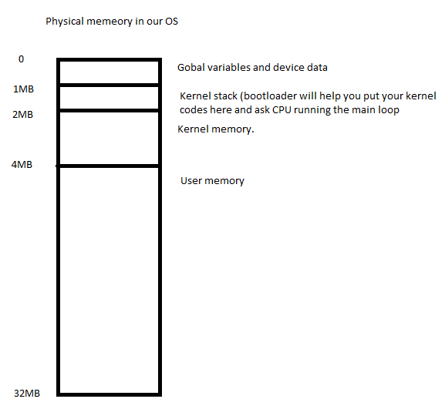
Layout of our OS memory
1. 32MB in total.
2. The first 4MB memory is for kernel. The rest is for user programs. (User space memory). The pages for kernel are directly mapping to their corresponding frames while they could be different for user memory.

Slide 5
Frame Pool
Supposed we cut off our memory into 4KB pieces, and we call each piece a frame. Frame pool is the manger of all the frames.
In our project, we will created two frame pool that are in charge of kernel memory space (2MB-4MB) and user memory space (4M-32MB).
You can see them in kernel.C

Slide 6
Dig into frame_pool
Private variable you need to think about
A list that indicates whether frames are used or not? This is the core of frame management. You can implement it in different way and the easiest way is probably bitmap here. (If you haven’t heard bitmap yet, imagine it’s a binary string. Eg. 1010110)
Start_frame. This is a physical memory address that your first frame starts. (Eg. Kernel memory pool starts at 2MB.)
Pool_size. Just a member that tells how many frames in your pool. (Eg. Kernel memory pool has all frames from 2M to 4M. Therefore it has (4MB-2MB) /4KB = 512 frames in total.

Slide 7
Frame_pool::frame_pool
Initialize your list. Make all frames in your pool available. If you are using bitmap implementation, set it all 0 or 1.

Slide 8
Frame_pool::get_frame
Consider it a low-level form of function malloc in C or reserved word ‘new’ in C++. You basically check your list and pick up one available frame. You also have to make it unavailable after that.
The most primitive way to ask for memory space…
If you want to ask a system for memory space before you have malloc or even get_frame(). The most primitive way is:
unsigned int * variable = 0x00000000.
This will apply in the same way when you want to use get_frame() later. Eg.unsigned int * variable = get_frame() * 4096 (4KB);
The reason to set it as unsigned int is because memory is a 32bit long positive number, which is the same as unsigned long.

Slide 9
FramePool::mark_inaccessible()
Mark parts of your frames in the pool unavailable, not a big deal if you complete the methods ahead.

Slide 10
FramePool::release_frame
When people release their memory space, we set those frames available again for later use.

Slide 11
If you understand what earlier slides talked about, it should help you implement Frame_pool yourself.
Let’s put our dirty hands into Page_table now.

Slide 12
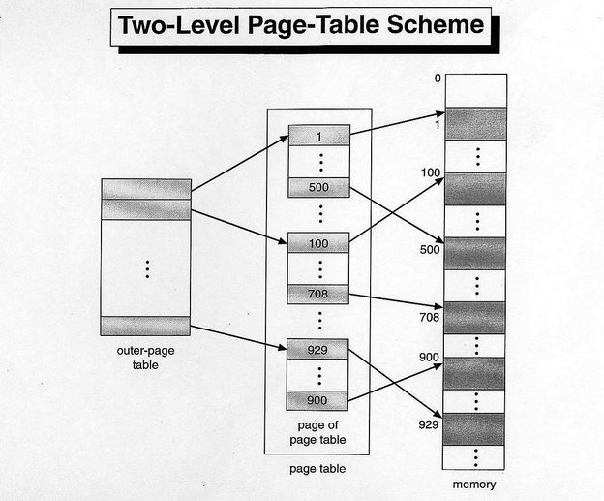
This is the best picture I could find and our page table work in the same way as it. People called it two-level page-table. The outer-page table consists of pointer to page_table. In our project, we call it directory. Both directory and page table are 4 KB long which means they are able to store at most 1024 entries(pointers). Therefore, a directory is able to map into 1k page tables and each page table is able to map to 1k frames.
Since each frame is 4KB long, the total memory size a directory is able to map would be 1k * 1k * 4KB = 4GB. But this is never gonna happen.

Slide 13
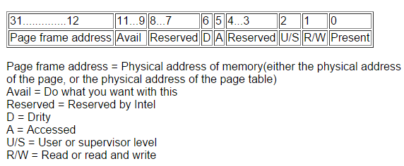
Let get further into Page_table entry . Since each entry will be a frame address, and each frame address is always a multiple of 4KB, the last 12 bits for each frame address will always be 0. (4KB is 2^12)
The first 20 bits are enough to indicate a unique frame in the memory and we can use the rest bits as some flags.
More information could be found at http://www.osdever.net/tutorials/view/implementing-basic-paging

Slide 14
Now let’s look at our Page_table

Slide 15
PageTable::init_paging()
Nothing difficult here. Pass the parameters to your private variables and remember to set paging_enable to false now.

Slide 16
PageTable::PageTable()
This is the most difficult part in this project I think. It’s not difficult to implement but it is difficult to understand what do we have to do here. Before we talk about it, let’s have a overall picture of how our OS is working.
When your bochs boots, start.asm is read first from your floppy image file. It set up some global variables we don’t need to care of and put kernel.C into the kernel memory stack (1MB-2MB). Then it tells CPU run the code from main loop and your OS wakes up!
The paging system is not yet working right now. The CPU treats all addresses in your program as physical memory addresses.

Slide 17
In fact, it is not until “PageTable::enable_paging();”, does CPU understand your purpose and start to treat each memory addresses as logical address.
Why doesn’t CPU mess up when we switch the memory reading mode? Because the memory for kernel is directly mapped. In another word, the logical addresses here are the same as physical.

Slide 18
Now, let’s look back to PageTable::PageTable()
Are we supposed to map all memory address (32MB) into our page_table as soon as we create Page_table instance?
We don’t as we can’t as well. It’s not direct mapping between pages and frames for user space memory. In fact, we only deal with direct mapping here and leave other stuff to PageTable::handle_fault().

Slide 19
Therefore, the first thing we need to do is to initialize page_directory (we need give it a frame to store entries)
We also need a frame for the first page table in the directory since the first page table maps address from 0-4MB, this is just the size as our kernel memory address. We initialize the first page_table by filling each entries with the real physical address start from 0KB.
(Remember you also need to add flags for each entry though most of them won’t be used in this project)
Done!

Slide 20
PageTable::load()
PageTable::enable_paging()
Those two methods are not difficult to implement. But you need some knowledge towards operations on registers. There is a file called paging_lwo.asm that has already defined the functions you need. Read the handout and try to invoke them here.

Slide 21
PageTable::handle_fault()
All the page fault happens when your page table is missing the entries that are supposed to tell CPU where the physical address are.
More specific this project (in Kernel.C)
int *foo = (int *) FAULT_ADDR;
int i;
for (i=0; i<NACCESS; i++) {
foo[i] = i;
}
\

Slide 22
Those evil sentences assigns addresses that have no record in our paging system (addresses larger than 4MB)
Therefore, the most important thing we have to do in handle_fault() is to make a record in our paging system and ask frames for them. We can find the fault address from CR2 register. Class Console will help you shout out some words in the screen while page fault happens as well.

