Slide 1
MACHINE PROBLEM 3 Overview -- Implement the virtual memory system
By: Sidian Wu

Slide 2
What is virtual memory
-- Logical memory address.
Pro: Can be larger than physical memory, which allows users to run more programs in their computer. It also more flexible than physical memory.

Slide 3
“I had implemented paging in MP2, it coverts logical address into physical, what’s the difference…”
Paging is only parts of VM system. Besides page table, VM also has some interfaces.
Eg.
Previous: addr = 0xFFFFFFFF;
Now: addr = allocate() or addr = new int;
In addition, VM enables users allocating more memory than 32MB.

Slide 4
The files that have to be crated or modified would be:
frame_pool.H
frame_pool.C
page_table.C
vm_pool.H
vm_pool.C

Slide 5
Since MP3 is on the top of MP2, you need reusing some of you codes in the previous work.
Frame pool remains the same it is in MP2. If you have made it work, copy files and replace them.

Slide 6
Changes in page_table.C
-- recursive page table
There is only two things need to be changed in page_table. The first one is simple -- adding a VMPool reference under register_vmpool().
The other is quite complicated… In the previous assignment, we don’t consider the situation when large amount of memory is in demand. Since one page is able to map 4MB address. 8 pages are enough and it is not a big deal to store all of them in the kernel_mem_pool (direct mapping)

Slide 7
Not enough…
However, VM enables 4GB logical memory in total (1024 pages).
Meanwhile, your kernel_mem_pool only has 512 frames in total.
We have to store them in proc_mem_pool
Problem occurs…

Slide 8
Assume page fault happens, you used to check your page_directory to see if the page is presented or not and then map it to a physical address…
But you have enabled paging, how to find page_directory in memory?

Slide 9
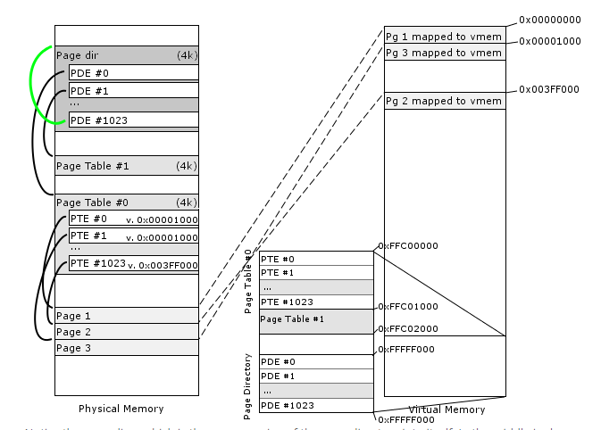
recursive page table
This is quite tricky. Read handout carefully and if you have time, I highly recommend a thread that is talking about it.
http://www.rohitab.com/discuss/topic/31139-tutorial-paging-memory-mapping-with-a-recursive-page-directory/

Slide 10
It is not hard to implement it once you understand what is going on. Most of changes would be PageTable::handle_fault()
The thread above also provides some codes segment, copy them into your method. SWEET!

Slide 11
VM_POOL
Let’s move on to VM_POOL.
It’s actually similar to Frame pool. Would not be hard if you understand frame pool previously.

Slide 12
Private variables
Similar to Frame pool, you need a record for which address has been occupied and which is still available.

Slide 13
VMPool::allocate(unsigned long _size)
Looking on the record, find a chunk of space depends on how large _size. There are difference algorithm here such as first-fit, wrost-fit, best-fit. Pick one up!
Return the beginning address.
The space must be contiguous in VM pool.
Recap in C++:
int a = new[10]; &a[n] is always following &a[n-1]

Slide 14
VMPool::release()
The opposite side of allocating.
VMPool::is_legitimate(unsigned long _address)
Check if current Vmpool is in charge of _address.
Those two are not too hard.

