Slide 1
Trump's China Visit: Stock Market Impact Analysis
November 8-10, 2017 | $250 Billion Trade Deals

Slide 2
Executive Summary
• President Trump visited China on November 8-10, 2017
• First state visit by a U.S. president since the founding of PRC
• Over $250 billion in trade deals announced
• Major sectors impacted: Energy, Aviation, Semiconductors, Manufacturing
• Chinese stock market showed positive reaction with 61.7% of stocks gaining
• Average market gain of +1.17% during the 3-day visit period

Slide 3
The Historic Visit & Trade Deals
• ENERGY: $84B West Virginia shale gas investment
• $43B Alaska LNG deal with Sinopec
•
• AVIATION: $37B Boeing deal for 300 aircraft
•
• TECHNOLOGY: $12B Qualcomm deals with Chinese smartphone makers
•
• AUTOMOTIVE: $10B Ford vehicle exports
• $756M Ford-Zotye EV joint venture
•
• AGRICULTURE: $5B soybean purchase agreements
•
• FINANCE: $5B Goldman Sachs-CIC investment fund

Slide 4
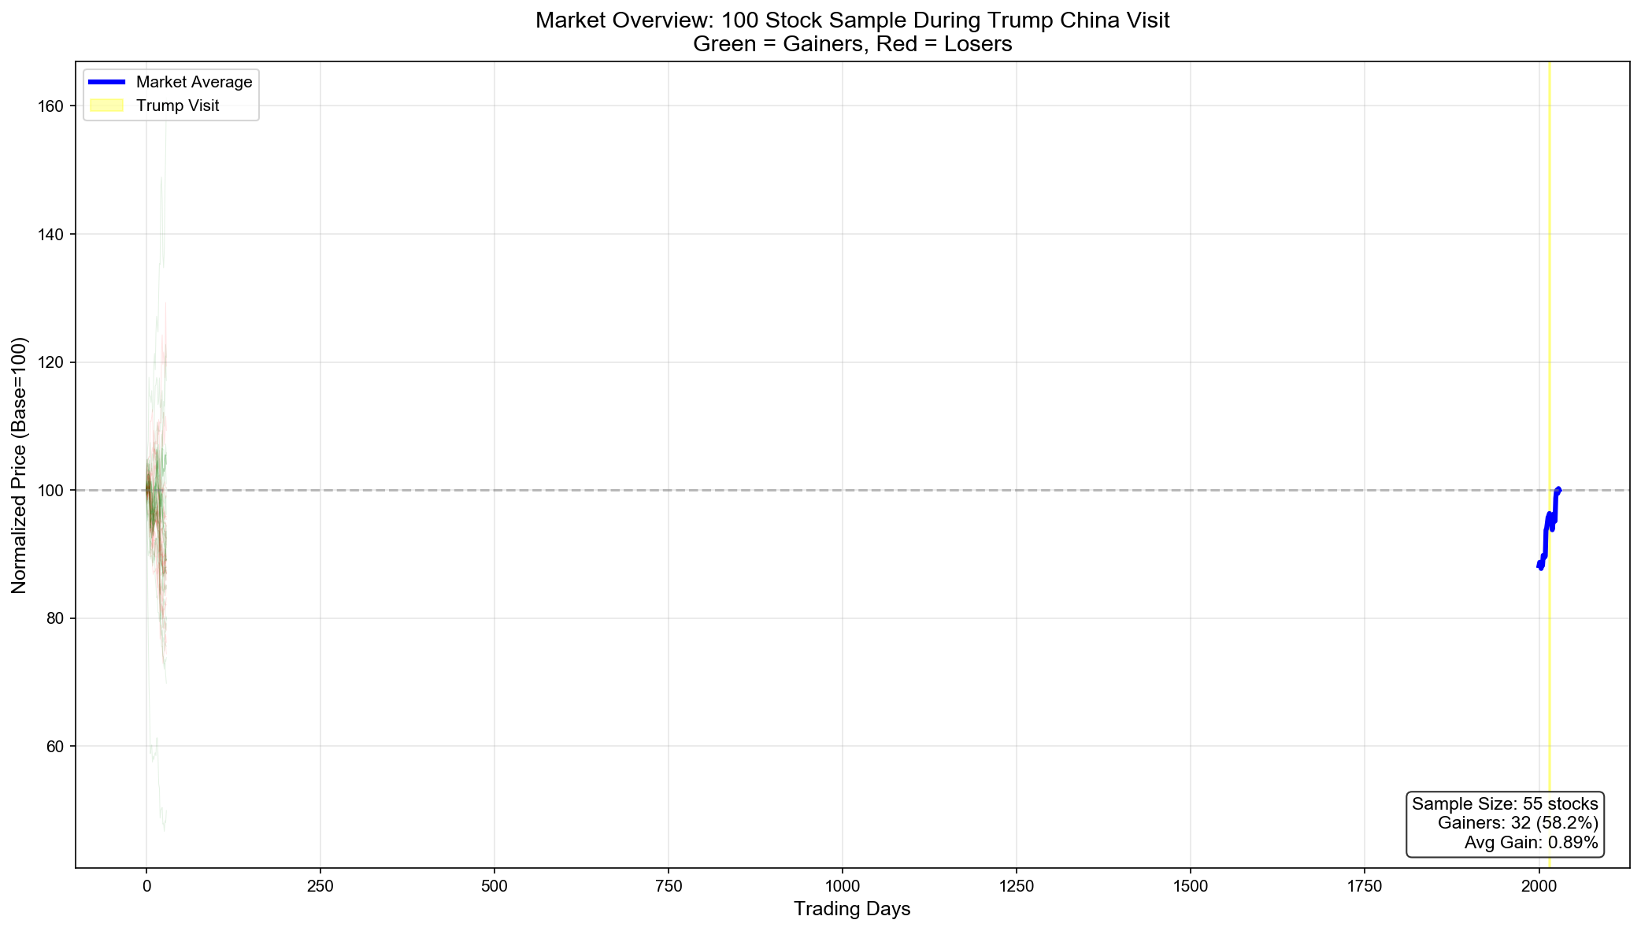
Overall Market Reaction

Slide 5
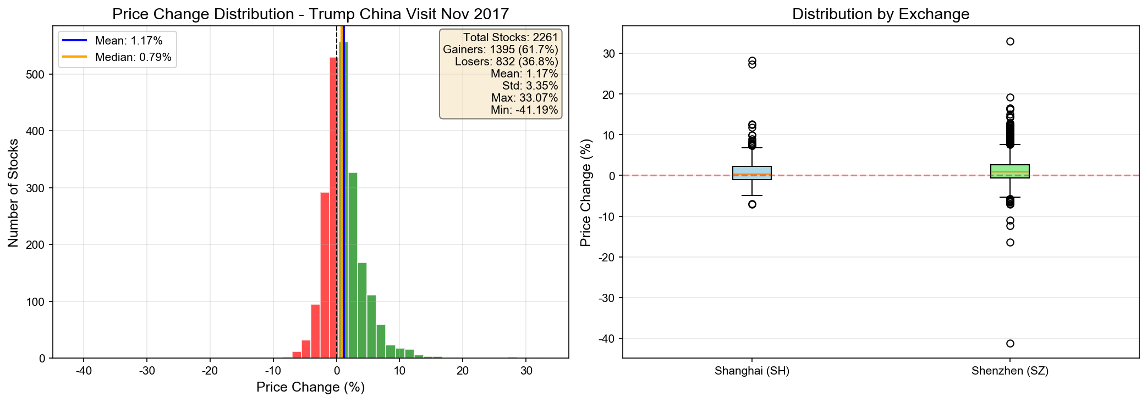
Price Change Distribution Across All Stocks

Slide 6
Key Findings
61.7%
+1.17%
+33%
$250B
of stocks gained during the visit
average market gain
top performer gain (雅克科技)
total trade deals signed

Slide 7
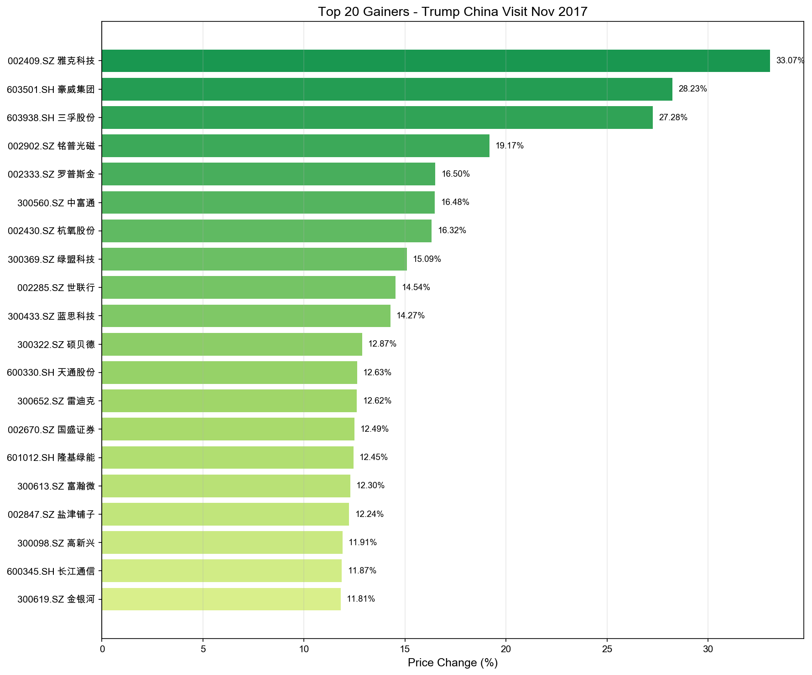
Top 20 Gaining Stocks During Trump's Visit

Slide 8
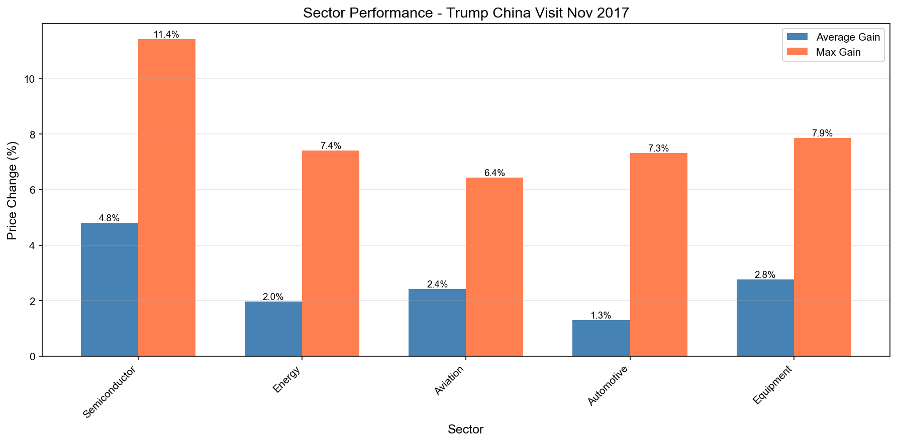
Sector Performance Comparison
• Semiconductor sector led with +4.8% average gain
• Aligned with Qualcomm's $12B deals
•
• Equipment/Manufacturing: +2.8% average
• Benefited from Caterpillar, GE partnerships
•
• Aviation: +2.4% average
• Boeing's $37B aircraft order boost
•
• Energy: +2.0% average
• LNG and shale gas deal impact
•
• Automotive: +1.3% average
• Ford and GM deal benefits

Slide 9
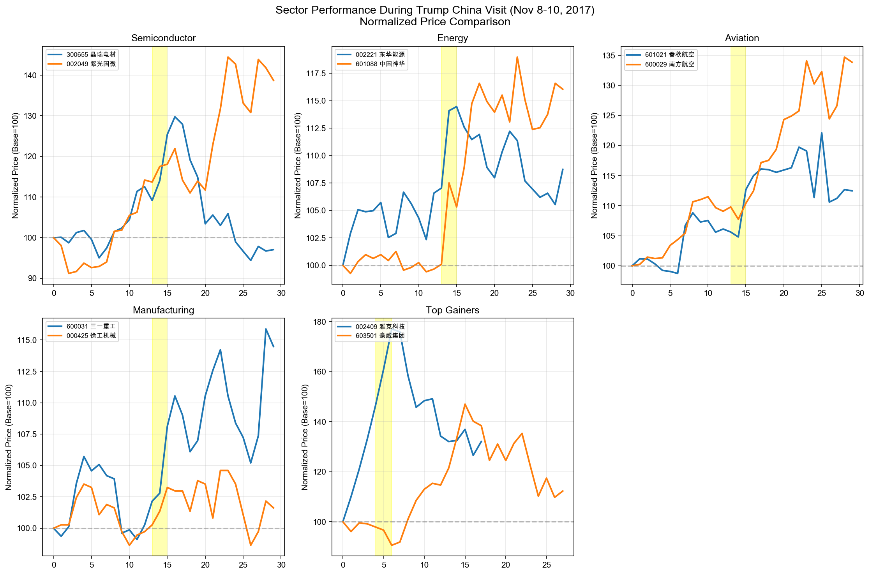
Normalized Price Comparison by Sector

Slide 10
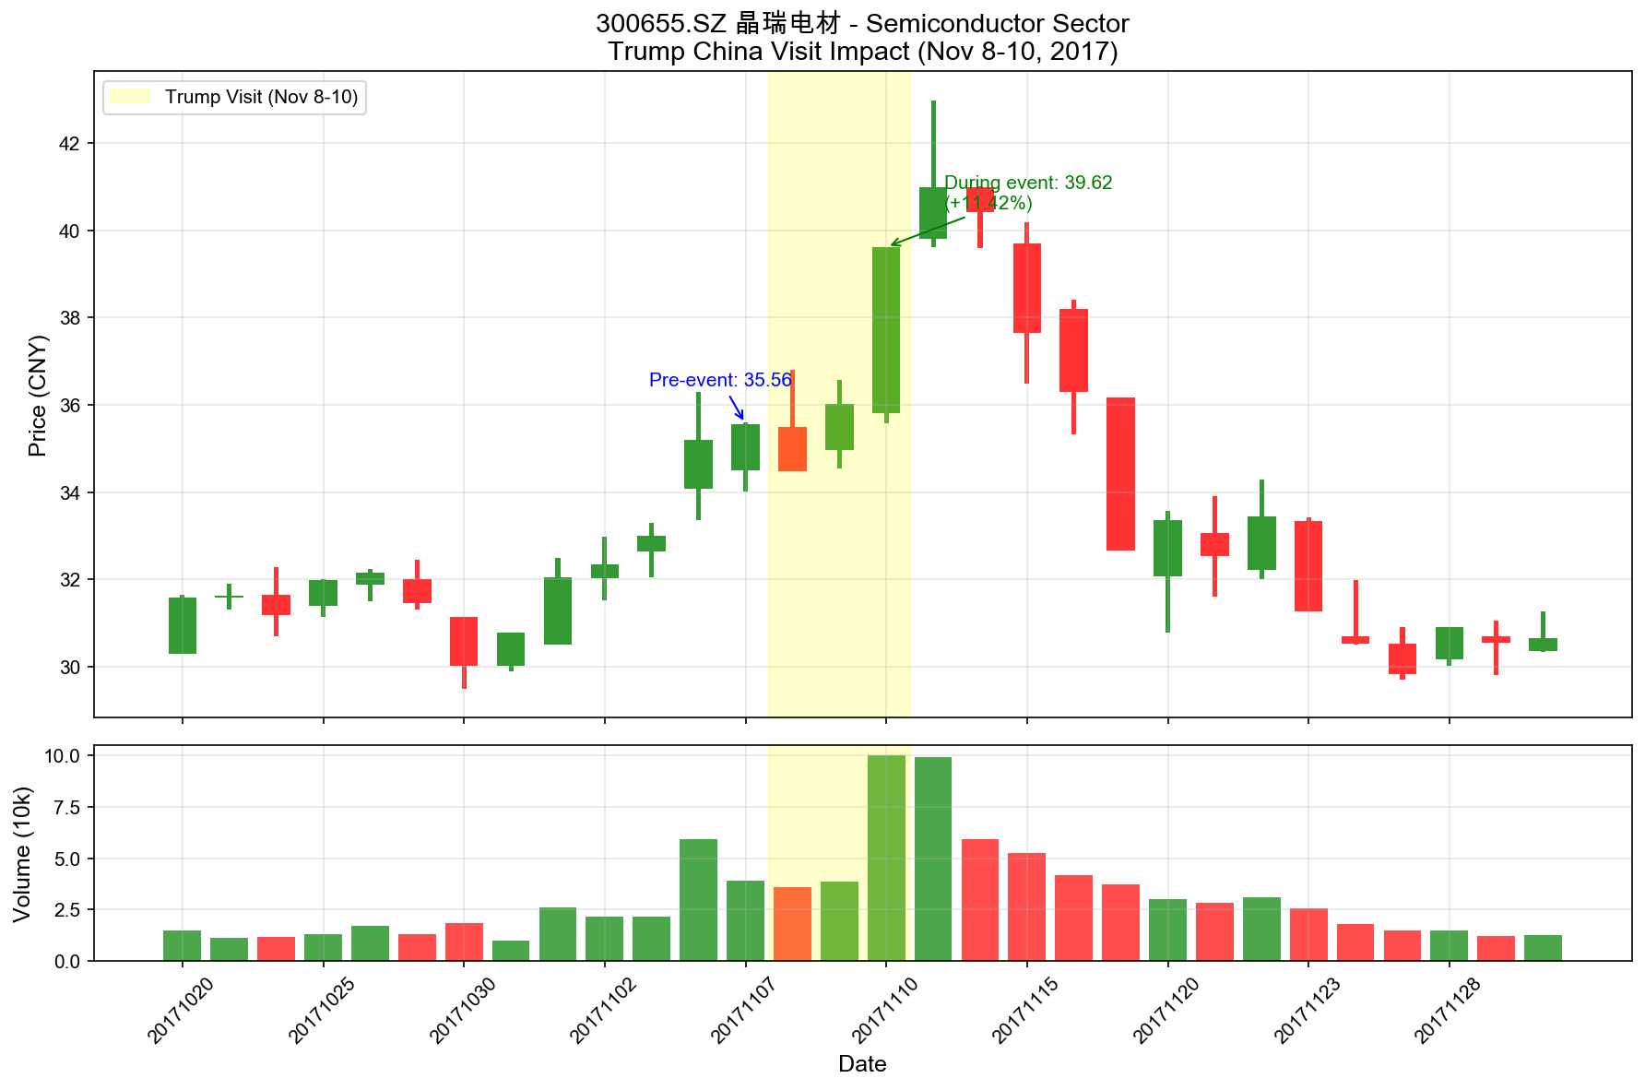
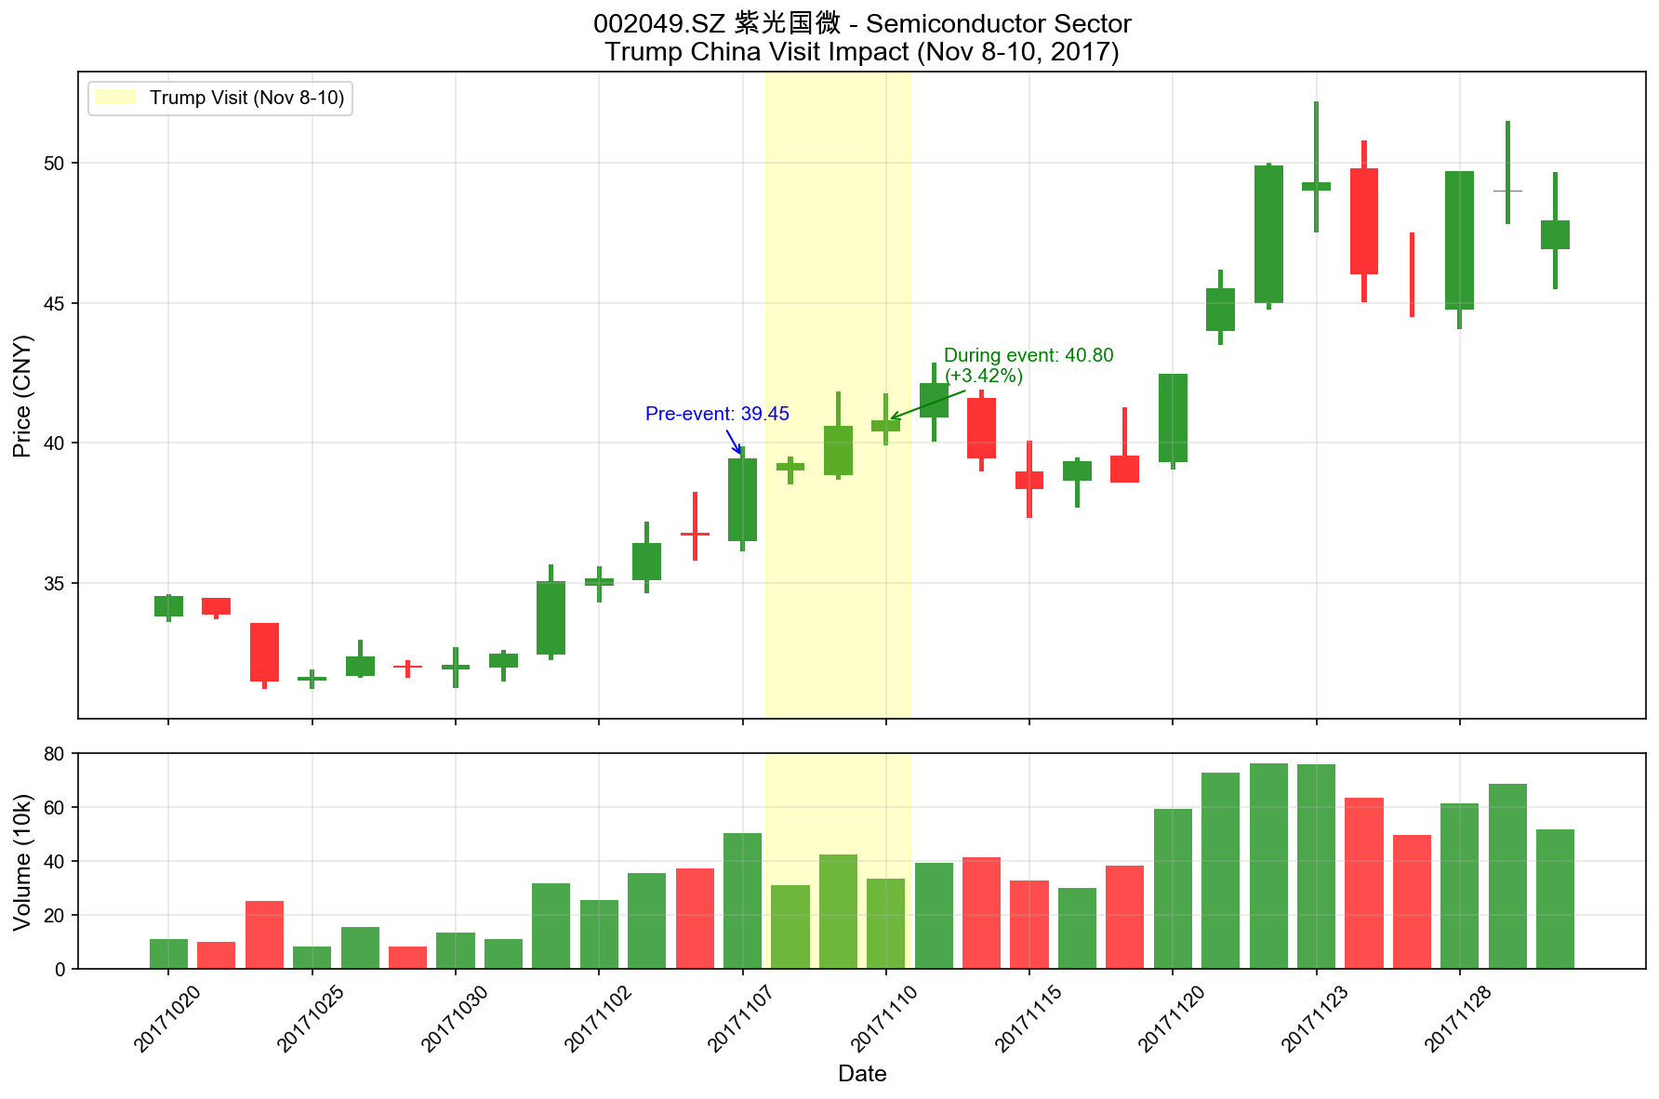
Semiconductor Sector: Qualcomm Deal Beneficiaries
300655.SZ 晶瑞电材 (+11.4%)
002049.SZ 紫光国微 (+3.4%)

Slide 11
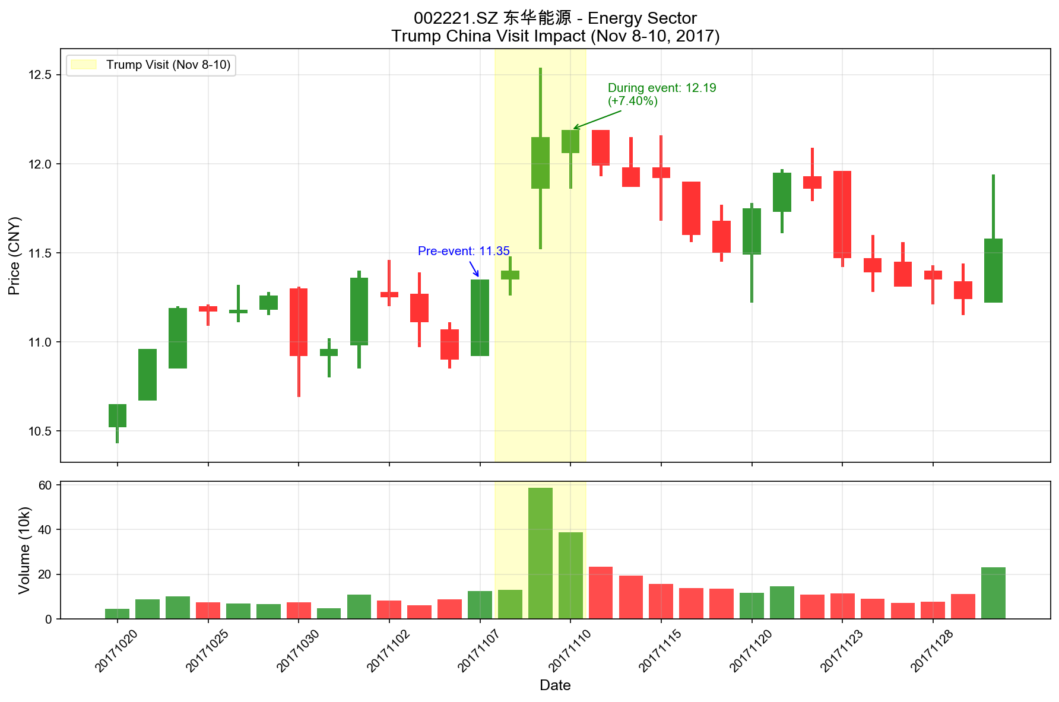
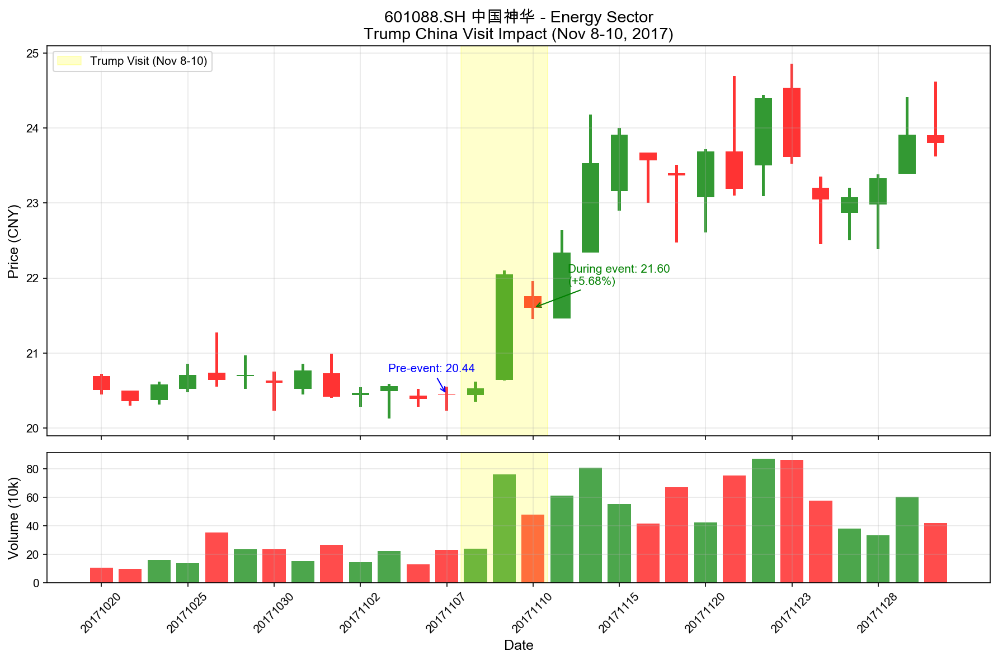
Energy Sector: LNG & Shale Gas Deal Impact
002221.SZ 东华能源 (+7.4%)
601088.SH 中国神华 (+4.9%)

Slide 12
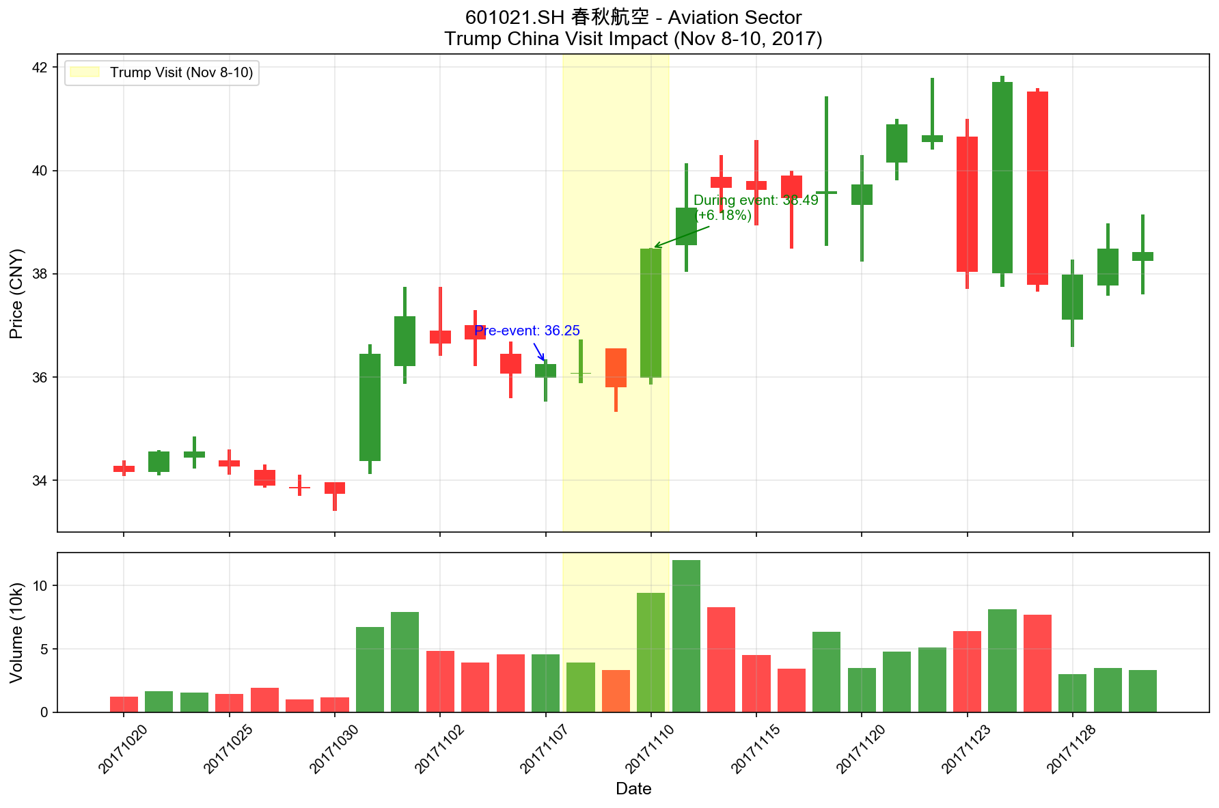
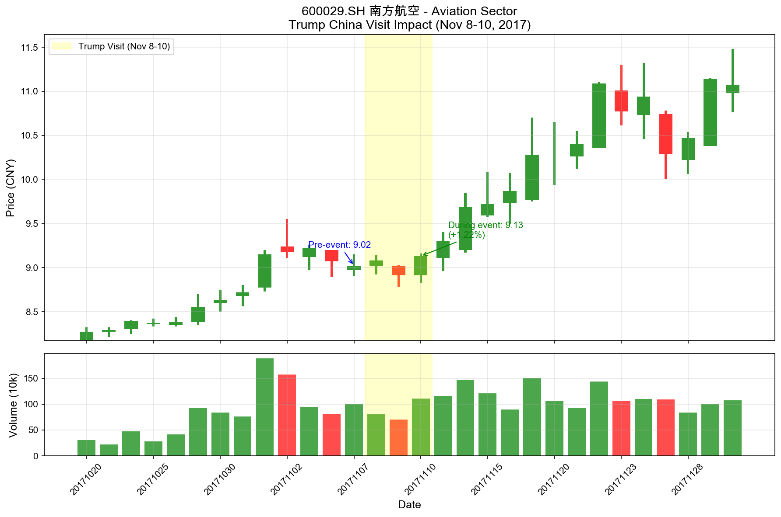
Aviation Sector: Boeing Aircraft Order Impact
601021.SH 春秋航空 (+6.2%)
600029.SH 南方航空 (+1.2%)

Slide 13
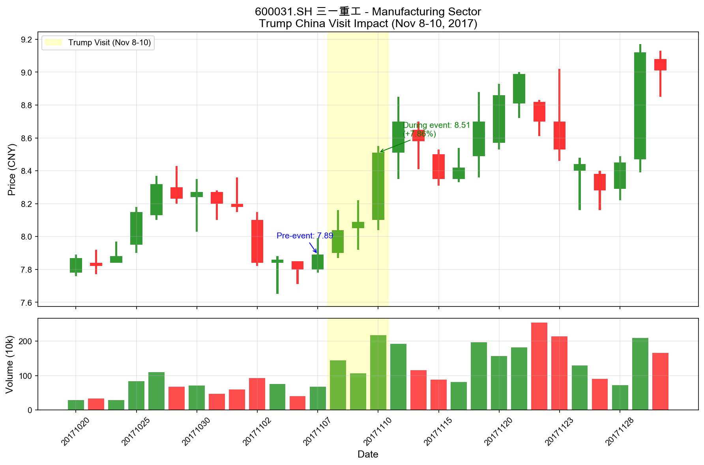
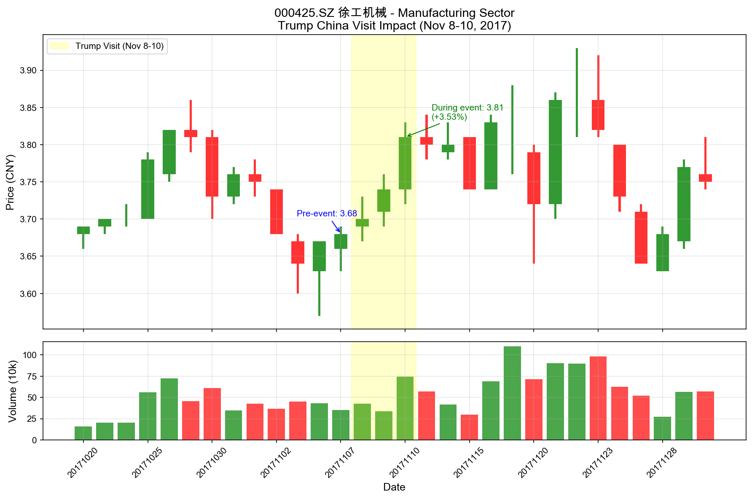
Manufacturing: Caterpillar & GE Partnership Benefits
600031.SH 三一重工 (+7.9%)
000425.SZ 徐工机械 (+3.5%)

Slide 14
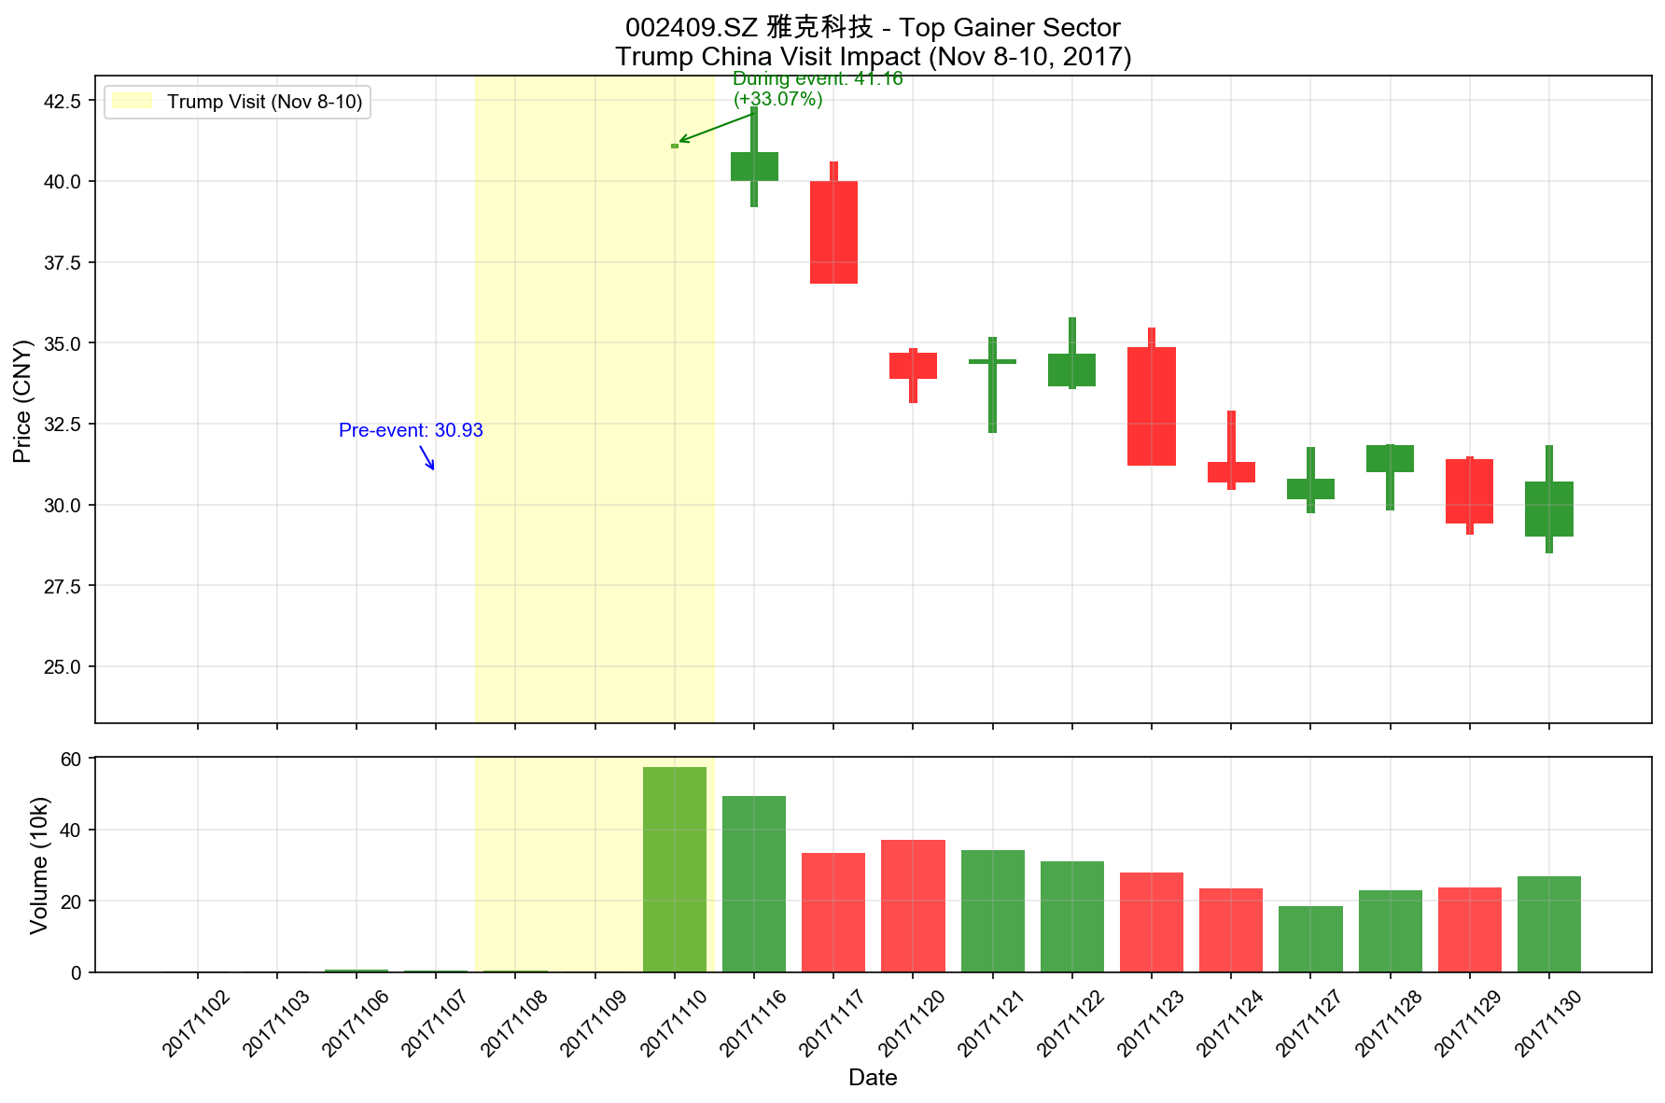
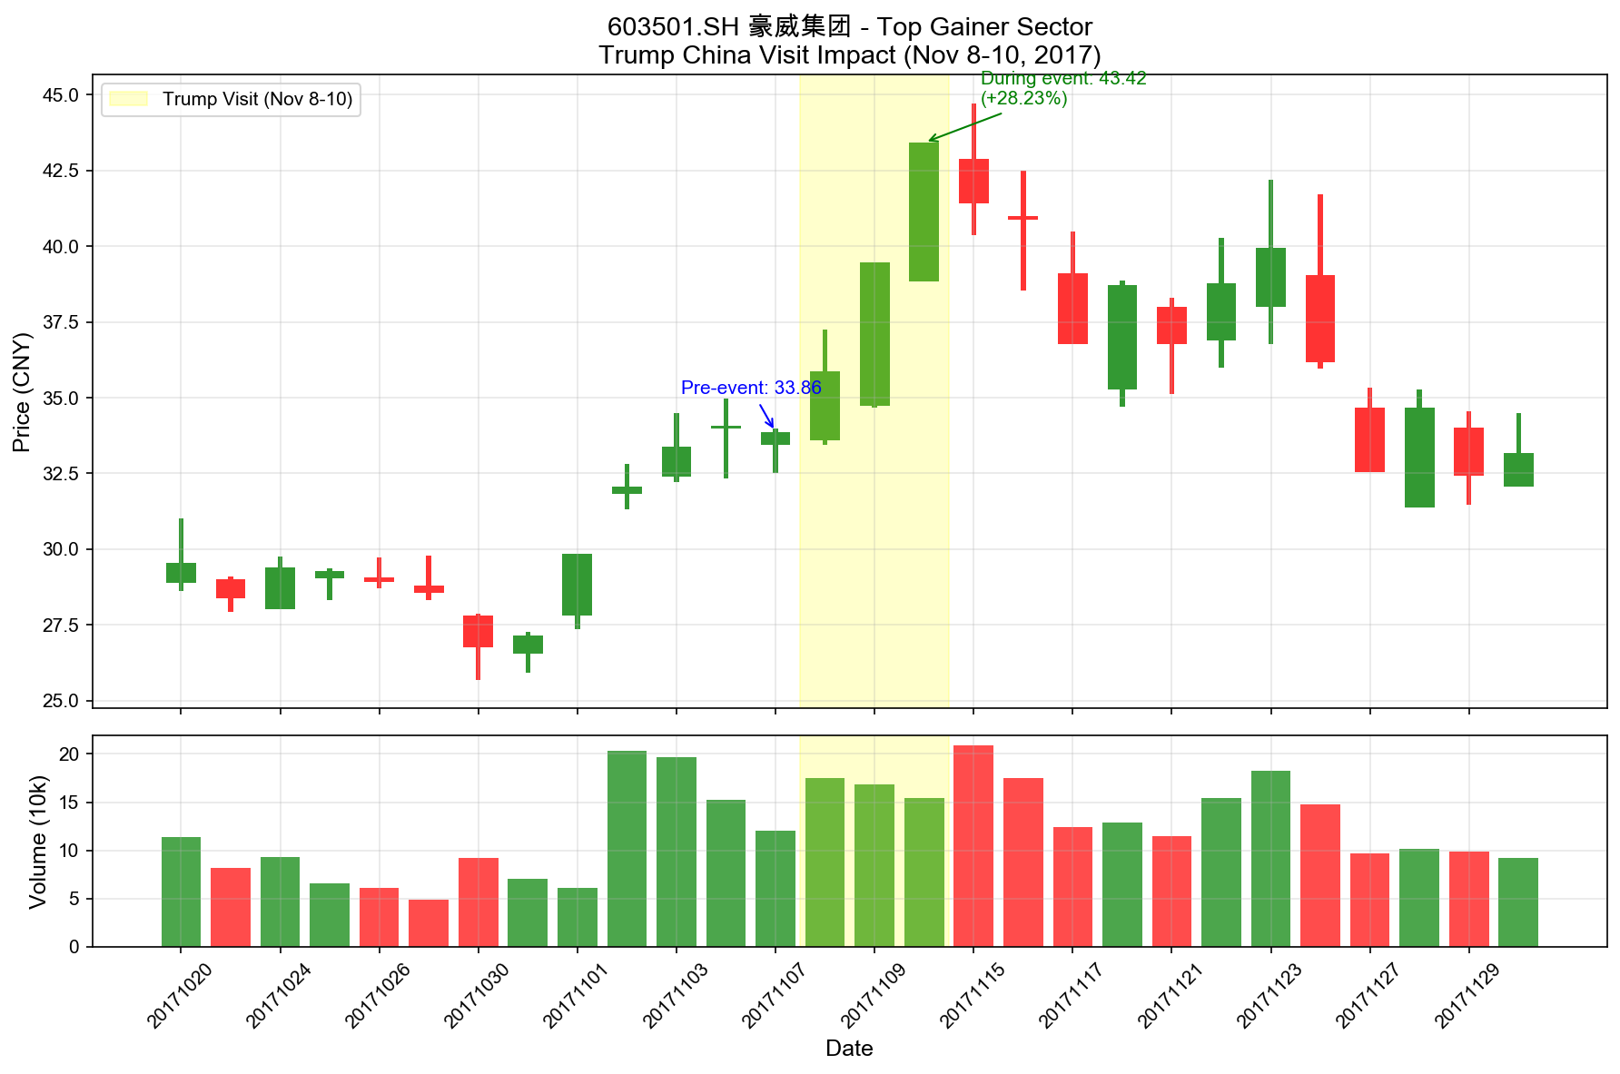
Top Individual Stock Performers
002409.SZ 雅克科技 (+33.1%)
603501.SH 豪威集团 (+28.2%)

Slide 15
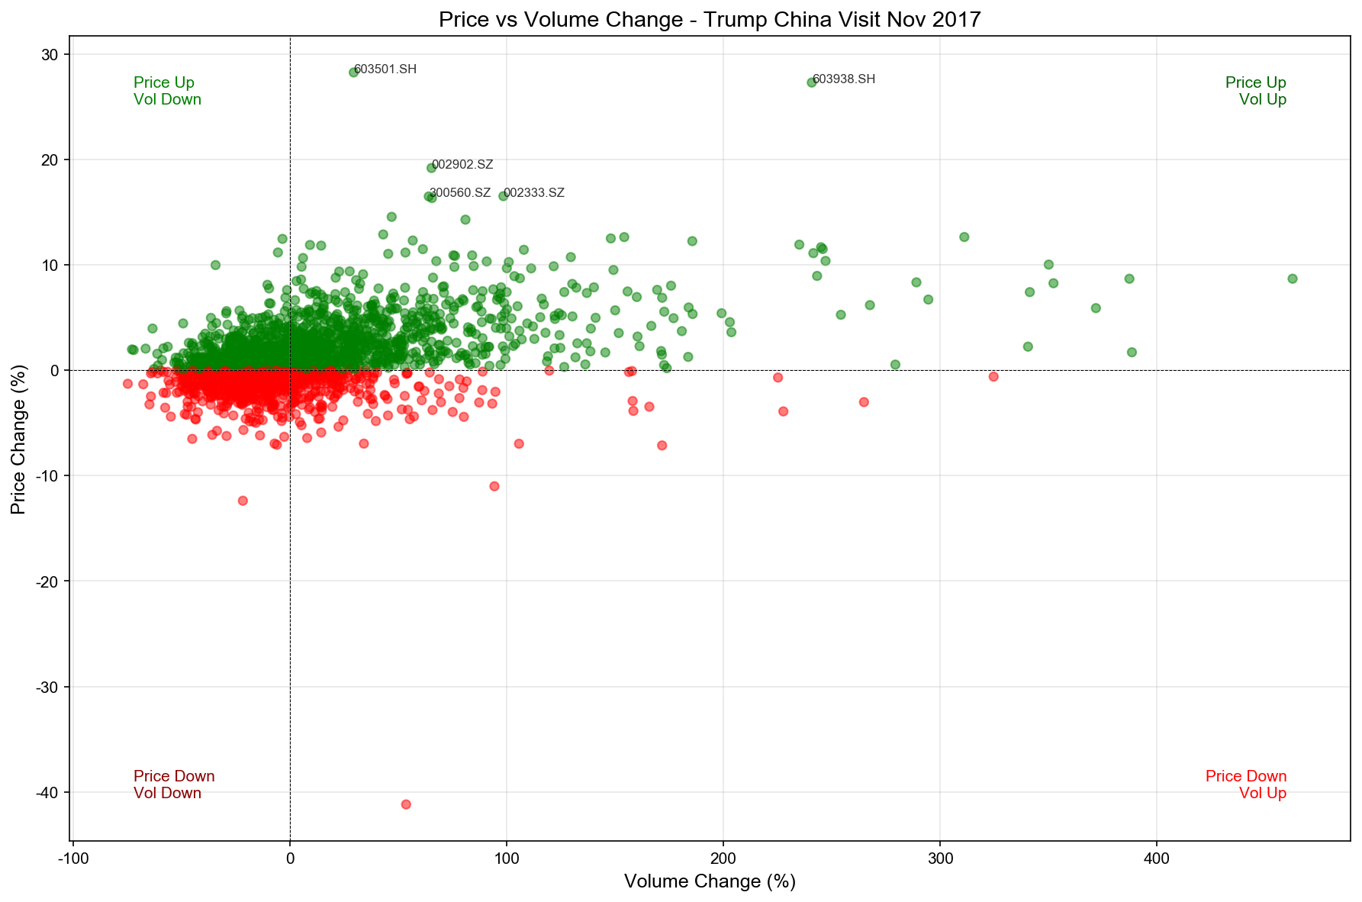
Price Change vs Volume Change Analysis
• High volume + price increase indicates strong buying interest
• Many gainers showed increased trading volume
• Top performers attracted significant investor attention
• Volume surge validates market confidence in trade deals

Slide 16
Conclusions
• Trump's China visit had a measurable positive impact on Chinese stocks
•
• Sector-specific gains aligned with announced trade deals:
• - Semiconductor stocks rose on Qualcomm smartphone deals
• - Energy stocks benefited from LNG/shale gas investments
• - Aviation stocks gained from Boeing aircraft orders
• - Manufacturing stocks rose on equipment partnerships
•
• Market showed broad-based optimism with 61.7% of stocks gaining
•
• The visit demonstrated how diplomatic events can create
• significant short-term market opportunities
•
• Investors who anticipated deal announcements could have
• positioned for sector-specific gains

Slide 17
Methodology & Data Sources
• Data Source: Tushare Pro API (daily OHLCV data)
•
• Analysis Period:
• - Pre-event: October 30 - November 7, 2017
• - Event: November 8-10, 2017 (Trump's visit)
• - Post-event: November 13-30, 2017
•
• Stocks Analyzed: 2,261 A-share stocks (SH + SZ)
•
• Metrics:
• - Price change = (Event close - Pre-event close) / Pre-event close
• - Volume change = (Event avg volume - Pre-event avg volume) / Pre-event avg
•
• Sector Classification: Based on company names and deal relevance
•
• Analysis Tool: Python with pandas, matplotlib, Tushare

