Slide 1
Vision Transformer & Contrastive Representation Learning
Chen Jiang

Slide 2
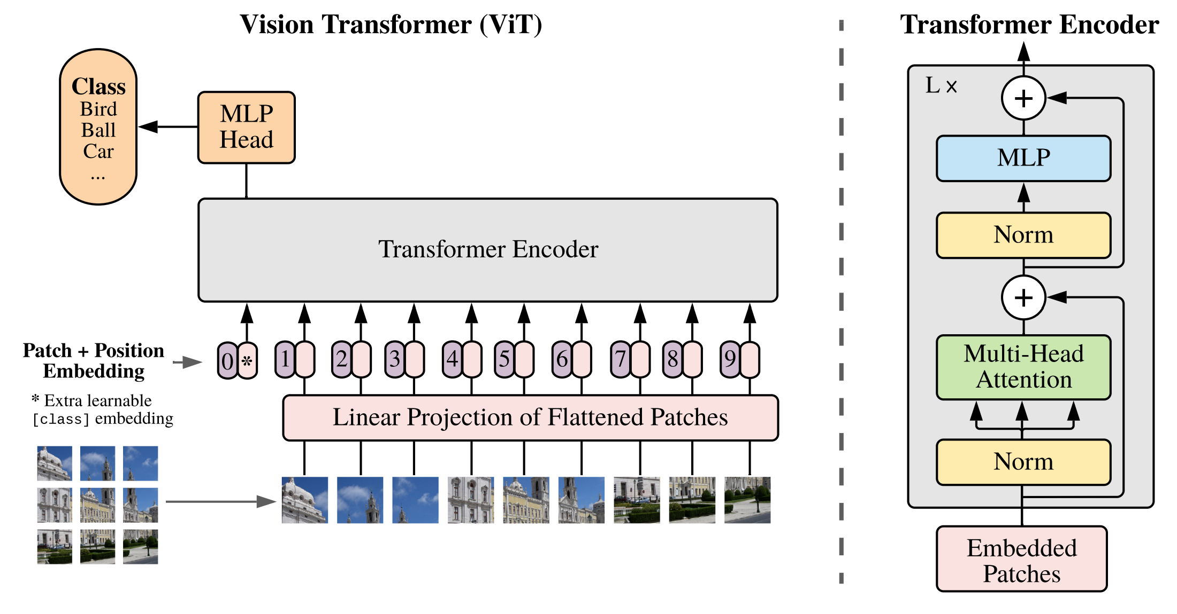
Vision Transformer: Overview
Notes:
https://openreview.net/pdf?id=YicbFdNTTy

Slide 3
Vision Transformer: Overview
A self-attention-based architecture to apply Transformer directly to images.
Given an image:
The image is split into fixed-size patches and are linearly embedded.
Similar to Transformers in NLP, position embeddings are added with the embedded patches, acquiring a sequence of vectors.
An extra learnable “classification token [CLS]” is added with the sequence of vectors, processed then by a standard Transformer encoder.
Final Output: Features of the input image, to be used to calculate classification scores or embedding vectors.

Slide 4
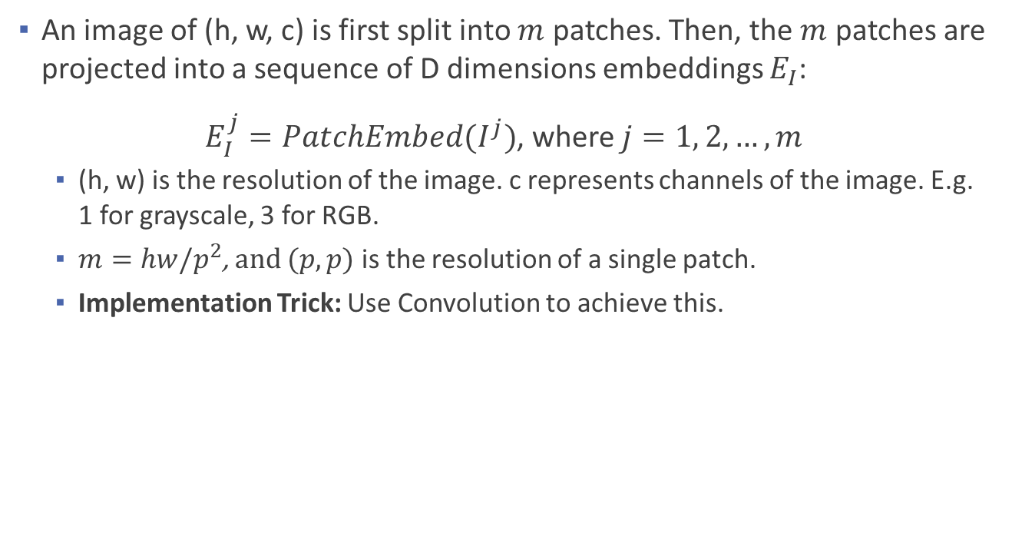
Vision Transformer: Formulation – Patch Embedding
An image of (h, w, c) is first split into $m$ patches. Then, the $m$ patches are projected into a sequence of D dimensions embeddings $E_{I}$:
$E_{I}^{j}=PatchEmbed(I^{j})$, where $j=1, 2, …, m$
(h, w) is the resolution of the image. c represents channels of the image. E.g. 1 for grayscale, 3 for RGB.
$m=hw/p^{2}$, and $(p, p)$ is the resolution of a single patch.
Implementation Trick: Use Convolution to achieve this.

Slide 5
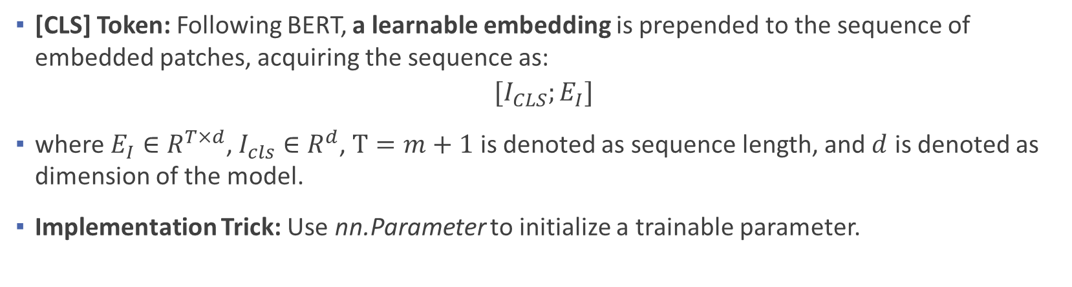
Vision Transformer: Formulation – [CLS] Token
[CLS] Token: Following BERT, a learnable embedding is prepended to the sequence of embedded patches, acquiring the sequence as:
$$[I_{CLS};E_{I}]$$
where $E_{I}∈R^{T×d}$, $I_{cls}∈R^{d}$, $T=m+1$ is denoted as sequence length, and $d$ is denoted as dimension of the model.
Implementation Trick: Use nn.Parameter to initialize a trainable parameter.

Slide 6
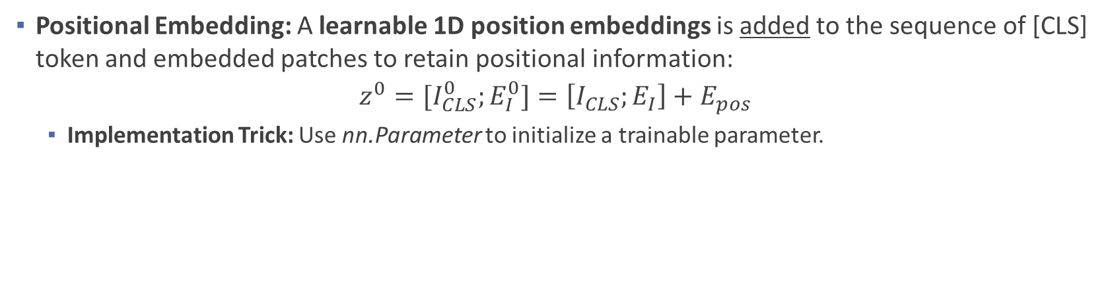
Vision Transformer: Formulation – Positional Embedding
Positional Embedding: A learnable 1D position embeddings is added to the sequence of [CLS] token and embedded patches to retain positional information:
$$z^{0}=[I_{CLS}^{0};E_{I}^{0}]=\left[I_{CLS};E_{I}\right]+E_{pos}$$
Implementation Trick: Use nn.Parameter to initialize a trainable parameter.

Slide 7
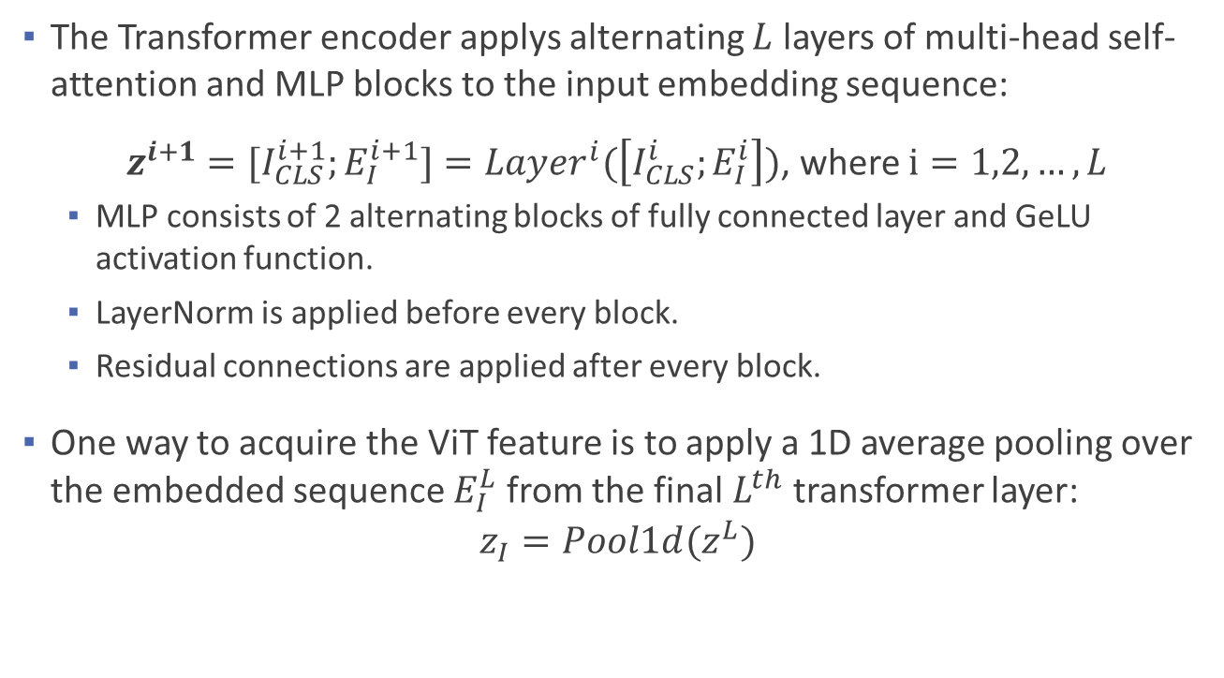
Vision Transformer: Formulation – Transformer Encoder
The Transformer encoder applys alternating $L$ layers of multi-head self-attention and MLP blocks to the input embedding sequence:
$z^{i+1}=[I_{CLS}^{i+1};E_{I}^{i+1}]=Layer^{i}(\left[I_{CLS}^{i};E_{I}^{i}\right])$, where $i=1,2, …, L$
MLP consists of 2 alternating blocks of fully connected layer and GeLU activation function.
LayerNorm is applied before every block.
Residual connections are applied after every block.
One way to acquire the ViT feature is to apply a 1D average pooling over the embedded sequence $E_{I}^{L}$ from the final $L^{th}$ transformer layer:
$$z_{I}=Pool1d(z^{L})$$
Residual Connection

Slide 8
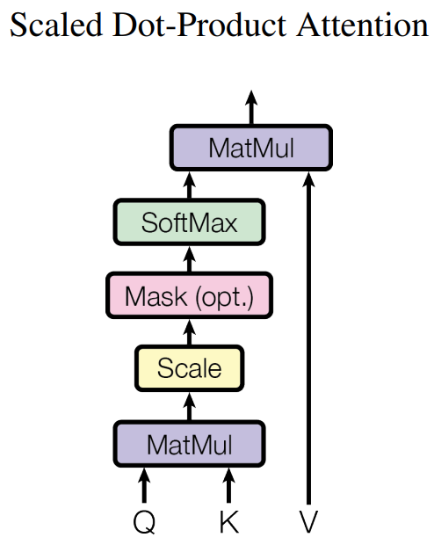
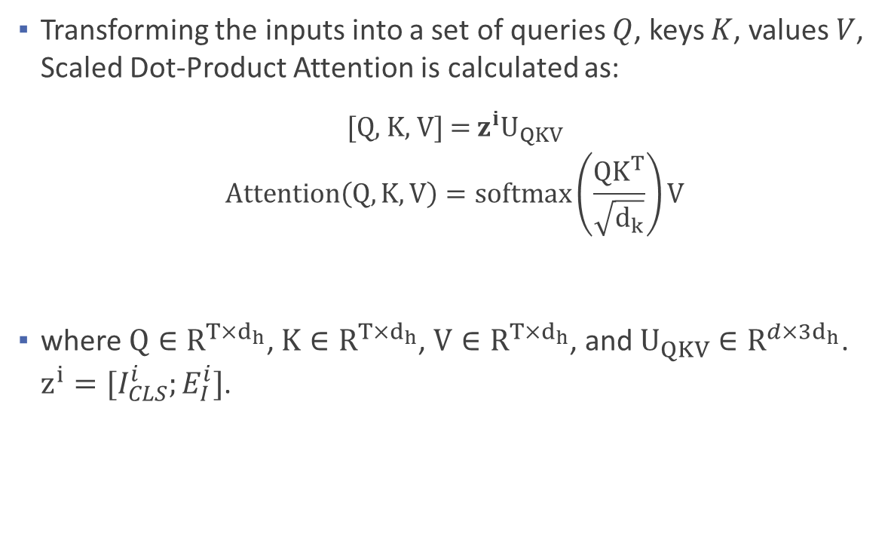
Vision Transformer: Formulation – Scaled Dot-Product Attention
Transforming the inputs into a set of queries $Q$, keys $K$, values $V$, Scaled Dot-Product Attention is calculated as:
[Q, K, V] = $z^{i}U_{QKV}$
$$Attention\left(Q, K,V\right)=softmax\left(\frac{QK^{T}}{\sqrt{d_{k}}}\right)V$$
where $Q∈R^{T×d_{h}}$, $K∈R^{T×d_{h}}$, $V∈R^{T×d_{h}}$, and $U_{QKV}∈R^{d×3d_{h}}$. $z^{i}=[I_{CLS}^{i};E_{I}^{i}]$.
Attention Weight

Slide 9
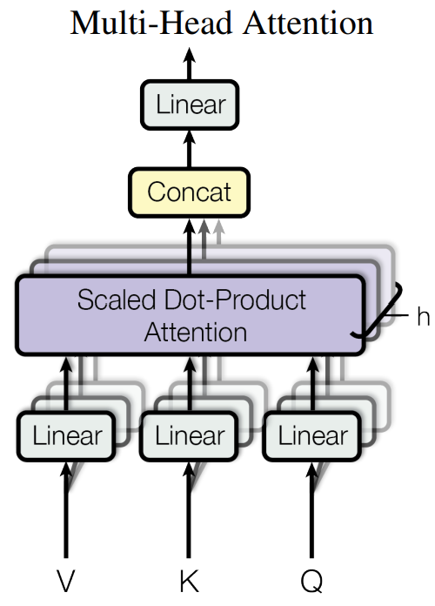

Vision Transformer: Formulation – Multi-head Attention
Multi-Head Attention runs $k$ scaled dot-product attentions in-parallel:
$$MSA(z^{i})=\left[SA_{1}\left(z\right);SA_{2}\left(z\right);…;{SA}_{k}\left(z\right)\right]U_{msa}$$
where $U_{msa}∈R^{k∙D_{h}×D}$, $D_{h}$ is denoted as the dimension of the head, typically set to $D/k$.
Implementation: Use nn.MultiheadAttention.

Slide 10
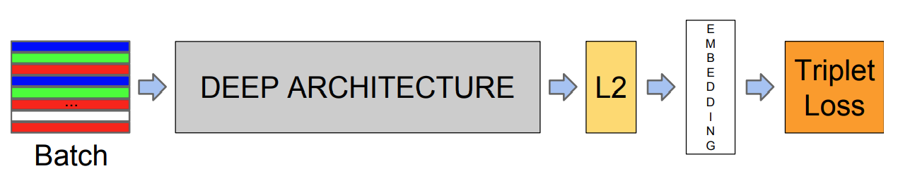
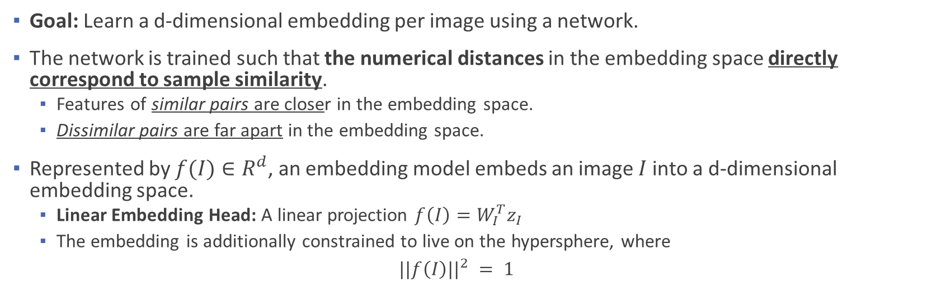
Contrastive Representation Learning: Overview
Goal: Learn a d-dimensional embedding per image using a network.
The network is trained such that the numerical distances in the embedding space directly correspond to sample similarity.
Features of similar pairs are closer in the embedding space.
Dissimilar pairs are far apart in the embedding space.
Represented by $f(I)∈R^{d}$, an embedding model embeds an image $I$ into a d-dimensional embedding space.
Linear Embedding Head: A linear projection $f\left(I\right)=W_{I}^{T}z_{I}$
The embedding is additionally constrained to live on the hypersphere, where
$$||f\left(I\right)||^{2} = 1$$

Slide 11
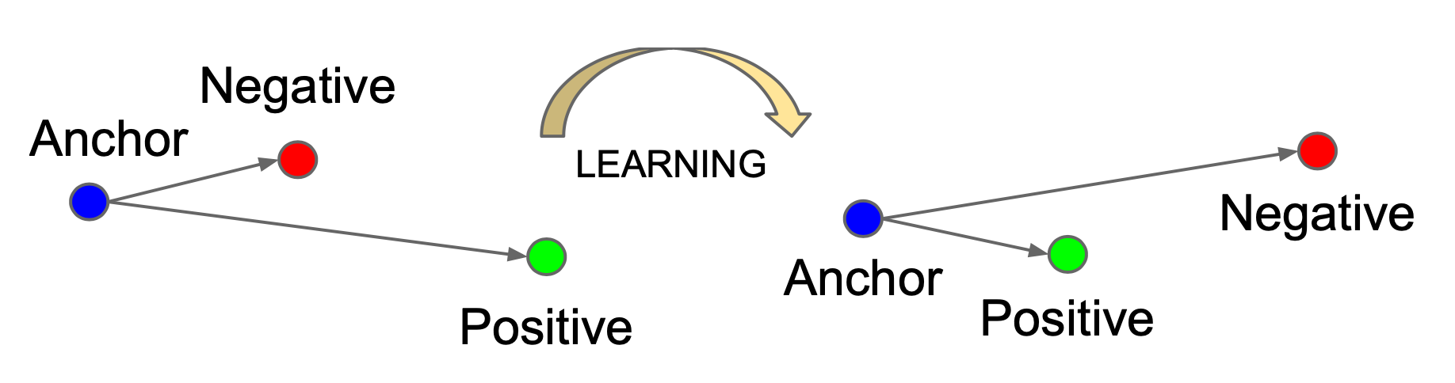
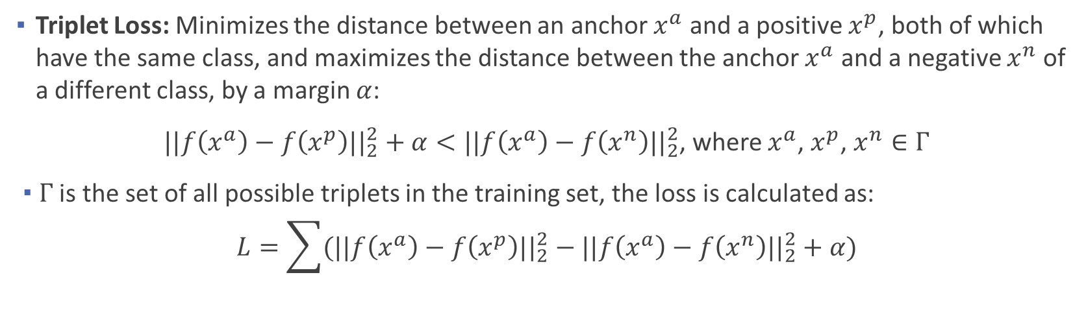
Contrastive Representation Learning: Triplet Learning
Triplet Loss: Minimizes the distance between an anchor $x^{a}$ and a positive $x^{p}$, both of which have the same class, and maximizes the distance between the anchor $x^{a}$ and a negative $x^{n}$ of a different class, by a margin $α$:
$||f\left(x^{a}\right)−f\left(x^{p}\right){||}_{2}^{2}+α<||f\left(x^{a}\right)−f\left(x^{n}\right){||}_{2}^{2}$, where $x^{a}$, $x^{p}$, $x^{n}∈Γ$
$Γ$ is the set of all possible triplets in the training set, the loss is calculated as:
$$L=\sum{(||f\left(x^{a}\right)−f\left(x^{p}\right){||}_{2}^{2}−||f\left(x^{a}\right)−f\left(x^{n}\right){||}_{2}^{2}}+α)$$
Notes:
minimize this loss, which pushes d(a,p) to 0 and d(a,n) to be greater than d(a,p)+margin

Slide 12
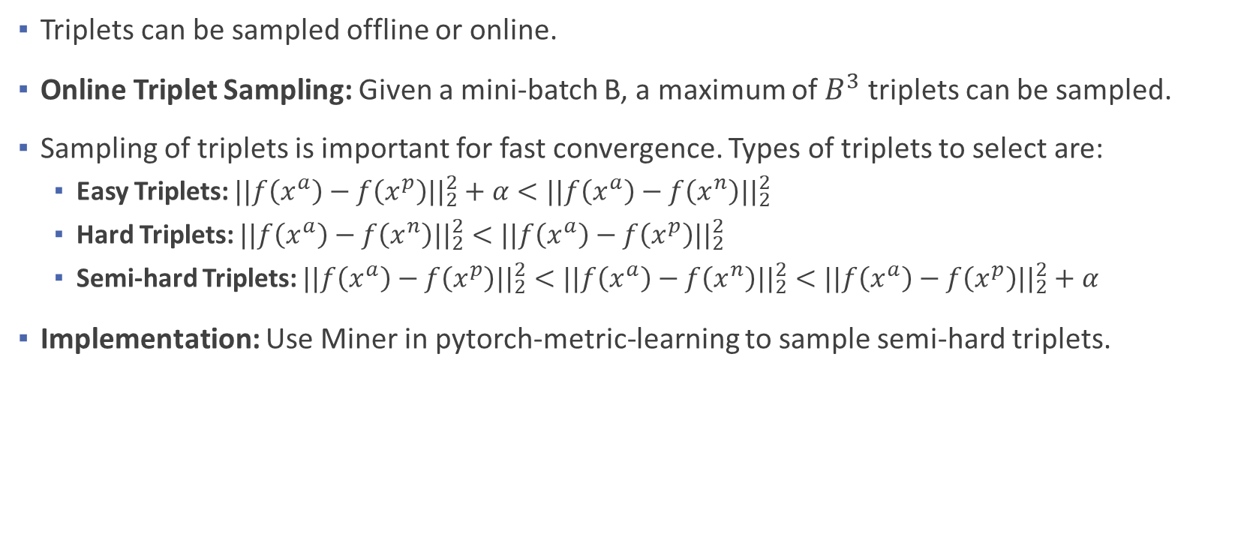
Contrastive Representation Learning: Triplet Mining
Triplets can be sampled offline or online.
Online Triplet Sampling: Given a mini-batch B, a maximum of $B^{3}$ triplets can be sampled.
Sampling of triplets is important for fast convergence. Types of triplets to select are:
Easy Triplets: $||f\left(x^{a}\right)−f\left(x^{p}\right){||}_{2}^{2}+α<||f\left(x^{a}\right)−f\left(x^{n}\right){||}_{2}^{2}$
Hard Triplets: $||f\left(x^{a}\right)−f\left(x^{n}\right){||}_{2}^{2}<||f\left(x^{a}\right)−f\left(x^{p}\right){||}_{2}^{2}$
Semi-hard Triplets: $||f\left(x^{a}\right)−f\left(x^{p}\right){||}_{2}^{2}<||f\left(x^{a}\right)−f\left(x^{n}\right){||}_{2}^{2}<||f\left(x^{a}\right)−f\left(x^{p}\right){||}_{2}^{2}+α$
Implementation: Use Miner in pytorch-metric-learning to sample semi-hard triplets.

