Slide 1
ISTA 350
Midterm Review
Spring 2020

Slide 2
Reminders + Previously in ISTA 350 Lab
Reminders
The midterm is next week: Tuesday, March 24th!
Last lab
Big-O and Recursion

Slide 3
Today: Midterm Review
Now is a good opportunity to ask any questions about the midterm.
Although in-person meetings are no longer available, there are still ways to contact your professor and SL’s!!!
Please take advantage of the listserve email (ista350-questions@list.arizona.edu) and office hours on Zoom!!!

Slide 4
Regular Expressions
a pattern describing a certain amount of text
We specify a pattern to search for by creating a string, but some of the characters have special meanings that allow them to match multiple other characters
Syntax:
import re #python module for regular expressions is re
text = open(file).read()
p = re.compile(r’<some regular expression>’) #r = raw string!!!
lst = [item[0] for item in p.findall(text)] #findall() to traverse results
Cheatsheet on next slide ->

Slide 5
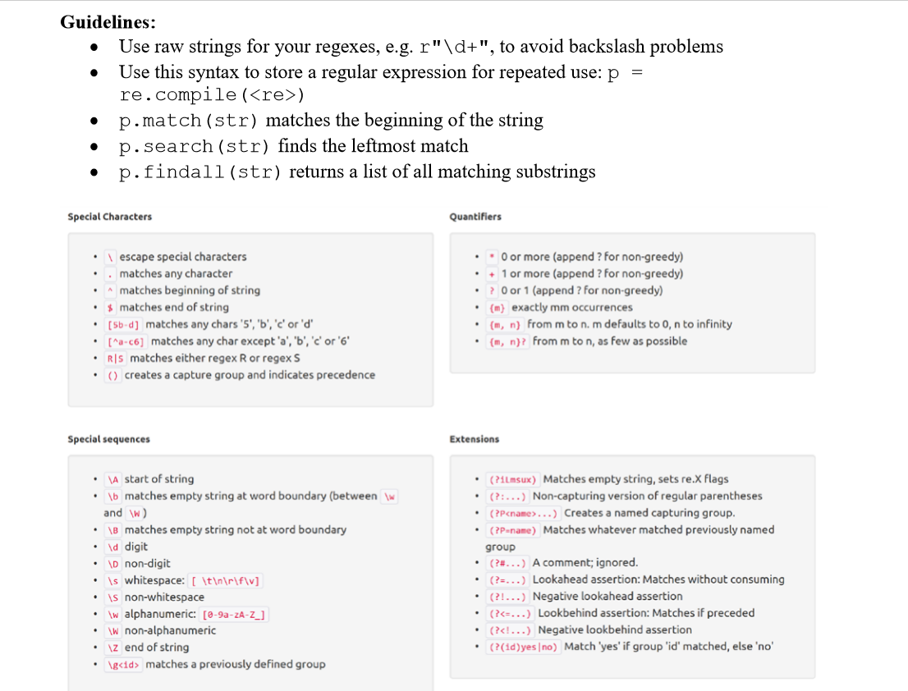

Slide 6
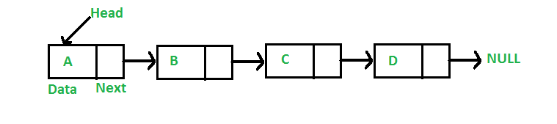
Linked Data Structures
Linked Lists
Each data element (node) contains data and a connection to another data element in the form of a pointer.
Head is the first element in your linked list.
The linked list ends when next == None.

Slide 7
Linked Data Structures
Parse Trees
Also a composed of nodes, with at least one link pointing into each node (except the root) and zero to many link pointing out of each node
Root: only node without incoming edges
Child: a node that is linked out from another node
Parent: a node that is linked down to another node
Leaf: a node with no children
Siblings: nodes that share a parent node

Slide 8
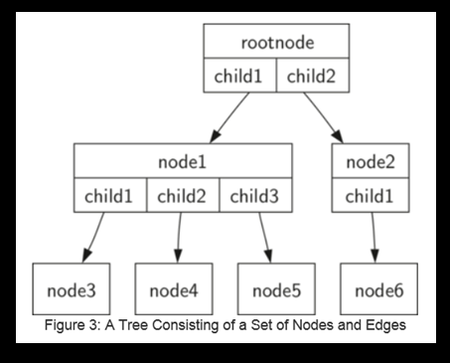
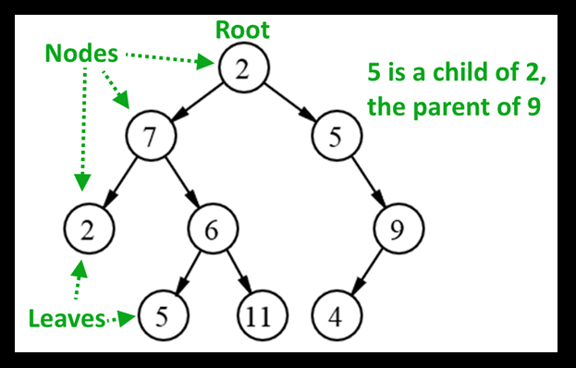
Linked Data Structures
Parse Trees

Slide 9
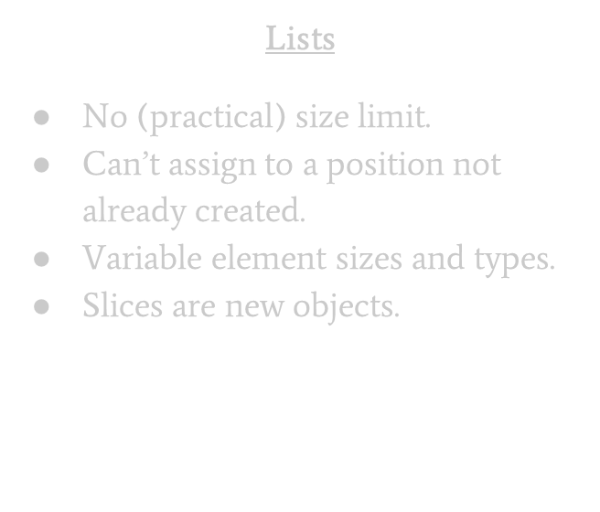
Numpy Arrays
Arrays vs lists
Arrays
Created with a fixed length.
Any element can be assigned to at any time.
All elements are of the same type.
Slices are views.

Slide 10
Numpy Arrays
Constructors:
np.array(list, dtype) #converts a sequence-type (list, string, tuple, etc….) to a numpy array
np.ones(shape, dtype)/np.zeros(shape, dtype) #creates an array of the given shape filled with ones/zeros
np.empty(shape, dtype) #creates an array of the given shape filled with random values
np.fill(shape, element, dtype) #creates an array of the given shape filled with a given element
np.arange(start, stop, step, dytpe) #creates an array from a given range

Slide 11
Numpy Arrays
dtype
Default dtype is float
Variety of string dtypes using U<integer> : denotes the max number of characters that can be held in a position in the array
U10 = max 10 characters, U250 = max 250, etc….
dtype = str will be interpreted as dtype = U1 (max 1 characters)

Slide 12
Magic Methods
methods that you can define in your classes that allow objects to behave like built-in types
invoked by Python under special conditions or when a specific syntax is used
Some examples:
__repr__: short for representation, invoked with print() function call
__add__, __sub__, __mult__, __neg__: define behavior for arithmetic between instances of a class object, invoked with arithmetic operators (+, -, *, etc.…)
__eq__, __lt__, __gt__ : define behavior for comparison between instances of a class object, invoked with relational operators (==, <, >, etc….)

Slide 13
Magic Methods
Operator overloading
use operator overloading on Python magic methods to overwrite how the operations work
This allows you to extend arithmetic (**, *, /, +, -, \) and relational (<, <=, >, >=) operators as well as some built-in functions to work on instances of the class you define
Decorators
a function that wraps over another function in order to modify the behavior of the function without actually modifying the code in the function itself
In Python, the operator for declaring a decorator is ‘@’

Slide 14
Binary
Adding binary numbers
From right to left, add the ones and zeros with this math:
0 + 0 = 0, 0 + 1 = 1, 1 + 1 = 0 carry 1, 1 + 1 + 1 = 1 carry 1
Negation/Two’s Complement
To change the sign of a binary number, switch all the zeros to ones and ones to zeros, then add binary 1
Binary numbers are identified as negative if they begin with 1, and positive if they begin with 0

Slide 15
Binary
Binary to decimal
To convert a binary number to a regular integer, use this formula (8 bit example):
i*2^7 + i*2^6 + i*2^5 + i*2^4 + i*2^3 + i*2^2 + i*2^1 + i*2^0
Where i is a zero or one in the binary number
For negative numbers, either use two’s complement on the number before converting and negate the result, or use this formula (8 bit example):
-i*2^7 + i*2^6 + i*2^5 + i*2^4 + i*2^3 + i*2^2 + i*2^1 + i*2^0 #first term is negative

Slide 16
Big O
Runtime: the amount of time required for an algorithm to run
n: the length of the input for an algorithm
Big O: an estimate of how the runtime changes as n changes
To find the Big-O of a function based on the size of the problem, f(n), we find the term that grows the fastest as n gets really large. We throw away any coefficients
Ex: f(n) = 8n + 2n² + 12 = O(?)
f(n) = O(n²)

Slide 17
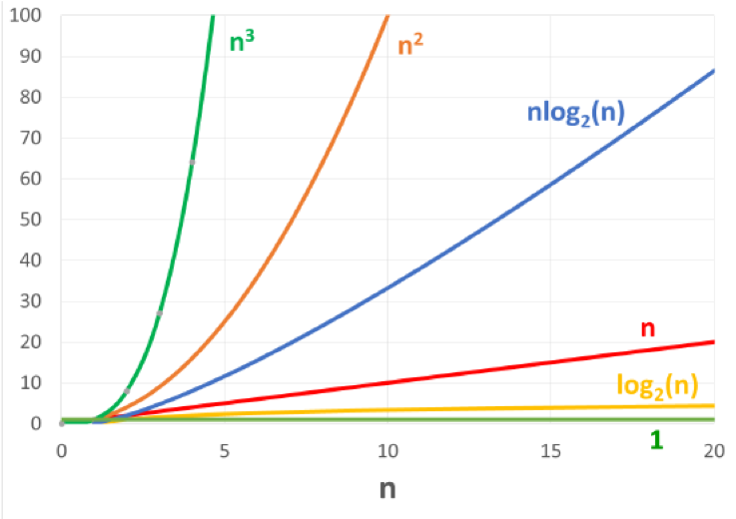
Big O
Big-O list (from smallest to largest):
O(1) - constant time
O(log n) - logarithmic time
O(n) - linear time
O(n log n) - log-linear time
O(n²) - quadratic time
O(n³) - cubic time
Algorithms with these runtimes are called “polynomial time” algorithms.

Slide 18
Recursion
involves the process of breaking the problem into smaller and smaller problems until the problem is small enough to be solved trivially
Three laws of recursion:
A recursive algorithm must have a base case. A base case determines when a function will no longer call itself.
A recursive algorithm must implement a change to something each time it calls itself so that the base case will eventually be reached.
A recursive algorithm must call itself recursively.

Slide 19
Exercise
Do your best to work on the exercise provided with today’s lab – it goes over several important concepts in this class. If you have questions, please send them along with your code to the listserve email.
The solution to this exercise will be posted tomorrow (3/17)

