Slide 1



A Comparative Study of Training Objectives for Clarification Facet Generation
Shiyu Ni^{1,2}, Keping Bi^{1,2}, Jiafeng Guo^{1,2}, and Xueqi Cheng^{1,2}
1. Key Lab of Network Data Science and Technology, ICT, CAS, Beijing, China
2. University of Chinese Academy of Sciences, Beijing, China
Notes:
Hello everyone. I am Shiyu Ni, from Chinese Academy of Sciences.
It is my pleasure to be here to report our work: A Comparative Study of Training Objectives for Clarification Facet Generation
The authors are

Slide 2


Introduction of Facet Prediction
In the real world, user queries can be ambiguous or vague
Facet prediction is predicting potential query facets for a given query
Query Facets
Web Search
The Band
Search
Query
Chicago The City
The City
Chicago
The Movie
Ask
Do you mean xxx?
…
Conversational Search
Notes:
If we can predict the facets, it would be conducive to many search scenarios
In web search, facets can help users refine their original queries.
In a conversational search system, they can be used to ask clarifying questions
So, Accurately predicting query facets is important

Slide 3
The Development of Facet Prediction
Facet extraction
Facet generation
Rule-based
Semantic relations
PLMs-based
Specific domains
Top-retrieved documents
Open-domain queries
Notes:
Current research on facet prediction can be mainly divided into facet extraction and facet prediction
Early studies on facet extraction mainly rely on specific domain
such methods may not be suitable for open-domain queries
Later, some studies find that utilizing top-retrieved documents can help identify open-domain query facets
However, facet extraction methods are always rule-based and could not capture semantic relations sufficiently
In recent years
Grounded on pre-trained language models, facet generation has been found to perform the best
So, we focus on facet generation based on pre-trained language models with top-retrieved documents

Slide 4

The Architecture of Facet Generation
For a given query, there are two steps for facet generation
First, search
Second, concatenate and generate
Documents
Top-Retrieved Documents
Search
Facets
Representation
…
PLMs
Concatenate
Query
Notes:
For a given query
First, we search the query and get related documents.
Second, concatenate the query and top-retrieved documents together and
feed it into a pre-trained language model to get the facets.

Slide 5
Existing Methods for Facet Generation
Two common training objectives in the existing methods
Seq-Default: generates the default sequence of facets
Order-sensitive
Q
D
The City
The Band
The Movie
The City
The Band
Target Output
The Movie
Facets
Only one of the possible combinations
Notes:
For a given query and it’s related documents, assuming the ground-truth facets for this query are FA, FB, and FC.
There two common training objectives
One is sequence-default
Seq-Default: generates the default sequence of facets.
It forces the model to learn the default facet ordering that is only one of the possible combinations and is order-sensitive. This may lead to suboptimal performance.

Slide 6
Existing Methods for Facet Generation
Two common training objectives in the existing methods
Seq-Min-Perm: enumerates the permutations and use the one with minimum loss
Existing methods are both sequential-prediction
Permutation-invariant
Permute & Sample
The City
The Band
The Movie
The City
The Movie
The Band
Minimum Loss
The City
The Movie
The Band
…
Target Output
The Movie
The Band
The City
Not leverage the permutations sufficiently
Revisiting Open Domain Query Facet Extraction and Generation, ICTIR 2022
Notes:
Realizing this issue,
This paper proposed Sequence-Minimum-Permutation.
It enumerates the xxx ,so this method is permutation-invariant.
Existing methods are both permutation-invariant

Slide 7
Are There Better Training Objectives?
What Impacts Do Different Objectives Have?

Slide 8
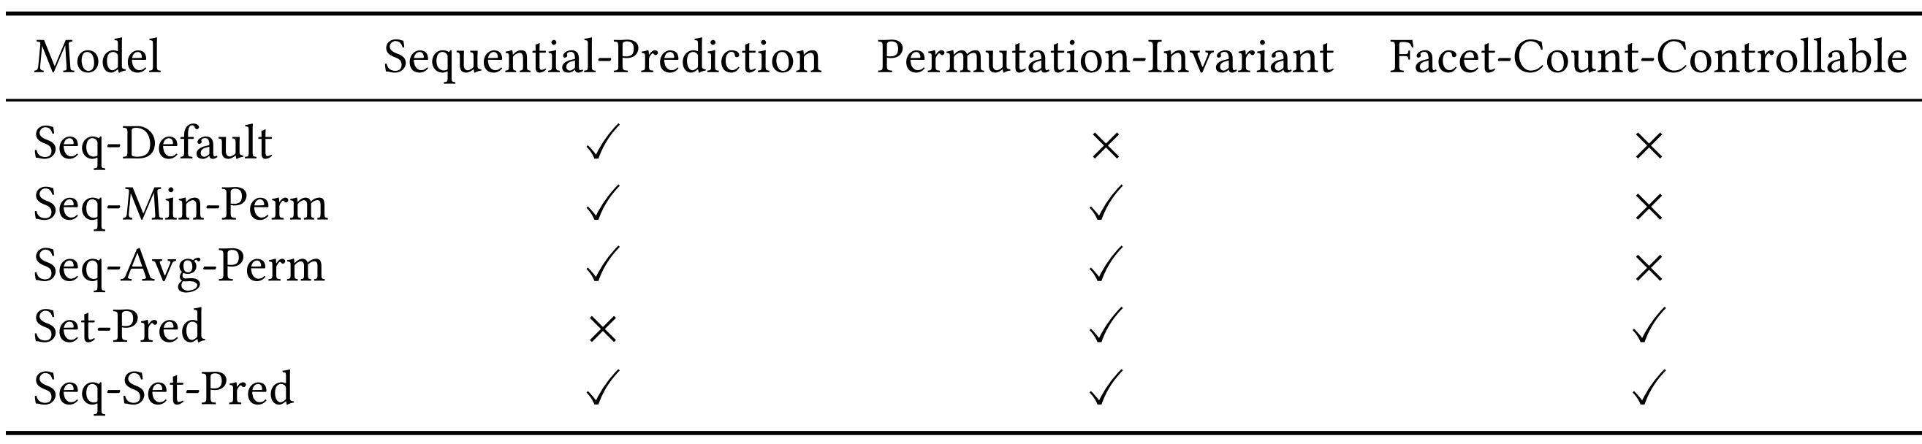
Various Training Objectives
Investigate various training objectives from multiple perspectives and propose another three training objectives
Multiple perspectives
Newly proposed training objectives
Notes:
We conduct
We investigate the impacts from,
Whether the method generates facets as a sequence
Whether it is premutation-invariant
And whether it is facet-count-controllable
Seq-min-perm的问题
I will give the details later

Slide 9
Sequence-Average-Permutation
Seq-Avg-Perm: an extension of seq-min-perm but trained with the average loss
Learn towards all the possible permutations
Leverage the permutations sufficiently
Permute & Sample
Q
D
The City
The Band
The Movie
Q
D
Q
D
The City
The Movie
The Band
…
…
Q
D
The Movie
The Band
The City
The City
The Band
The Movie
Input
Target Output
Inference
Training
Notes:
Seq-Avg-Perm is a
For the training, we ask the model to learn towards all the possible permutations
So, leverage the permutation sufficiently

Slide 10
Set-Prediction
Set-Pred: predicts each facet as independent targets
No previously generated facets as context
Generate similar facets
Q
D
The City
The City
Q
D
The Band
Q
D
The Band
Q
D
The Movie
The Movie
Training
Inference
Notes:
Seq-Pred predicts
No previously xxx, so, it could suffer from generating similar facets
To enhance the diversity of generated facets, we combine the ideas of seq-avg-perm and set-pred and propose the next objective

Slide 11
Sequence-Set-Prediction
Seq-Set-Pred: sequentially predicts the remaining facet set based on the generated facets
Training
Permute & Sample
Q
D
The City
Inference
Q
D
The Band
Q
D
The Movie
The City
Q
D
The City
Q
D
The Band
The Movie
The Band
Q
D
The City
The Band
Q
D
The Movie
The City
Q
D
The City
The Band
The Movie
Q
D
The City
The Band
The Movie
Q
D
The Band
The City
The Movie
Q
D
The Band
The Movie
The City
Notes:
Seq-Ser-Pred sequentially
We divide the generation of facets into many steps and generate one facet at each step
Similar to seq-avg-perm, for the training, to mitigate the influence of facet order, we train the model on all the possible permutations
Different from set-pred, the previously predicted facets could help it avoid generating similar facets.

Slide 12
What Are The Differences among These Five Training Objectives?

Slide 13
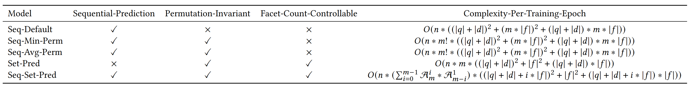
Differences among These Training Objectives
Sequential-Prediction: Set-Pred
Permutation-invariant: Seq-Default
Facet-Count-Controllable: Set-Pred and Seq-Set-Pred
Complexity-Per-Training-Epoch:
Seq-Set-Pred > Seq-Avg-Perm = Seq-Min-Perm > Set-Pred > Seq-Default
Notes:
Only set-pred dose not predict facets as a sequence so it may generate similar facets.
Only seq-default is order-sensitive so it may get suboptimal results.
And set-pred and seq-set-pred are facet-count-controllable
In terms of perplexity, Seq-set-pred is the highest, seq-avg-perm is the same as seq-min-perm, followed by set-pred, and seq-default is the lowest.

Slide 14
Dataset-Model-Evaluation
Datasets:
MIMICS: a set of search clarification datasets for real search queries sampled from the Bing query logs
Training: MIMICS-Click, includes 400k+ unique queries and their associated clarification panes
Evaluation: MIMICS-Manual, includes 2k+ unique real search queries
Matching Degree:
The matching between the ground-truth facets and the generated facets
Term Overlap: at the term level
Exact Match: at the facet level
Set BLEU-Score: at the phrase level
Set-BERT-Score: at the semantic level
Model:
BART-Base: a Seq2Seq model
Diversity:
The diversity among the generated facets
Term Diversity: at the term level
BERT-Score Diversity: at the semantic level
Revisiting Open Domain Query Facet Extraction and Generation, ICTIR 2022
Notes:
MIMICS is a set of search clarification datasets for xxxx
As the previous work, we use
MIMICS-Click for training and MIMICS-Manual for evaluation.
The model is BART-base
We evaluate our approach in terms of two aspects:
One is the matching degree between the generated facets and the ground-truth facets.
Besides, we also propose two diversity metrics Term Diversity and Bert-score diversity.
They measure the diversity among the generated facets at the term level and at the semantic level, respectively.
Diversity（如何show出diversity的重要性）

Slide 15
Results and Discussion
Notes:
We will discuss the results in the next part

Slide 16
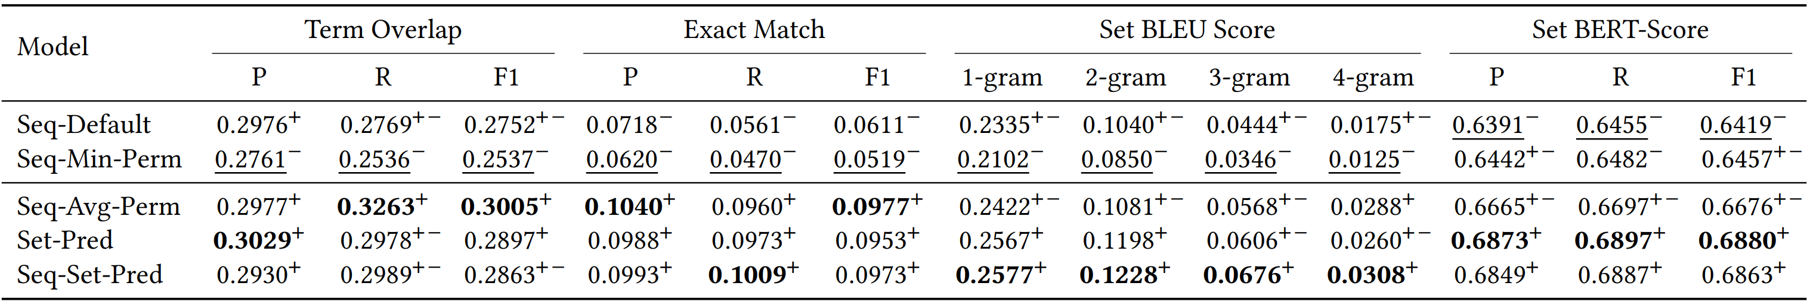
The Matching with Ground Truth
Findings:
Most permutation-invariant methods perform better than order-sensitive method(Seq-Default)
Set-Prediction has compelling performance
Facet-count-controllable methods have better semantic matching performance
Notes:
This table shows the evaluation of different methods based on matching scores
We find:
Most
The method xxx
Previous studies do not consider this way of training so this has not been observed

Slide 17
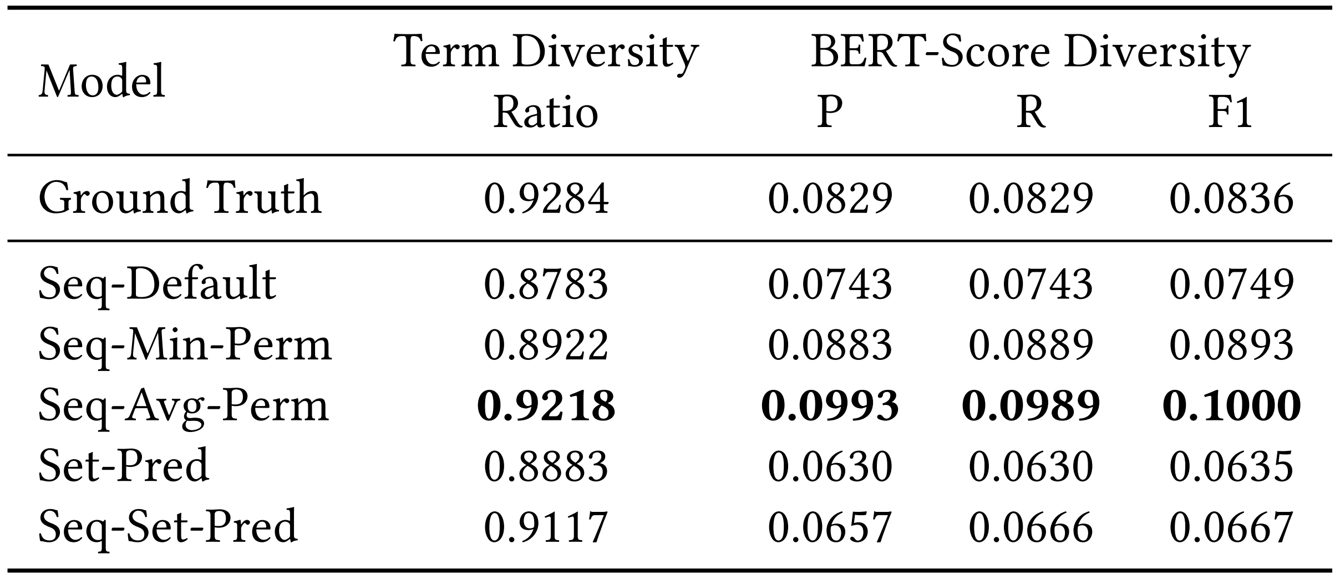
Diversity among Generated Facets
Findings:
Seq-Avg-Perm performs the best on both metrics
Set-Pred performs worse compared to sequential-prediction methods
Notes:
This table shows the results of diversity evaluation on the generated facets.
It shows:
Seq-Avg-Perm
Set-pred xx.

Slide 18
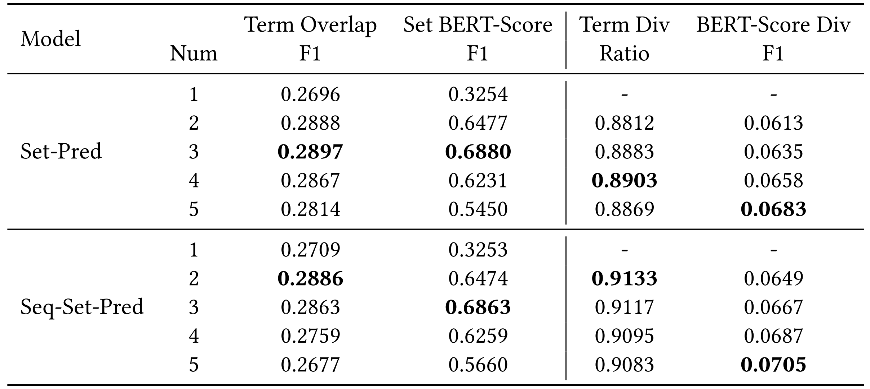
Performance w.r.t. Facet Counts
Findings:
The best matching scores are mainly achieved when generating 2 or 3 facets because the average number of ground truth facets is between 2 and 3
Seq-set-pred demonstrates better diversity than set-pred across all the numbers of generated facets.
Compared to seq-avg-perm, facet-count-controllable methods perform better on set BLEU score and set BERT-Score
Notes:
This table shows the performance when generating different numbers of facets using the facet-count-controllable methods.
We find,
the best xxxxx
Seq-Set-pred demonstrates xxxx and that’s the expected phenomena.
Compared to xxxxx. The possible reason is that these two metrics are more sensitive to the number of generated facets.
This table shows the proportion of the count of generated facets that matches that of the ground truth facets.
The ratio of Seq-AVG-perm is smaller and the mismatch results in worse matching scores

Slide 19
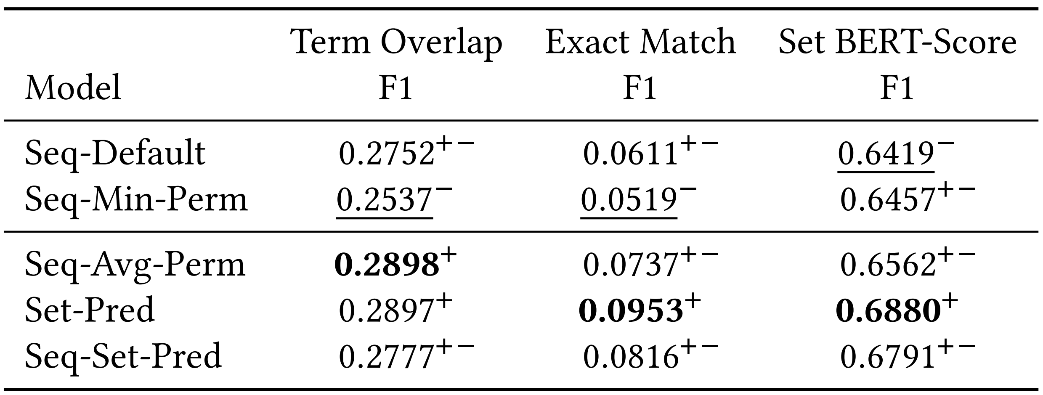
Impact of Training Data Amount
We compare each method when the amount of training data is at a similar scale
Findings:
Seq-avg-perm and seq-set-pred still outperform seq-default and seq-min-perm in terms of all the metrics
Notes:
we compare each method when the amount of training data is at a similar scale
We find:
The results xxxx
Seq-avg-prem and xxxx

Slide 20
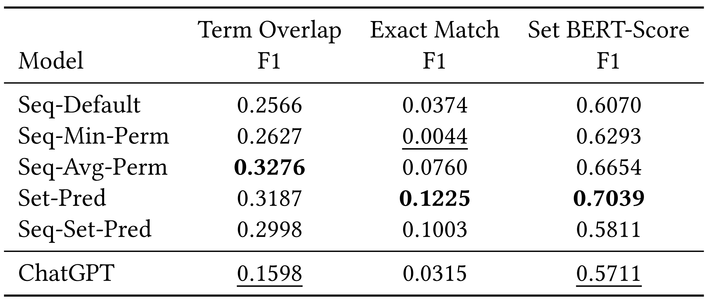
Facet Generation with ChatGPT
How do LLMs perform on the facet generation task
Data: 50 examples from MIMICS-Manual dataset
Model: ChatGPT
Query: Express vpn
Generated facets: “virtual private network”, “privacy and security”, “content access”, “server network”
Ground-truth facets:“expressvpn mac”, “expressvpn android”, “expressvpn windows”, “expressvpn linux” “expressvpn ios”
Findings:
ChatGPT has a large performance gap compared to all the methods
The generated facets are general but not related to the given documents
Notes:
In the age of large language model, we wonder how LLMs perform on the facet generation task. So we sample 50 xxxx and ask ChatGPT to do the task.
It shows:
ChatGPT xxx
The generated xxx

Slide 21
Conclusion
Permutation-invariant
Most permutation-invariant methods perform better than order-sensitive methods
Set-pred
Set-Prediction has compelling performance but worse diversity
ChatGPT
The generated facets are general but not related to the given documents
Notes:
In a summary

Slide 22

Thanks & Questions
shiyuni23z@ict.ac.cn
https://github.com/ict-bigdatalab/Facet-Generation
https://github.com/ShiyuNee/Facet-Generation
Notes:
That’s all, thank you for listening

