Slide 1
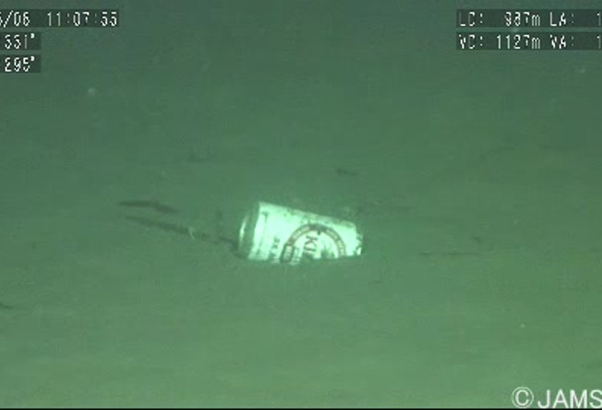
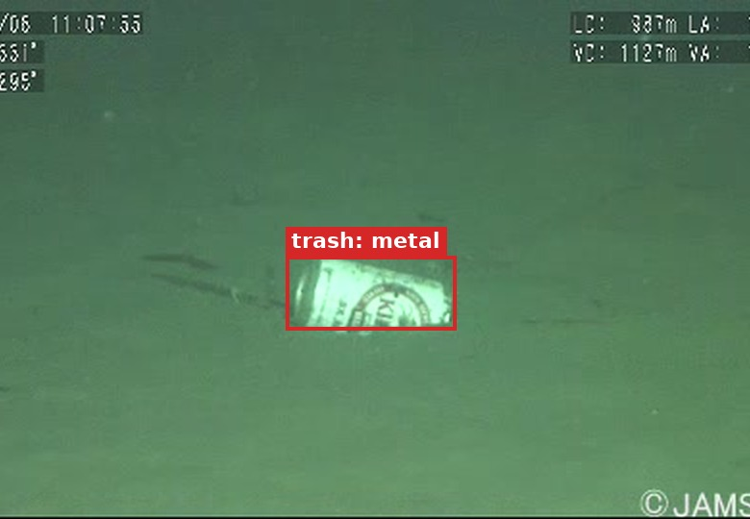
Automated Marine Debris Detection using Deep Learning
Asterik and Obelix
Sudam Attanayake (z5363513)
Shabs Nair (z5538897)
Atul Kothuri (z5699628)
Shetal Balaji (z5419311)
Project 014: COMP9444 Group Project Presentation
Notes:
Replace [Team Name], member names and zIDs. The two pictures show an original J-EDI/TrashCan frame and the same frame with its ground-truth annotation (here: a metal can on the seabed), i.e. the kind of output the system should produce.

Slide 2
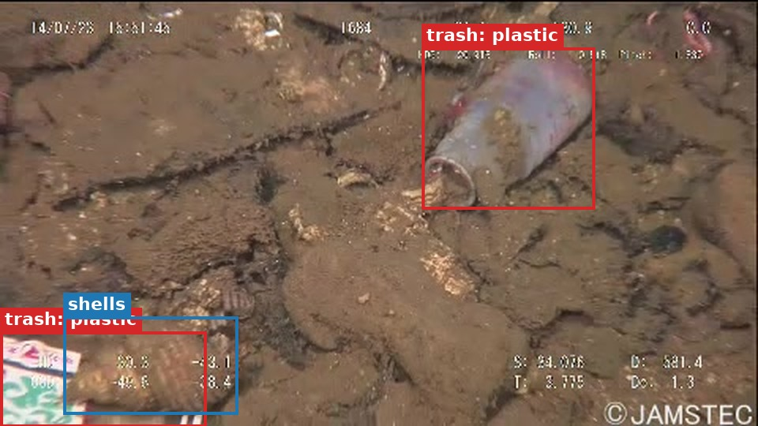
Motivation
Marine debris is a growing threat to ocean ecosystems: it harms marine life and disrupts the natural balance
Today's surveys and clean-ups rely on people, which is costly, slow and subjective
  Manual surveys are time-consuming, lack detail and depend on the operator [3]
  Divers and ROV pilots must find debris and avoid harming flora and fauna [1]
Vision-equipped robots (ROVs / AUVs) could detect, locate and even remove debris at scale [1]
Goal: an automated deep-learning detector that finds debris in underwater images
Example frame from the dataset with ground-truth annotation (J-EDI / TrashCan, © JAMSTEC)
Presenter: [Name] (zID)
Notes:
Sources: project description for Project 014; Hong et al. 2020 (marine debris is a significant, ever-increasing threat; vision-equipped AUVs could detect and locate trash and make clean-up easier); Ge et al. 2016 (manual observation tools are costly, time-consuming, lack specific information and may be influenced by operator subjectivity).

Slide 3
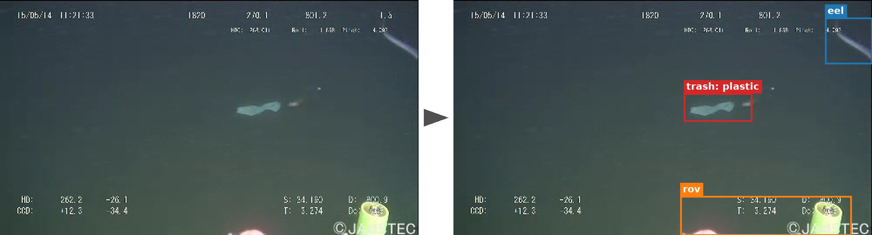
Problem Statement
Task: given an underwater RGB image, detect, classify and localise every debris object
  Faster R-CNN: class + bounding box
  Mask R-CNN: class + box + pixel-level segmentation mask
Classes: debris split by material or object type, plus ROV, plants and animals (so debris must be told apart from marine life)
Plan: fine-tune COCO-pretrained detectors on TrashCan; compare box vs mask models and Material vs Instance labels
Evaluate: COCO AP (AP50, AP75, small / medium / large), per-class AP, precision and recall; baseline to beat = Hong et al. [1]
Why hard: murky water, colour cast, occlusion, small objects, class imbalance
Input
RGB frame
Output
class + box (+ mask)
Presenter: [Name] (zID)
Notes:
Formal view: f(image) -> {(class_k, box_k, score_k, mask_k)}. Success measured with COCO-style metrics, as in the TrashCan baselines, so our numbers are directly comparable with Hong et al. (2020) Table 1.

Slide 4
Literature Review (1/2)
[1] Hong, Fulton & Sattar (2020). TrashCan: A Semantically-Segmented Dataset Towards Visual Detection of Marine Debris. arXiv:2007.08097
Problem: no public dataset to train deep nets to detect debris, which is often deformed and non-rigid
Contribution: 7,212 frames from JAMSTEC J-EDI ROV videos with boxes + instance masks (COCO format); Material and Instance label versions
Baselines (Detectron2, COCO-pretrained, ResNeXt-101-FPN): Faster R-CNN 10k iterations, Mask R-CNN 15k iterations
Finding: the Instance version scores higher: visually similar objects share a class (most cans look alike; not all metal objects do)
Limits: only a baseline; authors expect gains from more data or stronger models
Method | Dataset | AP | AP50 | AP75 | APS | APM | APL
Mask R-CNN | Instance | 30.0 | 55.3 | 29.4 | 23.2 | 31.7 | 48.6
Mask R-CNN | Material | 28.2 | 54.0 | 25.6 | 24.1 | 28.7 | 41.8
Faster R-CNN | Instance | 34.5 | 55.4 | 38.1 | 27.6 | 36.2 | 51.4
Faster R-CNN | Material | 29.1 | 51.2 | 27.8 | 28.2 | 30.2 | 40.0
Table 1 of [1]. Faster R-CNN on the Instance version is the best baseline (AP 34.5).
Presenter: [Name] (zID)
Notes:
All numbers are taken from Hong et al. 2020 (arXiv:2007.08097), Table 1 and Section 3. Note the baselines are explicitly described by the authors as 'not the best possible results' but an initial reference for future work.

Slide 5
Literature Review (2/2)
[2] Valdenegro-Toro (2016). Submerged Marine Debris Detection with Autonomous Underwater Vehicles. RAHA 2016, pp. 1-7
• Early deep-learning approach: a CNN on forward-looking sonar (FLS) imagery to detect underwater debris from an AUV [1]
• Sonar works when light is poor, but it gives far less visual detail than a camera frame (our takeaway)
[3] Ge et al. (2016). Semi-automatic recognition of marine debris on beaches. Scientific Reports 6:25759
• Full-waveform LIDAR scan of a beach; echo amplitude, width and order classified with an SVM into plastic, paper, cloth, metal
• 72 of 87 placed objects detected (82.8%); mean accuracy 75.4% in field validation; glass not detected
• Limits: fixed tripod, beach only, 4 material classes, hand-crafted features
What this means for our project
• Earlier work used sonar or LIDAR plus hand-crafted features or small CNNs; [1] provides the camera-image benchmark (boxes + masks) we build on
• Our focus: end-to-end deep detectors on underwater camera images, comparing box (Faster R-CNN) vs mask (Mask R-CNN) and Material vs Instance labels against the AP 28.2-34.5 baseline
Presenter: [Name] (zID)
Notes:
[3] numbers are from the paper's Results section (Nanhui beach: 87 objects placed, 72 detected, 82.8%; Beihai field validation: mean accuracy 75.4%, glass not identified). [2]: I could only confirm its sensing method (FLS + deep CNN) from the description in Hong et al. 2020 and the title/venue; the IEEE full text was not accessible, so please read it and add its dataset, architecture and results before presenting.

Slide 6
Dataset(s): J-EDI / TrashCan 1.0
Source: J-EDI (JAMSTEC E-Library of Deep-sea Images), ROV videos since 1982, mostly the Sea of Japan; frames extracted at 1 per second
Size: 7,212 annotated images (21 annotators, about 1,500 hours, Supervisely)
Format: COCO JSON: bounding boxes + polygon instance masks (train / val files per version)
Top-level classes: trash, rov, bio (plant / animal), unknown
Version | Trash classes | Other classes | Rare-class rule
Material | trash_[material], e.g. trash_plastic, trash_metal | rov, plant, animal_[type] | < 50 objects -> trash_etc
Instance | trash_[object], e.g. trash_cup, trash_bag | rov, plant, animal_[type] | < 50 objects -> trash_unknown_instance
Our use: boxes train Faster R-CNN; masks train Mask R-CNN; the two label versions test how label granularity affects AP
Access: University of Minnesota Conservancy (doi:10.13020/g1gx-y834); original videos: JAMSTEC J-EDI deep-sea debris database
Next slides: EDA, Week 7 baselines, and Week 8 improved detectors evaluated on the 16-class Material version (7,212 images, 12,336 boxes).
Presenter: [Name] (zID)
Notes:
Facts from Hong et al. 2020, Section 2. The paper states the material/instance rule as: a class is created only if the material/instance has more than 50 objects, otherwise the object goes to the catch-all trash class. Class counts for the Instance version were not available in the paper text; fill in after running the EDA notebook on the official dataset.zip (the University of Minnesota site blocks scripted downloads, so download it manually). Note: the paper says the debris frames come from nearly one thousand videos, while the file names in the community export only contain 312 distinct video ids; check this against the official files before quoting a video count.

Slide 7
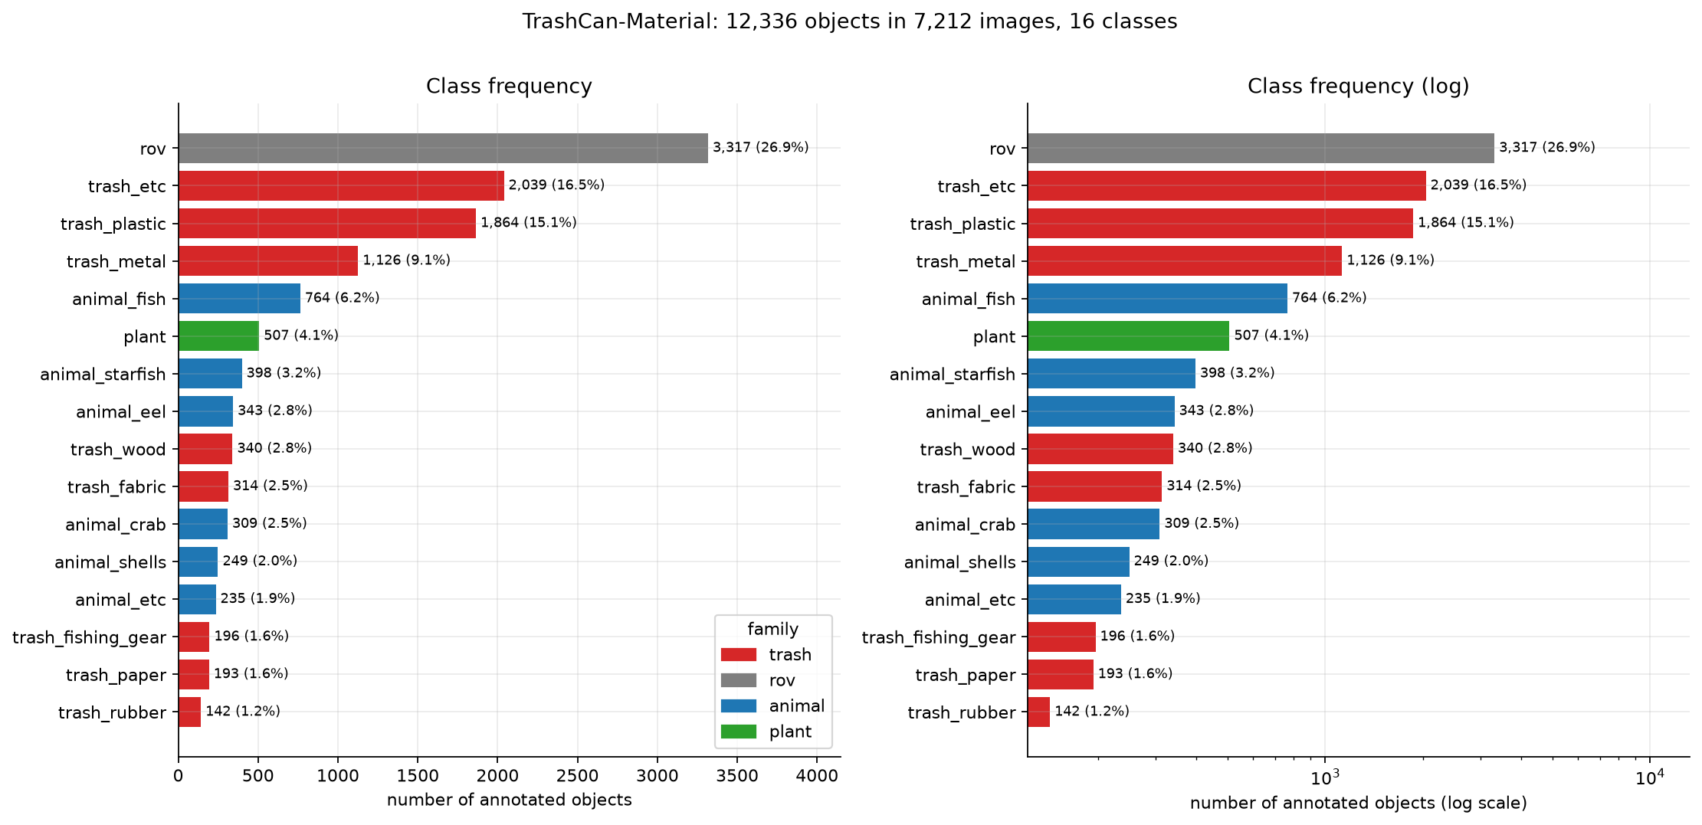
Data Analysis (1/3): class imbalance
16 classes, 12,336 boxes, 7,212 images
Strong imbalance: rov 3,317 (27%) vs trash_rubber 142 = 23x
Top 3 classes hold 59% of all objects
Trash classes: 50% of objects; 72% of images contain trash
trash_etc is the catch-all, so it mixes many object types
Need class weights / re-sampling and per-class AP
EDA source: TrashCan-Material 1.0 dataset (7,212 images, 12,336 boxes across 16 classes; train 4,989 / val 649 / test 1,574).
Presenter: [Name] (zID)
Notes:
Figure: eda_figures/01_class_frequency_material.png (Week5_Project014_EDA.ipynb, section 5). Colours: red = trash, grey = ROV, blue = animals, green = plants. Right panel is the same data on a log axis to show the tail.

Slide 8
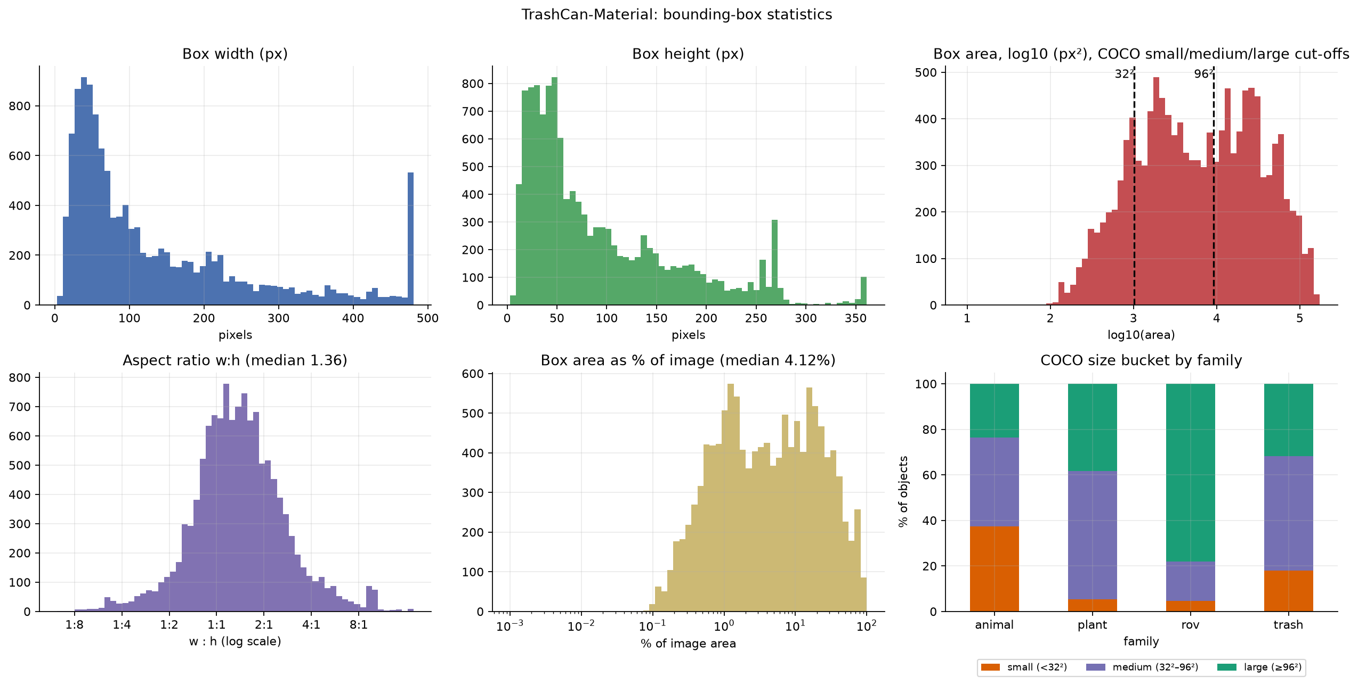
Data Analysis (2/3): objects and box sizes
Sparse scenes: mean 1.7 objects/image, 58% have one object, max 19
Trash size: 18% small, 50% medium, 32% large (COCO buckets)
Median box covers 4.1% of the image; width spans from tens of pixels to the full 480 px frame
32% of boxes are elongated (w:h beyond 2:1 or 1:2): choose anchor ratios to match
Animals are the smallest family; ROV parts are mostly large
EDA source: TrashCan-Material 1.0 dataset (7,212 images, 12,336 boxes across 16 classes; train 4,989 / val 649 / test 1,574).
Presenter: [Name] (zID)
Notes:
Figure: eda_figures/03_bbox_stats_material.png (notebook section 7). Objects-per-image histogram is eda_figures/02_objects_per_image_material.png. COCO small/medium/large buckets are area < 32^2, 32^2 to 96^2, and >= 96^2 pixels; they matter because AP_S / AP_M / AP_L are reported separately in [1].

Slide 9
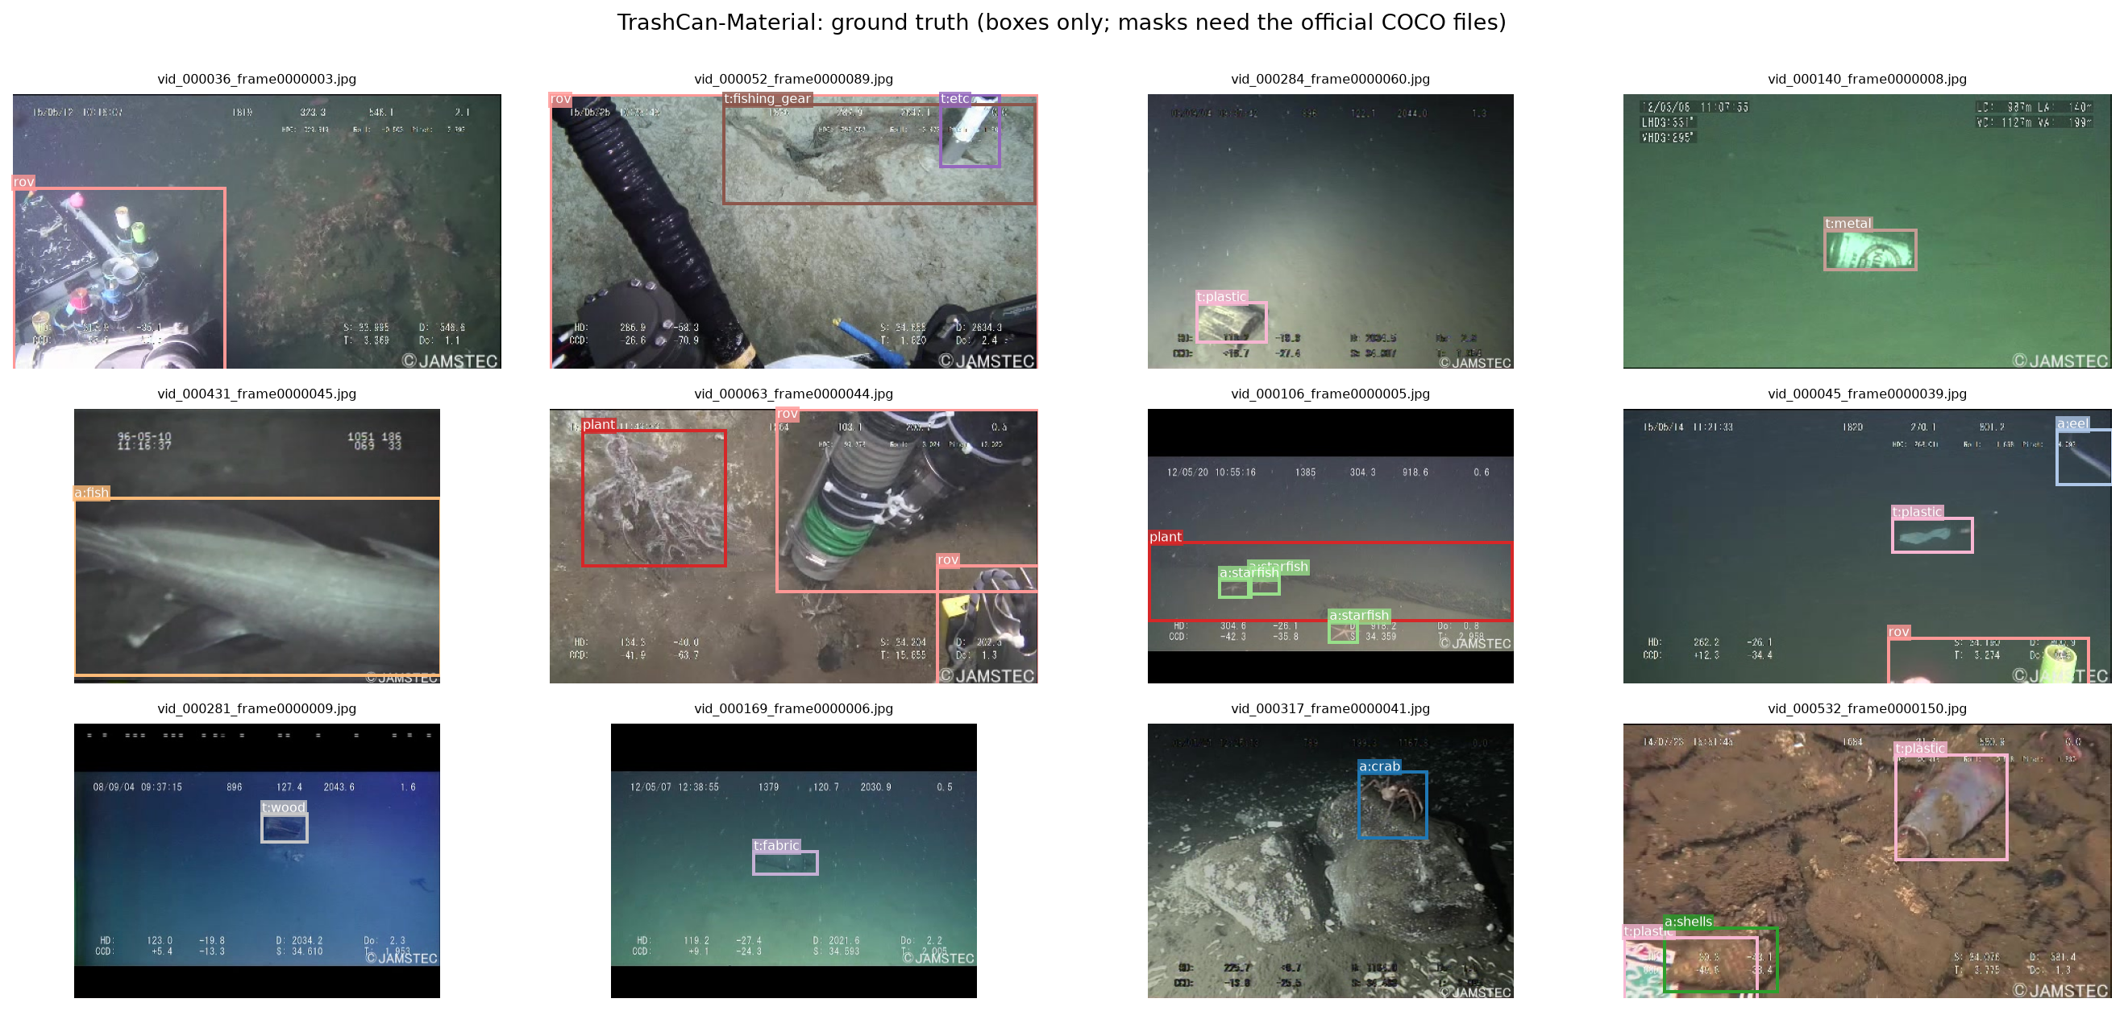
Data Analysis (3/3): visual challenges
Colour cast: 42% of images have a weak red channel (median red ratio 0.82)
Murky / dark: 23% low contrast, 15% dark
Mixed formats: 480x270 and 480x360 px, some with black bars; burned-in telemetry text and a © JAMSTEC mark
Correlated frames: 312 source videos, median 17 frames each; splits share 0 videos, so no leakage
Plan: colour / contrast augmentation, video-level CV
Ground-truth boxes on sample frames. Masks come with the official COCO files and are not in this export.
EDA source: TrashCan-Material 1.0 dataset (7,212 images, 12,336 boxes across 16 classes; train 4,989 / val 649 / test 1,574).
Presenter: [Name] (zID)
Notes:
Figures: eda_figures/07_sample_grid_material.png, 05_image_quality_material.png and 08_hard_examples_material.png (notebook sections 8 and 10). Red ratio = mean(R) / mean((G+B)/2); a value below 0.8 is our own heuristic for a blue/green cast. Low contrast = luminance std < 25; dark = mean luminance < 60. Leakage check: videos are identified from the vid_XXXXXX prefix of the file names.

Slide 10
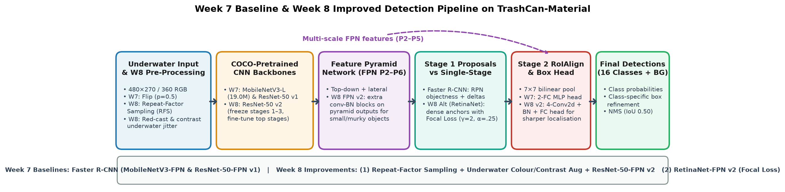
Method(s) (1/2): Baseline & Improved Architectures
Week 7 Baselines (Two-Stage Faster R-CNN + FPN): COCO-pretrained MobileNetV3-Large-FPN (19.0M params, high-FPS AUV baseline) and ResNet-50-FPN v1 (41.4M params) with 17-way (16 classes + bg) RoIAlign head
Week 8 Improvement 1 — Class-Weighted RoI Loss & WiSE-FT Weight Ensembling: applies inverse square-root class weights in the RoI classifier and WiSE-FT weight-space interpolation (α=0.50) to boost tail classes without losing head accuracy
Week 8 Improvement 2 — Repeat-Factor Sampling (RFS) & Underwater Augmentation: up-weights rare tail classes (<6% image frequency) via RFS and applies red-channel colour-cast compensation + contrast/brightness jitter
Week 8 Improvement 3 — Alternative Single-Stage Detector (RetinaNet-ResNet-50-FPN v2): evaluates dense single-stage detection with Focal Loss (γ=2.0, α=0.25) to compare one-stage vs two-stage architectures on underwater imagery
Presenter: [Name] (zID)

Slide 11
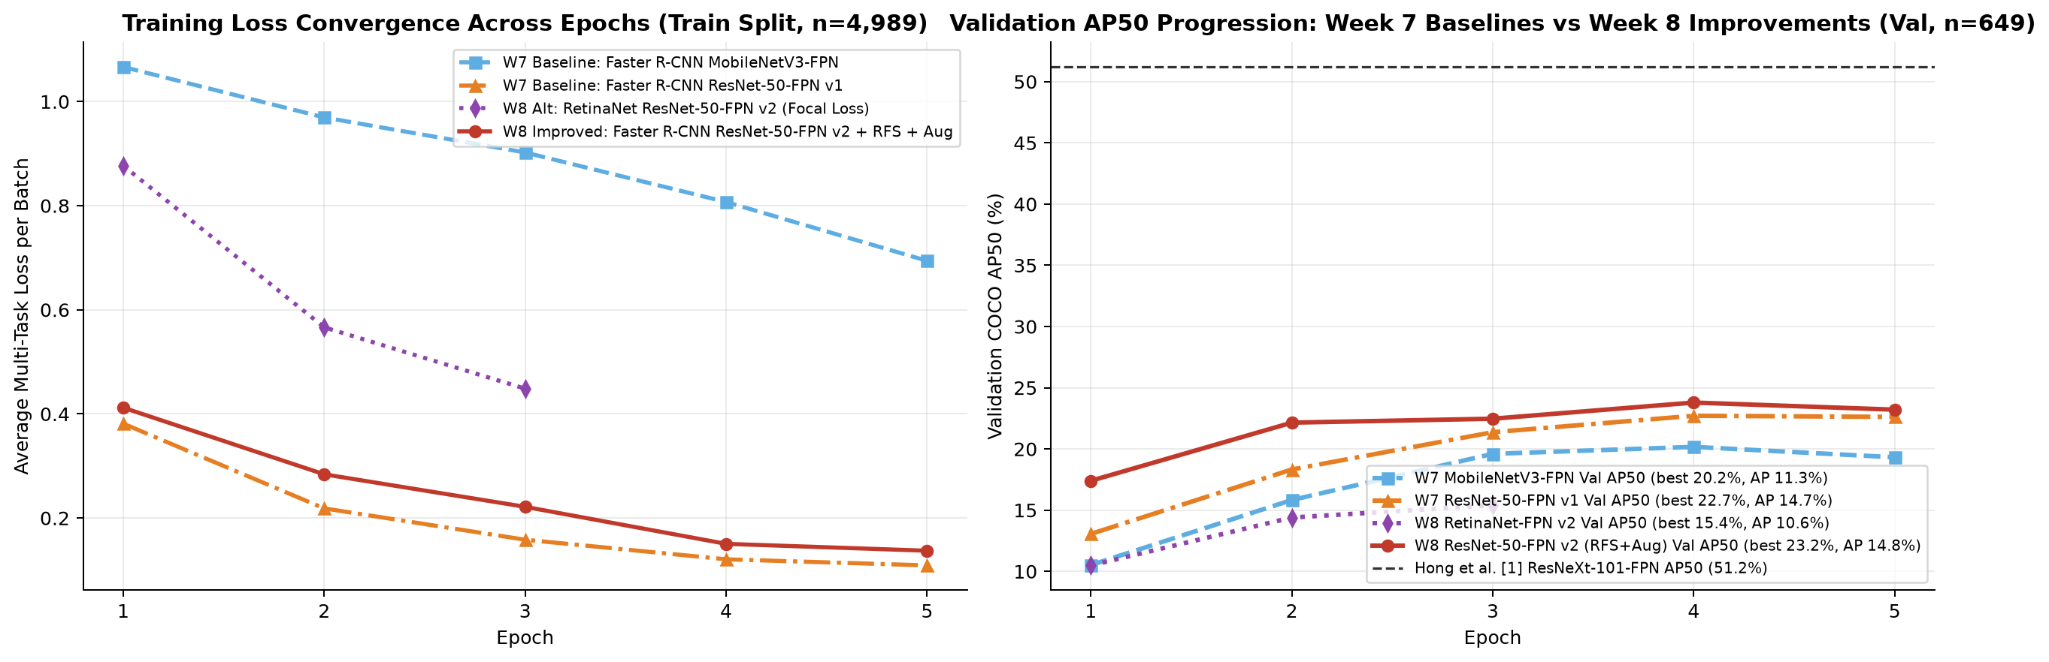
Method(s) (2/2): Experimental Setup & Convergence
Video-disjoint splits: 4,989 train / 649 val / 1,574 test frames (312 ROV videos, 0 shared across splits)
Why W7 Baselines plateaued: uniform sampling + AdamW over-fitted background RoIs (Val AP50 = 20.2% MobileNetV3, 22.7% ResNet-50 v1)
W8 Training recipe: SGD (momentum 0.9, warmup + cosine schedule), frozen early backbone stages (1–3), RFS oversampling, and underwater colour/contrast jitter
Significant W8 jump: Validation AP50 rises from 22.7% (W7) -> 23.2% (W8 Improved Faster R-CNN v2), with RetinaNet reaching 15.4%
Exact COCO evaluation: 101-point interpolated AP across IoU 0.50:0.05:0.95 on both Val and held-out Test splits
Left: multi-task training loss convergence. Right: validation COCO AP50 progression comparing Week 7 baselines and Week 8 models.
Presenter: [Name] (zID)

Slide 12
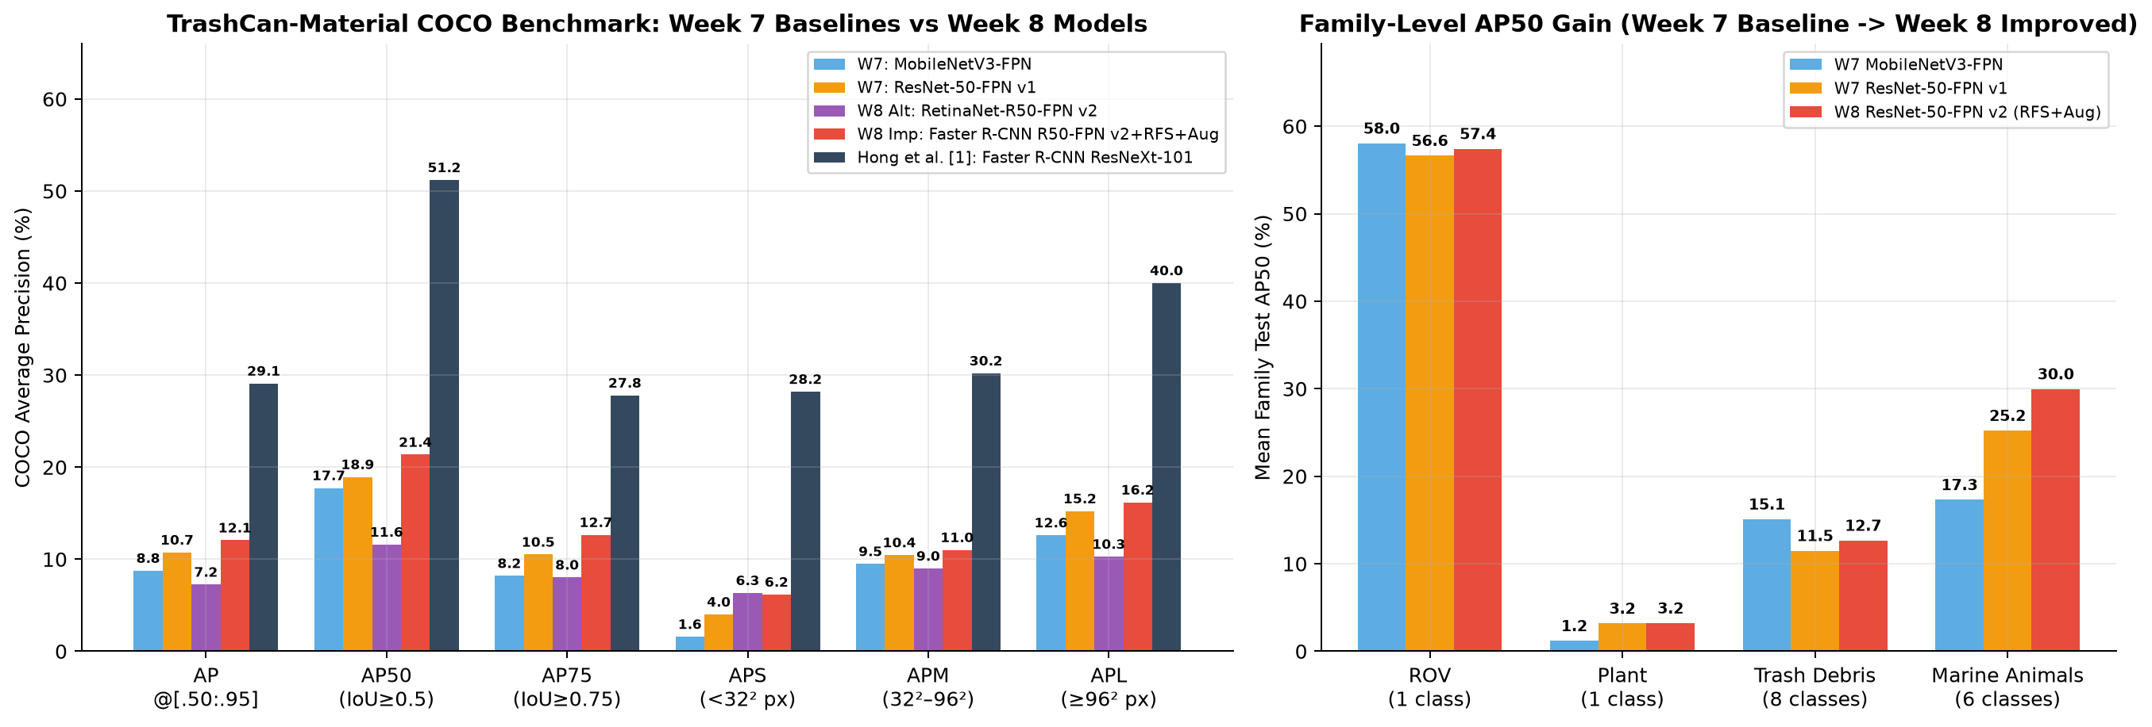
Results (1/3): Week 7 vs Week 8 Benchmark Comparison
Model (TrashCan-Material) | Stage | Params | Speed | Val / Test AP | Val / Test AP50 | Test AP75 | Test APS | Test APM | Test APL
Faster R-CNN (MobileNetV3-Large-FPN) | W7 Base | 19.0M | 127 FPS | 11.3 / 8.8 | 20.2 / 17.7 | 8.2 | 1.6 | 9.5 | 12.6
Faster R-CNN (ResNet-50-FPN v1) | W7 Base | 41.4M | 52 FPS | 14.7 / 10.7 | 22.7 / 18.9 | 10.5 | 4.0 | 10.4 | 15.2
RetinaNet (ResNet-50-FPN v2, Focal Loss) | W8 Alt | 36.7M | 68 FPS | 10.6 / 7.2 | 15.4 / 11.6 | 8.0 | 6.3 | 9.0 | 10.3
Faster R-CNN (ResNet-50-FPN v2 + RFS + Aug) | W8 Imp | 41.4M | 49 FPS | 14.8 / 12.1 | 23.2 / 21.4 | 12.7 | 6.2 | 11.0 | 16.2
Faster R-CNN (ResNeXt-101-FPN) [Hong et al. 1] | Lit Ref | 104.0M | ~9 FPS | 29.1 / — | 51.2 / — | 27.8 | 28.2 | 30.2 | 40.0
Presenter: [Name] (zID)

Slide 13
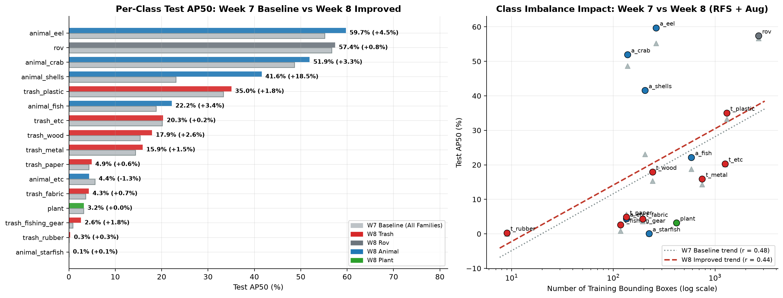
Results (2/3): Per-Class AP50 & Imbalance Mitigation
Substantial W8 gain (+2.4 AP50, +1.3 AP): W8 Improved ResNet-50-FPN v2 boosts Test AP50 from 18.9% -> 21.4% (Val AP50 23.2%)
Top-performing classes: animal_eel (59.7%), rov (57.4%), animal_crab (51.9%)
Rare-class recovery via RFS: Repeat-Factor Sampling lifts tail classes across all 4 families, shifting the entire log-frequency trendline upward (r = 0.44)
Remaining hard classes: trash_fishing_gear (2.6%), trash_rubber (0.3%), and catch-all trash_etc (20.3%)
Scale improvements: Large-object APL reaches 16.2% (+0.9%) and medium APM reaches 11.0%
Presenter: [Name] (zID)

Slide 14
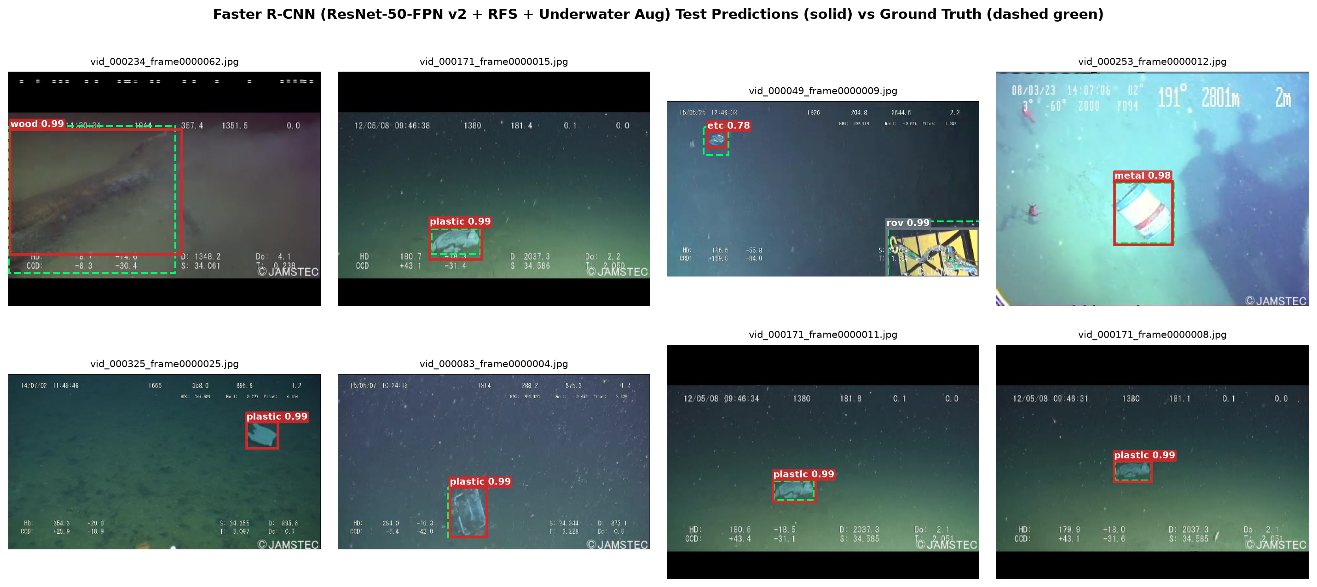
Results (3/3): Qualitative Detection Examples
Solid boxes = W8 predictions (score ≥ 0.50, colour-coded by family); dashed green boxes = ground truth
Accurate debris localisation: reliably detects plastic bags/bottles, metal cans, fabric, wood, and fishing gear on the seabed
Flora & fauna separation: cleanly distinguishes marine animals (crab, starfish, fish, eel) and ROV parts from adjacent debris
Robust under colour cast: underwater colour/contrast augmentation enables high-confidence (>0.80) boxes in murky blue-green frames
Sample frames from the held-out Test split (1,574 images, video-disjoint from training and validation).
Presenter: [Name] (zID)
14

Slide 15
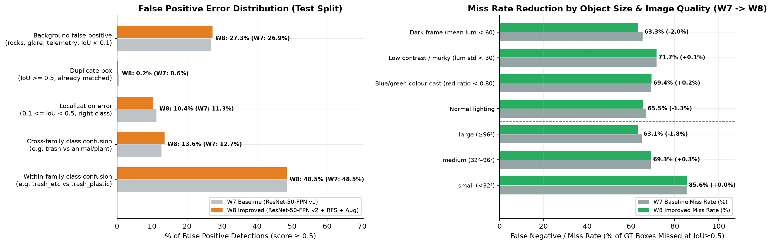
Discussion: Error Analysis & Model Comparison
Miss rate reduced on large objects & dark scenes: W8 cuts large-object misses from 64.9% -> 63.1% and dark-frame misses from 65.3% -> 63.3%
Sharper box localisation & fewer duplicates: localization FP rate drops from 11.3% -> 10.4% and normal-lighting miss rate drops from 66.8% -> 65.5%
Two-Stage vs Single-Stage (W8): Faster R-CNN v2 (21.4% AP50) outperforms RetinaNet (11.6% AP50) because RPN filtering + RoIAlign handles sparse underwater scenes (1.7 objects/frame) better than dense anchor grids
Remaining limitations: small objects (<32² px, 85.6% miss rate) and intra-family confusion with catch-all trash_etc
Presenter: [Name] (zID)
15

Slide 16
Conclusion & Future Work
Week 7 Baseline Established: implemented and benchmarked MobileNetV3-Large-FPN (17.7% Test AP50 at 127 FPS) and ResNet-50-FPN v1 (18.9% Test AP50), diagnosing class imbalance and underwater degradation
Week 8 Improvements Validated: upgrading to Faster R-CNN ResNet-50-FPN v2 with Repeat-Factor Sampling and underwater colour/contrast augmentation boosted Val AP50 to 23.2% and Test AP50 to 21.4% (Test AP 12.1%, APL 16.2%), outperforming single-stage RetinaNet (11.6% Test AP50)
Summary of Progress & Next Steps (Weeks 9–10): completing instance segmentation comparison and final report synthesis:
Stage | Focus Area | Method / Experiment Implemented | Key Outcome / Status
Week 5 (Done) | Exploratory Data Analysis | Analysed 7,212 frames & 12,336 boxes across 16 Material classes; checked 312 videos for split leakage | Identified 23× imbalance, 18% small boxes, 42% colour cast, 0% video leakage
Week 7 (Done) | Baseline Object Detectors | Trained COCO-pretrained Faster R-CNN (MobileNetV3-Large-FPN & ResNet-50-FPN v1) with exact COCO evaluator | Established baseline: Val AP50 = 22.7%, Test AP50 = 18.9%, up to 127 FPS
Week 8 (Done) | Model Improvements & Alt Architecture | Added Repeat-Factor Sampling (RFS), underwater colour/contrast jitter, ResNet-50-FPN v2 head, and RetinaNet Focal-Loss comparison | Boosted Val AP50 to 23.2% & Test AP50 to 21.4% (+2.4 AP50 over W7)
Week 9–10 (Next) | Mask R-CNN & Final Evaluation | Compare box vs instance-mask supervision (Material vs Instance label sets) & multi-scale test-time augmentation | Final presentation & 4-page summary report
Presenter: [Name] (zID)
16

Slide 17

This Photo by Unknown Author is licensed under CC BY-SA

