Slide 1
A Parameter-free Multi-view Information Bottleneck Clustering Method by Cross-view Weighting
Shizhe Hu, Ruilin Geng, Zhaoxu Cheng, Chaoyang Zhang, Guoliang Zou, Zhengzheng Lou, Yangdong Ye*
School of Computer and Artificial Intelligence
Zhengzhou University
Zhengzhou, Henan, China
Notes:
1:08

Slide 2
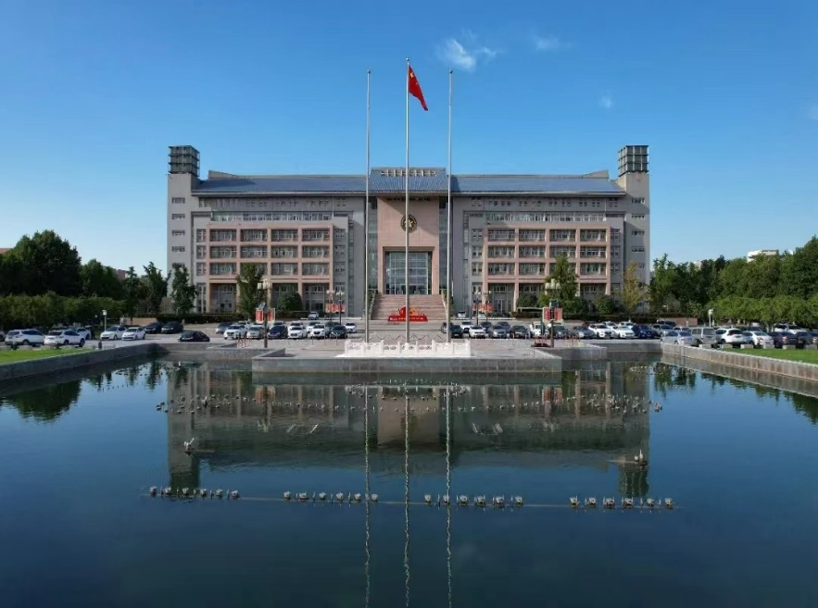





Zhengzhou University (Also called “Western Park of Zhengzhou”)

Slide 3



Tourist Spot

Slide 4
Outline
Problem background
Previous works
Our proposal
Experiments
Conclusion

Slide 5
Outline
Problem background
Previous works
Our proposal
Experiments
Conclusion

Slide 6
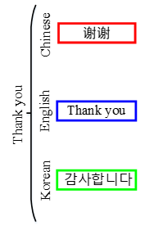
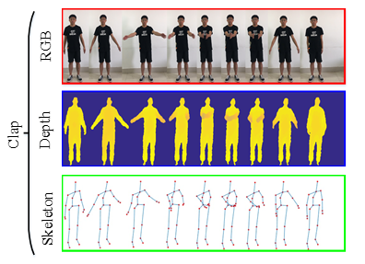
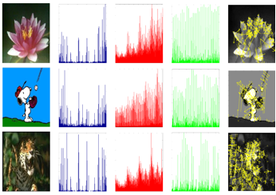
In Big Data era, many kinds of multi-view data are emerging.
Multi-lingual Text
Multi-feature Image
Multi-modal human action video
Property: Heterogeneous, Large-scale, Diversification, Complexity

Slide 7
Limitations of supervised multi-view classification methods:
1. Time-consuming and cost-expensive for labelling;
2. Over-reliance on the label information of trained data;
3. Ignoring the characteristics of the input data itself.
Multi-view Clustering

Slide 8
Outline
Problem background
Previous works
Our proposal
Experiments
Conclusion

Slide 9
Previous multi-view clustering methods
View weighted-based methods:
integrating and utilizing the complementary information among views by linear sum of the learned view weights.
Limitations:
Most of them always need additional parameters or prior knowledge to regularize the weight distribution, which limits their applications in broad fields.

Slide 10
Previous multi-view clustering methods
Self-weighted methods:
Employing the complementary information without needing weight parameters.
Limitations:
Failing to quantify how complementary the information across views is actually utilized for benefiting the final data clustering.
Most of them still need one or more other parameters to regularize the variants or terms in their objective functions.

Slide 11
Outline
Problem background
Previous works
Our proposal
Experiments
Conclusion

Slide 12
Our proposed method:
Parameter-free Multi-view Information Bottleneck (PMIB):
Informative View Discovery;
Cross-view Weights Learning;
Clustering structure Learning.

Slide 13
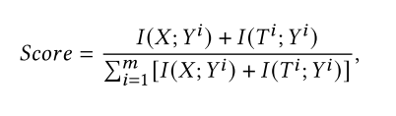
Informative View Discovery:
Motivation: one most informative view usually makes the greatest contribution to the final clustering performances.
Strategy: by measuring the relevant information preserved by the original data and the compact clusters with the concept of MI.

Slide 14






Concept Definition:
Deﬁnition (Cross-view weight):
Unlike existing view-weighted schemes only considering the importance of individual view, cross-view weight takes into account the importance of pairwise views by quantifying how complementary across views.
Two view matrix

Slide 15


Objective function of PMIB:

Slide 16
Advantages of the PMIB:
Usage of quantitative complementary information
Cross-view weighting
No parameters are involved

Slide 17
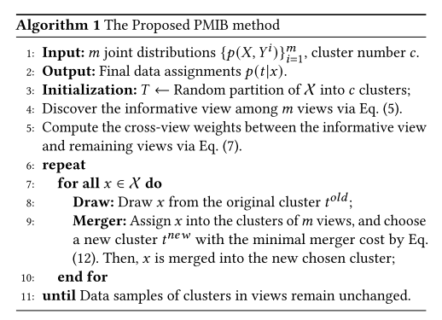
Optimization method:

Slide 18
Outline
Problem background
Previous works
Our proposal
Experiments
Conclusion

Slide 19
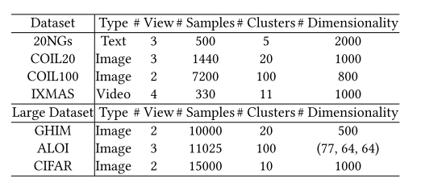
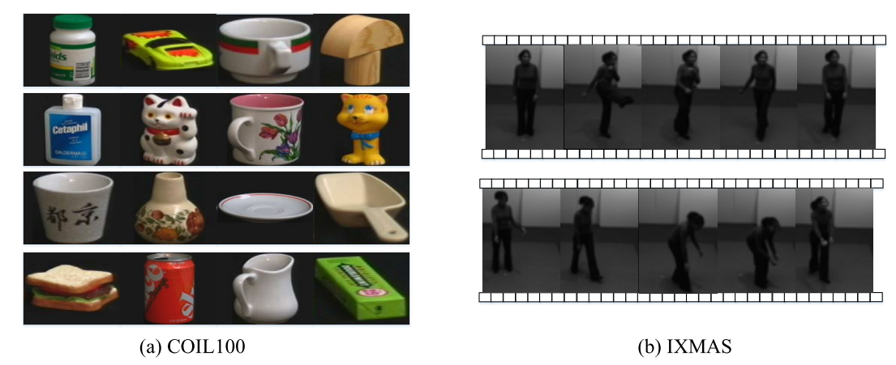
Datasets:

Slide 20
Compared methods:
Single-View Clustering: K-Means (KM) and IB.
2) All-View Clustering: AVKM and AVIB, where different views are concatenated and then clustered by the corresponding single-view methods above, respectively.
3) Multiview Clustering:
(1) MVIB: A multi-view information bottleneck for web document clustering.
(2) Co(reg): A co-regularized multi-view clustering method.
(3) RMKMC: A robust multi-view 𝑘 -means clustering method.
(4) MfIB: A weighted multi-feature information bottleneck method for image clustering.
(5) RMSC: A robust multi-view spectral clustering method.
(6) DEKM: A discriminatively embedded 𝑘 -means method.
(7) MLAN: A multi-view learning method with adaptive neighbors.
(8) GMC: A graph-based multi-view clustering method.
(9) ONMSC: An optimal neighborhood multi-view spectral clustering method.
(10) SMVSC: A scalable multi-view subspace clustering method with unifi ed anchors.

Slide 21
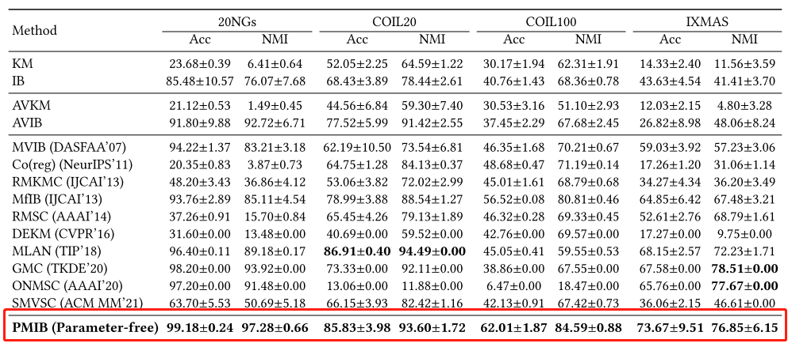
Clustering results:

Slide 22
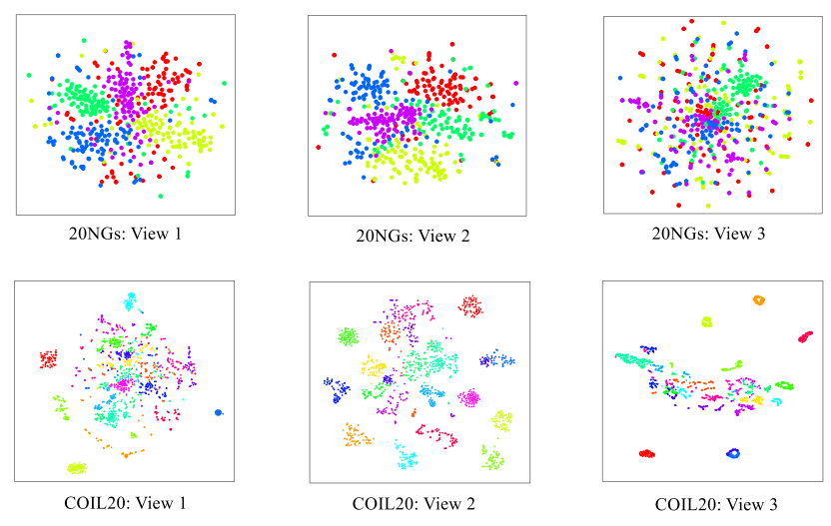
T-SNE visualization of Clustering results on 20NGs and COIL20 dataset:

Slide 23
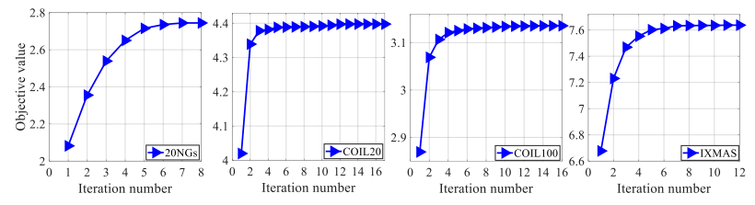
Convergence results:

Slide 24
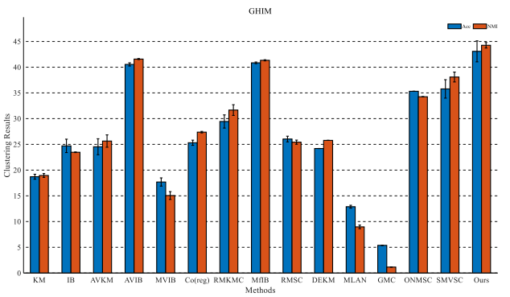
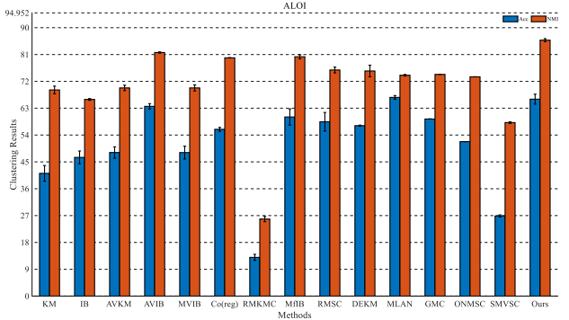
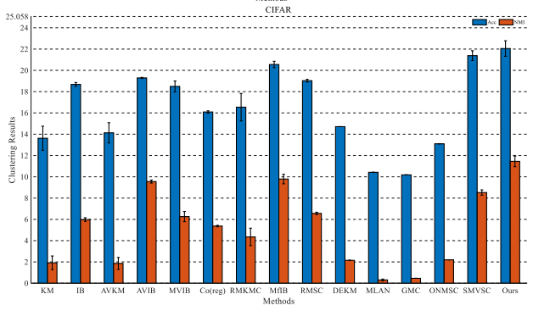
Effectiveness on Large-scale Multi-view Datasets:

Slide 25
Outline
Problem background
Previous works
Our proposal
Experiments
Conclusion

Slide 26
Summary
Create a novel parameter-free multi-view information bottleneck (PMIB) for multi-view clustering;
A new cross-view weight learning scheme is designed for quantifying how complementary the information between the informative view and remaining views is actually utilized for benefiting the data clustering.
Our approach achieves state-of-the-art performance.

Slide 27
Thank You!
Contact for communication:
ieshizhehu@zzu.edu.cn

