Slide 1
APPENDIX D
When to listen.
How to transmit.
How to keep service.
Joint sensing, robust beamforming and causal scheduling
for terrestrial / non-terrestrial coexistence
Information
Protection
Service
Theory + reproducible finite-model and fresh ray-tracing evidence
Paper: Appendix D · direction.tex | 22 September 2026
01 / 30
Notes:
Slide 1: Service-Constrained Joint Sensing and Robust Transmission
Opening: The main paper tells us where to suppress interference. Appendix D asks the next question: when should a base station pay the cost of sensing, and how should it transmit until the next useful observation? The aim is to maximize delivered terrestrial service while controlling deadline failures and non-terrestrial interference exposure. This presentation follows the five parts of the appendix, then adds explicitly labeled results from our current implementation. The theory is conditional on its observation and protection models. Current fresh ray tracing validates the spatial component, not the complete physical dynamic controller. Suggested duration: 25–30 minutes for slides 1–25; slides 26–30 are backups.
Source: Paper: Appendix D · direction.tex | 22 September 2026

Slide 2
MOTIVATION
A better estimate is useful only if it earns back its cost
Listen longer
Transmit now
Stay silent
Potentially better
information
More lost DL/UL
resources
The result arrives later
More immediate service
Older channel
information
Possible power backoff
Zero controlled-BS
leakage
No TN downlink service
TN uplink may continue
The objective is delivered service after sensing overhead—not estimation accuracy
alone.
Appendix D
02 / 30
Notes:
Slide 2: A better estimate is useful only if it earns back its cost
Explain the three competing actions. Listening is not free: reusing the front end removes scheduled downlink and uplink opportunities. Continuing service uses old, potentially less informative protection sets. Silence controls this base station’s interference contribution but sacrifices downlink bits. A received estimate is also already aged by the time processing finishes. The desired optimization compares the complete service and risk consequences of all three choices. This is why a static INR curve, or a smaller direction-estimation error, is not sufficient evidence for the joint controller.
Source: Appendix D

Slide 3
SYSTEM
One controlled sector, two networks, partial information
interference
NTN receiver
TN user
service
TN base station
Protected DL reception
May emit observable
UL
Desired DL service
Fixed DL/UL calendar
Shared array and front
end
UL sensing
UL-silent NTN
Known online: current TN CSI, released observations, actions and
service history.
Hidden: true NTN DL channels, identities, future activity and
future observations.
DL-active, no UL signal
Appendix D.A–B · eq:joint_exposure
03 / 30
Notes:
Slide 3: One controlled sector, two networks, partial information
TN means terrestrial network; NTN means non-terrestrial network. The controlled object is one TN sector with one scheduled stream per resource. Its downlink can interfere with an NTN downlink receiver. The base station listens to an NTN uplink band, which can differ from the protected downlink frequency. An uplink-silent terminal can still be receiving its satellite downlink and therefore require protection. The controller has its own current TN channel in the declared model, but it does not receive the true victim channel or the future physical state. Other interference is fixed or separately budgeted in the exact core.
Source: Appendix D.A–B · eq:joint_exposure

Slide 4
ARCHITECTURE
The appendix connects sensing to service through two optimizers
Available history
Protection catalog
Robust SOCP
Released estimates
Quality and age
Anonymous path groups
Residual and gain bounds
Beam + power
Best feasible service
observation transitions + risk + deadline costs
Finite-history occupation-measure LP
Choose listening time, duration, template, service and
silence
SOCP chooses the best protected transmission; LP decides when it is worth using.
Appendix D
04 / 30
Notes:
Slide 4: The appendix connects sensing to service through two optimizers
Walk left to right. Released sensing information is mapped to a catalog of uncertainty sets and conditional coverage-risk bounds. For each usable state, a robust second-order cone program computes the best desired-channel amplitude and the corresponding power. The outer linear program uses those service values, sensing outcomes and deadline events to choose a randomized causal policy. Observation quality, delay and unsuccessful sensing enter the transition model. These are layers of one design, not three unrelated algorithms. This slide is the roadmap: timing, sets, service and risk, SOCP, then LP.
Source: Appendix D

Slide 5
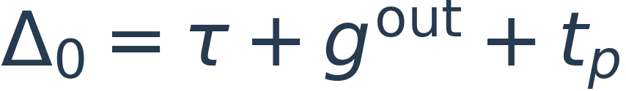
A · TIMING
A new estimate is unavailable until its release time
Enter
Listen
Return
Process
0
1
3
4
7
RF unavailable: no affected TN
DL/UL
RF returned: service may resume
using the old record
At release: age = 7 − 1 = 6. A rejected observation keeps the previous record.
Appendix D.A · eq:joint_timing · illustrative 1/2/1/3 time units
05 / 30
Notes:
Slide 5: A new estimate is unavailable until its release time
Use the example rather than starting with symbols. Entry takes one time unit, collection two, return one, and processing three. Samples are referenced to time one, not time seven. The front end is unavailable until time four. With nonblocking processing, the base station can resume calendar-permitted service at time four, but it must use the old record until time seven. Acceptance at time seven gives a record aged six units. Rejection preserves the old reference time. This is an illustrative appendix timeline, not the shorter guard values in the current 12-tick simulator. Blocking processing would extend unavailability through release.
Source: Appendix D.A · eq:joint_timing · illustrative 1/2/1/3 time units

Slide 6
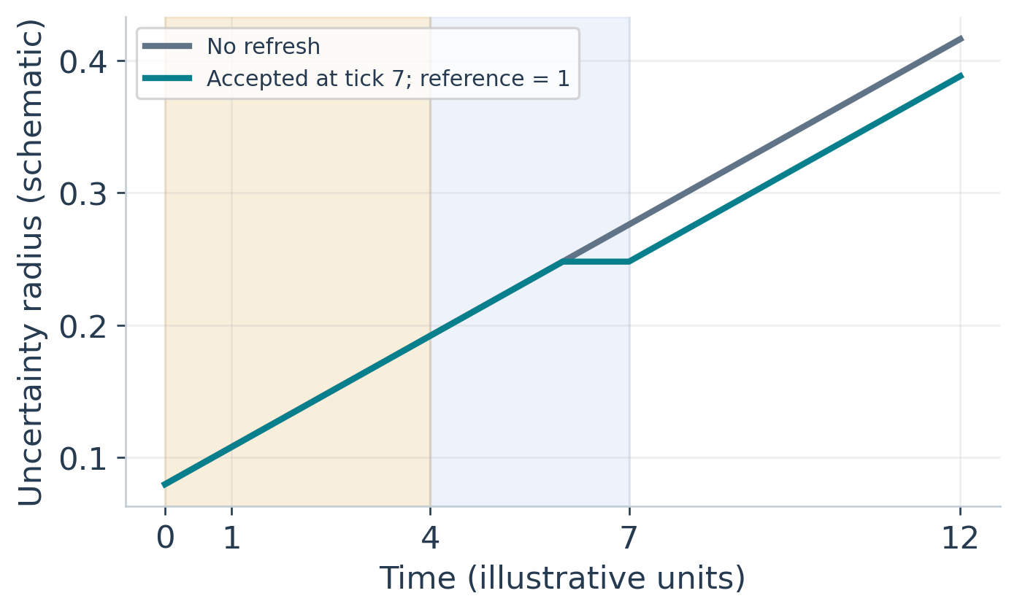
A–B · INFORMATION AGE
Longer listening trades accuracy against usable service time
•
Age grows from the sample
reference time.
•
An accepted refresh may
shrink uncertainty.
•
Longer sensing also delays
release and consumes
service time.
The policy must compare successful, rejected and no-detection branches.
Appendix D.A–B · schematic, not fitted experimental data
06 / 30
Notes:
Slide 6: Longer listening trades accuracy against usable service time
This plot is deliberately schematic. It visualizes uncertainty growing while the previous record is used; after an accepted observation, the reference changes to the start of that listening window, not to its release time. A refreshed record can therefore start with substantial age. Better observation quality can reduce an estimation component, while age, calibration error and missing multipath remain. The appendix does not assume a universal inverse-square-root law in listening duration. For a fixed ground BS-to-VSAT link, satellite orbital speed must not be substituted for ground-link direction change.
Source: Appendix D.A–B · schematic, not fitted experimental data

Slide 7
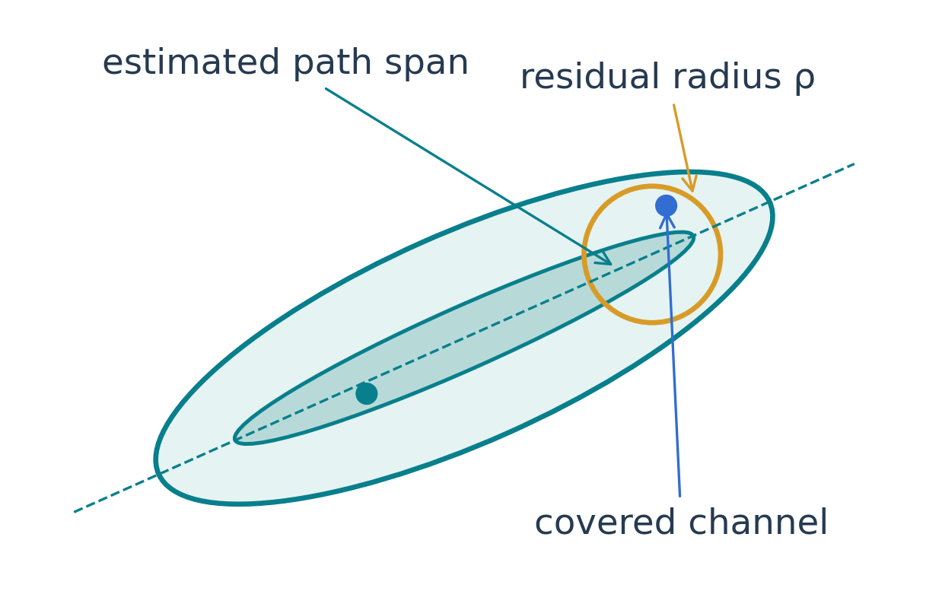
B · UNCERTAINTY
Protect a set of complete channels, not individual peaks
Aᵣ: reconstructed DL path responses
Cᵣ: bound on complex coefficients
ρᵣ: unresolved paths and model
error
r: anonymous group, not a UE
identity
Complex coefficients retain coherent path addition; the full receiver channel must be
covered.
Appendix D.B · eq:joint_multipath_set
07 / 30
Notes:
Slide 7: Protect a set of complete channels, not individual peaks
Explain A, C and rho separately. Columns of A are downlink array responses reconstructed from observed directions. The complex coefficient vector permits arbitrary coherent relative phases within its norm bound. The residual ball covers unmodeled or nontransferable paths and other errors. A group does not require identification of a specific receiver. A complete victim channel must belong to at least one imposed group; independently protecting individual peaks is insufficient when their coherent sum is the actual channel. The two-dimensional figure is a conceptual projection of a complex high-dimensional set, not an exact physical channel plot.
Source: Appendix D.B · eq:joint_multipath_set

Slide 8
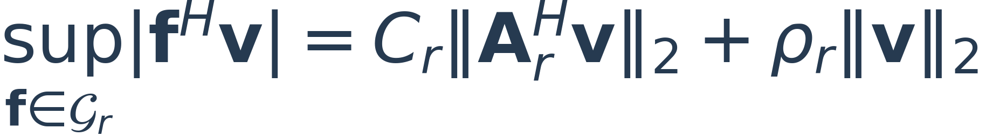
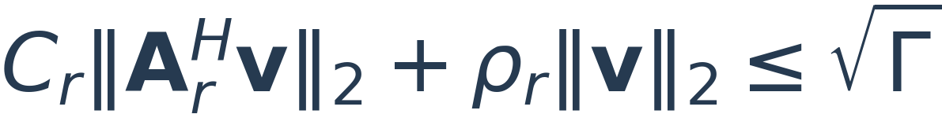
B · ROBUST PROTECTION
The worst-case leakage has an exact closed form
Modeled-path contribution
Residual contribution
Suppress the estimated DL subspace.
More directions can cost spatial freedom.
Uncertain directions remain.
Power backoff limits their leakage.
Exact for the declared set; the set itself may conservatively overbound physical
channels.
Appendix D.B · Proposition: exact set-wise protection
08 / 30
Notes:
Slide 8: The worst-case leakage has an exact closed form
The upper bound comes from Cauchy–Schwarz and the triangle inequality. It is attainable: choose the coefficient vector aligned with A Hermitian v and the residual aligned with v, with phases that add rather than cancel. That is why the support expression is exact for this uncertainty set. The two terms explain the engineering tradeoff. Steering away from the estimated subspace reduces the first term, but a residual ball generally leaves a term proportional to total beam norm. The INR threshold Gamma is a power ratio; therefore the amplitude constraint uses square root Gamma.
Source: Appendix D.B · Proposition: exact set-wise protection

Slide 9
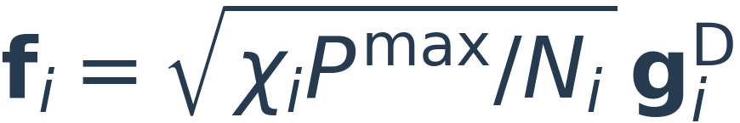
B–C · BACKGROUND PROTECTION
A silent receiver can still force power backoff
Directional information
Arbitrary-direction background
A known path span supports spatial
suppression.
Unknown complex DL gains still require
valid bounds.
If ||f|| ≤ β, every direction is possible.
The only universal control is beam norm.
Passive UL sensing cannot distinguish an absent receiver from a permanently silent
one.
Appendix D.B–C · eq:joint_exposure · background catalog
09 / 30
Notes:
Slide 9: A silent receiver can still force power backoff
The normalized channel f includes receiver noise, spectral coupling and the power limit. The vector v combines beam shape and power fraction: physical power is Pmax times p. A background norm ball can be represented either with A equal to the identity and coefficient bound beta, or as a pure residual ball of radius beta; both give beta times beam norm. A receiver with no observable uplink requires prior coverage, a valid arrival/activity model, or side information. The method cannot infer an unknown downlink antenna gain from a MUSIC weight alone. Zero downlink transmission protects the controlled contribution, but not unrelated external interference.
Source: Appendix D.B–C · eq:joint_exposure · background catalog

Slide 10
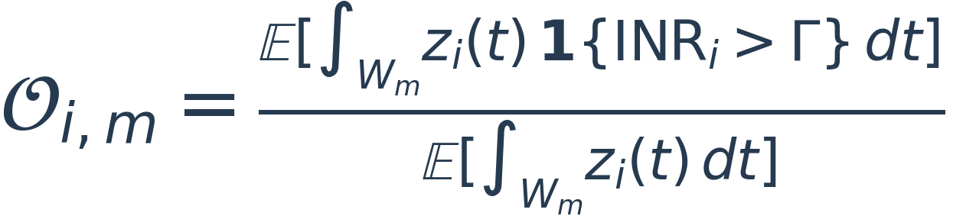
C · PERFORMANCE METRICS
Service reliability and interference exposure use different metrics
TN: deadline service
NTN: active-time exposure
Accumulate only available resources.
Check each user, direction and window.
The demand is frozen in advance.
Include missed and UL-silent receivers.
Count activity during gaps and silence.
Aggregate durations across episodes.
Mean throughput cannot replace this
event.
A ratio of expectations, not a window
event.
Use identical windows, calendars, references and budgets for every policy.
Appendix D.C · eq:joint_service_target · eq:joint_activity_outage
10 / 30
Notes:
Slide 10: Service reliability and interference exposure use different metrics
The TN constraint is a chance constraint on deadline service, independently for each applicable user, direction and window. The reference and demand cannot be recalculated after seeing a favorable Gamma or future channel. The NTN metric is the expected exceeding active duration divided by expected active duration. In measurements, estimate it by total exceeding duration divided by total active duration across complete independent episodes, not an unweighted average of episode ratios with varying denominators. BS silence makes the controlled interference zero but does not erase the receiver’s active time. Gamma controls interference magnitude; delta NTN controls the allowable active-time fraction.
Source: Appendix D.C · eq:joint_service_target · eq:joint_activity_outage

Slide 11
C · CONDITIONAL RISK
Coverage risk bridges robust constraints and actual outage
Coverage failure
Set failure
Gain-bound failure
Missing receivers
or missing groups
Channel outside the
modeled uncertainty set
Noise / gain / coupling
bounds do not hold
Marginal calibration coverage is not a certificate for every adaptively selected history.
Appendix D.C/E · eq:joint_risk_union · eq:joint_risk_cost
11 / 30
Notes:
Slide 11: Coverage risk bridges robust constraints and actual outage
On valid catalog coverage, the robust beam constraint makes the exceedance event impossible for the controlled contribution. Exceedance can therefore occur only through a coverage or bound failure. Use component upper bounds under the same history, action and receiver-activity conditioning; their union bound does not require independence. Multiplying a valid throughout-segment conditional probability bound by expected active duration yields a risk-duration coefficient. Overall average calibration coverage does not automatically remain valid after a policy selects particular histories. Sparse histories require conservative fallback bounds or a narrower model. Statistical confidence in an estimated bound is separate from the physical outage budget.
Source: Appendix D.C/E · eq:joint_risk_union · eq:joint_risk_cost

Slide 12
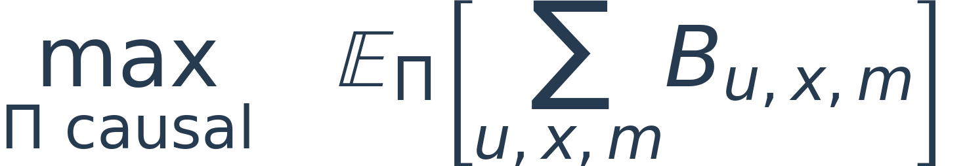

C · JOINT PROBLEM
The joint problem maximizes net service under explicit budgets
Calendar • RF availability • transmit power • robust set constraints
The old leakage penalty λ is replaced by physical constraints and service
requirements.
Appendix D.C · eq:joint_policy_problem
12 / 30
Notes:
Slide 12: The joint problem maximizes net service under explicit budgets
The decision variable is a causal policy, not just a beam vector. It chooses legal sensing starts, listening durations and templates, plus transmission or silence. C is a computable upper bound on expected exceeding active duration; D is expected active duration. For valid positive activity, C less than delta times D is sufficient for the actual outage target. The objective directly rewards bits delivered after overhead, so a common arbitrary penalty lambda is unnecessary in this core. Infeasibility is a legitimate result: do not relax the TN requirement silently just to draw a curve.
Source: Appendix D.C · eq:joint_policy_problem

Slide 13
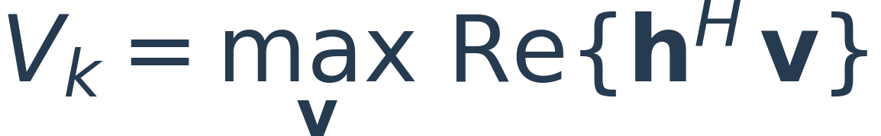
D · ROBUST SOCP
At one state, a convex program selects beam and power
•
Rotate the common phase:
no loss of optimality.
•
Recover p = ||v||² and the
beam direction.
•
Convert Vₖ into service;
retain mute separately.
for every imposed protection group r
This solves the best current protected transmission—not the sensing schedule.
Appendix D.D · eq:joint_value_socp
13 / 30
Notes:
Slide 13: At one state, a convex program selects beam and power
With fixed current TN channel and protection catalog, all constraints depend on phase-invariant magnitudes. Rotate the beam so the desired inner product is real and nonnegative, then maximize its real part. This gives an SOCP. The optimum can use full power, partial nulling, or power backoff. When the solution is nonzero, p is its squared norm and w is the unit-normalized direction. Its rate is B log2(1 + Pmax V squared divided by noise plus external interference). The feasible beam set always contains zero; positive service feasibility is the real issue. Age expansion of fixed-center uncertainty sets can only shrink the feasible set.
Source: Appendix D.D · eq:joint_value_socp

Slide 14
D · BEAM ELIMINATION
Why the outer controller does not search every beam
Coupling argument
Conditions that make it valid
Keep the same physical trajectory.
Keep sensing and mute decisions.
Replace each nonmute beam by the SOCP
optimizer.
Delivered bits cannot decrease.
Fixed calendar and external interference.
No energy carryover or switching cost.
Exogenous physical/observation laws.
One shared certified nonmute risk bound.
The result concerns certified risk; beam-dependent true-outage costs need a different
reduction.
Keep one SOCP maximizer and an explicit mute action at each available history.
Appendix D.D · Proposition: lossless beam elimination
14 / 30
Notes:
Slide 14: Why the outer controller does not search every beam
This is the key reduction linking continuous beam design to a finite policy problem. Consider a virtual copy of any original policy with its original service counters. On the same exogenous trajectory and random seed, keep the sensing and mute choices, but use the SOCP maximizing beam whenever transmitting. Actual service only increases, while the certified risks and future observation laws remain unchanged under the stated assumptions. Minimum-service failures cannot become worse. A virtual copy is needed because later decisions may depend on the original service counters. This theorem does not cover beam-dependent actual outage costs, intertemporal energy, coupled network SINR, or uncertain current TN CSI without further analysis.
Source: Appendix D.D · Proposition: lossless beam elimination

Slide 15
E · HISTORY GRAPH
A causal state contains what is known—not the hidden channel
S = time + revealed history + RF / pending status + delivered bits + record
timestamps
Serve / mute
Use available
information
Known history
At release only
Legal actions
Available record
Accepted → new record
Listen
Rejected → old record
Commit resources
No detection → old
record
Pending metadata includes the release time, but never the unreleased estimate.
Appendix D.E · eq:joint_history_state · eq:joint_belief_update
15 / 30
Notes:
Slide 15: A causal state contains what is known—not the hidden channel
The complete observable history supports a belief over hidden physical states without revealing them to the controller. The state also carries timing, pending-release metadata, delivered service and timestamps, because those affect legal actions and deadline events. The graph branches on observations actually released. Rejection and no detection remain explicit branches; pruning them and renormalizing changes the declared model. Time increases along each edge, so the graph is acyclic. It can nevertheless grow exponentially with horizon and observation alphabet, which is why the exact solver is a small-instance benchmark rather than an automatic solution to arbitrary large deployments.
Source: Appendix D.E · eq:joint_history_state · eq:joint_belief_update

Slide 16
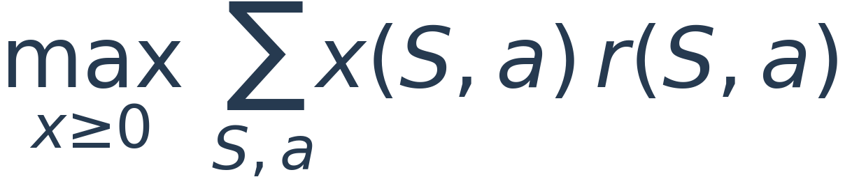
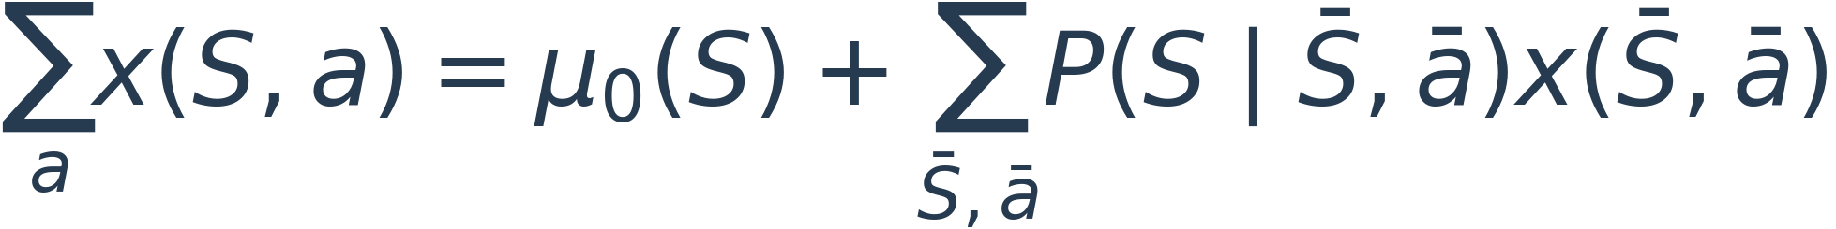
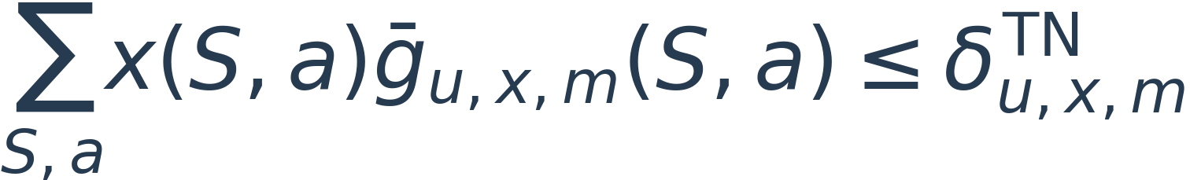
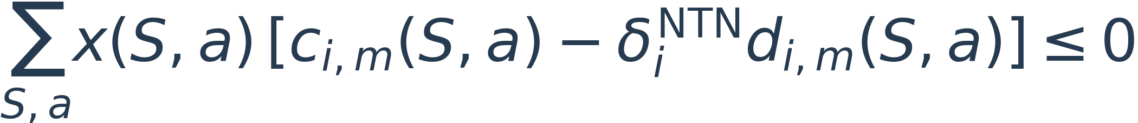
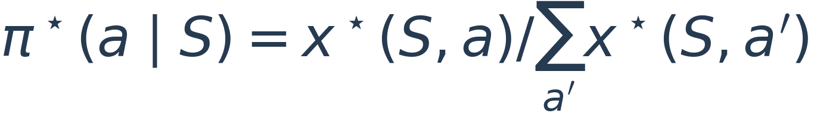
E · LINEAR PROGRAM
Occupation measures turn policy optimization into an LP
x(S,a) = probability of reaching state S and choosing action a
Normalize state–action mass to recover the executable randomized policy.
Appendix D.E · eq:joint_occupancy_objective through eq:joint_policy_extraction
16 / 30
Notes:
Slide 16: Occupation measures turn policy optimization into an LP
Read the four lines as reward, probability flow, TN deadline failures and NTN risk-duration budgets. The LP variables are probabilities of state-action visits. Flow conservation ensures they correspond to a causal policy. The coefficient g-bar is a deadline-failure event cost, charged once after crediting the just-completed resource. Coefficients c and d are expected exceeding-duration bounds and activity durations under the declared model. All SOCP values and coefficients are fixed before solving the LP. At positive-mass states, divide each action mass by the sum over actions to get action probabilities. Terminal states absorb mass and have no outgoing actions.
Source: Appendix D.E · eq:joint_occupancy_objective through eq:joint_policy_extraction

Slide 17
E · POLICY EXECUTION
Randomization is sometimes required, not merely convenient
Policy A (illustration)
Policy B (illustration)
50 / 50 mixture
NTN cost = 0.02
TN failure = 0.20
NTN cost = 0.08
TN failure = 0.02
NTN cost = 0.05
TN failure = 0.11
Example limits: NTN cost ≤ 0.05 and TN failure ≤ 0.11.
A fails TN, B fails NTN; the mixture satisfies both.
Actual E6 check: 128 deterministic policies; none feasible in the randomization case; mixed
optimum = 1.125.
Executing only the most likely action can destroy the probability constraints.
Appendix D.E + E6/E6_validation.csv · illustrative mixture below
17 / 30
Notes:
Slide 17: Randomization is sometimes required, not merely convenient
The top example uses deliberately simple illustrative numbers, not measured results. Treat the NTN cost as a normalized risk cost with a common fixed active denominator. Policy A is safe but has excessive TN failures; policy B has better service reliability but excessive NTN risk. The equal mixture is feasible in both coordinates. A deterministic choice of either whole policy fails a requirement. In the actual E6 finite test, all 128 deterministic policies are infeasible for the randomization-required configuration, but their randomized mixture and the occupation LP achieve the same feasible objective 1.125. The extracted probabilities must be executed as probabilities; taking an argmax is not an equivalent implementation.
Source: Appendix D.E + E6/E6_validation.csv · illustrative mixture below

Slide 18
THEOREM & SCOPE
There are three distinct levels of guarantee
1 Set-wise protection
Every channel inside an imposed set satisfies the INR limit.
2 Finite-model optimality
Exact SOCP + complete finite history + exact transitions/costs → optimal certified policy.
3 Physical-system protection
Also requires valid physical state laws, active-time expectations and conditional certificates.
Appendix D.B/D/E · robust support, beam elimination, finite optimality theorem
18 / 30
Notes:
Slide 18: There are three distinct levels of guarantee
Do not merge these claims. The support-function proposition is exact for the declared uncertainty set. The beam-elimination proposition and occupation-measure theorem establish optimality over randomized causal policies in the declared finite certified problem, assuming exact transitions, coefficients and solutions. A physical outage guarantee additionally requires that the implemented model and conditional certificates remain valid for the physical system. A favorable static CDF alone does not establish that final condition. Similarly, approximate history compression or numerical solutions require their approximation and residual errors to be addressed. State these distinctions explicitly during the talk.
Source: Appendix D.B/D/E · robust support, beam elimination, finite optimality theorem

Slide 19
IMPLEMENTATION
Most optimization is offline; execution follows released events
Freeze the model
Build and solve
Execute causally
Calendar, demands,
kernels and risk bounds
Reachable histories
SOCP values → LP
Sample an action
Reveal only released
results
Carry pending jobs, record ages and service counters through deadlines.
Charge online computation latency. Report infeasibility separately from solver
failure.
The complete history can be exponential even though the explicit LP is polynomial in
size.
Appendix D.E · finite-model construction and execution
19 / 30
Notes:
Slide 19: Most optimization is offline; execution follows released events
The algorithm freezes model inputs, expands all reachable histories, builds catalogs and risk bounds, solves or caches state-specific SOCPs, computes transition rewards and costs, and solves the LP. Online operation follows the conditional policy and only updates on events that have actually been released. A beam cache key must include every quantity affecting the solution, including current CSI, sets, radii, interference and Gamma. Deadline boundaries do not justify resetting ages, pending jobs or unfinished requirements. If a zero-probability history is physically reached, that signals model mismatch: a silent fallback controls the BS contribution, but its service loss must still be counted.
Source: Appendix D.E · finite-model construction and execution

Slide 20
EVIDENCE MAP
What the current experiments validate
E4
Set calibration and coverage
Synthetic whole-scene split
E5
Worst leakage and robust SOCP
Numerical identities + geometry tests
E6
Beam reduction and policy LP
Complete-policy enumeration
E7
F / T / L / J service tradeoff
Declared finite dynamic model
E8
Failure, delay, arrivals, correlation
Model stress + fixed causal diagnostics
Fresh RT
New drops + DL/UL tracing + Γ-CDF
Static held-out physical channels
Run 20260921_235448_775259 · E4–E8 + fresh_rt_spatial
20 / 30
Notes:
Slide 20: What the current experiments validate
This table prevents a common overclaim. E4 verifies a synthetic whole-scene calibration procedure; it does not supply a physical conditional risk table for arbitrary adaptive histories. E5 and E6 provide solver and reduction checks. E7 is the dynamic finite-model service comparison. E8 includes both optimized-model stress cases and separate fixed-policy mechanism diagnostics. Fresh ray tracing now really redraws user positions and recomputes propagation, but it validates the static spatial component. The 34 regression tests and full notebook execution support implementation consistency, not a universal physical deployment guarantee. The pinned run is September 21 at 23:54:48 local time.
Source: Run 20260921_235448_775259 · E4–E8 + fresh_rt_spatial

Slide 21
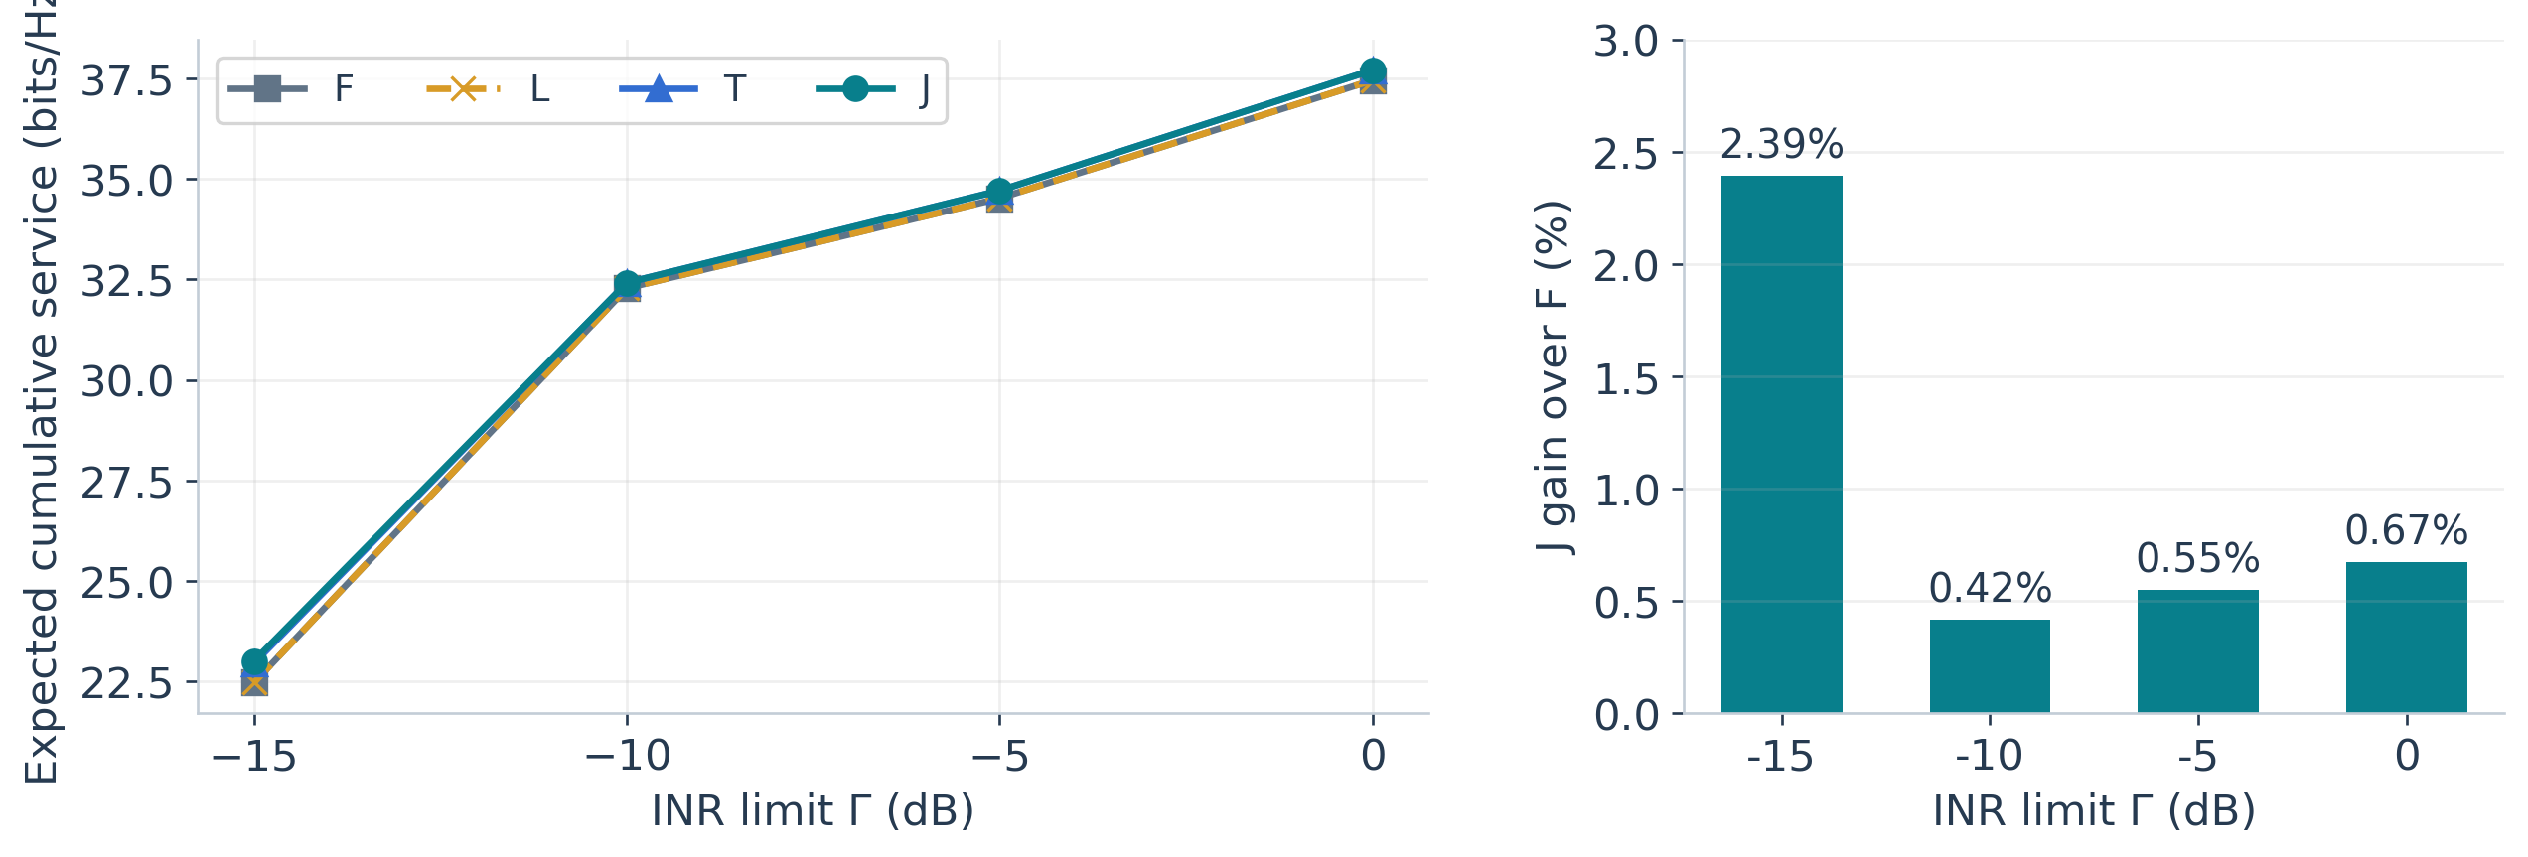
RESULTS · E7
Finite-model gains are positive, but small
F: fixed T: timing only L: duration only J: joint adaptation
J = T at three Γ values; current evidence does not show a broad duration-adaptation
gain.
E7/strategy_summary.csv · exact model expectations; Monte Carlo: 400 episodes per setting
21 / 30
Notes:
Slide 21: Finite-model gains are positive, but small
All four classes use the same robust transmission subproblem and can serve or mute; fixed baselines are optimized within their declared classes. These are exact model expectations accumulated over 12 ticks, not per-tick throughput or noisy simulation means. At minus 15 dB, J yields 23.0089 bits/Hz versus F at 22.4713, a 2.39% gain. Its advantage over T is only 0.247%. At the other three Gamma values J and T coincide; F and L coincide throughout. Increasing the Monte Carlo sample count will tighten uncertainty but will not separate identical model optima. Sixteen main configurations were feasible. Confidence on actual simulated risk is discussed in a backup slide.
Source: E7/strategy_summary.csv · exact model expectations; Monte Carlo: 400 episodes per setting

Slide 22
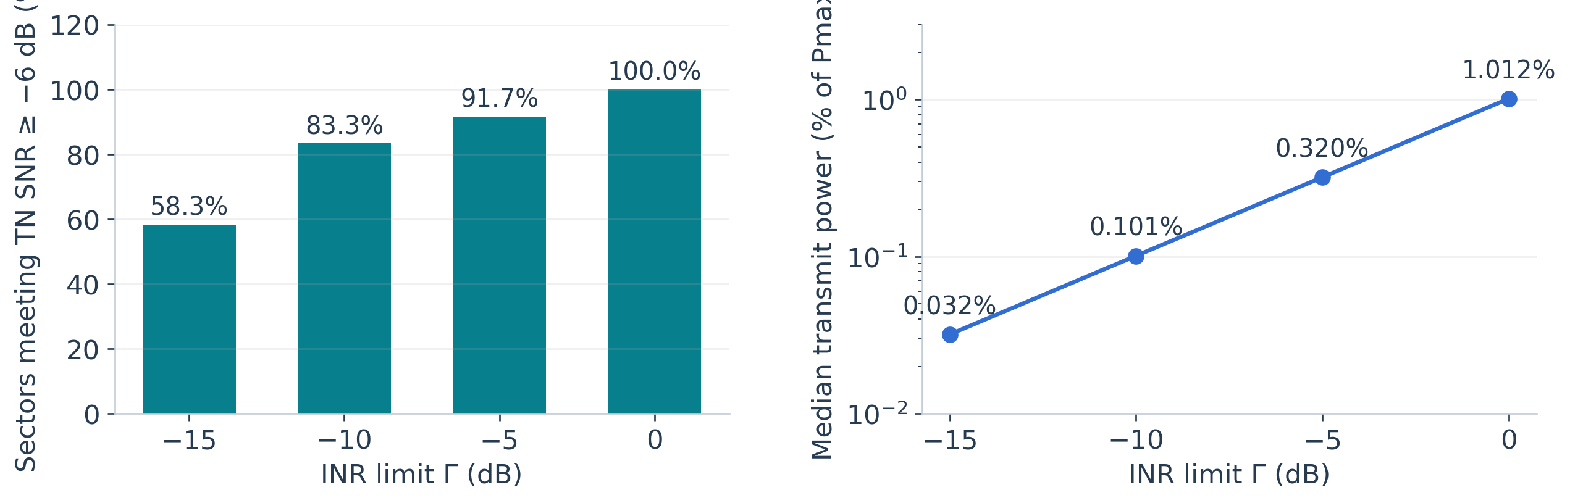
RESULTS · PHYSICAL SPATIAL TEST
Fresh ray tracing reveals a substantial service cost
7 GHz DL / 6.3 GHz UL · 64 antennas · depth 3 · 800-snapshot MDL-MUSIC
Low INR alone is insufficient: the current empirical envelope is conservative.
fresh_rt_spatial/gamma_summary.csv · 6 drops, 2/2/2 split; 24 test sectors
22 / 30
Notes:
Slide 22: Fresh ray tracing reveals a substantial service cost
Unlike the earlier cache-only path, this run creates six fresh TN/NTN drops and retraces both bands. Each drop contains 12 TN users, 20 NTN receivers and 12 sectors. Two complete drops each are used for training, calibration and test, with all 24 test sectors evaluated. The plotted INR is one controlled sector’s contribution, not the network sum. At Gamma minus 15 dB, only 58.33% of sectors meet the static minus 6 dB TN SNR floor; median power is just 0.032% of Pmax. The broad empirical residual bound strongly limits power. Zero observed exceedances in this small test do not certify a tail probability. This is physical static validation, not physical dynamic E7/E8. Quick RT also uses a coarser search and ray budget than full.
Source: fresh_rt_spatial/gamma_summary.csv · 6 drops, 2/2/2 split; 24 test sectors

Slide 23
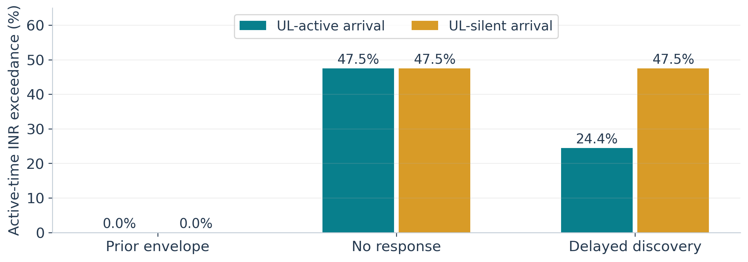
RESULTS · CAUSAL ARRIVAL DIAGNOSTIC
Unknown arrivals expose the gap before usable information
Only released detections reach the controller.
UL-active case: detection 67.5%; observed exceedance after protection activates = 0.
Fixed diagnostics violate the main TN QoS budget; these are not optimized J policies.
UL-silent arrivals require prior coverage; delayed discovery cannot protect the unseen
past.
E8/random_arrival/summary.csv · fixed policies, 400 paired episodes per case
23 / 30
Notes:
Slide 23: Unknown arrivals expose the gap before usable information
Arrival times are drawn by the evaluator and hidden from the controller. All three comparison policies share arrival trajectories, sensing random numbers and RF costs. The prior-envelope policy protects the newcomer class from the outset. No-response ignores detection. Delayed-discovery starts protection only after detection has completed and its processing delay has elapsed. For an UL-active newcomer, exposure falls from 47.53% with no response to 24.45% with delayed discovery; detection probability is 67.5%. The permanently UL-silent newcomer is never detected and receives no discovery-based benefit. These are mechanism diagnostics using fixed policies, not an optimal random-arrival LP solution. Their TN deadline failures violate the main budget, so they cannot be presented as feasible service improvements.
Source: E8/random_arrival/summary.csv · fixed policies, 400 paired episodes per case

Slide 24
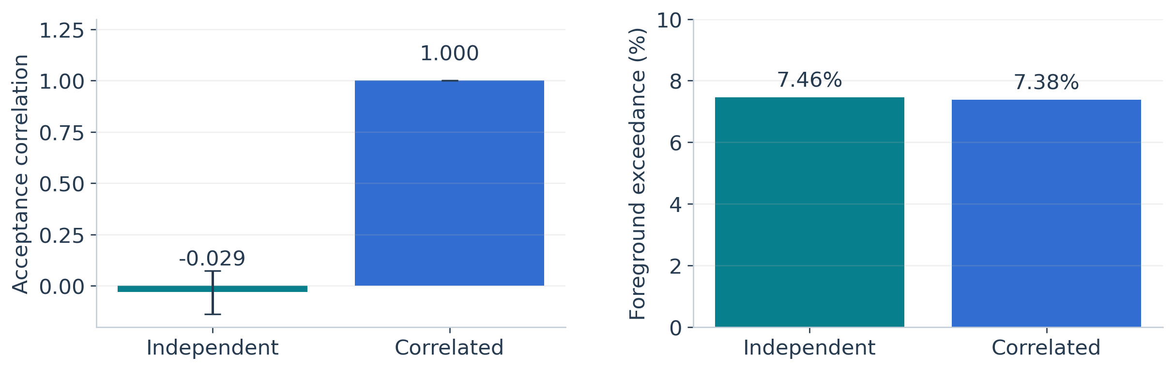
RESULTS · CORRELATION DIAGNOSTIC
Repeated observations now genuinely test temporal correlation
Every path executes two listens. The fixed diagnostic violates the main TN budget;
it tests the observation mechanism, not a feasible optimized-J service gain.
Correlation is present; this run does not show a statistically significant performance
loss.
E8/repeated_observation/summary.json · fixed two-listen policy, 400 paired episodes
24 / 30
Notes:
Slide 24: Repeated observations now genuinely test temporal correlation
The original optimized J policy listened at most once along each reachable trajectory, so making latent observation uniforms correlated did not actually test repeated observations. The new diagnostic fixes two listening occasions before observing any outcomes. Independent and correlated cases use paired physical trajectories and the same observation marginal probability. The first/second acceptance correlation changes from about minus 0.029, with a confidence interval spanning zero, to one. Foreground exposure is about 7.46% versus 7.38%; the paired difference confidence interval spans zero. Do not force a negative result into a robustness claim: the mechanism is now exercised, but these parameters do not show a significant loss. The fixed schedule is explicitly not feasible under the original TN constraints.
Source: E8/repeated_observation/summary.json · fixed two-listen policy, 400 paired episodes

Slide 25
TAKEAWAYS
The contribution is a causal connection from sensing to service
One channel-set model
Single paths, coherent multipath and background uncertainty share a robust constraint.
One structured optimization
SOCP supplies protected service values; an occupation LP chooses a causal policy.
One clear validation boundary
Finite-model optimality is established conditionally; physical dynamic calibration remains to
be built.
Appendix D + current implementation scope
25 / 30
Notes:
Slide 25: The contribution is a causal connection from sensing to service
Close with three points. First, complete-channel uncertainty sets unify dominant-path and coherent-multipath protection, including unobserved background. Second, under explicit assumptions, beam elimination lets a finite causal policy combine sensing decisions, power, service and silence. Third, exact finite-model optimality and physical-system protection are different claims. We have verified numerical identities and policy consistency, exercised the previously missing causal mechanisms, and connected fresh physical ray tracing for spatial evaluation. The next research step is an independently calibrated physical dynamic model with repeated observations, user activity and timing, together with less conservative but valid observable-condition protection sets.
Source: Appendix D + current implementation scope

Slide 26
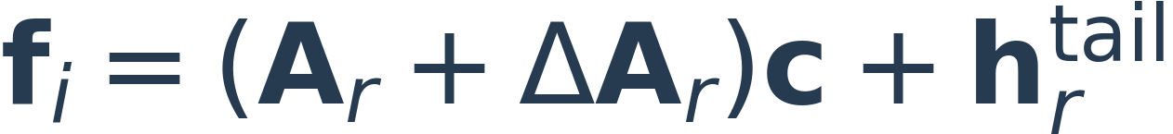
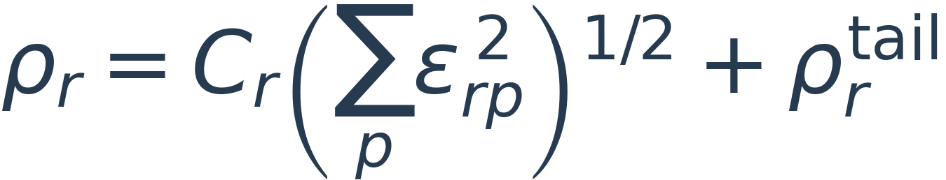
BACKUP · B
How listening quality enters the multipath residual
Finite observation error + directional aging + calibration / multipath mismatch.
Cᵣ requires path-power bounds or independent calibration: coherent cancellation
can hide large path coefficients in a small total channel.
Raw UL MUSIC weights do not certify protected-band gain or noise bounds.
Appendix D.B · eq:joint_error_envelope · eq:joint_multipath_radius
26 / 30
Notes:
Slide 26: How listening quality enters the multipath residual
Derive the residual bound by writing the error as delta-A times c plus the missing tail. The spectral norm of delta-A is no larger than its Frobenius norm, which is bounded by the root-sum-square of per-path response errors. Multiplying by C and adding the tail gives a sufficient radius. This is a constructive sufficient bound, not a claim that every path can be resolved. Total channel power cannot in general bound path coefficient norm, because coherent cancellation can hide large coefficients. The illustrative age envelope can be replaced by independently calibrated tables, and its validity must cover the intended service interval.
Source: Appendix D.B · eq:joint_error_envelope · eq:joint_multipath_radius

Slide 27
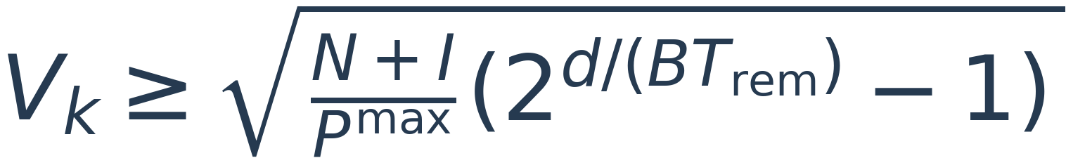
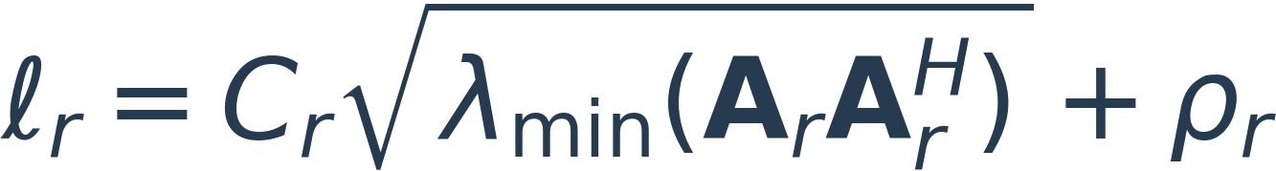
BACKUP · D
Silence is feasible; positive deadline service may not be
d remaining bits; Trem available DL time; fixed channel and catalog.
This is a constant-input screening bound, not a universal per-symbol QoS constraint.
Appendix D.D · eq:joint_service_feasibility · eq:joint_power_cap
27 / 30
Notes:
Slide 27: Silence is feasible; positive deadline service may not be
For a fixed channel and catalog over remaining usable downlink time, completing d bits is equivalent to the amplitude threshold on the first line. The second pair gives a necessary screening bound using the smallest eigenvalue of the protected subspace Gram matrix and the residual radius. A rank-deficient span can leave a spatial null space, but nonzero residual still caps power. A full span can cap power even when residual is zero. The screening bound is not sufficient, because it ignores alignment of the desired TN channel with the protected subspace. Do not use a current-catalog bound to discard a full sensing plan whose future accepted observation can change that catalog.
Source: Appendix D.D · eq:joint_service_feasibility · eq:joint_power_cap

Slide 28
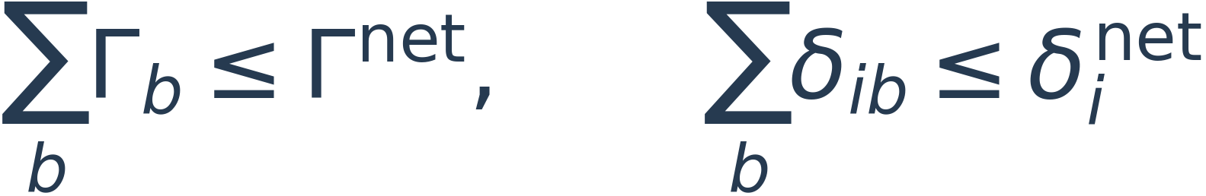

BACKUP · NETWORK INTERFACE
A network extension needs local budgets and an external reserve
Sector 1
Sector 2
Sector 3
Local amplitude/risk
budgets
Local amplitude/risk
budgets
Local amplitude/risk
budgets
Independent data streams add average powers; failure events need not be
independent.
Appendix D.E · eq:joint_network_allocation · eq:joint_external_budget
28 / 30
Notes:
Slide 28: A network extension needs local budgets and an external reserve
For independent BS data streams, symbol-averaged interference powers add. Assign local Gamma budgets whose sum is within the network budget and local risk allowances whose sum is within the per-receiver risk target. If every local contribution is below its budget, the total is below the summed budget, so network exceedance requires at least one local exceedance. A union bound works under common receiver-activity conditioning without independent certificate failures. Uncontrolled TN uplink or other sources require a valid reserved external contribution, including failure risk if the reserve is uncertain. Endogenous inter-sector TN SINR coupling is outside the exact separable theorem. A negative remaining budget cannot be fixed by silencing these base stations alone.
Source: Appendix D.E · eq:joint_network_allocation · eq:joint_external_budget

Slide 29
BACKUP · STATISTICAL INTERPRETATION
A target, an estimate and a confidence bound are different
E4 scene miscoverage
E7: J at Γ = −15 dB
Target: 10%
Observed: 13 / 128 = 10.16%
95% interval: 5.52%–16.74%
Compatible with target; not proof of a
≤10% physical risk.
Model risk bound: 8%
Observed exposure: 8.19%
95% bootstrap: 6.67%–9.75%
400 complete trajectories; ticks are not
independent samples.
Split and resample whole scenes / trajectories. Keep missed and silent
receivers.
Zero observed events do not establish zero risk.
E4/scene_coverage.csv · E7/strategy_summary.csv
29 / 30
Notes:
Slide 29: A target, an estimate and a confidence bound are different
The E4 interval is Clopper–Pearson for independent scene failure indicators. There are 128 independent scenes even though the stratified CSV has many more rows. The E7 interval resamples complete episodes because time samples within an episode are dependent. These are different experiments: E4’s scene marginal coverage does not certify E7’s conditional state risks. A measured value just above a budget is not by itself evidence of a solver or theorem failure when the confidence interval includes the target. Conversely, a mean below budget is not a high-confidence certification if its upper confidence bound exceeds that budget. Formal simultaneous or one-sided risk certification needs an explicitly designed statistical procedure.
Source: E4/scene_coverage.csv · E7/strategy_summary.csv

Slide 30
BACKUP · REFERENCE
Notation and source map
v = √p w
Power-weighted transmit beam; actual power = Pmax p
Aᵣ, Cᵣ, ρᵣ
DL path responses, coefficient bound, residual radius
Γ / δNTN
INR magnitude limit / active-time exceedance budget
L / δTN
Frozen deadline demand / service-failure budget
η / c / d
Conditional coverage-risk bound / risk time / active time
S / x(S,a) / π(a|S)
Observable history state / occupation mass / action probability
Paper: overleaf_ntn_paper/direction.tex
Results: result/appendix_d_20260921_235448_775259/
Local paper and pinned result archive; full paths and hashes in sources.json
30 / 30
Notes:
Slide 30: Notation and source map
This is a reference slide for questions. Sources are local and pinned to the current paper and the September 21 23:54:48 experiment archive. All chart values are replotted from saved CSV or JSON without re-running or modifying the experiments. Mathematical illustrations are explicitly marked schematic. The deck distinguishes current implementation details from the broader Appendix D theorem. Speaker notes cite the relevant local source and explain qualifications that would overload the visible slides. The source manifest records SHA256 hashes so the deck can be reproduced and checked after future changes.
Source: Local paper and pinned result archive; full paths and hashes in sources.json

